Slide 1


Higgs Boson Challenge
Ashwini, Dhruthi, Ishwarya

Slide 2


Contents
Problem Statement
Preprocessing
EDA
Baseline Model
Ensemble model :Random forest
Ensemble model :Ada Boost
SMOTE
Ensemble Results after SMOTE
Observations

Slide 3
Problem Statement
From the machine learning point of view the problem can be formally cast into a binary classification problem.
Events generated in the collider are preprocessed and represented as a feature vectors. The problem is to classify these events as signal (that is, an event of interest, in our case a H to tau tau decay) or background (an event produced by already known processes).
More precisely, a classifier is used as a selection method, which defines a signal-rich region in the feature space.

Slide 4
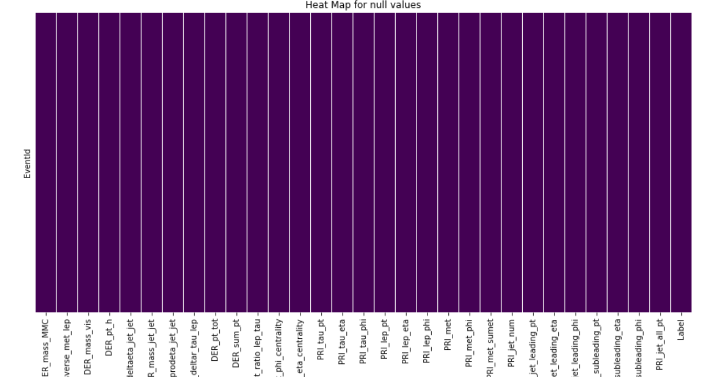
Preprocessing
Our preprocessing involved :checking and understanding the data that was given, handling the null values , dropping the feature “weight”, type transformation on the “Label” column & splitting of train and test data sets (test size=0.3)

Slide 5
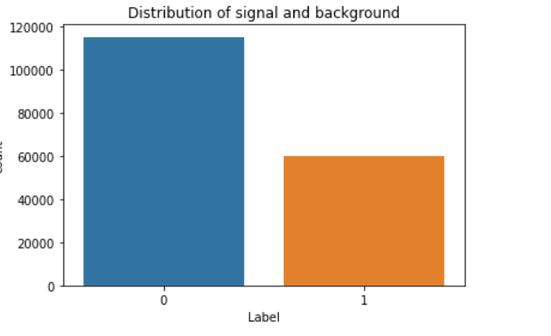
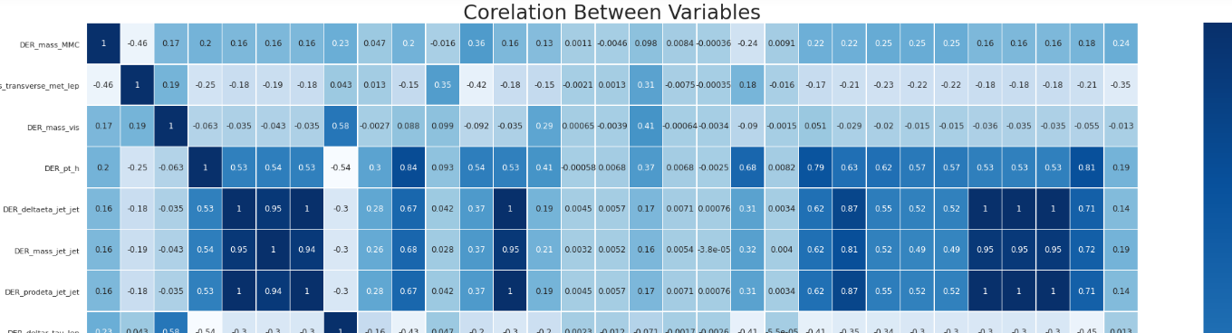
EDA
We did a lot of data visualizations and analysis, but our main insights form our EDA are:
(i)there is imbalance in between signal and background data which needs to be reduced
(ii) from the correlation matrix we can observe that there are lot columns which are similar or same as each other. Hence, we have listed such redundant columns and dropped them.

Slide 6
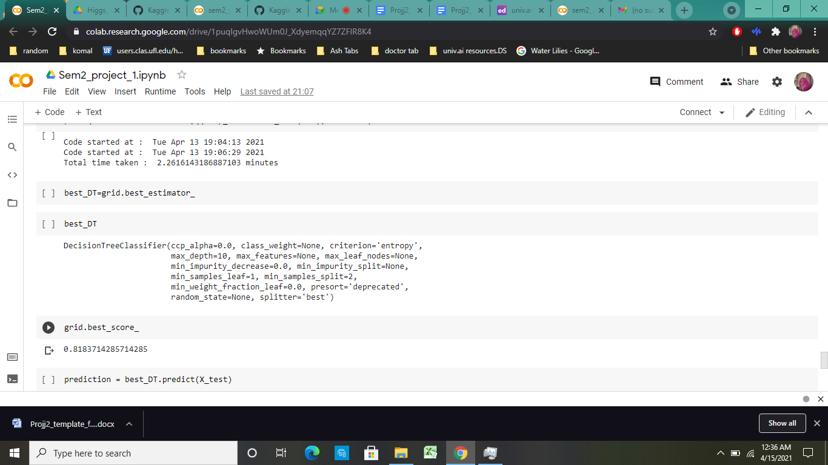
Baseline Model
For our base line model, we have chosen decision tree classifier
By running our baseline model on the selected features, we were able to achieve accuracy up to 82%

Slide 7
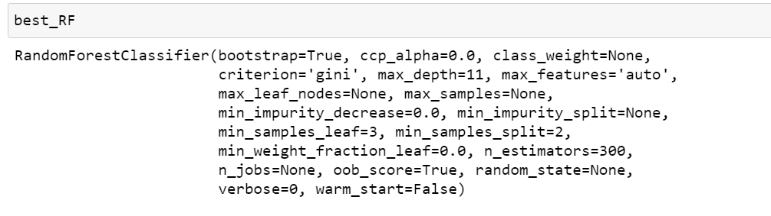
Ensemble Model :Random forest (Bagging)
Using Grid search we have found the random forest model with best parameter values for the given train data.
We trained the model and obtained predictions for X_test
The accuracy achieved was 83% & F1 score: 0.83

Slide 8
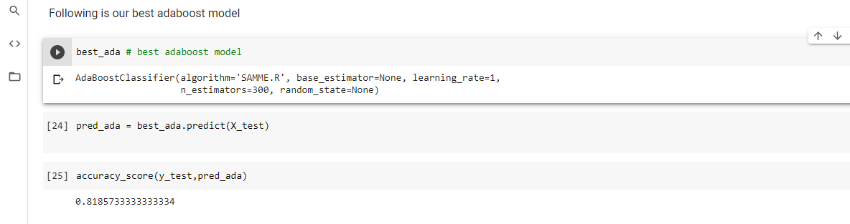
Ensemble Model: Ada boost (Boosting)
Using Grid search we have found the Ada boost model with best parameter values for the given train data.
We trained the model and obtained predictions for X_test
The accuracy achieved was 81.85% ,F1 score: 81.69

Slide 9
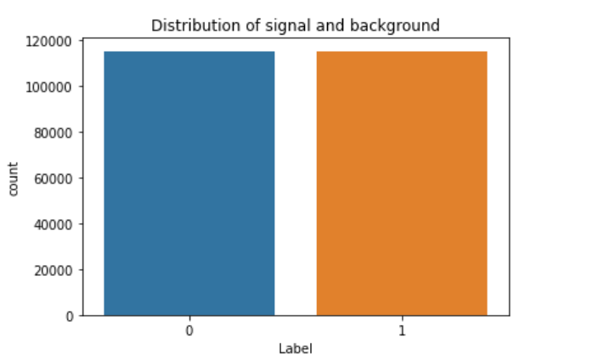
SMOTE
As in The EDA we have observed that there is imbalance in between signal and background data which needs to be reduced.
SMOTE (Synthetic Minority Over-sampling Technique) is a type of over-sampling procedure that is used to correct the imbalances in the groups.
We used SMOTE to balance the signal and background data

Slide 10
Ensemble Model results after SMOTE
After balancing the data using SMOTE, we have run the Ensemble models with balanced data.
Below we mentioned the results of the ensemble models which were run on the balanced dataset
Random forest: Accuracy:81.80 , F1 Score:0.8209
AdaBoost: Accuracy:79.83 , F1 Score:0.8015

Slide 11
Observations
Random Forest | Ada boost | Random Forest with balanced Data | Ada boost with balanced Data
Accuracy:83% | Accuracy:81.85% | Accuracy:81.80% | Accuracy:79.83%
F1 score: 0.83 | F1 score: 81.69 | F1 Score:0.8209 | F1 Score:0.8015
From the observations we conclude that Random forest relatively performs well on the Higgs boson data and it is not much affected by the data imbalance.

