Slide 1
Correcting AEMO's Own Price Forecast
Data-chain audit, predictor baseline, and a first error model for the 5-minute P5 product
EMPC Water Pumping · Capstone Project · weekly update 2026-09-23
AEMO NEMWEB archive + monthly dashboard files · MATLAB predictor suite · Python data pipeline

Slide 2
1
The predictor is one link: this week we added a second one
Pipeline overview · the new branch is the AEMO error model
▪ MPC layer (teammate) decides tank levels over a receding horizon
▪ Decision layer picks the pump combination
▪ Predictor (this work) supplies the 5-minute price track
▪ New this week correct AEMO's own forecast instead of forecasting from scratch
Why the change of plan
AEMO sees unit outages, network limits and interconnector flows that we never will. Beating them head-on with price history alone is the wrong fight — so we forecast their residual instead.
This week in one line: the price disagreement we were asked to explain does not exist — what exists is a broken capture store and a hidden one-hour timebase shift, both now fixed.

Slide 3
Part I — Data chain audit
Four producers, three timebases, one broken store

Slide 4
2
AEMO_Data holds four unrelated datasets, not one
Inventory by producer · AEMO_Data · 2026-09-23
Class | File pattern | Producer | Granularity | Span held
A | PRICE_AND_DEMAND_YYYYMM_VIC1.csv | Dashboard → Historical aggregated | 5 min, trade | 2026-01-01 → 2026-08-09
B | NEMPRICEANDDEMAND_<REGION>_<stamp>.csv | Dashboard → Price & demand → Dispatch | 5 min actual + 30 min forecast | ~30–48 h rolling
C | zip_cache/ + dispatch_actual / p5min / predispatch | Online_Data_Capture_Script (NEMWEB current) | 5 min / 30 min | 2 days / 5 h
D | PUBLIC_*.CSV at the root | one-off manual download | raw reports | single point, 2026-09-04
▪ Only class A feeds the predictor today — it is the training and test series for every experiment below.
▪ Class B is the only place where today's actual and today's official forecast sit on one axis; it is the embryo of the error matrix, but it is a manual download.
▪ Class C is the intended online feed. Its timestamp columns were all empty (see next-but-two).
▪ Class D is archaeology — one report kept from a manual download.

Slide 5
3
Same market, three conventions — the mismatches are all ours
Field-by-field comparison of the three price sources
 | A · monthly dashboard | B · dashboard dispatch export | C / D · NEMWEB raw reports
Price column | RRP | Spot Price ($/MWh) | DISPATCH/PRICE → RRP
Precision | 2 decimal places | 5–7 significant digits | full precision
Timestamp | 2026/03/01 00:05:00 | 09/09/2026 12:50 | "2026/09/04 03:55:00"
Interval meaning | interval-ending, 5 min | interval-ending, 5 min | interval-ending, 5 min
Timebase | NEM time (AEST) | NEM time (AEST) | NEM time (AEST)
Demand column | TOTALDEMAND | Scheduled Demand (MW) | REGIONSUM → TOTALDEMAND
Units | $/MWh | $/MWh | $/MWh
▪ Every source is 5-minute and interval-ending, so slot 1 = 00:05 and slot 288 = 24:00 in all of them.
▪ The only real price difference is publication precision: A is C rounded to 2 decimals.
▪ The one dangerous trap: B's “Scheduled Demand” is NOT REGIONSUM.TOTALDEMAND (mean gap 125 MW in NSW1, 425 MW in QLD1).

Slide 6
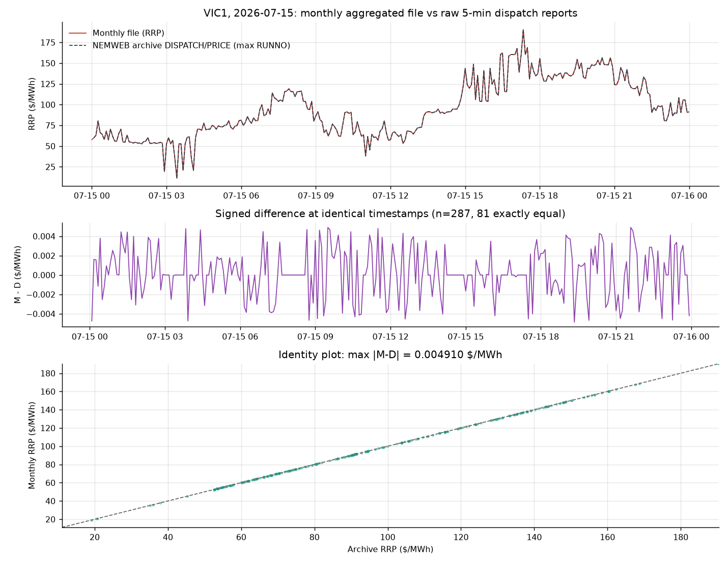
4
The monthly and real-time prices never disagreed
8 sampled days, VIC1, point-by-point against the NEMWEB archive
Sample day | Monthly rows | Archive rows | Matched | Exactly equal | mean |diff| | max |diff|
2026-01-15 | 288 | 288 | 287 | 147 (51.2%) | 0.00112 | 0.00500
2026-07-01 | 287 | 288 | 287 | 168 (58.5%) | 0.00050 | 0.00493
2026-07-15 | 288 | 288 | 287 | 81 (28.2%) | 0.00187 | 0.00491
2026-07-29 | 288 | 288 | 287 | 178 (62.0%) | 0.00072 | 0.00488
2026-09-03 / 09 | n/a | 288 each | n/a | n/a | n/a | n/a
▪ max |diff| ≤ 0.005 $/MWh on every day — that is exactly the 2-decimal rounding bound of the monthly file.
▪ Demand matches to 0.0000 MW with correlation 1.000000.
▪ So the professor's question “why does the monthly VIC1 RRP differ from the real-time report?” has the answer: it does not.

Slide 7
5
Five defects in the capture chain — all of them ours, all fixed
Online_Data_Capture_Project · measured, not guessed · 1 of 2
# | Where | Symptom | Root cause
D1 | aemo_parser._split_record | settlement_date, interval_datetime and period_id all empty | NEMWEB double-quotes every datetime field; str.split keeps the quotes, so every timestamp parse returned None
D2 | aemo_common.parse_nem_datetime | predispatch_seqno stored as 2026-09-01 05:01:05 | %Y%m%d%H%M%S has no width guard, so the 10-digit code 2026091515 matches as 4+2+1+1+1+1 and becomes a fake time
D3 | aemo_parser.parse_predispatch | total_demand empty in every row | the new PREDISPATCHIS splits RRP (REGION_PRICES) from TOTALDEMAND (REGION_SOLUTION); selection only asked for the RRP table
Evidence: data_audit/scripts/parser_replay.txt (before) and store_verify.txt (after).

Slide 8
6
The blast radius, and the fifth defect that was not in the parser
Online_Data_Capture_Script · measured, not guessed · 2 of 2
# | Blast radius | Fix
D1 | dispatch_actual.csv collapsed to 5 rows: the dedup key (settlement_date, region_id) was empty, so every new interval overwrote the previous one — the store had been deleting its own history since the day it was written | csv.reader instead of str.split
D2 | 1,925 predispatch rows carried a sequence code disguised as a timestamp | compact date formats get a width guard; the raw code is stored verbatim
D3 | 1,925 rows with no demand | merge REGION_PRICES with REGION_SOLUTION on (seqno, region, period)
D4 | 1,925 rows with no period_id | PERIODID is an index in the new layout, not a timestamp
D5 | USE_AUS_LOCAL_TIME = True rewrote NEM time into Sydney local time, so the store shifted timebase twice a year and sat 12 slots off the training data during daylight saving | default changed to False, with the measurement written into the config
D5 evidence: data_audit/scripts/timebase_verdict.txt — with the conversion off, all eight sampled months align at zero shift.

Slide 9
7
After the fix the store accumulates intervals instead of overwriting them
Same command, same source, before and after D1–D4
 | Before | After
dispatch_actual.csv rows | 5 | 2,880
Rows per region | 1 | 576
settlement_date empty | 5 / 5 | 0 / 2,880
Interval step | n/a (one row) | 300 s × 575
p5min interval_datetime | 3,600 / 3,600 empty | 0 / 3,600
predispatch period_id | 1,925 / 1,925 empty | 0 / 2,975
predispatch total_demand | 1,925 / 1,925 empty | 0 / 2,975
predispatch_seqno | 2026-09-01 05:01:05 | 2026092333 (raw code)
The one-hour shift, settled
With USE_AUS_LOCAL_TIME = True the archive needed a +60 min shift to line up with the monthly file in Jan/Feb/Mar/Apr-4, and 0 min from Apr-6 on. With it False, all eight sampled months align at 0 (mean |diff| 0.0005–0.0019 $/MWh = pure rounding).
The first analysis blamed AEMO. Cross-checking our own reading layer is what overturned it — the archive's DST-transition day is a clean 5-minute ladder, so the archive was never the problem.
▪ T
▪ h
▪ e
▪
▪ s
▪ t
▪ o
▪ r
▪ e
▪
▪ w
▪ a
▪ s
▪
▪ n
▪ e
▪ v
▪ e
▪ r
▪
▪ m
▪ e
▪ r
▪ e
▪ l
▪ y
▪
▪ s
▪ t
▪ a
▪ l
▪ e
▪
▪ —
▪
▪ i
▪ t
▪
▪ w
▪ a
▪ s
▪
▪ w
▪ r
▪ i
▪ t
▪ i
▪ n
▪ g
▪
▪ i
▪ t
▪ s
▪
▪ o
▪ w
▪ n
▪
▪ h
▪ i
▪ s
▪ t
▪ o
▪ r
▪ y
▪
▪ a
▪ w
▪ a
▪ y
▪
▪ e
▪ v
▪ e
▪ r
▪ y
▪
▪ f
▪ i
▪ v
▪ e
▪
▪ m
▪ i
▪ n
▪ u
▪ t
▪ e
▪ s
▪ .

Slide 10
Part II — Predictor baseline
Where the six-model suite stands, re-run today

Slide 11
8
Six predictors, one 288×288 error surface each
run_predictor_benchmark.m · re-run 2026-09-23
Setting | Value
Warm-up (online) | 2026-01-01 00:05 → 2026-01-31 00:00, 8,640 points
Forecast origins | 2026-01-31 00:05 → 2026-02-15 00:00, 4,320 origins
Scored targets | 2026-02-01 00:05 → 2026-02-15 00:00, 4,032 points (14 days)
Update cadence | every 5-minute observation re-issues the full 288-step forecast
Price clamp | rolling 30-day global Q1/Q99, recomputed daily, applied to forecast and actual
RNG / model state | gains, AR coefficients and template trained on RAW prices; scoring on clamped prices
▪ Every test point is forecast 288 times, so each model yields a 288×288 RMSE(slot, lead) matrix — coverage verified at 14 samples per cell.
▪ Clamped signal std = 51.3 $/MWh: any RMSE near that value means the forecast carries no information.

Slide 12
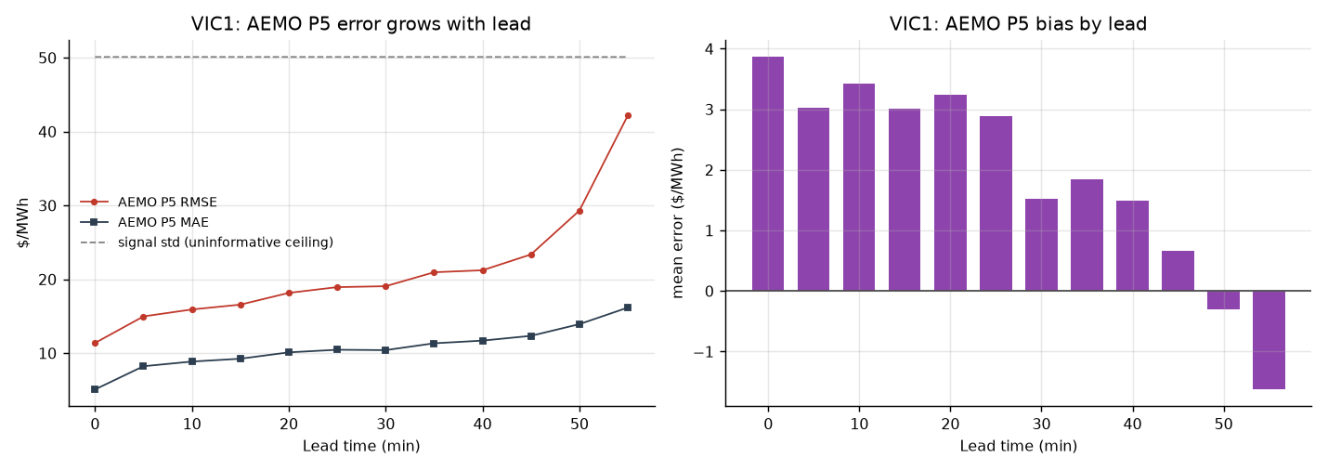
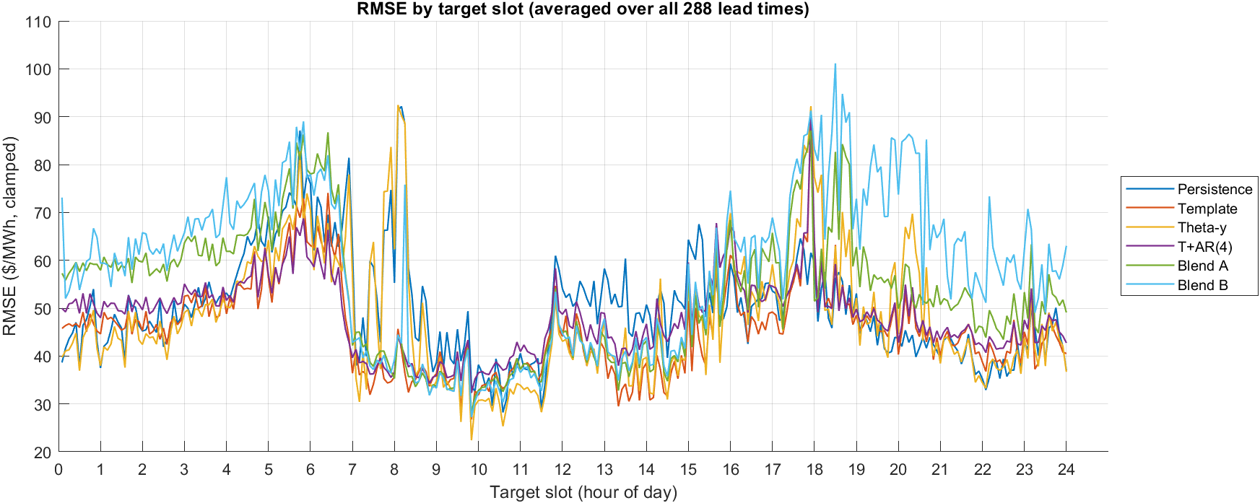
9
Template + AR(4) owns the first three hours and loses beyond six
Two-week test, clamped prices, $/MWh
Model | RMSE 2wk | MAE | Bias | 5 min | 1 h | 3 h | 6 h | 24 h
Persistence (yesterday) | 51.2 | 38.8 | −5.2 | 51.2 | 51.2 | 51.2 | 51.2 | 51.2
Rolling template | 46.4 | 36.6 | +9.6 | 46.4 | 46.4 | 46.4 | 46.4 | 46.4
Theta-y tracker | 49.7 | 37.3 | +13.6 | 49.7 | 49.7 | 49.7 | 49.7 | 49.7
Template + AR(4) | 51.9 | 37.5 | +1.0 | 15.8 | 28.0 | 39.4 | 50.3 | 58.5
Blend A | 55.6 | 41.3 | +23.1 | 38.0 | 43.9 | 49.1 | 53.8 | 62.6
Blend B | 61.4 | 45.5 | +29.3 | 43.6 | 49.5 | 55.5 | 59.9 | 68.6
▪ Best 5 min / 30 min / 1 h / 3 h: Template + AR(4) (15.8 / 23.4 / 28.0 / 39.4)
▪ Best 6 h / 12 h / 24 h: Rolling template (46.4, flat)
▪ vs persistence: +69.2% at 5 min, −14.3% at 24 h
▪ Two-week aggregate: −1.4% — worse than persistence

Slide 13
10
Averaging over 288 leads hides the only horizon that matters
Reading the baseline honestly
The two-week column is a trap
Pooling all 288 leads gives T+AR(4) 51.9 against the template's 46.4. The same pooling that the professor warned against — picking the minimum cell as an accuracy claim — also hides a model that wins every lead up to three hours.
MPC only ever executes the first control move and re-optimises five minutes later, so leads 1–12 are the ones that pay.
The four-hour crossover is real
T+AR(4) beats the template by 30.6 $/MWh at 5 min, 18.5 at 1 h, 7.0 at 3 h, then loses by 3.9 at 6 h. The iterated residual AR decays to zero somewhere between three and six hours, after which the forecast is the template.
Blends do not work yet
Blend A and B are convex combinations with a per-slot weight learned by scalar RLS. Both lose to both of their own components, with biases of +23.1 and +29.3 — the weight has settled on the wrong side.
Practical reading: the per-slot weight has one update per slot per day, which is far too slow to track a weight that should vary with lead time.

Slide 14
Part III — The AEMO error model
Forecast their residual, not their problem

Slide 15
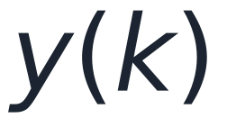


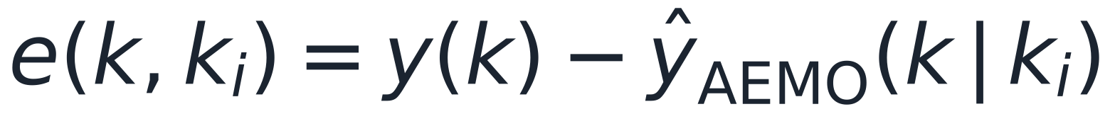
11
We do not need to beat AEMO — we need to correct them
The brief, restated with the symbols the professor asked for
Definitions
Why short leads only
MPC computes a full future control sequence but executes only the first move, then re-optimises five minutes later. Everything past the first hour is recomputed long before it is used.
So the target is leads 1–12 (5–60 min), with the correction decaying to zero as lead grows so that the long horizon falls back to AEMO's own number.
AEMO's P5 product publishes 12 targets per 5-minute batch, k_i through k_i+55 min — exactly the window we need, at exactly our resolution.
actual price at time k
issue time of the forecast
AEMO forecast made at k_i for target k
The quantity the team must model
historical forecast error
corrected forecast

Slide 16
12
The pairing had to be rebuilt from the NEMWEB archive
The current feed keeps only two days, which is not a dataset
Pairing rule
What had to change first
The professor's list included “save more historical AEMO forecast versions, not just the last 10”. The shipped retention keeps 5 hours of forecasts, so the error matrix could never be fitted from the live store.
Until that retention policy is raised, the archive backfill is how the dataset gets built. It is reproducible: backfill_archive.py --start --end --regions.
Same parser as the live feed, so the D1–D4 fixes apply here too.
▪ Actuals — ARCHIVE DispatchIS daily zips, 5-min RRP, highest RUNNO per interval
▪ Forecast — ARCHIVE P5MIN daily zips, REGIONSOLUTION.RRP, keyed by (effective_time, region, interval)
▪ Lead h = (target − issue time) / 5 min, h = 0–11
▪ No lookahead — both the batch and the realised price for interval k_i are published about 5 min before k_i
 | Value
Daily zips available | 375 (2025-09-12 → 2026-09-21)
DispatchIS size | 5.7 MB / day
P5MIN size | 57 MB / day
Backfill window used | 2026-08-25 → 2026-09-21, VIC1

Slide 17
13
AEMO's 5-minute forecast is good — and it degrades fast
P5 error against realised dispatch price, VIC1
▪ RMSE climbs from ~11 $/MWh on the in-progress interval to ~17.7 at 5 min and ~26.4 at 55 min, against a signal standard deviation of 33 $/MWh.
▪ Bias is positive throughout (+3.9 to +5.9 $/MWh): in this window AEMO is systematically under-forecasting VIC1.
▪ The in-progress interval (h=0) is descriptive only — AEMO's h=0 entry is the dispatch target for that interval, not a prediction of an unknown, so it never enters a skill comparison.

Slide 18
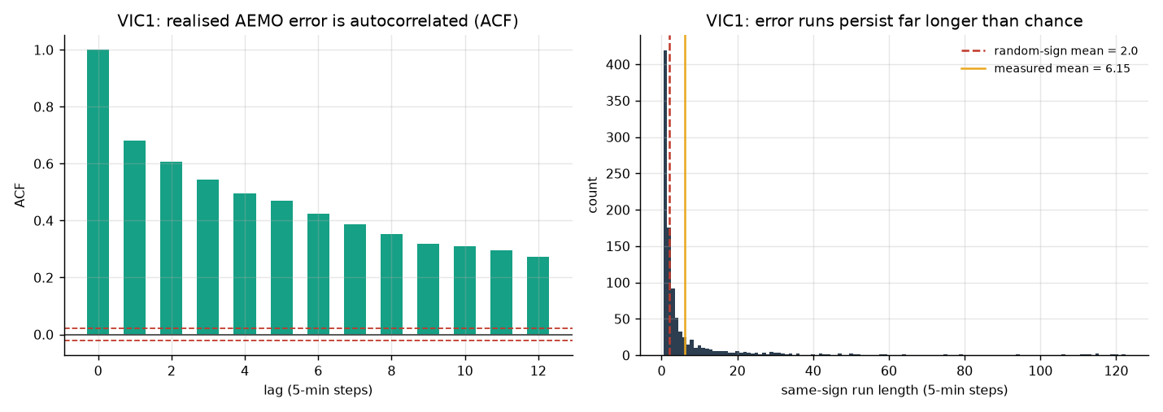
14
The error is not noise: it arrives in runs
The professor's hypothesis, tested directly
▪ ACF of the realised error ε(k): +0.50 at lag 1, +0.48 at lag 2, still +0.19 at lag 12 — far outside the ±1.96/√n band.
▪ Same-sign run length averages 5.05 intervals against 2.00 for random signs, with a longest run of 94 intervals.
▪ “If AEMO is currently high or low, the next few intervals tend to stay the same way” is therefore true in this sample, and the residual is worth modelling.

Slide 19
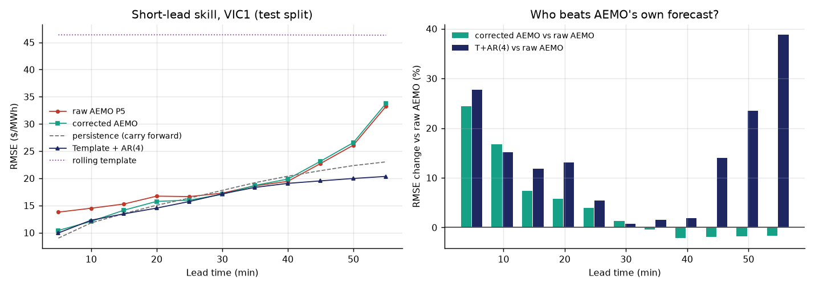
15
No single candidate wins the hour: persistence takes 5–10 min, T+AR(4) takes the rest
Five candidates on a held-out 30% of origins · RMSE in $/MWh
▪ At 5 min lead: raw AEMO 13.78, corrected 10.42, persistence 9.00, T+AR(4) 9.96 — winner persistence.
▪ At 55 min lead: raw AEMO 33.25, corrected 33.80, persistence 23.03, T+AR(4) 20.35 — winner T+AR(4).
▪ Winner by lead: 5 min persistence, 10 min persistence, 15 min T+AR(4), 20 min T+AR(4), 25 min T+AR(4), 30 min corrected AEMO, 35 min T+AR(4), 40 min T+AR(4), 45 min T+AR(4), 50 min T+AR(4), 55 min T+AR(4)

Slide 20
16
Short-lead table, all four candidates, by lead
Test split · RMSE and MAE in $/MWh
Lead | n | raw AEMO | corrected | persistence | T+AR(4) | corr gain | TAR gain
5 min | 1555 | 13.78 | 10.42 | 9.00 | 9.96 | +24.4% | +27.8%
10 min | 1554 | 14.50 | 12.08 | 11.81 | 12.30 | +16.7% | +15.2%
15 min | 1553 | 15.28 | 14.14 | 13.50 | 13.46 | +7.4% | +11.9%
20 min | 1552 | 16.72 | 15.76 | 15.05 | 14.53 | +5.8% | +13.1%
25 min | 1551 | 16.64 | 15.99 | 16.36 | 15.74 | +3.9% | +5.4%
30 min | 1550 | 17.28 | 17.05 | 17.78 | 17.15 | +1.3% | +0.7%
35 min | 1549 | 18.62 | 18.70 | 19.20 | 18.33 | -0.4% | +1.6%
40 min | 1548 | 19.44 | 19.85 | 20.38 | 19.07 | -2.1% | +1.9%
45 min | 1547 | 22.72 | 23.15 | 21.41 | 19.53 | -1.9% | +14.1%
50 min | 1546 | 26.09 | 26.56 | 22.34 | 19.97 | -1.8% | +23.4%
55 min | 1545 | 33.25 | 33.80 | 23.03 | 20.35 | -1.7% | +38.8%
▪ gain = RMSE change relative to raw AEMO; positive means the challenger is better.
▪ This is the by-lead reporting the professor asked for — no single aggregate number is quoted as “the” accuracy.

Slide 21
17
What the error study says, and what it does not
Honest reading before this goes anywhere near the MPC
Established▪ AEMO's P5 error is strongly autocorrelated and arrives in runs (ACF(1) = 0.68, mean same-sign run 6.15 intervals, longest 122), so it is a legitimate modelling target.
▪ A per-lead linear correction on four lagged realised errors cuts raw AEMO RMSE by 24% at 5 min and 17% at 10 min.
▪ The correction turns negative past 30 min — the decay-to-zero behaviour the professor predicted shows up as a crossover rather than a gentle fade.
▪ AEMO's own 5-minute product is not the strongest short-lead forecaster in this window: raw P5 loses to plain persistence out to 10 min and to T+AR(4) from 15 min on.
Not established yet▪ One region, one five-day test split. VIC1 only, September only — this is a pilot, not a result.
▪ The template inside T+AR(4) was warmed up on 10 days here, not the 28–30 days the January benchmark used, so the two T+AR(4) numbers are not comparable.
▪ The corrected-AEMO model was fitted on raw prices without the Q1/Q99 clamp the MPC will apply, so the scored signal differs from the benchmark's.
▪ No cost impact has been demonstrated — that needs the MPC in the loop.

Slide 22
Next
● Raise the forecast retention so the live store, not a backfill, feeds the error model.
● Extend the error study to all five regions and a longer window; report by lead, never as one number.
● Re-fit the correction so the corrected line is compared against persistence and T+AR(4) on identical origins.
● Map public holidays into the template class logic, then wire the correction into the MPC once the residual model is stable.
Todo list and handover: Weekly/EMPC/2026-09-23/TODO.md and HANDOVER.md

