Slide 1

SCHOOL OF MANAGEMENT STUDIES AND RESEARCH
SIIT PHASE 4 – PRESENTATION
ON
“ A Study on Perception of Students and Teachers Towards E-Learning”
UNDER THE GUIDANCE OF
INTERNAL GUIDE EXTERNAL GUIDE
PROF. NAGARAJ NAVALGUND BISHOP ADHIKARI

Slide 2
COMPAY PROFILE
Company Name - BISJHINTUS PRIVATE LIMITED
Founder – Bishop Adhikari
Company Status – Active
Company Sub Category - Non-government company
Class of Company – Private
Date of Incorporation - 18 February 2021
Age of Company - 1 years, 0 month, 15 days
Sector – Education Sector (Online Platform)
Number of Members - 23

Slide 3
ABSTRACT
The educational system across the world has immensely been affected due to outbreak of COVID-19; it forced the shutdown of educational institutions, which adversely affected students across the globe. Due to its contagious nature, COVID-19 demanded containment and enforced isolation that tremendously affected personal interaction of teachers and students. In the absence of traditional classroom teaching and one-to-one interaction, computer-based learning has emerged as closest substitute for off-line teaching. Against such a backdrop, it is pertinent to examine the student awareness, perception and satisfaction towards online-learning system adopted at the university level during the ongoing pandemic. Technology-enhanced learning method has been adopted worldwide in order to develop globalised competitiveness among students. E-Learning has taken the place of traditional face-to-face educational environment. This study was undertaken to assess perception of teacher and students towards e-learning based on the data analysis teachers don’t have good perception towards e-learning platform as the majority of teachers opted teaching is not effective as well as interaction with students helps them to deliver the concepts more effectively as all students are not equally capable. Also students perception towards e-learning concludes students face connectivity issues in e-learning platform as well as e-learning makes their learning process easy and e-learning is helpful to learn new concepts.
Keywords: E-Learning, Perception, Behavior, Technology Acceptance Model

Slide 4
RESEARCH PROBLEM
Skilled Students play a significant role in the development of nation. In imparting skills the education sector play an important role. But in the time of crisis one of the major sectors affected by lockdown is education sector. Students has to face new challenges in this VUCA world. Teachers as well as students need to adapt new teaching and learning methodologies during pandemic. Both online learning and offline learning have their own merits and demerits where as online learning suffers from limitations of interactivity, accessibility etc.
In the backdrop of this scenario the present study is undertaken to identify factors influencing on e-learning behavior of students also to know their perception towards e-learning

Slide 5
RESEARCH SCOPE
E-L is growing as a new pattern to deliver information in the educational area. Most of the higher education universities are offering there courses using online platform. This study focuses on education sector and aims to know the perception of students and teachers towards e-learning platform.

Slide 6
LITERATURE REVIEW
[1]Awareness of Online Learning among Teacher Trainees-A Review (Pradeep Kumar Mallick) [2013] - More than three forth of the teacher trainees have very high awareness of online learning[2] Student Awareness Towards E-Learning In Education[Azliza Yacob*]2011 The concepts of e-learning should be more wider since the technology today provide many opportunities to the academician and students to gather their knowledge.[3] The role of ICT in higher education for the 21st century (Ron Oliver)[2014] ICTs have impacted on educational practice in education to date in quite small ways but that the impact will grow considerably in years to come and that ICT will become a strong agent for change among many educational practices. [4]The Role and Impact of ICT in Improving the Quality of Education: An Overview (Koushik Das)[2019] The use of ICT will enhance the learning experiences of students. It also helps for building a successful career, in a technology savvy world. [5]Impact of modern technology in education(R. Raja*, P. C. Nagasubramani)[2018] Technology has a positive impact on education. Teachers and students should take advantage of this in the good light and eliminate the drawbacks. [6]The social impact of technology on millennials and consequences for higher education and leadership (Manuel Au-Yong-Oliveira*) [2017] Using technology in class is seen to be essential in getting messages across to students. Lecturers compete for students attention with facebook, instagram, snapchat, whatsapp, Twitter, and other online platforms, and so need to entice them into the academic discussion by using the same digital-based tools

Slide 7
[7]Factors effecting learner’s satisfaction towards e-learning (Dr. Pushkar Dubey*)[2020] Technology-enhanced learning is the need for government to focus more on technology-equipped learning in the higher education institutions in order to improve the teaching-learning process and develop globalised competitiveness among graduates. [8] The role of e-learning, advantages and disadvantages of its adoption in higher education (David Castillo-Merino*)[2013] ICT has a positive effect on students’ performance from the adoption of innovations in the technology of teaching and learning. [9] Effects of COVID-19 in E-learning on higher education institution students: the group comparison between male and female (Arfan Shahzad*)[2020] implies that females students of Malaysian universities are more focused on the E-learning portal as compare to male students also time to time feedback from the user will increase the durability and acceptability of the E-learning portal. [10]Students Perception towards E-Learning during COVID-19 Pandemic in India: An Empirical Study (Mohammed Arshad Khan)[2020] study reveals the preferences of students for e-learning as it provides them much freedom to connect with their teachers, fellow students and engage with their study materials at the comfort and flexibility of space and time. [11]Teachers Perception of Online Learning during Pandemic Covid-19 (Retno Puji Rahayu*) [2020] Teachers showed a positive perception of the usefulness and ease of use of the online system during pandemic Covid-19. [13] Exploring factors influencing online classes due to social distancing in COVID-19 pandemic: a business students perspective (Adil Zia) [2020] Attitude, curriculum, motivation, technology and training were found to have an impact on online classes. [14] Students satisfaction with online learning (Brittany Landrum) [2020] Student satisfaction depends on the convergence of the students expectations as well as facilitating students aim

Slide 8
OBJECTIVES
To identify the factors influencing on the E-learning behavior of students and teachers
To analyze the relation between the factors and e-learning behavior of students and teachers

Slide 9
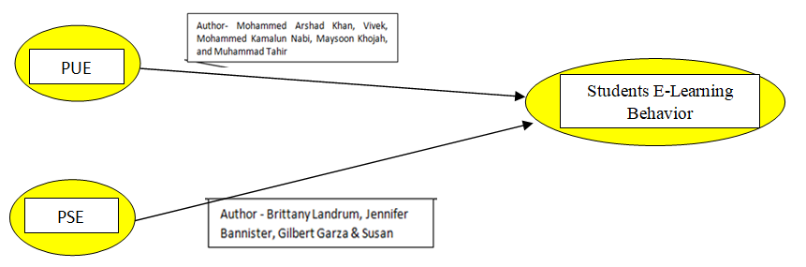
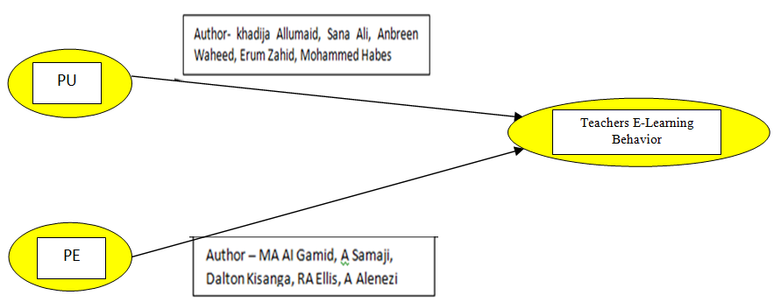
CONCEPTUAL MODEL

Slide 10
RESEARCH METHODOLOGY
Data – Primary and Secondary data
Research Type – Quantitative and Qualitative Research
Research – Descriptive and Exploratory Research
Data Collection Method – Questionnaire
Target Population – Students And Teachers
Scaling – Likert Scale (5 point)
Sample Size – More than 100

Slide 11
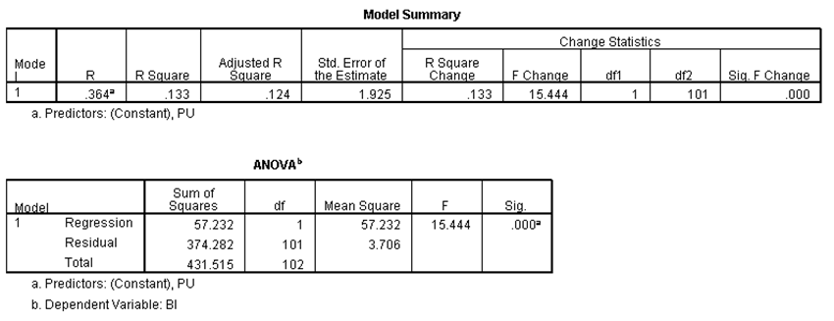
DATA ANALYSIS
Hypothesis Testing
HO – There is no relation between the Perceived usefulness and teachers e-learning behavior
HA- There is a relation between Perceived usefulness and teachers e-learning behavior
→ From the Anova table, the r squared value is 0.133. Hence we reject the null hypothesis H0 and accept alternative hypothesis HA Therefore, based on the regression calculation only 13% of the perceived usefulness is related to e-learning behavior which is less.

Slide 12
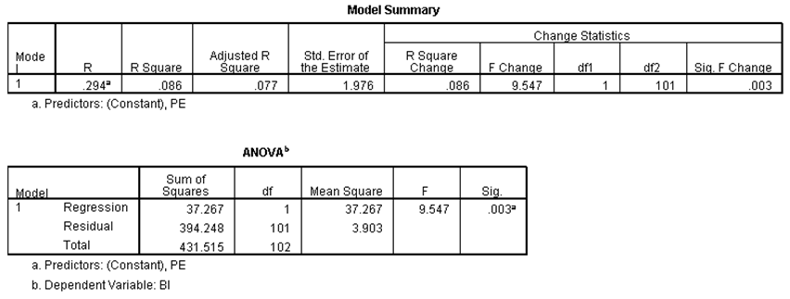
HO – There is no relation between the Perceived ease of use and teachers e-learning behavior
HA- There is a relation between Perceived ease of use and teachers e-learning behavior
→ From the Anova table, the r squared value is 0. 86 . Hence we reject the null hypothesis H0 and accept alternative hypothesis HA Therefore, based on the regression calculation 86% of the perceived ease of use is related to e-learning behavior of teachers

Slide 13
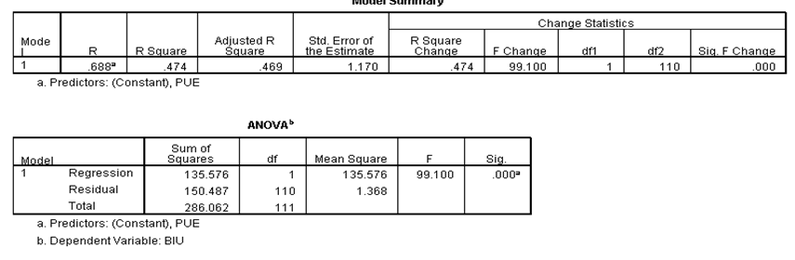
HO – There is no relation between the Perceived usefulness and students e-learning behavior
HA- There is a relation between Perceived usefulness and students e-learning behavior
→ From the Anova table, the r squared value is 0.474. Hence we reject the null hypothesis H0 and accept alternative hypothesis HA Therefore, based on the regression calculation 47.4% of the perceived usefulness is related to e-learning behavior of students

Slide 14
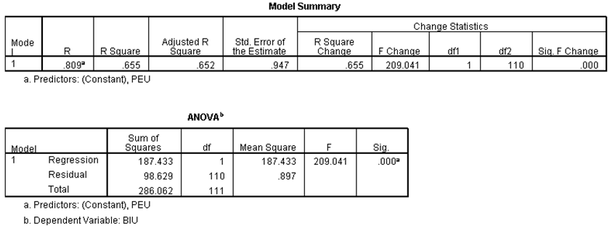
HO – There is no relation between the Perceived ease of use and students e-learning behavior
HA- There is a relation between Perceived ease of use and students e-learning behavior
→ From the Anova table, the r squared value is 0. 655. Hence we reject the null hypothesis H0 and accept alternative hypothesis HA Therefore, based on the regression calculation 65.5 % of the perceived ease of use is related to e-learning behavior of students

Slide 15
FINDINGS
Research study focuses on students and teachers perception towards e-learning platform and depicts influence of factors perceived usefulness perceived ease towards e-learning behavior. On analyzing data using SPSS software identified R squared value as 13 percent which implies there is less relation between perceived usefulness and teachers e-learning behavior followed by R squared value 86 percent concludes that there is relationship between perceived ease of use and teachers e-learning behavior, whereas R squared value 47.4 percent implies there is relation between perceived usefulness and students e-learning behavior followed by R squared value 65.5 percent implies there is relation between perceived ease of use and students e-learning behavior

Slide 16
CONCLUSION
Skilled students play a significant role in the development of our nation but during the time of crisis students and teachers moved from offline traditional learning to online learning, online has merits as well as demerits in the backdrop of this research is undertaken to understand perception of students and teachers towards e-learning in Karnataka state. On the basis of analysis using SPSS software concludes that there is only 13 percent relation between perceived usefulness and teachers e-learning behavior followed by 86 percent relation between perceived ease of use and teachers e-learning behavior , whereas there 47.4 percent relation between perceived usefulness and students e-learning behavior followed by 65.5 percent of relation between perceived ease of use and students e-learning behavior.
Also as per the interaction I had with teachers and students perception on e-learning. Though e-learning helps students to learn new concepts browse more required information students prefer classroom learning where they get opportunity to interact with teachers and learn and get their doubts clarified. Also majority of teachers opted for classroom learning as they can interact with students though teaching is effective all students are not equally capable to understand concepts and online education is preferred only during pandemic situation at the time of crisis where social distance was mandatory and e-learning cannot be recommended in future.

Slide 17
ADVANTAGES AND DISADVANTAGES OF E-LEARNING
Advantages
❖ It makes students more excited to learn.
❖ Help students with busy schedules, freedom to study at home on their own time.
❖ Allows students to learn new skills they can use later in the work place.
❖ E-Learning platform improved students performance in their exams.
Disadvantages
❖ Many experts and experienced people say that, due to such technology in education, students imagination is affected, their thinking ability is reduced.
❖ Sometime there is an accessibility issue.
❖ There can be health issues too when used over limit.

Slide 18
THANK YOU

