Slide 1

SQL Server Debugging Made Easy using Extended Events
Amit Banerjee
Senior Program Manager
Microsoft Data Group

Slide 2
C:\Users\> whoami Known on Twitter as @banerjeeamit
An affair with SQL Server for nearly a decade
Was part of SQL Escalation Services and Premier Field Engineering team at Microsoft
Now a Sr. Program Manager on the Microsoft SQL Server (TIGER) product team focusing on HADR and Replication
Speaker at SQL PASS 24HOP TechEd Virtual TechDays User Groups SQL Saturdays
Dabble around with supportability tools and have contributed to SQL Backup Simulator SQLDIAG/PSSDIAG Manager and SQL Nexus
Co-authored “Professional SQL Server 2012: Internals and Troubleshooting”
Own TroubleshootingSQL.com
Also found on http://aka.ms/sqlserverteam

Slide 3













Please Support Our Sponsors
SQL Saturday is made possible with the generous support of these sponsors. You can support them by opting-in and visiting them in the sponsor area.

Slide 4
Don’t Forget
Silence your cell phones
Online Evaluations
www.sqlsaturday.com/572/sessions/sessionevaluation.aspx
www.sqlsaturday.com/572/eventeval.aspx
Submit for raffles by 3:30PM

Slide 5
Session Objectives And Takeaways
Understand capabilities of Extended Events to troubleshoot and mitigate issues quickly in mission-critical environments
Set up session templates proactively to reduce mitigation time during reactive situations
Use Extended Events to
troubleshoot and resolve complex issues in a timely manner and improve CPE

Slide 6

Agenda
Best Practices
Common Troubleshooting Scenarios
System Health
Query Performance
Always On
Backup, Restore and Recovery
Demos

Slide 7
Best Practices
Premise: “drop events, not performance”
Avoid EVENT_RETENTION_MODE = NO_EVENT_LOSS
Event Buffers
None: 3 buffers (fixed) x 1.3 MB ~4.0 MB (Default MAX_MEMORY=4.0 MB)
Node: 3 * number_of_nodes
CPU: 2.5 * number_of_cpus
For high end machines
MEMORY_PARTITION_MODE=PER_NODE | PER_CPU
Increase MAX_MEMORY, use multiple XE file targets to increase write throughput
Example: 4 node,
16 logical cores/node
Avoid expensive
Events e.g. showplan
Actions e.g. callstack
Filters on text columns
Notes:
Event session options
http://blogs.msdn.com/b/extended_events/archive/2010/03/31/option-trading-getting-the-most-out-of-the-event-session-options.aspx
Memory partitioning
http://blogs.msdn.com/b/extended_events/archive/2010/12/07/session-memory-who-s-this-guy-named-max-and-what-s-he-doing-with-my-memory.aspx
Buffer memory
http://blogs.msdn.com/b/extended_events/archive/2010/06/28/take-it-to-the-max-and-beyond.aspx

Slide 8
Configure Extended Events Session
Why am I showing this?

Slide 9
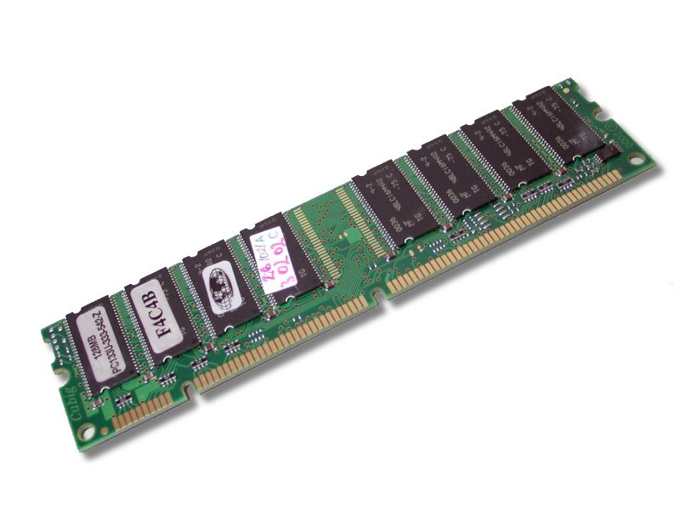
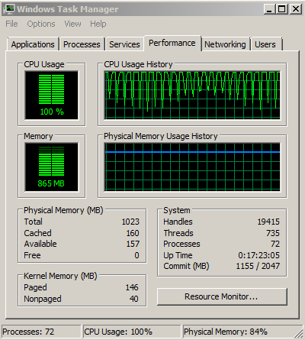








Common Scenarios

Slide 10
Backup and Restore tracing
Long running tasks
Not enough insight into progress
Trace flag (3004) output is cryptic and unformatted
Errorlog
TF 3014 = TF 3014 + TF 3004 + TF 3212 (buffer config details)
Formatted messages - Backup(dbname) and Restore(dbname)
All errors (currently sent to the client, which can be lost)
Extended Event
backup_restore_progress_trace
SQL Server 2016
Notes:
Options - checksum, compression, encryption, and buffer configs
Size estimation before starting actual copy operation
Elapsed time - checkpointing, zeroing files (restore), history table updates
Percentage progress during file processing
Waits for locks - only high-level/database-level locks
Major steps for filestream filegroups
First/last LSNs in consistent format
Backup and restore are long running tasks in SQL Server with limited insights into progress. Often a question asked is “How much longer will it take for this operation to complete?”. Though there are trace flags and DMVs that provide some information, they are either unstructured (ex: trace flags send output to error logs and can be hard to parse) or hard to interpret.
In SQL Server 2016 (starting with CTP 2), we have introduced a new extended event that can be used to easily gain insight into progress of any of these long running activities. In addition, you can leverage the rich collection and diagnostic capabilities of extended events for advanced analysis. We hope that this extended event will simply your troubleshooting experience with backup and restore activities.
Single Extended Event
You can turn on the backup_restore_progress_trace extended event to trace both Backup and Restore progress.
CREATE EVENT SESSION [Backup trace] ON SERVER ADD EVENT sqlserver.backup_restore_progress_trace ADD TARGET package0.event_file(SET filename=N’Backup trace’) WITH (MAX_MEMORY=4096 KB,EVENT_RETENTION_MODE=ALLOW_SINGLE_EVENT_LOSS, MAX_DISPATCH_LATENCY=5 SECONDS,MAX_EVENT_SIZE=0 KB,MEMORY_PARTITION_MODE=NONE, TRACK_CAUSALITY=OFF,STARTUP_STATE=OFF) GO
The event has the following data that is part of the payload.
name type_name description operation_type database_operation_type Type of operation – Indicates whether the database is being backed up or restored trace_level backup_restore_trace_level Backup/Restore trace level database_name unicode_string Logical name of the database trace_message unicode_string Progress trace messages for key steps in backup or restore
name map_key map_value database_operation_type 0 Backup database_operation_type 1 Restore backup_restore_trace_level 0 Information of major steps in the operation backup_restore_trace_level 1 Verbose I/O related information

Slide 11
Database Recovery tracing
Limited information available during database recovery activities such as Analysis, Redo and Undo
Errorlog
Does not output during Analysis phase
“Recovery of database ‘%’ is xx% complete (approximately yy seconds remaining)
Three new Extended Events:
database_recovery_progress_report
database_recovery_times
database_recovery_trace
SQL Server 2016
Notes:
As most of you can attest, there is limited information available during database recovery activities such as Analysis, Redo and Undo phases. I am happy to share that in SQL Server 2016, we have introduced three new extended events to help you gain insight into database recovery.
database_recovery_progress_report This event can be used to gather high level progress information such as phase, percent_complete and estimated time during database recovery. The following data is available as part of the event:
name
phase
percent_complete
total_elapsed_time_sec
estimated_remaining_time_sec
database_name
Recovery phase in the extended event payload can be one of the following:
PreRecovery
Analysis
Redo
Undo
Complete
PostRecovery
database_recovery_times With this extended event, you can also get the recovery time for specific steps during database startup.
database_recovery_trace If the two extended events listed above are not sufficient and you wanted detailed insight, you can also turn on database_recovery_trace extended event. Note that this can generate lot of data and use with caution. Off course, you can leverage the filtering capabilities of the extended event framework to limit the collection to a specific database or a specific phase.
Some of the useful information that you can instantly get are:
Number of VLFs
Estimated log size
Number of transactions
Time spent in each phase

Slide 12
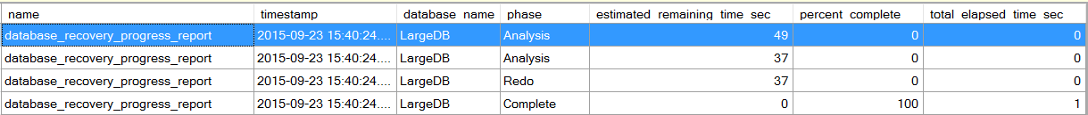
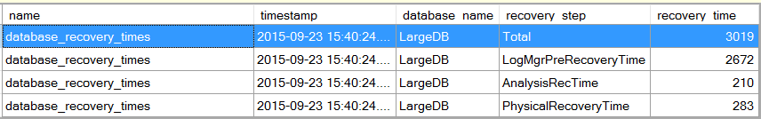
Database Recovery progress
Progress and time estimates for various phases
Recovery time for specific steps during database startup
SQL Server 2016
Notes:
Extended Event Session Script
The following session definition was used to collect the events above. Though the session can be launched any time during the middle of a long running recovery to gather insight, you can turn on the startup state for the session to automatically launch at startup in case you want to collect data during server startup when database recovery usually happens.
CREATE EVENT SESSION [recovery_trace] ON SERVER ADD EVENT sqlserver.database_recovery_progress_report(SET collect_database_name=(1)), ADD EVENT sqlserver.database_recovery_times, ADD EVENT sqlserver.database_recovery_trace ADD TARGET package0.event_file(SET filename=N’recovery_trace’) WITH (MAX_MEMORY=4096 KB,EVENT_RETENTION_MODE=ALLOW_SINGLE_EVENT_LOSS,MAX_DISPATCH_LATENCY=3 SECONDS,MAX_EVENT_SIZE=0 KB,MEMORY_PARTITION_MODE=NONE,TRACK_CAUSALITY=OFF,STARTUP_STATE=ON) GO

Slide 13
Powershell Extensions
PS SQLSERVER:\XEvent\TR23DEMO\SQL2016\Sessions\system_health> dir Events
Name Package Name Predicate Description
---- ------------ --------- -----------
sqlclr.clr_allocation_failure sqlclr A memory allocation failed.
sqlclr.clr_virtual_alloc_fa... sqlclr A virtual memory allocation failed
sqlos.memory_broker_ring_bu... sqlos Memory broker ring buffer recorded
sqlos.memory_node_oom_ring_... sqlos Memory node OOM ring buffer recorded
sqlos.process_killed sqlos Process killed
sqlos.scheduler_monitor_dea... sqlos Deadlock ring buffer recorded for sch...
sqlos.scheduler_monitor_non... sqlos Nonyielding IOCP ring buffer recorded...
sqlos.scheduler_monitor_non... sqlos Nonyielding ring buffer recorded for ...
sqlos.scheduler_monitor_non... sqlos Non-yielding resource manager ring bu...
sqlos.scheduler_monitor_sta... sqlos Stalled dispatcher event recorded for...
sqlos.scheduler_monitor_sys... sqlos System health ring buffer recorded fo...
sqlos.wait_info sqlos ([duration]>(1500... Occurs when there is a wait on a SQLO...
sqlos.wait_info_external sqlos ([duration]>(5000... Occurs when a SQLOS task switches to ...
sqlserver.connectivity_ring... sqlserver Occurs when there is a server-initiat...
sqlserver.error_reported sqlserver ([severity]>=(20)... Occurs when an error is reported.
sqlserver.security_error_ri... sqlserver Security error ring buffer recorded
sqlserver.sp_server_diagnos... sqlserver ([sqlserver].[is_... Occurs when a component state is dete...
sqlserver.sql_exit_invoked sqlserver Occurs when SQLExit() routine is invoked
sqlserver.xml_deadlock_report sqlserver Produces a deadlock report in XML for...
Notes:
https://msdn.microsoft.com/en-us/library/ff877887(v=sql.130).aspx

Slide 14
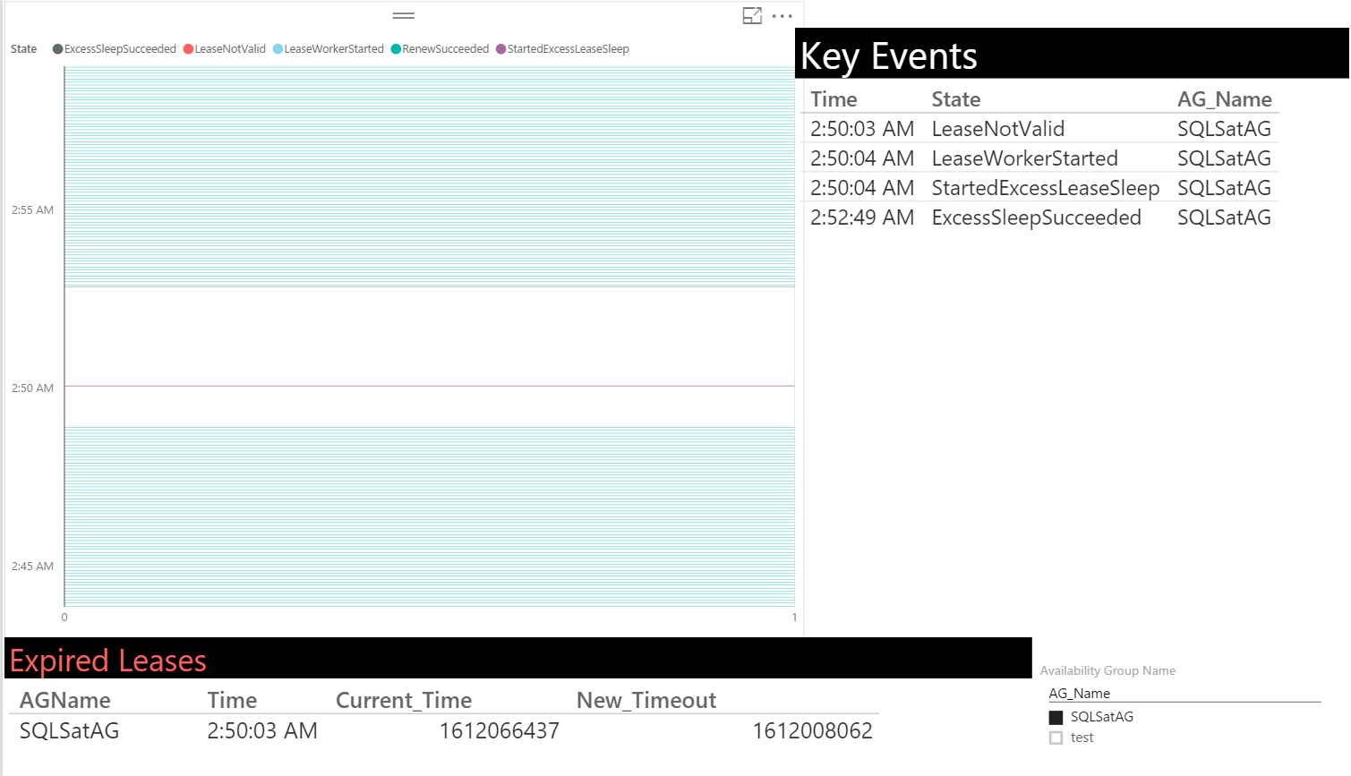
Lease Timeout
Somebody got hurt real bad!!! ☹

Slide 15
Availability Group: Lease Timeout
hadr_ag_lease_renewal
- Renews every 5 seconds
availability_group_lease_expired
– Raised when the lease expires
SQL Server 2012 Service Pack 3 and above
Notes:
More information about this improvement can be found in the following articles:
https://blogs.msdn.microsoft.com/alwaysonpro/2016/02/23/improved-alwayson-availability-group-lease-timeout-diagnostics/
https://support.microsoft.com/en-us/kb/3112363
Refer the following for Lease Timeouts: https://blogs.msdn.microsoft.com/psssql/2012/09/07/how-it-works-sql-server-alwayson-lease-timeout/

Slide 16
Availability Group: Latency
hadr_apply_log_block
hadr_capture_log_block
hadr_capture_vlfheader hadr_database_flow_control_action
hadr_db_commit_mgr_harden
hadr_log_block_compression
hadr_log_block_decompression
hadr_log_block_group_commit
hadr_log_block_send_complete
hadr_lsn_send_complete
hadr_receive_harden_lsn_message
hadr_send_harden_lsn_message
hadr_transport_flow_control_action
hadr_transport_receive_log_block_message
log_block_pushed_to_logpool
log_flush_complete
log_flush_start
recovery_unit_harden_log_timestamps
SQL Server 2012 Service Pack 3 and above

Slide 17
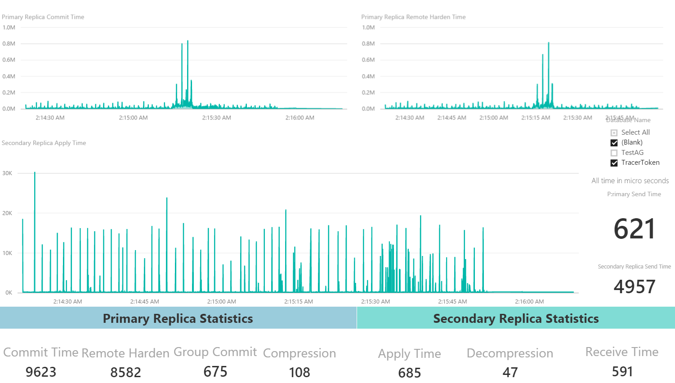

Slide 19
DEMO
Let’s look at something COOL!

Slide 20

Questions
Resources
Blog:
Aka.ms/sqlserverteam
www.troubleshootingsql.com
Twitter:
@banerjeeamit
@mssqltiger
Github:
https://github.com/Microsoft/tigertoolbox
https://github.com/Microsoft/sql-server-samples

Slide 21
Thank You
This FREE SQL Saturday is brought to you courtesy of these sponsors, speakers and volunteers who staff this event

