Slide 1


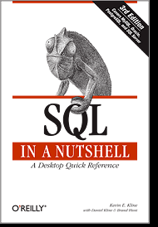
SQL Server Internals & Architecture
Kevin Kline, SQL Sentry
Tech Evangelist, SQL Sentry
Microsoft SQL Server MVP since 2003
Twitter , Facebook, LinkedIn @ KEKline
Website: http://blogs.sqlsentry.com/KevinKline

Slide 2
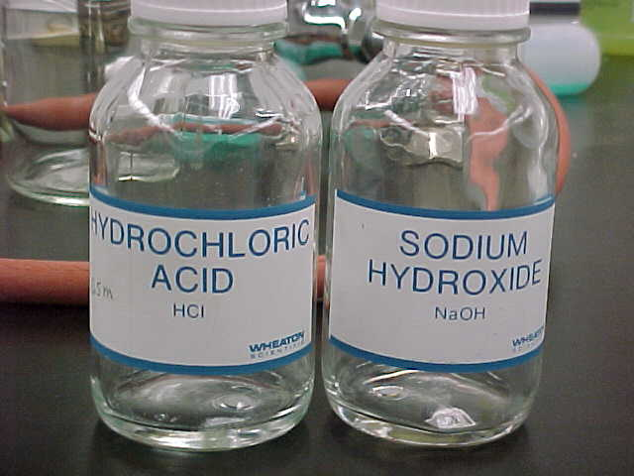
Dropping acid - Why Does SQL Server Do what it Does?
ACID properties of Transactions
Atomic
Consistent
Isolated
Durable
Speed, scalability, and
performance; Maximize hardware
Competitive features

Slide 3

OUR TOUR GUIDE
Talk nerdy to me, baby!

Slide 4

OK, We’re Done
Query
Tree
SELECT
Language
Event
Relational Engine
Protocol Layer
Optimizer
Cmd Parser
Query
Plan
SNI
Query Executor
SQL Server Network Interface
?
TDS
T-Log
OLE
DB
Storage Engine
Buffer Pool
- - - - - - - - - - - -
Data Cache
- - - - - - - - - - - -
Plan Cache
Trans-action Manager
Access Methods
Buffer Manager
Data File
?
Notes:
Sheldon wants to do some work on SQL Server.
Let’s start with a simple SELECT statement.
Sheldon will connect from his client to the protocol layer using TDS (tabular data stream) endpoints. There’s one TDS for each protocol, plus one for the DAC. The protocol layer will probably use TCP/IP, VIA (virtual interface adapter), or maybe Named Pipes to further connect to the SQL Server.
The protocol layer reverses the work of the SNI, unwrapping your packet to see what it contains.
The SELECT statement is marked as a “SQL Command” and sent to the Command Parser.
The Cmd Parser’s role is to handle T-SQL language events: checks syntax, returns error codes when invalid.
If valid, Cmd Parser generates an execution plan using a hash of the T-SQL then checks it against the plan cache to see if it already exists.
If it finds a match, the plan is read from cache and passed to the Query Executor. Otherwise:
The Optimizer is invoked to build a query plan on a “cost-based” method. Don’t forget – it’s not looking for the BEST PLAN, it’s looking for the MOST EFFICIENT PLAN (i.e. the best plan it can find in a split second). It can also perform multi-stage optimizations:
Pre-optimization: a trivial plan that’s super simple
Phase 0: Looks for simple nested loops w/o parallelization options. These are called transactional processing plans.
Phase 1: Uses a quick subset of rules containing the most common patterns. These are called quick plans.
Phase 2: This is for complex queries with parallelism and indexed views, called full plans.
How much does it cost? Nuttin honey – cost is a made-up, abstract definition.
Once the SQL Server Query Executor knows what it needs to do, now it has to actually do it. So the QE hands over the retrieval of data to the Storage Engine (using OLEDB, in case you’re interested) to handle the data using its preferred Access Method.
Access Methods are a collection of code that figures out how to best get to the data stored in tables, indexes (and partitions) . However, it doesn’t do the actual work of retrieving data. That’s handled by the Buffer Manager.
The Buffer Manager checks to see if the page(s) exist in cache. If not, BM gets the pages from the database (reading from disk in the process, creating physical reads) and puts them into data cache (creating logical reads). The key point to take away is that data is only actually ever read from cache!

Slide 5
Query optimization
Query Processor / Relational Engine
Parser
Query Optimizer
Query Executor
Optimization is cost-based
Optimized for worst case scenario: “everything comes from disk”
The cost numbers may as well be unicorn freckles
Estimated costs may have no basis in current reality
Multiple phases (a.ka. “searches”)
Pre-optimization determines if the plan is “trivial”
Phase 0: simple plans: e.g. nested loops without parallelism
Phase 1: quick plans: plans that can be simplified
Phase 2: full plans: complex queries, parallelism, spills & spools to tempdb
Notes:
Want to dig deeper? Plenty of resources online, e.g. http://blogs.technet.com/b/josebda/archive/2009/03/30/sql-server-2008-sqlos.aspx
The ones we care about for this workshop:
Query Processor
Parsing, binding, optimization, compilation
Query Optimizer & Executor
You get three guesses
Storage Engine
Buffer management, retrieve results

Slide 6

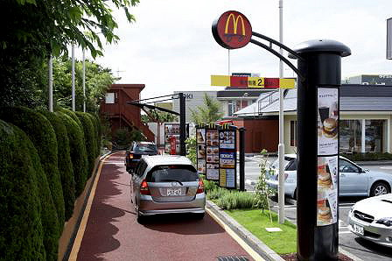

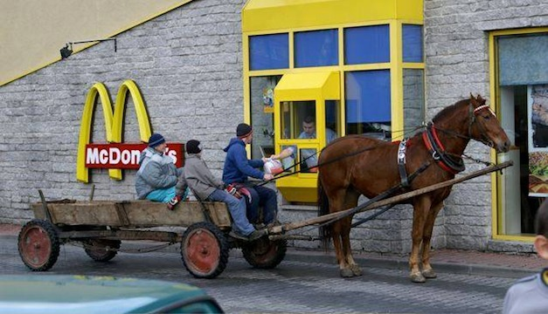
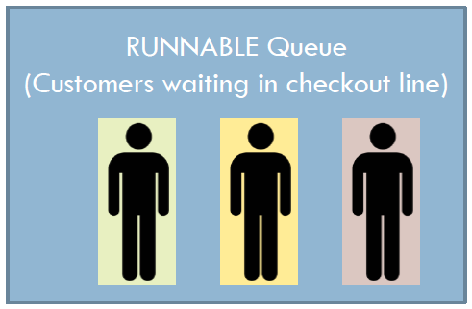
Schedulers, Threads, and waits
1 Cash Register = 1 scheduler
Users are assigned
to a thread
Uh oh! Out of soda!
No problem. Step aside… More syrup for the sodas!
Yeah! I’m next in line!
Goes to the waiting, i.e.
“suspended queue”

Slide 7

SQL Server waits
Resource Waits
Running Scheduler 1
Suspended Scheduler 1
55 Running
53 Running
55 PAGEIOLATCH_SH
52 PAGEIOLATCH_SH
Runnable Scheduler 1
54 CXPACKET
53 Runnable
60 LCK_M_S
56 Runnable
61 LCK_M_S
59 Runnable
52 Runnable
Signal Waits
Notes:
Credit goes to Joe Sack for this animation!

Slide 8
Trouble-shooting wait stats?
SOS_Scheduler_Yield
Query
Tree
Async_Network_IO
Language
Event
SQL
OS
Writelog, Logbuffer
Relational Engine
Protocol Layer
Optimizer
Cmd Parser
Query
Plan
SNI
Query Executor
SQL Server Network Interface
Pagelatch_x, Latch_x, Resource_Semaphore
?
TDS
T-Log
PageIOLatch_x, Async_IO_Completion, IO_Completion
OLE
DB
Latches
Storage Engine
Buffer Pool
- - - - - - - - - - - -
Data Cache
- - - - - - - - - - - -
Plan Cache
Check Point
Trans-action Manager:
Log & Lock Mgr
Access Methods
Buffer Manager
Data File(s)
?
Data
Write
Locks
LCK_x, LCK_M_x
Lazywriter
Notes:
CPU PRESSURE
CPU pressure: SOS_SCHEDULER_YIELD
Parallelism: CXPACKET
LOCKING
Long term blocking: LCK_X, LCK_M_U, & LCK_M_X
MEMORY
Buffer latch: PAGELATCH_X
Non-buffer latch: LATCH_X
Memory grants: RESOURCE_SEMAPHORE
I/O
Buffer I/O latch: PAGEIOLATCH_X
Tran log disk subsystem: WRITELOG & LOGBUFFER
General I/O issues: ASYNC_IO_COMPLETION & IO_COMPLETION
NETWORK PRESSURE
Network I/O: ASYNC_NETWORK_IO
From Jimmy May: http://blogs.msdn.com/jimmymay/archive/2009/04/27/wait-stats-by-joe-sack.aspx
and
Joe Sack: Presentation Deck for "Performance Tuning with Wait Statistics" http://blogs.msdn.com/joesack/archive/2009/04/22/presentation-deck-for-performance-tuning-with-wait-statistics.aspx

Slide 9
Memory manager: Buffer pool
OS
OS
CLR, MPA, DWA, TS
DWA, TS
Buffer Pool
(SPA)
Buffer Pool
(SPA)
Memory allocations within sqlservr process space
Memory allocations within sqlservr process space
Max server memory
Max server memory
Data cache
-~-~-~-~-~-
Plan cache
-~-~-~-~-~-
Other caches
Data cache
----------------
Plan cache
----------------
Other caches
SQL Server 2008 R2 & earlier
SQL Server 2012 & later
Notes:
SPA = single-page allocations
MPA = multi-page allocations
DWA = direct Windows allocations
TS = thread stacks
Picture credit Microsoft, from this blog post:
http://blogs.msdn.com/b/sqlosteam/archive/2012/07/12/memory-manager-configuration-changes-in-sql-server-2012.aspx

Slide 10

Caches?
How long does a page of data or a block of code stay in cache?
Uses a LRU algorithm
Usually performed by the lazy-
writer, but can also be done by any worker thread after scheduling its own I/O

Slide 11

Plan Cache Aging
Plan Cache
get_order
14
12
16
16
13
15
reset_user
What about buffer cache?
7
7
4
5
6
proc11
proc14
3
3
2
1
0
2
2
1
0
Notes:
Here is sp memory (talk about cost to build query plan on left and current cost on right.
Here is stored procedure cache – a subset of memory with the sps which are currently in memory
Here is the cost to compile and optimize the proc – here is the current cost factor.
A call is made to procedure getord – it is not in cache. The source is gotten from syscomments and it is compiled and placed into cache
CLICK – and here is the current cost
Lazywriter is responsible for cleaning up stored procedure cache.
CLICK Every once in a while lazywriter wakes up and goes through SP Cache. He decrements current cost by 1 for each one of the stored procedures (he also does this for all cached plans). When the current cost reaches 0, the proc is kicked out of cache and the memory is made available for re-use.
CLICK
(Point each out 2 second intervals)
CLICK then he goes back to sleep
CLICK Here he comes again – when memory is tighter he runs more frequently
CLICK and he decrements the counters ( NOTice this counter is at zero. Next time he comes around, he’ll make that available for re-use).
CLICK
CLICK (he’s back)
Click and derements and removes
CLICK he’s gone
Now someone is calling the stored procedure finduser – and it’s already in cache and the plan can be re-used… Watch the current counter
CLICK It gets re-set to the cost of compilation.
CLICK lazywriter runs
CLICK and derements and cleans up
CLICK and goes
And now someones calls get ord which is already in memory so its current counter gets reset.
TF661 disables the ghost cleanup process.

Slide 12
But Wait! There’s More!
Query
Tree
INSERT, UPDATE, or
DELETE
Language
Event
Relational Engine
Protocol Layer
Optimizer
Cmd Parser
Query
Plan
SNI
Query Executor
SQL Server Network Interface
?
TDS
T-Log
OLE
DB
Storage Engine
Buffer Pool
- - - - - - - - - - - -
Data Cache
- - - - - - - - - - - -
Plan Cache
CheckPoint
Transaction Manager: Log & Lock Mgr
Access Methods
Buffer Manager
Data File
?
Oooh! So dirty!
Data
Write
Lazywriter
Notes:
We’re doing the exact same thing behind the scenes, up to the point were the Access Manager gets busy. In this case, we’ll need to persist our data changes to disk. So we must now involve the Transaction Manager.
The Transaction Manager has two very important components:
The Lock Manager: Maintains concurrency and the ACID properties of transactions according to the specified isolation level.
The Log Manager: Controls writes to the transaction log, using a method called write-ahead logging.
Once the transaction log confirms that it has physically written the data change and passed the confirmation back to the TM, the TM in turn confirms to the AM, and then passes the modification request back to the BM for completion
But guess what, the BM has to confirm (as before) that the page is either in cache or on disk. And if it’s on disk, it must retrieve the page(s) to cache. A key point to remember is that the data is now changed, but only in cache and not on disk. This means the page is dirty and is not “cleaned” until it is flushed to disk. (A page is considered clean when it’s exactly the same on disk as in memory).
Flushing to disk happens thru a process called checkpointing. Unlike the lazywriter, checkpointing flushes the pages to disk but it does not remove them from cache. Checkpointing also ensures that a database never has to recovery past its last checkpoint. On a default install of SQL Server, that happens every minute or so (as long as there’s more than 10mb of data to write).

Slide 13
Hekaton, a.k.a. in-memory OLTP
bit.ly/1uLrXLN - Ovw
bit.ly/1u4nODQ - WP
Query
Tree
Language
Event
SQL
OS
Relational Engine
Protocol Layer
Optimizer
Cmd Parser
Query
Plan
SNI
Query Executor
SQL Server Network Interface
?
TDS
T-Log
OLE
DB
Latches
Storage Engine
Buffer Pool
- - - - - - - - - - - -
Data Cache
- - - - - - - - - - - -
Plan Cache
Check Point
Trans-action Manager:
Log & Lock Mgr
Access Methods
Buffer Manager
Data File(s)
?
Data
Write
Locks
Lazywriter
Notes:
With Hekaton, SQL Server doesn’t use interpreted T-SQL code, doesn’t use latches, doesn’t use locks, can optionally not use the Transaction log, and many more behind the scenes changes. But it has a lot of limitations and constraints too, for example, no use of foreign keys. So it’s not just a straight port.
To take advantage of In-memory OLTP, a user defines a heavily accessed table as memory optimized. In-memory OLTP tables are fully transactional, durable and accessed using T-SQL in the same way as regular SQL Server tables. A query can reference both In-memory OLTP tables and regular tables, and a transaction can update data in both types of tables. Expensive T-SQL stored procedures that reference only In-memory OLTP tables can be natively compiled into machine code for further performance improvements. The engine is designed for extremely high session concurrency for OLTP type of transactions driven from a highly scaled-out mid-tier. To achieve this it uses latch-free data structures and a new optimistic, multi-version concurrency control technique. The end result is a selective and incremental migration into In-memory OLTP to provide predictable sub-millisecond low latency and high throughput with linear scaling for DB transactions. The actual performance gain depends on many factors but we have typically seen 5X-20X in customer workloads.

Slide 14


SUMMARY
Understanding the internals is as important as any other bit of info you might have
Remember:
ACID!!!
key components of the relational engine?
key components of the storage engine?
Key areas of cache?
Key areas of the transaction manager?
What two processes conduct writes?
More info?

