Slide 1
习题课4
2019.06.06
By DYX

Slide 2
第九次作业

Slide 3
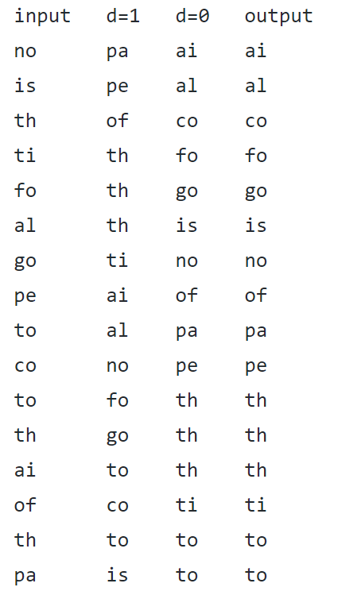
5.1.2
Notes:
相对顺序不发生改变

Slide 4
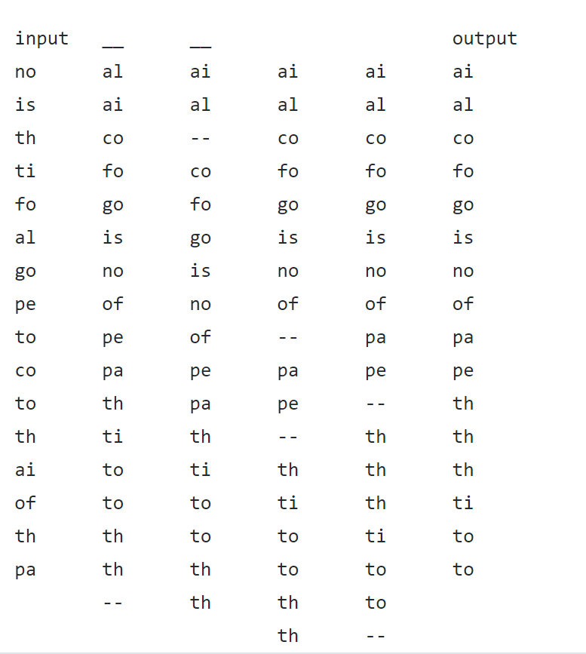
5.1.3

Slide 5
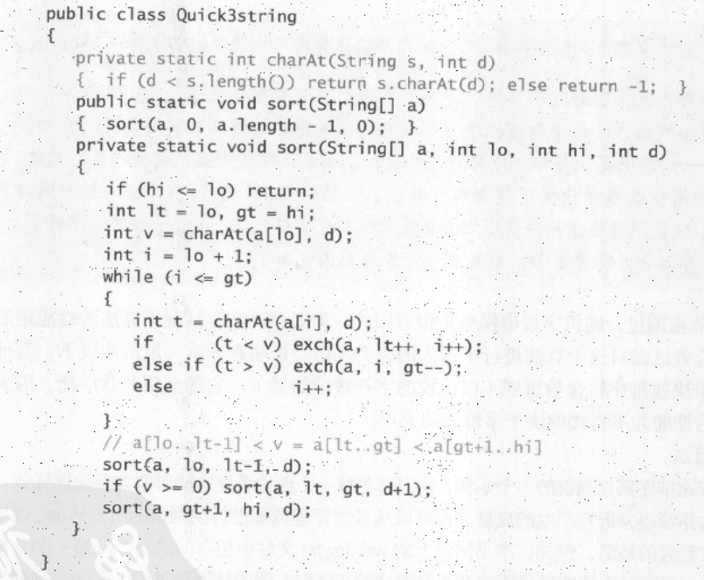
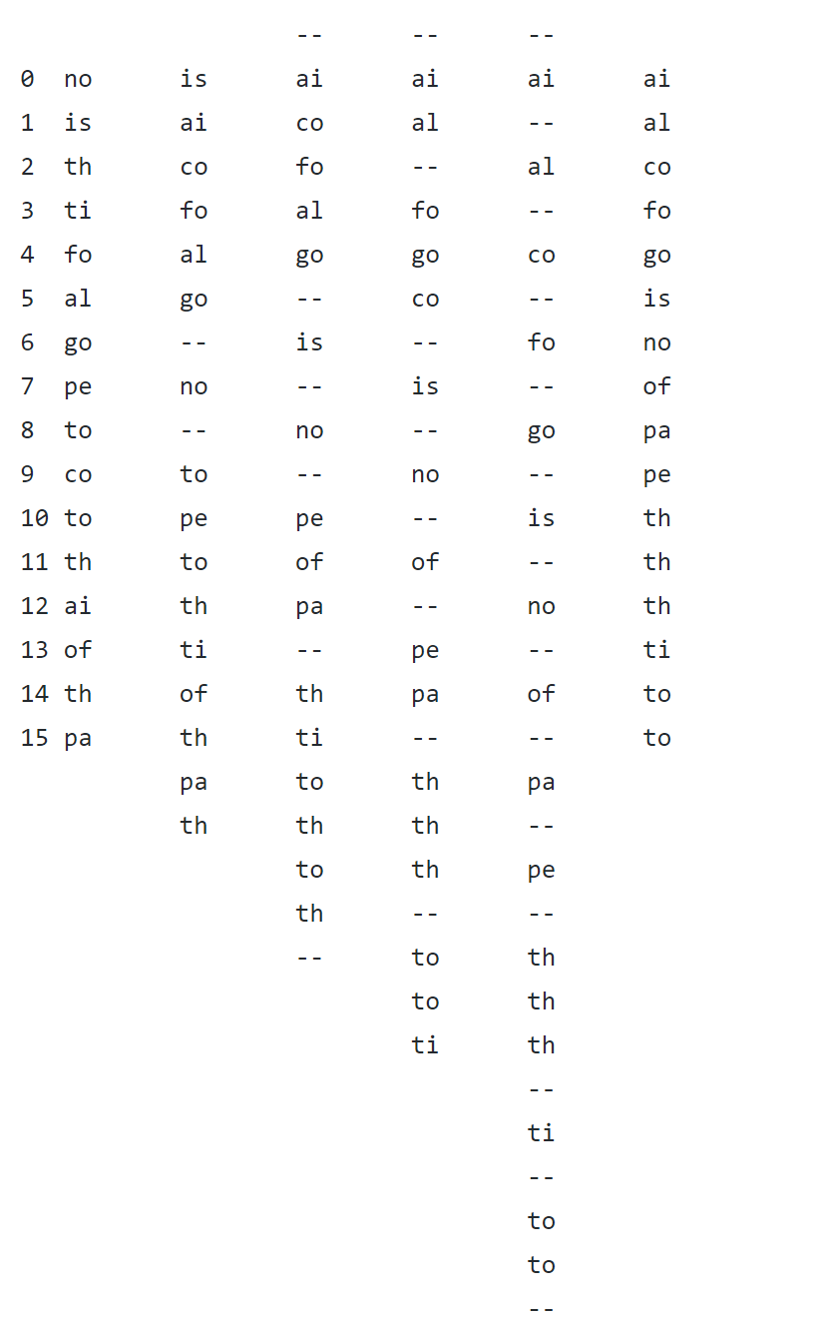
5.1.4
Notes:
P.469

Slide 6
6.38
a. In any max flow, there is no directed cycle on which every edge carries positive flow.
False
b. There exists a max flow for which there is no directed cycle on which every edge carries positive flow.
True
c. If all edge capacities are distinct, the max flow is unique.
False

Slide 7
6.38
d. If all edge capacities are increased by an additive constant, the min cut remains unchanged.
False
e. If all edge capacities are multiplied by a positive integer, the min cut remains unchanged.
True

Slide 8
第十次作业

Slide 9
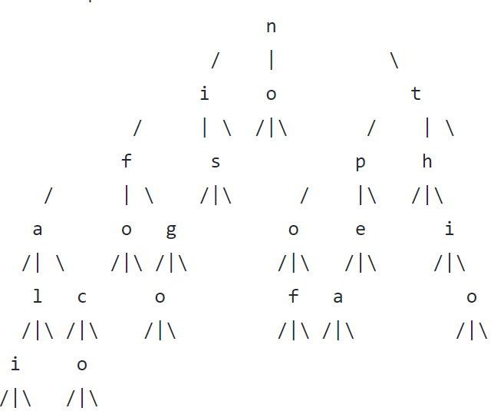
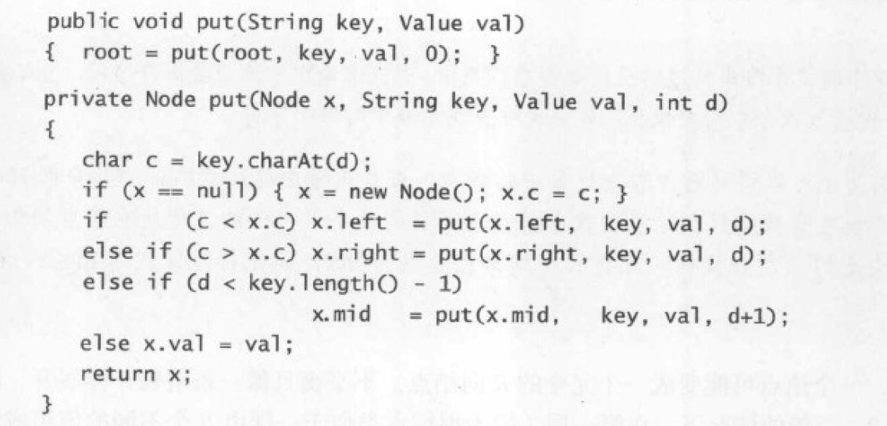
5.2.2

Slide 10
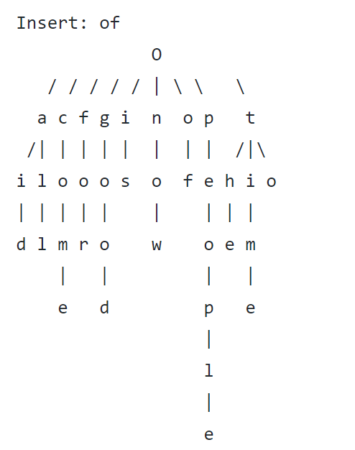
5.2.3

Slide 11
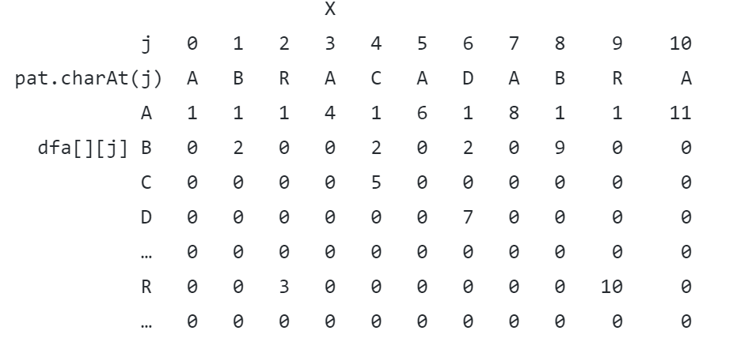
5.3.3

Slide 12
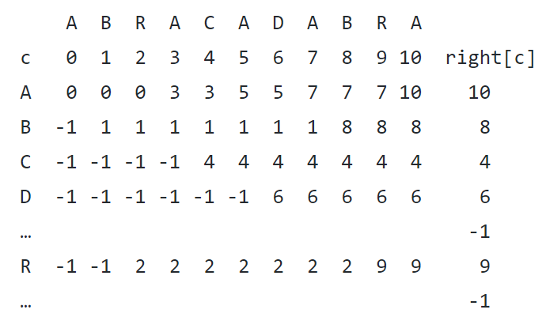
5.3.6

Slide 13
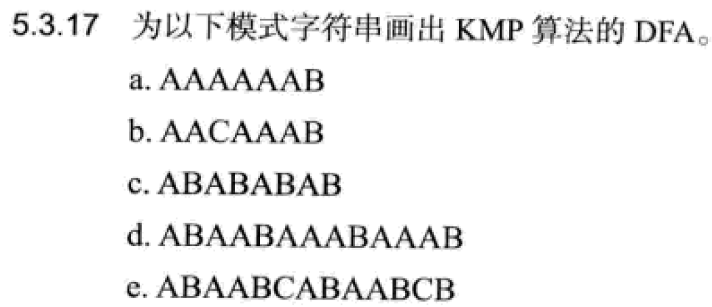
5.3.17
略

Slide 14
第十一次作业

Slide 15
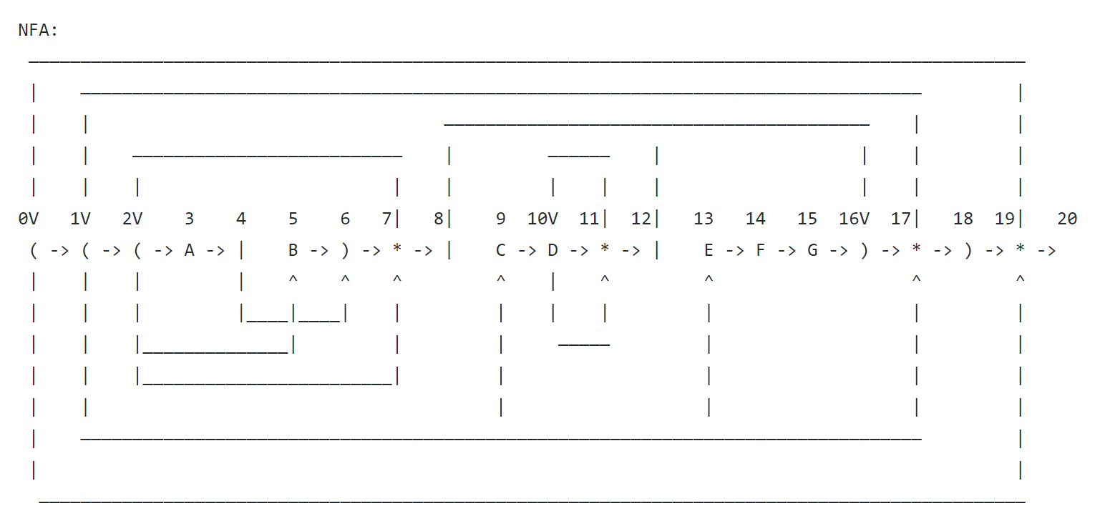
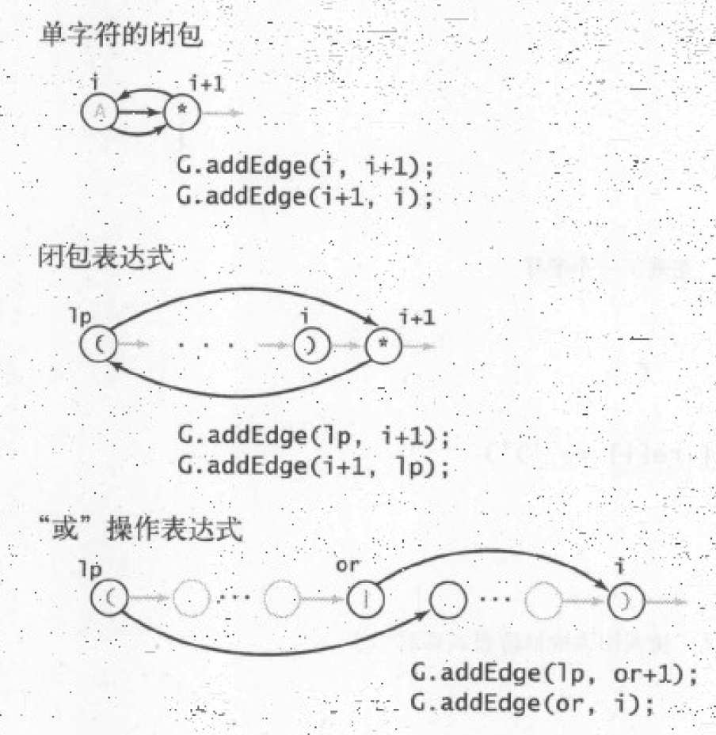
5.4.4
Notes:
p. 524

Slide 16
5.4.6
略

Slide 17
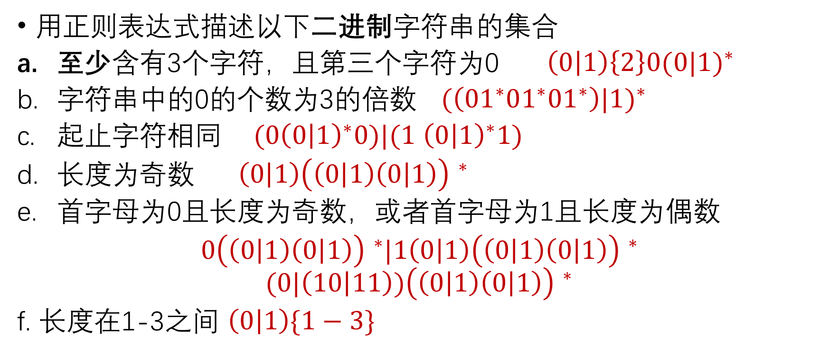
5.4.10
用正则表达式描述以下二进制字符串的集合
至少含有3个字符，且第三个字符为0 $\left(0 | 1\right)\left\{2\right\}0{(0|1)}^{∗}$
字符串中的0的个数为3的倍数 ${(\left(01^{∗}01^{∗}01^{∗}\right)|1)}^{∗}$
起止字符相同 $(0{\left(0 | 1\right)}^{∗}0)|(1$ ${\left(0 | 1\right)}^{∗}1)$
长度为奇数 $\left(0 | 1\right){\left(\left(0 | 1\right)\left(0 | 1\right)\right) }^{∗}$
首字母为0且长度为奇数，或者首字母为1且长度为偶数
$0{\left(\left(0 | 1\right)\left(0 | 1\right)\right) }^{∗}|1\left(0 | 1\right){\left(\left(0 | 1\right)\left(0 | 1\right)\right) }^{∗}$
$$(0{|\left(10 | 11\right))\left(\left(0 | 1\right)\left(0 | 1\right)\right) }^{∗}$$
f. 长度在1-3之间 $\left(0 | 1\right)\{1−3\}$
Notes:
二进制字符串

Slide 18
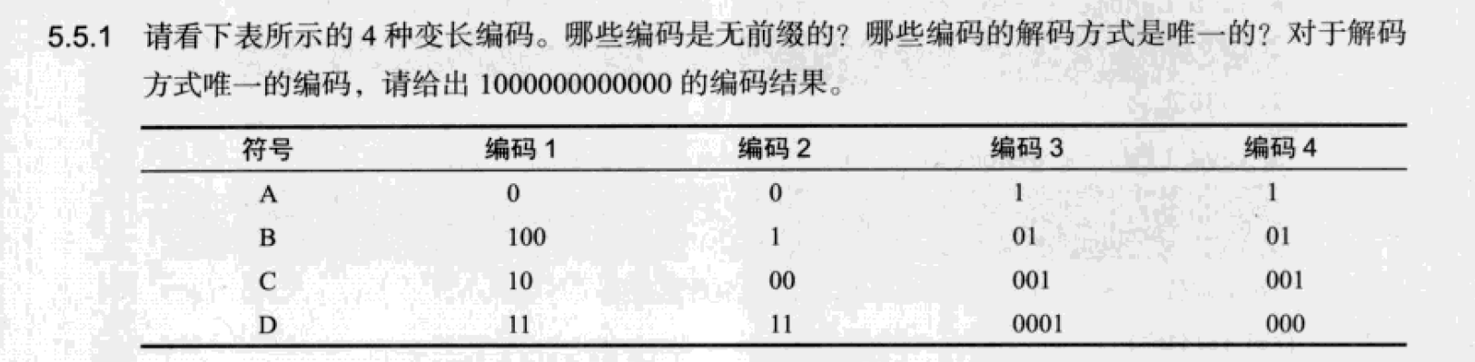
5.5.1
无前缀的编码，编码的解码方式是唯一的： 编码3和编码4
编码3：无对应编码结果
编码4：ADDDD

Slide 19
5.5.4
{01,1001,1011,111,1110} 的解码方式不唯一
如：
11101011111001（111-01-01-111-1001）(1110-1011-1110-01)
11101111001 (111-01-1110-01)(1110-111-1001)
…

Slide 20
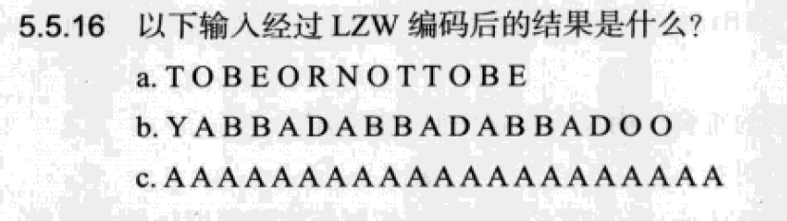
5.5.16
从81开始
89之后是8A

