Slide 1
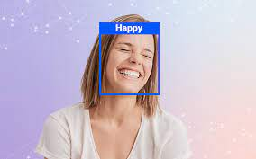
PSYCHOMO-D
A Psychometric Motion Detector
SUPERVISED LEARNERS
Team members
-ANANYA SHARMA
-ASHA SINGH
-AnANYA CHIBBER
-SHIVRAJ CHOUDHARY

Slide 2
ABSTRACT
Human emotions are the mental state of feelings and are spontaneous. There is no clear connection between emotions and facial expressions and there is significant variability making facial recognition a challenging research area.
Recently online video interviews have been increasingly used in the employment process. The use of non-verbal cues such as gestures, body movements and facial expressions convey the feeling and feedback of the user. Though several automatic techniques have emerged to analyze the interview videos, so far, only simple emotion analyses have been attempted, e.g. counting the number of smiles on the face of an interviewee.
So we have created Psychomo-D which helps in Emotion Detection using Haar-Cascade Classifier and Convolutional Neural Network(CNN) for the psychometric interviews.
A CNN model is trained with grayscale images from the FER dataset to classify expressions into five emotions, namely happy, sad, neutral, fear and angry. To improve the accuracy and avoid overfitting of the model, batch normalization and dropout are used. The test results obtained show that Model is 89% accurate for all the five emotions.

Slide 3
INTRODUCTION
Facial emotions are important factors in human communication that help to understand the intentions of others. In general, people infer the emotional state of other people, such as joy, sadness using facial expressions and vocal tones. Therefore, it is natural that facial emotion research has gained a lot of attention over the past decade with applications in perceptual and cognitive sciences.
Job interviews are an important tool for employee selection. In recent years, video-based Structured Interviews have been increasingly used in hiring processes. Conducting online interviews brings many beneﬁts to both interviewers and interviewees, including allowing many job applicants to be evaluated by HR staﬀ, the convenience of oﬄine reviewing and decision making by HR staﬀ and supporting long-distance interviews to reduce costs.
Pre-hire assessments can save thousands of dollars per headcount in turnover costs, not including the higher cost of employing poor performers. With AI, you can compare a candidate against an ideal, model employee. AI tools can add additional insights into people’s personalities and motivations that screeners can’t see on paper.
Hence, comes our model, Psychomo-D which will help to identify the emotions of the interviewee not just using his submitted video but also while interviewing him on the skype call. We can use all his submitted pictures too and it will detect the five emotions: angry, happy, sad, surprise and neutral.

Slide 4
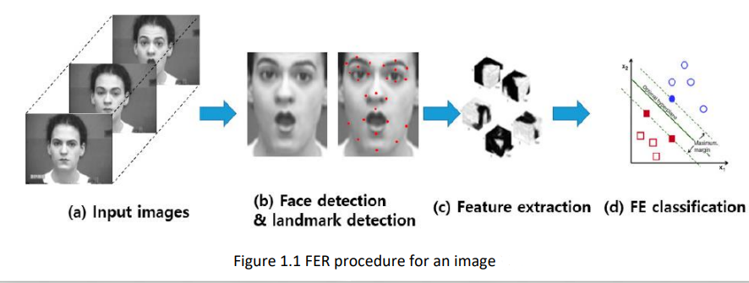
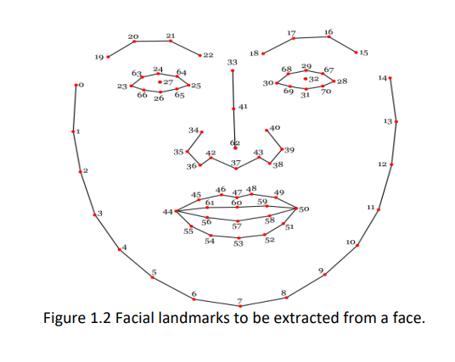
Face Detection and Emotion Recognition using Geometric Feature based Process
FER typically has four steps. The first is to detect a face in an image and draw a rectangle around it and the next step is to detect landmarks in this face region. The third step is extracting spatial and temporal features from the facial components. The final step is to use a Feature Extraction (FE) classifier and produce the recognition results using the extracted features

Slide 5
Image standardization: it includes various sub-processes such as the removal of noise from the image, making all the images uniform in size and conversation from Red, Green and Blue (RGB) to grayscale.
Face detection: It aims to remove all the unwanted things from the picture, such as background and to keep relevant information, the face from the data.
Facial component analysis: Here, regions of interests are detected. This step is necessary as it helps to minimize the errors that can arise due to rotation or the alignment of the face.
FUNCTIONING OF THE DATA:
Before using the data, it is important to go through a series called pre-processing. This makes the data easier to handle.
The images are 48X48 grayscale cropped images. The csv file consists of a flattened array of image stored in the form of a string.
The target labels are integer encoded in the csv file. They are mapped as follows:
0 → Angry
1 → Happy
2 → Sad
3 → Surprise

Slide 6
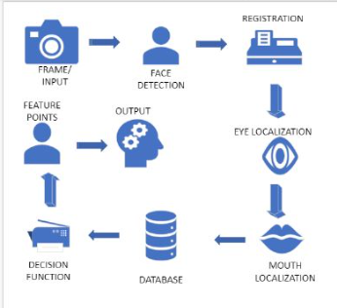
4 → Neutral
Load the dataset:
This data contains the raw pixel values of the images.
Splits the data:
Training set: the algorithm will read or train on this over and over again to try and learn its task.
Testing set: the algorithm is tested on this data to see how it works.
Face detection diagram:
Convolutional Neural Network(CNN) : CNN, is a deep learning neural network sketched for processing structured arrays of data such as portrayals.
CNN are very satisfactory at picking up on design in the input image, such as lines, gradients, circles, or even eyes and faces.
CNN can run directly on a underdone image and do not need any preprocessing.
Firstly we have imported libraries such as numpy, keras and OpenCV for emotion detection
We have used webcam for capturing video to enculcate the emotions.
Cascade algorithm helps in detecting the pixels of the particular image or video.

Slide 7
Python libraries used
NumPy: Numerical Python (NumPy) is an open source Python library used for working with arrays and matrices. An array object in NumPy is called nd.array. CNN inputs are arrays of numbers and NumPy can be used to convert images into NumPy arrays to easily perform matrix multiplications and other CNN operations.
OpenCV: OpenCV is an open source library for CV, ML and image processing. Images and videos can be processed by OpenCV to identify objects, faces and handwriting. When it is integrated with a library such as Numpy, OpenCV can process array structures for analysis. Mathematical operations are performed on these array structures for pattern recognition.
Keras: Keras is an open-source software library that provides a Python interface for artificial neural networks. Keras acts as an interface for the TensorFlow library.
TensorFlow: TensorFlow is a free and open-source software library for machine learning and artificial intelligence. It can be used across a range of tasks but has a particular focus on training and inference of deep neural networks.

Slide 8
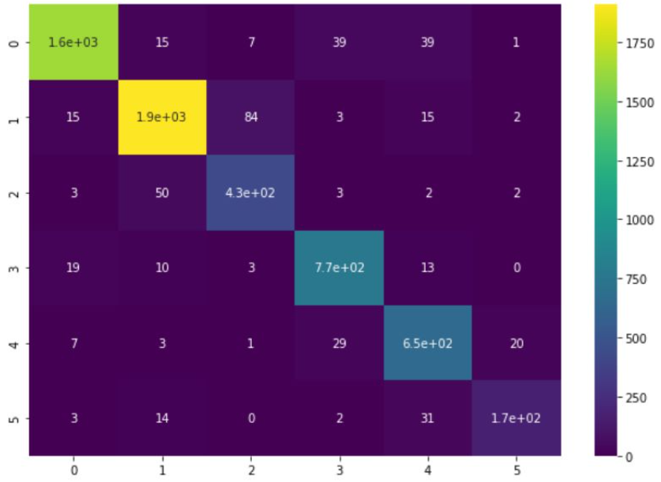
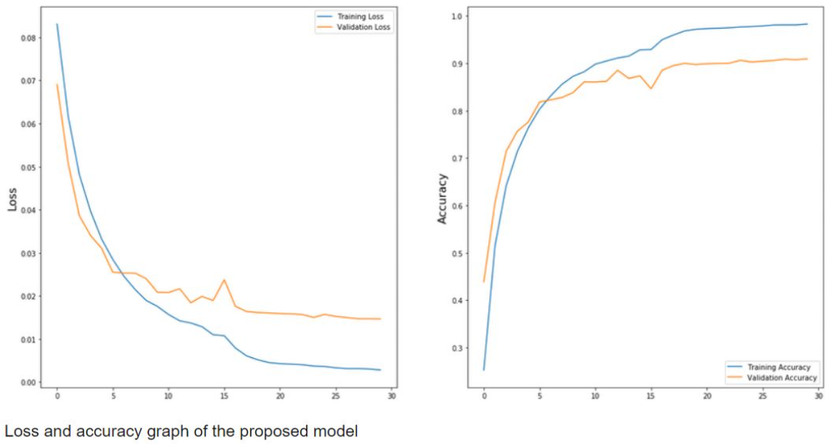
Fig.: The heatmap shows the correlation between the predicted value and the actual value. From this we can infer the correct number of emotions predicted for each class
Fig.: The graph is predicting the loss and accuracy of detecting emotions

Slide 9
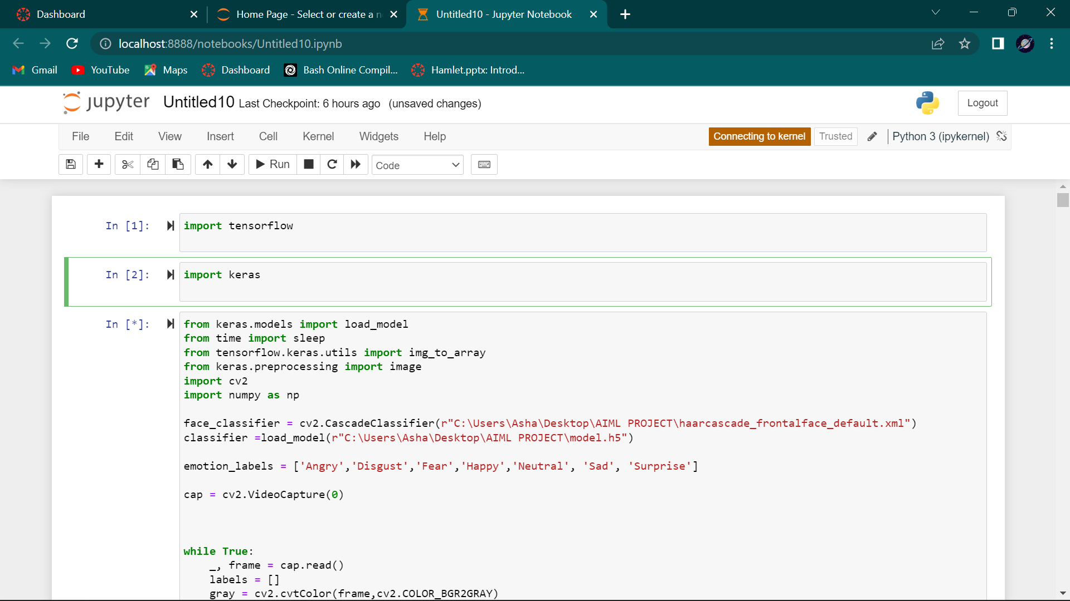
CODE:

Slide 10
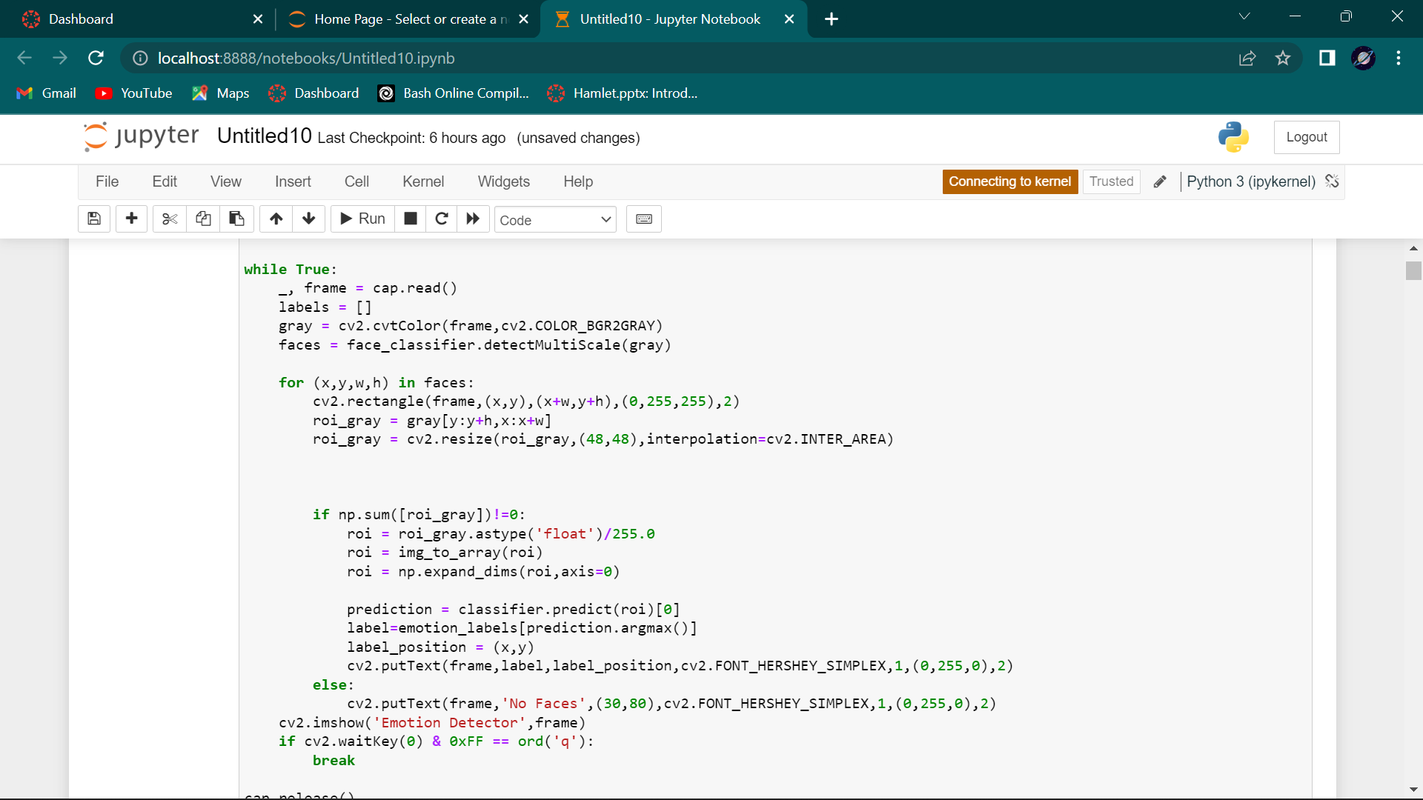

Slide 11
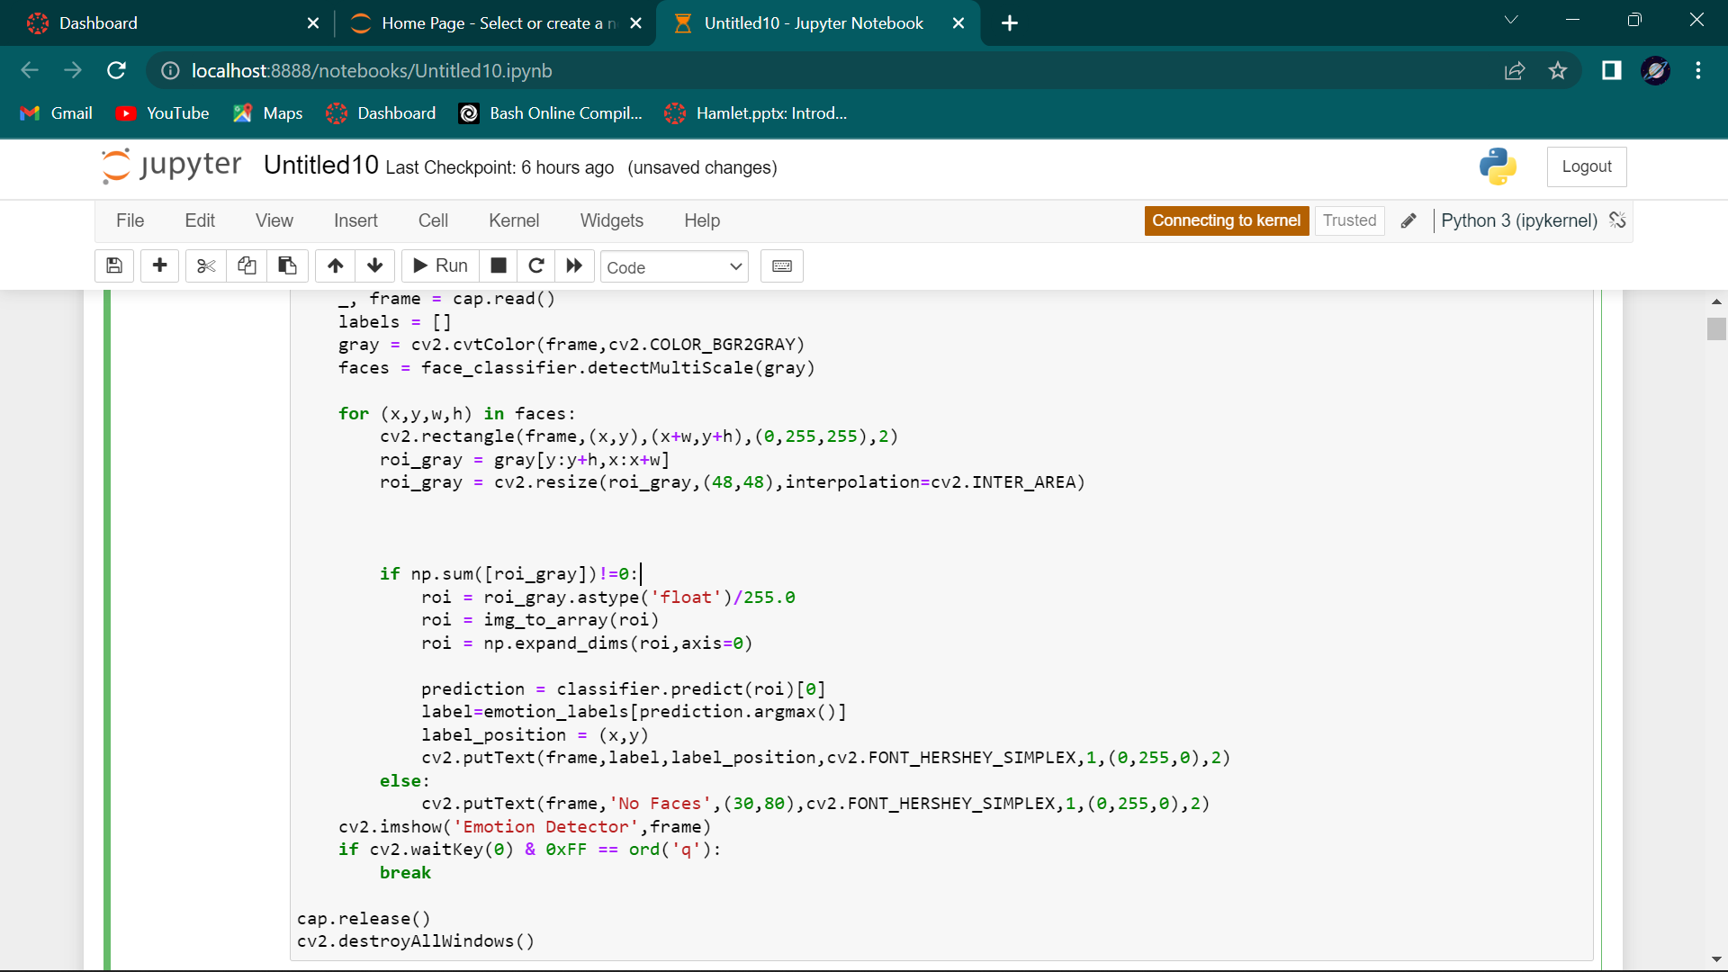

Slide 12
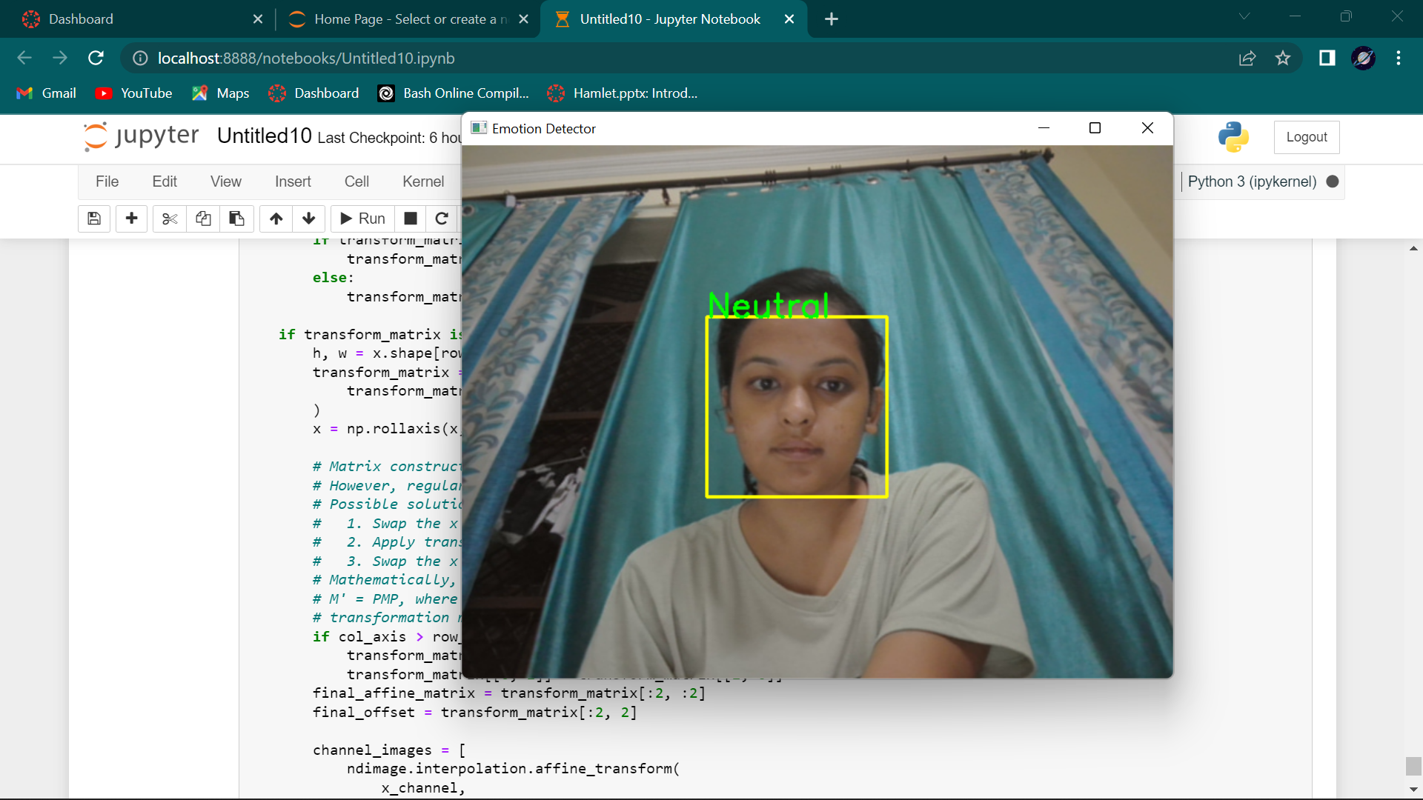
OUTPUT:

Slide 13
CONSTRAINTS:
Psychomo-D only works and can detect only 5 emotions- anger, happy, sad, surprise and neutral.
Although it works for all the profiles of the face, but it is important that the face must be visible to the detector clearly.
It works for the faces at a distance of approximately 15 cm from the screen because that is the distance when you can actually see the face clearly.
There are limitations with different types and versions of the software such as dataset input is only image and video. Audio inputs, patterns, textual data are invalid.
Future Scope:
Devices to detect an employees’ mental well-being can be created which will detect the face of the employee at the time he enters the company and give it’s results which will not only improve the performance of employees but issues such as depression and anxiety can be caught at early stages and they do not have to suffer in silence.
Facial emotion recognition is an emerging field so considering other NNs such as Recurrent Neural Networks (RNNs) may improve the accuracy. The feature extraction is similar to pattern recognition which is used in intelligence, military and forensics for identification purposes. Thus, techniques such as the Capsnet algorithm for pattern recognition can be considered.

