Slide 1

Java Inheritance

Slide 2
Contents
Composition Relationship
Inheritance Relationship
Types of Inheritance
Single or Simple Inheritance
Multilevel Inheritance
Hierarchical Inheritance
Hybrid Inheritance
Protected Access Specifier
final keyword(in inheritance)
Multiple Inheritance - not supported in Java
Cyclic Inheritance - not allowed
super keyword
Object class
Garbage Collector

Slide 3
Contents
15.Base class reference
16.Method Overriding
17.abstract class
18.interface inheritance
19.when to use extends and implements
20.Difference between abstract class and interface

Slide 4
Composition Relationship
Below are the relationships that can exist between classes
1.Composition or has a or Container relationship :
class Employee{
int I;
Address obj; / /Address is another class
void met1(){
//…statements
}
}
Above is has a relationship between class Employee and class Address, i..e class Employee has class Address

Slide 5

Composition/Container/has-a Relationship

Slide 6
2. Inheritance Relationship:
Another relationship that can exist between classes is Inheritance relationship.
One class inherits data members and member methods of another class.
Inheritance is also called is-a relationship. Or Generalization. extends keyword is used in inheritance
Class which is being inherited/derived is called Base
class or Parent class or Super class.
Class which inherits from Base class is called Derived class or Child class or Sub class.

Slide 7
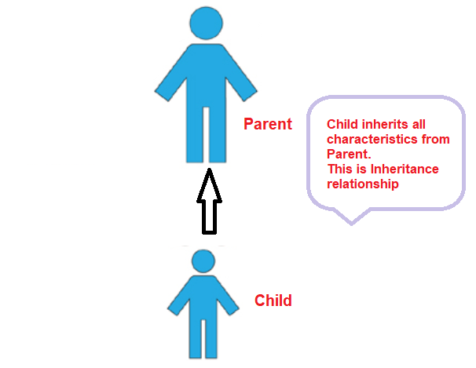
Advantage of Inheritance:
Improves code reusability.
Decrease duplication of code.
Inheritance provides one more access specifier, which is protected

Slide 8
3. Types of Inheritance
Below are different types of inheritance
Single or simple inheritance.
Multi Level inheritance
Hierarchical inheritance
Hybrid Inheritance
Multiple Inheritance(Not supported in Java)

Slide 9
4. Simple or Single inheritance: One class is derived from another class. Here class A is base class, class B is derived class. That means there is only one Base class and one Derived class in Single inheritance.
Syntax:
class A{
//…
}
class B extends A{
//…
}
NOTE: class B has direct access to all non private members of class A .Arrow shows that B is dependent on A
Order of invocation of Constructors:
When an object of B is created, first the constructor of A gets invoked(automatically), and then constructor of B is invoked.
Parent class
Super class
Base class
A
Child class
Sub class
Derived class
B

Slide 10
5. Multi Level inheritance: A Derived class acts as a Base class of some other class
Syntax:
class A{
//…
}
class B extends A{
//…
}
class C extends B{
//….
}
Order of invocation of Constructors:
When an object of C is created, first constructor A is called, then constructor B is called, and then constructor C is called.
Even though you explicitly invoke constructor of only class C, class C is dependent on class B, class B is dependent on class A.
NOTE: There can be even 4 or more levels
A
B
C

Slide 11
6. Hierarchical inheritance: More than one derived class has a common Base class
Syntax:
class A{
//…
}
class B extends A{
//…
}
class C extends A{
//….
}
A
B
C
Note: Class C and class B are not dependent on each other.
Relationship between B and C is siblings.
In any type of inheritance, all the classes having inheritance relationship can be spread across multiple .java files or even multiple packages.
Static members are also inherited.

Slide 12
7. Hybrid inheritance: combination of more than one inheritance. In below example Multi level inheritance exist between Q, Rand T. And Hierarchical inheritance exist between Q, R and S.
Q
W
R
S
X
T
Y
Z

Slide 13
8. Protected Access specifier
A class member declared as protected, can be accessed within the class, and in derived class, and within current package
 | private | No modifier (default) | protected | public
Within class | yes | yes | yes | yes
Same package subclass | no | yes | yes | yes
Same package non sub class | no | yes | yes | yes
Different package sub class | no | no | yes | yes
Different package non sub class | no | no | no | yes

Slide 14
9. final keyword (in Inheritance)
As already known final keyword can be used with data member or local variable/object. There final was used to declare constants.
final keyword can also be used with a class or a method.
A class declared as final can never be a base class. For eg. Inbuilt String class is final, also wrapper classes like Integer, Float, etc… are final
A method declared as final cannot be overridden by derived classes. For eg. wait(), notify() & notifyAll()

Slide 15
9. final keyword (in Inheritance)
NOTE:
1.interface or interface methods cannot be declared final
2.Inner class also can be declared final.
Constructor cannot be final
A class or a method can be made final due to Business or Technical reasons(like optimization, etc…)

Slide 16
10. Why multiple inheritance not supported in Java?
Multiple inheritance is not supported in Java, due to ambiguity reasons, and almost there is nothing which cannot be achieved without Multiple inheritance.
ambiguity with Diamond problem, consider a class A has met1()
method and then B and C derived from A and has their own met1()
implementation and now class D derive from B and C using multiple inheritance and if we refer just met1()
compiler will not be able to decide which met1()
it should invoke. This is also called Diamond problem, as shown below.
A
public void met1()
Override met1()
B
C
Override met1()
Confusing which met1() need to be picked
D

Slide 17
11. Cyclic relationship not allowed in inheritance
As shown in beside diagram, Cyclic dependency is not allowed in inheritance. Java Compiler give error, when such cycles exist in your source code.
A
C
B
Type casting between class, and return, parameter passage
As known, a Base class reference can refer Derived class object.
A method accepting an object as parameter, allows objects of any derived classes as parameter.
The same applies to return, and composition relationship, as well.

Slide 18
12. Super keyword
super keyword is used
1.To invoke constructor of immediate Base class
super(); //parameters also can be passed
super(10,”Naveen”);
super() can be invoked only from constructors, and that too it should be first line of constructor. super() is mandatory, when default/implicit constructor, is not available in Base class
2.To avoid same name collisions between members of the class and members of immediate Base class super.i = i;
super.show();

Slide 19
12. Super keyword
super is just like this keyword. this keyword refers to the object of current class, where as super refers to object of immediate base class
super keyword cannot be used in static methods.

Slide 20
13. Object class
Object class(in java.lang package) is base class of all classes in Java, by default. Java provides basic functionality required by each and every class thru methods of Object class.
Below are methods provided in Object class.
boolean equals(Object obj); -- checks if the objects are equal
int hashCode(); -- returns unique hash code of the object, which is used to identify an object, if required.
final Class getClass(); -- returns Class object of the class
String toString(); -- returns String format of the object

Slide 21
Object class
final void wait();
final void wait(int seconds);
final void wait(long milliseconds);
final void notify();
final void notifyAll();
void finalize(); -- invoked by Garbage Collector, when destroying the object
Since Object class is base class of all classes in Java, pls mind that below statements are valid.
1. Object obj = any_object;
i..e a reference of an Object class can refer to object of any class.
Used for thread communication

Slide 22
Object class
2. Similarly a method accepting Object as parameter, can accept object of any class as parameter.
3. An object of Object class can be type casted to object of any class.
A oa = (A)Obj;
Used for thread communication

Slide 23
14. Garbage Collector
Garbage Collector keeps running in background, and automatically deallocates the memory, which is not required further in the Program under execution. Garbage Collector manages memory in Heap only.
When there are no references to an object, it is assumed to be no longer needed, and the memory, occupied by the object is being deleted.
It is possible to control working of Garbage Collector(like selection of garbage Collector algorithm and related details), by using command line arguments, and APIs such as System.gc()

Slide 24
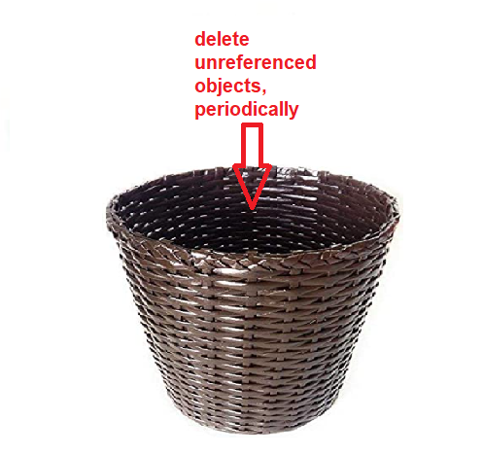
Garbage Collector
Garbage Collector

Slide 25
15. Base class reference
Base class reference can refer to Derived class object. The reason is Derived class object is of Base class type.
Hence if A is Base class, and B is derived class, below is valid
A obj = new B(); //valid
B ob = new A(); //invalid
16. Method Overriding
When Base and Derived classes has a method with same declaration(i..e same name, parameter types, and return types).
Then the method which gets invoked(with base class reference) in run time depends on the object to which base class reference is pointing to.

Slide 26
16. Method Overriding
This is also called Run time Polymorphism, or Dynamic Method dispatching. Here the method which need to be invoked is decided in run time and not during compile time.(Note that method overloading is Compile time Polymorphism)

Slide 27
Method Overriding
When Base and Derived classes have a method with same name, but with different parameters, they participate in method overloading and not in overriding.
Method Overiding helps to dynamically invoke methods of any Base class without compiling with Base class together. Here Base and Derived classes can be developed by different developers, they can work together without compiling them together, and by just sharing binary files.

Slide 28
Method Overriding
Static method and overriding
static methods are not overridden, and do not take part in run time polymorphism

Slide 29
Method Overiding helps to dynamically invoke methods of any Base class without compiling with Base class together.
Here Base and Derived classes can be developed by different developers, they can work together without compiling them together, and by just sharing binary files.
Below is valid Syntax
class Q{
Q obj;
}

Slide 30
Base class object
Base class reference can refer to itself or any Derived class object.
Derived1 class object
Base class reference
Derived2 class object
Derived3 class object

Slide 31
17. abstract keyword
abstract keyword can be used with methods or classes. An abstract method is a method, which has only declaration, and method definition(or body) need to be provided by the derived class.
An abstract class, cannot be instantiated, as it is not complete.
An abstract class can have
constructor.
private, public, protected, default, final, static members
Though abstract class cannot be instantiated, it is possible to use it as reference.

Slide 32
6. Interface
An interface(traditionally) is a collection of method declarations , and without method definitions(i..e with out method body). In Java 8 even interface can have default methods which have definitions.
An interface is a pure abstract class
An interface can have declarations of constants. By default Constants in interface are static and final.
For eg.
interface Circle{
double PI=3.14;
double getSurfaceArea(double radius);
double getCircum(double radius);
}

Slide 33
Below are the keywords used in interfaces
interface – to declare an interface
implements – used with class which provides body for interface methods
An interface cannot be instantiated, but a reference can be declared of an interface.
Private, protected members are not allowed in interface. An interface cannot have constructor(s).
Each interface can have multiple implementations. And an interface reference can refer to any object(whose class implements the interface). Hence by using interface, it is possible to switch between multiple implementations, during run time. This is called run time polymorphism.

Slide 34
Reference
class A{
//statments
}
A obj;
obj = new A();
Reference

Slide 35
Interface
An interface can extend from one or more other interfaces, using extends keyword. Hence multiple inheritance is supported in interfaces.
Constructors not allowed in interface
An outer interface can be public or default. Public interface can be used in current and other packages as well.

Slide 36
By default interface and methods declared in interface are abstract, of course they can be explicitly declared as abstract.
A single class can implement from multiple interfaces.
Interfaces play vital role, in developing loosely coupled classes.

Slide 37
Basic advantages of Interface
Since java does not have header file, an interface can act like a header. So when you want to provide APIs(Application Program Interface) to your clients(who may further use your classes, etc.. in their Application) without source code, you can provide them an interface, instead of actual class.
Also, when there are multiple implementations for an interface, it is possible to dynamically switch between each implementation, in the run time.

Slide 38
17. Difference between abstract and interface
Extends is used between classes
Implements is used between an interface and a class
NOTE: An interface and methods declared in interface are abstract by default. Hence mentioning abstract keyword for them makes no difference.
An interface cannot have constructor, private, protected members.
An interface is a pure abstract class.

Slide 39
18. interface inheritance
One interface can be extended from one or more interfaces, hence multiple inheritance is supported in Java.
interface A{
//methods or data members declaration
}
interface B{
//methods or data members declaration
}
interface C extends A,B{
}

Slide 40
19. extends and implements
A class can extend another class and implement one or more interfaces
class A{
//methods or data members declaration
}
interface B{
//methods or data members declaration
}
interface C{
}
class D extends A implements B,C{
}

Slide 41
20. Immutable objects
Immutable objects are the objects whose state cannot be modified. As known state of object is the values held by data members of the class.
All below rules need to be applied
Make class final
Make all data members final, initialize them only in constructor and do not update them anywhere else
Do not use Setter methods
Incase you need to change the state of object in any method, create new copy and return.

Slide 42
Java Reflection
Reflection is a feature in Java, using which it is possible to analyze characteristics of any object or class during run time. It is possible to find number of constructors, methods etc… and even invoke the methods, during run time. This feature may be useful to load a library and analyze, dynamically during run time.

Slide 43
Thank You!

