Slide 1


Java Exception Handling

Slide 2
What is an Exception?
An Exception is run time problem or error which occurs, when program is under execution.
An Exception may occur due to Environment, bad programming, or due to unexpected input data.
For example:
When you access an array element which is beyond the range of array, an java.lang.ArrayIndexOutOfBoundsException is thrown.
In C Language there is no built in Exception handling, developer need to manually write the code to check the range, using multiple if statements, which clutters the code.

Slide 3

What is an Exception?
Car Wheel broken on run, An exception handler avoids crashing/overturn/accident of car, and slows down in next few meters

Slide 4
2. Purpose of Exceptions?
Exceptions improves User Experience
makes the Program more Robust, avoiding Crashes
Helps developer by generating basic Exception Handling code
Improves code readability separating Business Logic and Exception handling code
Stack Unwinding
Java has built in support for Exception handling.

Slide 5
3. Exception Keywords
Java provides inbuilt Exception Handling as
5 keywords
Few inbuilt classes(Exception related classes)
Below are keywords used in Exception handling
1.try - set of program statements which may throw an Exception need to be enclosed within try block
2.catch – set of program statements which can handle Exception scenario need to be enclosed in catch block. A try block can have multiple catch blocks.
3.throw – throw keyword is used to manually throw an Exception. Is used in the method body.

Slide 6
Exception Keywords
Code snippet with try, catch, throw keywords
try
{
//statements
throw new Exception(); //optional
}
catch(Exception e)
{
System.out.println(“Exception occurred”+ e);
}

Slide 7
4.throws – is used along with method declaration to specify that a method can throw one or more Exceptions. Is used with method declaration.
void met() throws AbcException, XyzException;
Exception can be thrown across methods in different classes, which can be different packages.
5.finally – statements in finally block gets executed whether are not Exception occurs. Generally releasing used resources, like closing file, network connections,etc… need to be done in finally block. finally block gets executed, before returning from the method , in all cases.

Slide 8
try
{
//statements
}
catch(Exception1 e1)
{
//statements
}
finally
{
//statements
}

Slide 9
4. Control Flow of Exceptions:
Flow of Execution when Exception Occurs
void met1()
{
//business logic
try{
//business logic
//exception occurred
//when above exception is thrown, these statements does not execute
}
catch(Exception et)
{
//statements in catch block gets executed only if exception occurs
}
}

Slide 10
Execution Flow when Exception does not occur
void met1()
{
//business logic
try{
//business logic
//full code in try block gets executed if exception is not thrown
}
catch(Exception et)
{
//if exception is not thrown, statements in catch block does not execute
}
finally
{
//statements here always gets executed whether or not Exception occurs
}
}

Slide 11
try with finally and without catch
As already known finally block can exist only with a try block, and may be without catch block. since the Exception is either directly or indirectly thrown from the statements within try block, and since this Exception is not being handled within the method, as there is no catch block.
throws statement may need to be used in method declaration, however we want some statements to be always executed(either Exception occurs or not) before returning this method, such statements need to be placed in finally block

Slide 12
void met() throws XyzException
{
//statements here
try{
//statements here
}
finally
{
//statements which need ot be always executed
}
}

Slide 13
5. List of some built in Exceptions
Below Exceptions are in java.lang package
Exception class name | Occurs when
NullPointerException | referring a Reference which is null
ArrayIndexOutofBoundsException | accessing an array element which doesn’t exist(i..e actual size of array is < index being referred)
NumberFormatException | occurs when Integer.parseInt(“10”), and given string cannot be converted into valid Integer
ArithmeticException | dividing by zero
OutofMemoryError | Heap memory is full(UnChecked)
StringIndexOutOfBoundsException | referring a String index which doesn’t exist
StackOverflowError | Stack memory is full, generally occurs due to nested calls(UnChecked)
There a number of other Exceptions like IOException, SocketException, etc…

Slide 14
6. Exceptions in other Packages & Frameworks:
Most of commonly used Exceptions exist in default package(i..e java.lang)
There are a number of Exceptions such as SQLException(defined in java.sql package), ConnectException, UnknownHostException(defined in java.net package)
Similarly there can be a number of Pre defined/Custom Exceptions which are defined by its own packages or Framework, for it’s specific purpose, you need to refer documentation of that specific Framework to know the purpose of it.

Slide 15
7. Order of catching Exceptions
A try block can have zero or more catch blocks.
When a try block has multiple catch blocks, the derived most Exceptions classes need to be caught first, and then Base Exception classes need to be caught, else it leads to Compiler error due to unreachable code.

Slide 16
Order of catching Exceptions
This applies to Custom Exception classes as well.
try{
//program statements
}
catch(ArrayIndexOutofBoundsException abe)
{
//
}
catch(Exception e)
{
//
}

Slide 17
8. Nested Exceptions
It is possible to have a try block within another try block.
A catch block can have another try catch blocks
try
{
//stmt 1
try{
//stmt 2
}catch(Exception et){ et.printStackTrace(); }
//stmt 3
}catch(Exception e)
{
e.printStackTrace();
}

Slide 18
Though the flow of program execution can be controlled using Exceptions.
Exceptions need to be used only to handle Exception Scenarios, and should not be used to actually control flow of execution of program.
java.lang.Exception is base class of all Exception classes.
Exception class has below methods.
1.printStackTrace()

Slide 19
9. Exception class Hierarchy
Object
Throwable
Error
Exception
RuntimeException

Slide 20
Difference between Exception and Error classes
The first one catches all subclasses of Throwable (this includes Exception and Error), the second one catches all subclasses of Exception.
Error is programmatically unrecoverable in any way and is usually not to be caught, except for logging purposes (which passes it through again).
Exception is programmatically recoverable.
Its subclass RuntimeException indicates a programming error and is not mandatory to be caught.

Slide 21
try{
}
catch(Throwable t){}
try{
}catch(Exception e){}

Slide 22
10. Exception class Hierarchy
In Java, exceptions are objects. When you throw an exception, you throw an object.
You can't throw just any object as an exception. you can throw only those objects whose classes descend from Throwable.
Throwable serves as the base class for an entire family of classes, declared in java.lang, that your program can instantiate and throw.
Throwable has two direct subclasses, Exception and Error.

Slide 23
Exception class Hierarchy
java.lang.Exception class represents the exceptions which are mainly caused by the application itself.
For example, NullPointerException occurs when an application tries to access null object or ClassCastException occurs when an application tries to cast incompatible class types.
Errors (members of the Error family) are usually thrown for more serious problems, such as OutOfMemoryError or StackOverflowError, that may not be so easy to handle.
In general, code you write should throw only exceptions, not errors.
Errors are usually thrown by the methods of the Java API, or by the Java virtual machine itself, due to environment issues.

Slide 24
Exception class is base class of all Exception classes
eg. ArithmeticException,
NullPointerException,
ArrayIndexOutofBoundsException,etc…

Slide 25
11. Checked & Unchecked Exceptions
Exceptions are broadly classified into two
Checked Exceptions – These are the Exceptions which are checked by Compiler, and need to be handled(using try, catch) or thrown(using throws) explicitly.
All Checked Exceptions are derived from Exception class
UnChecked Exceptions – It is not mandatory to handle or throw(using throws) Unchecked Exceptions explicitly.
All Unchecked Exceptions are derived from RuntimeException class

Slide 26
Since forcing a developer to catch each and every Exception is not a good option, Java provides UnChecked exceptions. These are the exceptions which need not be explicitly handled by the developer.

Slide 27
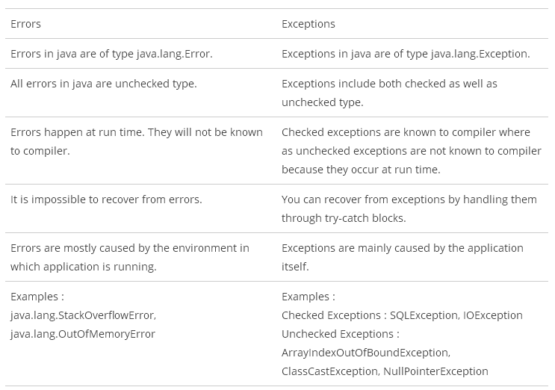

Slide 28
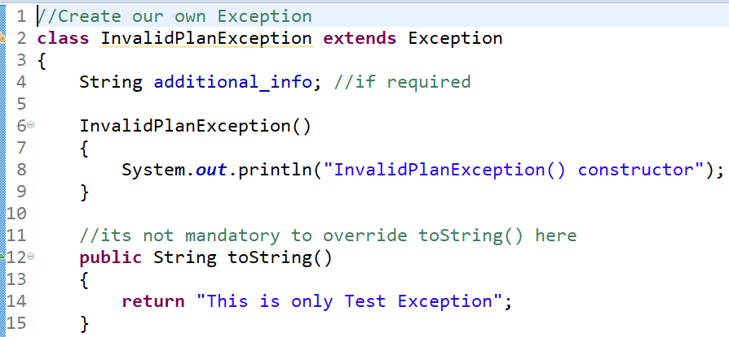
12. How to create User defined Checked Exception

Slide 29
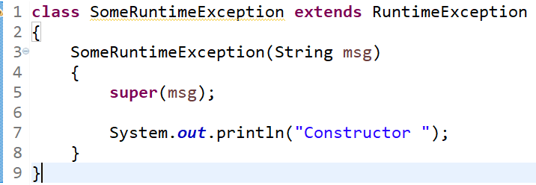
13. How to create user defined UnChecked Exception

Slide 30
Thank You!

