Slide 1

JDBC
Java Database Connectivity

Slide 2
Contents
What is Database?
Relational Table
SQL(Structured Query Language)
Multiple conditions in WHERE clause
Join Multiple Tables
SQL Datatypes
Column Constraints
Foreign Key
Java Database Connectivity
Different Types of JDBC Drivers
Program to connect to MySQL DB
java.sql.PreparedStatement
java.sql.CallableStatement

Slide 3
What is Database?
Database is used to store data permanently. These days almost all Applications needs database to store its data persistently. Below are the most popular databases 1. MySQL 2. Oracle 3. SQL Server
4. PostGre SQL etc…
Clients interact with Database servers to avail database storage Services. SQL(Structured Query Language) is used to interact with databases. SQL is case insensitive language.

Slide 4
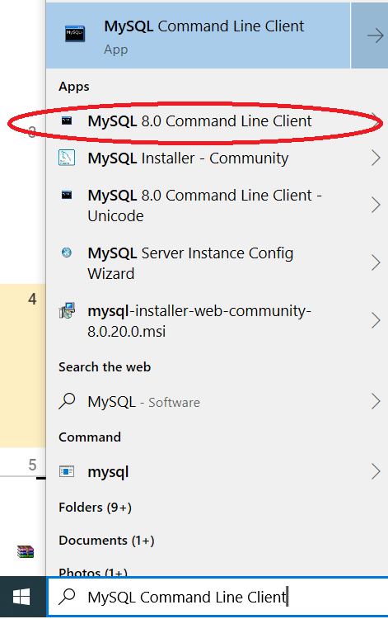
Installation of MySQL DB Server
MySQL DB Server can be downloaded from https://dev.mysql.com/downloads/mysql/, click “Download” button beside Windows (x86, 64-bit), ZIP Archive. After downloading follow onScreen Instructions, and complete installation & configuration of MySQL DB Server.
Open MySQL Command Line prompt as shown beside

Slide 5
2. Relational Table
Data is stored in tables, with rows and columns
id | Name | Age
1 | Ravi | 23
2 | Kumar | 48
Now you may start typing the commands in MySQL prompt of MySQL Command line Client

Slide 6
3. SQL(Structured Query Language) is divided into 1.DDL(Data Definition Language): Queries related to creating or changing structure of db or table. Example: create db, create table, alter table(add column or drop column), drop db or table 2.DML(Data manipulation Language) insert, update, delete, truncate: to insert rows, delete rows and to update data 3.DQL(Data Query Language) select : used to retrieve data in table(s) 4.TCL(Transaction Control Language) commit, rollback a Transaction 5.DCL(Data Control Language) grant, revoke Privileges to/from a user. Generally DCL is used by DBA.

Slide 7
SQL Commands show databases; - to view all existing databases in the database server use kkkk; - to select a specific database drop database aaaa; - completely destroy the database aaaa create database abcdef; - create the database abcdef show tables; - to view all tables in current database CREATE TABLE institute(id INT, name VARCHAR(50), addr VARCHAR(100)); - creates a table with the name institute, with three columns id, name, and addr DESC institute; - describe the structure of institute table INSERT INTO institute VALUES(2,'abc institute','jp ngr'); SELECT * FROM institute; -retrieve all rows and cols from institute table INSERT INTO institute(id, name) VALUES(3,'some inst name'); -insert a row with data only for specified columns

Slide 8
SQL Commands INSERT INTO institute(id, name) VALUES(3,'some inst name'); -insert a row with data only for specified columns SELECT name,addr FROM institute WHERE id=2; - retrieve only name and addr cols, for the rows whose id is 2 ALTER TABLE institute ADD COLUMN city VARCHAR(20); - adds a city column to institute table UPDATE TABLE institute set id=25 WHERE id=3; delete from institute where name like 'java%'; - deletes the rows with name column value starts with java delete from institute; - deletes only rows(and not table), one by one, where condition can be used truncate institute; - deletes only rows in table, all at a time. No where condition drop table institute; - destroys institute table along with all table rows

Slide 9
4. Multiple Conditions in WHERE CLAUSE It is possible to specify multiple conditions in WHERE clause by using AND, OR keywords For eg: DELETE FROM institute WHERE id>4 AND name like ‘a%’; - deletes all records whose id greater than 4 and name starts with a NOTE: same procedure can be applied to any number of conditions

Slide 10
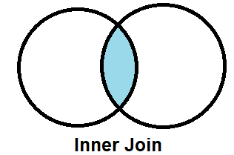
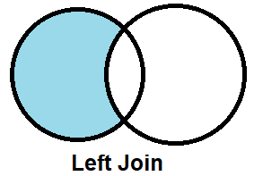
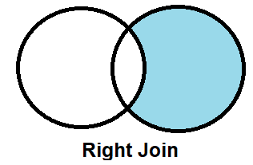
5. Join Multiple Tables: As known, data is stored in various tables, and quite often it is required to retrieve data or records by joining multiple tables. employee db table
department db table
employee
department
employee
department
employee
department

Slide 11
5. Join Multiple Tables: As known, data is stored in various tables, and quite often it is required to retrieve data or records by joining multiple tables. select * from employee e inner join department d on e.dept_id=d.dept_id; - JOIN has all rows of left and right side table select * from employee e left join department d on e.dept_id=d.dept_id; - LEFT JOIN has all rows of left side table select * from employee e right join department d on e.dept_id=d.dept_id; - Right JOIN has all rows of right side table

Slide 12
6. SQL DATATYPES Data types used in SQL are not same as Java. Below are few SQL data types. Also note that SQL data types may be slightly different for each database(like MySQL, Oracle, etc…) BIGINT, SMALLINT, TINYINT, INT VARCHAR – to store variable length strings CHAR – to store fixed number of characters DATE – to store date DATETIME – to store date and time BLOB – to store pictures, videos,etc…

Slide 13
7. Column Constraints Below are column constraints which can be specified while creating or altering table 1.NOT NULL – NULL Values not allowed 2.DEFAULT – default value is used, if no value is specified in insert stmt 3.PRIMARY KEY – ensures all values are different in a column, and NULL not allowed 4.AUTO_INCREMENT – Automatically increments a column value, when new record is inserted

Slide 14
Column Constraints Example
CREATE TABLE institute(id INT PRIMARY KEY, name VARCHAR(50) NOT NULL, addr VARCHAR(100) DEFAULT ‘BTM’);
- creates a table with the name institute(null values not allowed), with three columns id(duplicate values not allowed), name(null values not allowed), and addr

Slide 15
8. Foreign Key A Foreign key creates relationship between two columns in different tables. Lets consider an example with two tables Customer and Plans table. When FK exists between Customer Plan column and Plan id column, only existing plans can be taken by Customers
Customer id | Customer Name | Customer Plan
1 | Ravi | 2
2 | Kumar | 1
3 | Krishna | 2
4 | Sukumar | 2
5 | Rao | 3
Foreign Key
Plan id | Plan Name
1 | PRE PAID
2 | POST PAID
3 | SPECIAL SMS

Slide 16
Foreign Key example create table plans(plan_id int primary key,plan_name varchar(50)); insert into plans values(1,'plan a'); insert into plans values(2,'plan b'); insert into plans values(3,'plan c'); create table customers(cust_id int, cust_name varchar(50), cust_plan int, foreign key fk(cust_plan) references plans(plan_id)); insert into customers values(1, 'ravi', 8); ERROR 1452 (23000): Cannot add or update a child row: a foreign key constraint fails (`yyyy`.`customers`, CONSTRAINT `customers_ibfk_1` FOREIGN KEY (`cust_plan`) REFERENCES `plans` (`plan_id`)) insert into customers values(1, 'ravi', 2);

Slide 17
Foreign Key constraints ON DELETE CASCADE
ON DELETE RESTRICT
ON UPDATE RESTRICT ON DELETE SET DEFAULT ON DELETE SET NULL

Slide 18
How to convert string to date format in MySQL using STR_TO_DATE() MySql function Eg. Insert into abc values(STR_TO_DATE(‘30-12-2011,’%d-%m-%Y’));

Slide 19
10. Java Database Connectivity
Java Application
(Console based app)
JDBC Driver (available as JAR file)
Database Server

Slide 20
DBC(Java DataBase Connectivity) JDBC Acts as an Mediator between Java Application and Database Server. Package used for Java Applications to interact with database is java.sql JDBC is provided by database vendor. JDBC is provided as jar(Java Archive) file, which need to added to the Java project. Using JDBC either console based App or web based app can connect to underlying database.

Slide 21
11. Different Types of JDBC Drivers
Type 1: JDBC-ODBC Bridge driver (Bridge)
Type 2: Native-API/partly Java driver (Native)
Type 3: AllJava/Net-protocol driver (Middleware)
Type 4: All Java/Native-protocol driver (Pure Java)
Currently Type4 driver is used.
Each of above drivers, differs in Performance and portability
In production environment, generally Database Server runs on a dedicated machine, of course with high end configuration.

Slide 22
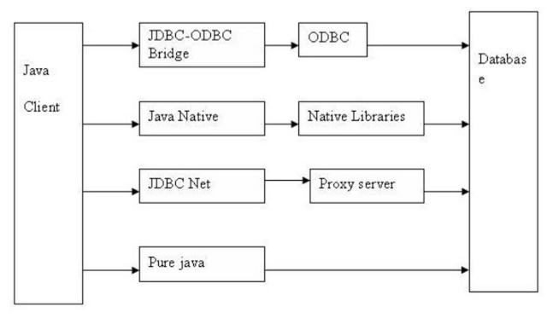
Type 1
Type 2
Type 3
Type 4

Slide 23
Difference between different types of JDBC driver comes from the fact how they work, which is basically driven by two factor, portability and performance. Type 1 JDBC driver is the poorest in terms of portability and performance, while type 4 JDBC driver is highly portable and gives best performance.
MySQL JDBC Type 4 Driver can be downloaded from
https://mvnrepository.com/artifact/mysql/mysql-connector-java/8.0.11

Slide 24
13. JDBC Statements, PreparedStatement, CallableStatement
There are three different types of sql Statements in Java.
1.java.sql.Statement
2.java.sql.PreparedStatement
3.java.sql.CallableStatement
Statement uses actual sql query, along with hard coded data items. Generally to execute a query only once, then Statement can be used.
In PreparedStatement, first the query is built without data. Then data is set, and executed.
Advantage of prepared statement is, same statement can execute multiple times, with different data. Execution of PreparedStatement is faster, since the Query is already prepared. PreparedStatement is also safer, as it avoids SQL Injection attacks, etc…

Slide 25
executeQuery() & executeUpdate() & execute()
boolean execute(“”) - executes SQL DDL statements, it returns a boolean value specifying weather the ResultSet object can be retrieved
int executeUpdate(“”) - executes SQL statements such as insert, update, delete. It returns an integer value representing the number of rows affected.
ResultSet executeQuery(“”) - executes statements that returns tabular data (example select). It returns an object of the class ResultSet.

Slide 26
CallableStatement is used to execute stored procedures in the database.
SQLException is thrown, if invalid db name, table name, column name, etc… are provided, while trying to connect or querying the database.

Slide 27
Stored Procedure: A stored procedure is just like a method in Java. But Stored procedure exists in database, and is written in SQL. A Stored procedure can perform certain manipulations on data, when executed.
Advantage of using Stored procedure is, Stored procedure executes within database server itself, and hence there is no need to transfer data between database server and web/app server.
Hence, stored procedure is a preferred solution, when minor data manipulations need to be done, on huge number of records/rows.

Slide 28
1.java.sql.ResultSetMetadata
To query an unknown result set for information about the columns that it contains, you need to use ResultSetMetaData. ResultSetMetaData methods provide the following types of information:
getColumnCount() method returns the number of columns in the ResultSet
getTableName() method returns the qualifier for the underlying table of the ResultSet
getSchemaName() method returns the the designated column's table's schema name

Slide 29
2.java.sql.DatabaseMetadata
public String getDriverName() : it returns the name of the JDBC driver.
public String getDriverVersion() : it returns the version number of the JDBC driver.
public String getUserName() it returns the username of the database.
public String getDatabaseProductName() : it returns the product name of the database.
public String getDatabaseProductVersion() : it returns the product version of the database.
public ResultSet getTables(String catalog, String schemaPattern, String tableNamePattern, String[] types)

Slide 30
Applets: Applets are used to develop GUI(Graphical User Interface) based programs in Java. Until now, we were developing only console based Java Programs, i..e without User Interface. Below are packages that need to be imported
java.applet.*
java.awt.*
Applets can also be embedded in a html web page, by using <applet> html tag

Slide 31
Screens(Views)
Implemented using Java swings
Database and Logic(Model)
Reusable Model
JDBC Driver
MySQL Database Server

Slide 32

Thank You!

