Slide 1
EDA OF PRODUCTS SOLD BY AMAZON

Slide 2
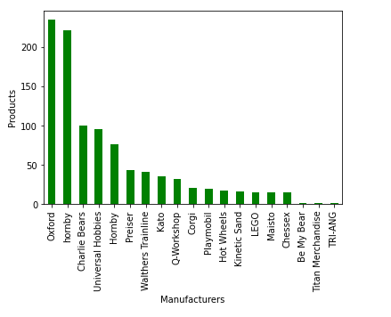
The most popular manufacturer of Amazon

Slide 3
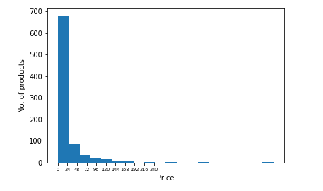
The average prices of Amazon

Slide 4
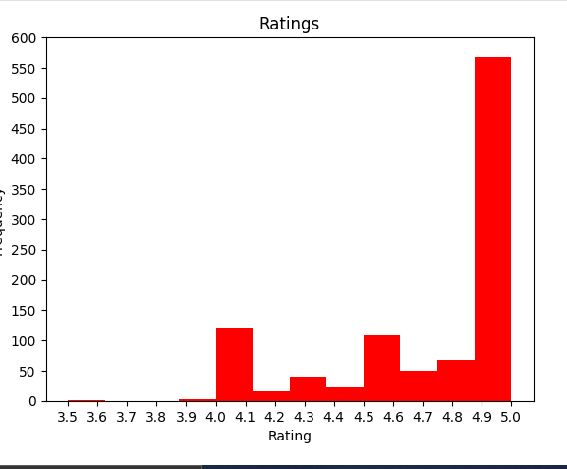
Rating of 5 stars for products

Slide 5
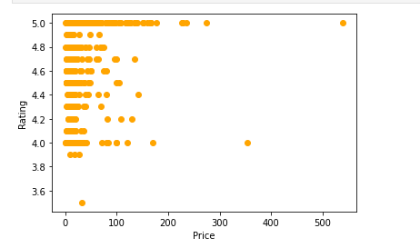
Expensive products worth the price?

Slide 6
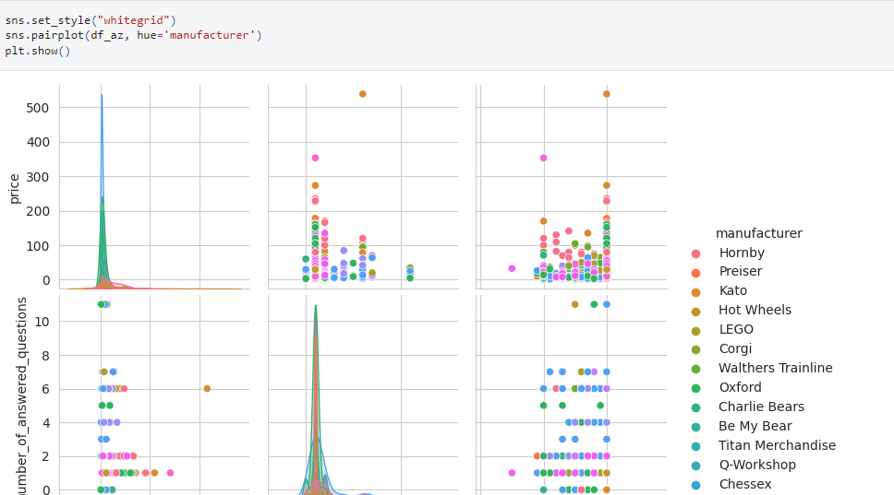
Questions are generally answered

Slide 7
