Slide 1

EDA OF PRODUCTS SOLD BY AMAZON

Slide 2
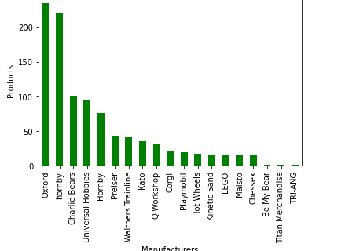
The most popular manufacturers of Amazon
This graph shows the most popular manufacturers of Amazon.
Oxford is most popular manufacturer and followed by Hornby. TRI-ANG is the least popular manufacturer.
and other companies are manufacturing products less than 50.

Slide 3
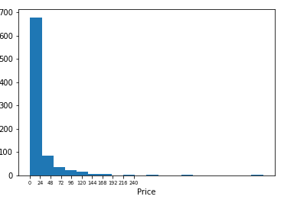
The average prices of Amazon
This graph indicates the average prices of Amazon which is between $1 to $ 24.
It shows the prices of amazon’s products are reachable to customers .

Slide 4
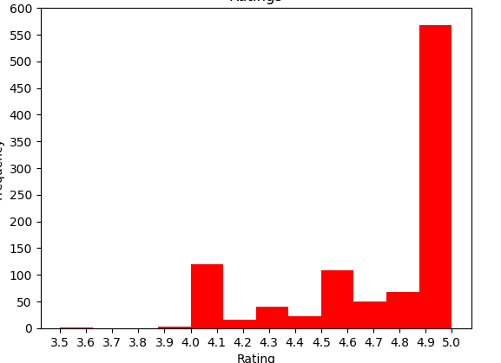
Rating of 5 stars for products
This graph indicates the rating of Amazon’s products, out of which most received 5.0 stars. However, there are some products which received a rating of 4.0 stars.
It states that most products are considered nice by the customers.

Slide 5
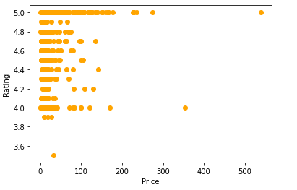
Are Expensive products worth the price?
This graphs indicates the rating of products, which is mostly between 4.0 to 5.0. It shows that expensive products are worth the price.
It shows the prices of products of amazon are not expensive because of customer’s choice.

Slide 6
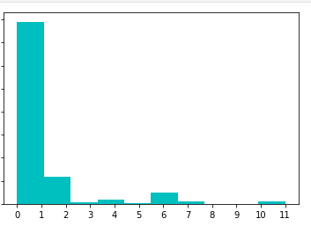
Questions are generally answered
This graph shows the number of answered questions. It is clear that mostly, 1-2 questions are answered, and sometimes, none are answered, which is a point of concern.

Slide 7
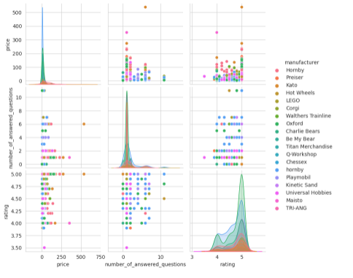
The Relation between Brands and other values
These graphs show the relation between brands and other values.
It shows different manufacturer’s relation with price, answered questions, rating, etc. which is indicated by different colors.

