Slide 1

EDA OF PRODUCTS SOLD BY AMAZON

Slide 2
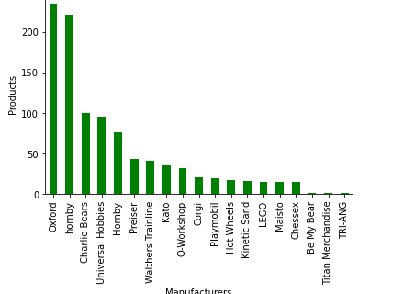
The most popular manufacturer of Amazon
This data shows the most popular manufacturers in Amazon.
Oxford is most popular manufacturer and followed by hornby TRI-ANG is least popular manufacturer.

Slide 3
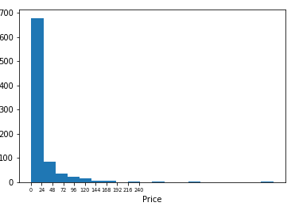
The average prices of Amazon
This graph indicates the average prices of Amazon which is between
$1 to $ 24 .

Slide 4
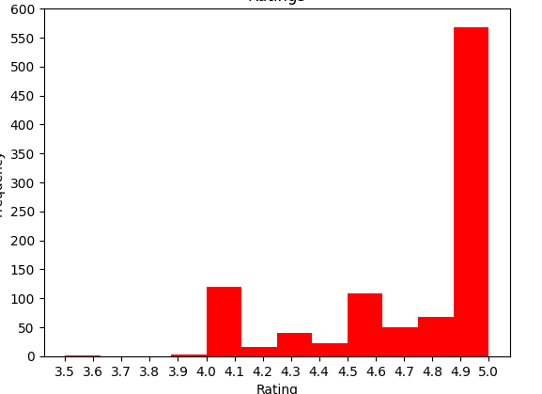
Rating of 5 stars for products
This graph indicates the rating of Amazon’s products, out of which most received 5.0 stars. However, there are some products which received a rating of 4.0 stars.

Slide 5
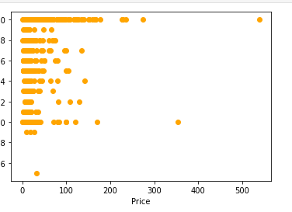
Expensive products worth the price.

Slide 6
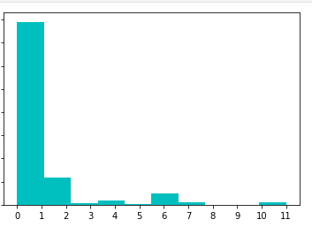
Questions are generally answered

Slide 7
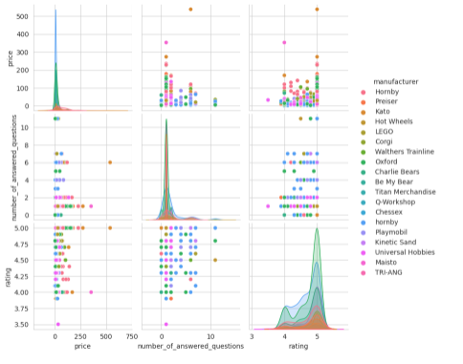
The Relation between Brands and other values

