Slide 1
FLIGHT PRICE PREDICITON Report
By:
Asha Vinod Kumar

Slide 2
Table of contents
1. Introduction
2. Data Visualization
3. Interpretation of Results
4. Conclusion

Slide 3
INTRODUCTION

Slide 4
Business Problem Framing
Anyone who has booked a flight ticket knows how unexpectedly the prices vary. The cheapest available ticket on a given flight gets more and less expensive over time. This usually happens as an attempt to maximize revenue based on –
1. Time of purchase patterns (making sure last-minute purchases are expensive)
2. Keeping the flight as full as they want it (raising prices on a flight which is filling up in order to reduce sales and hold back inventory for those expensive last-minute expensive purchases) So, you have to work on a project where you collect data of flight fares with other features and work to make a model to predict fares of flights.

Slide 5
Data Description
In this section we have to scrape the data of flights from different websites (yatra.com, skyscanner.com, official websites of airlines, etc). The number of columns for data doesn’t have limit, it’s up to us and our creativity. Generally, these columns are airline name, date of journey, source, destination, route, departure time, arrival time, duration, total stops and the target variable price. we can make changes to it, you can add or you can remove some columns, it completely depends on the website from which we are fetching the data.
The dataset contains 5805 rows and 9 columns including the target column.
Let’s have a look at the feature columns and its description.

Slide 6
Problem Solving Approaches
We follow the below mentioned approach to get the best predictive model:
Data preparation
Data cleaning
Data analysis
Conclusion

Slide 7
DATA VISUALIZATION

Slide 8
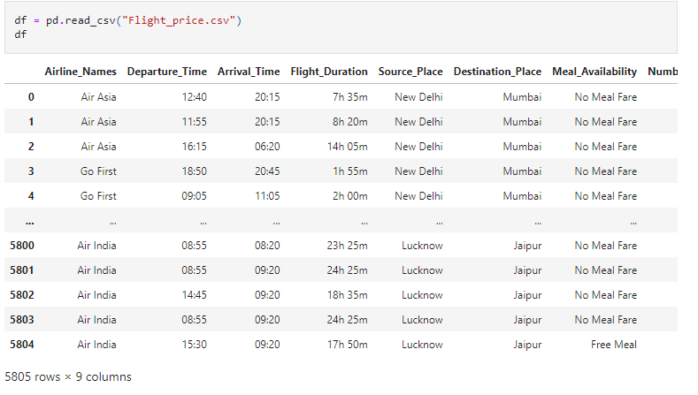
The data types of the dataset are mentioned below:

Slide 9
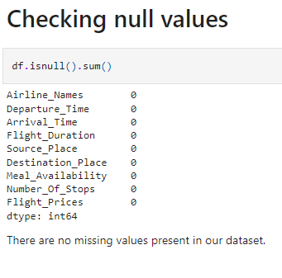
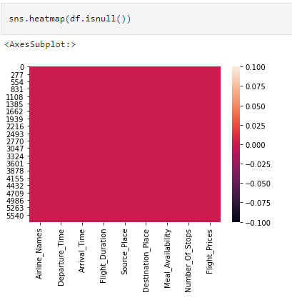
Data Pre-processing checking for the null values in the dataset: After loading the dataset, we checked for the presence of null values or missing values in the dataset. we found that there were no null values in the dataset.
[{"metadata":{"trusted":true},"id":"d2b995ed","cell_type":"code","source":"# Checking for the null/missing values in the dataset\ndf.isnull().sum()","execution_count":7,"outputs":[{"data":{"text/plain":"label 0\naon 0\ndaily_decr30 0\ndaily_decr90 0\nrental30 0\nrental90 0\nlast_rech_date_ma 0\nlast_rech_date_da 0\nlast_rech_amt_ma 0\ncnt_ma_rech30 0\nfr_ma_rech30 0\nsumamnt_ma_rech30 0\nmedianamnt_ma_rech30 0\nmedianmarechprebal30 0\ncnt_ma_rech90 0\nfr_ma_rech90 0\nsumamnt_ma_rech90 0\nmedianamnt_ma_rech90 0\nmedianmarechprebal90 0\ncnt_da_rech30 0\nfr_da_rech30 0\ncnt_da_rech90 0\nfr_da_rech90 0\ncnt_loans30 0\namnt_loans30 0\nmaxamnt_loans30 0\nmedianamnt_loans30 0\ncnt_loans90 0\namnt_loans90 0\nmaxamnt_loans90 0\nmedianamnt_loans90 0\npayback30 0\npayback90 0\npcircle 0\npdate 0\ndtype: int64"},"execution_count":7,"metadata":{},"output_type":"execute_result"}]}]

Slide 10
checking And Cleaning data.
We are renaming meal availability column for no meal fare as no meals, free meal as free meals and ecash 250 as ecash meals.
Also renaming the column number_of_stops values non stop=0, I stop=1, 2 stops=2, 3 stops=3 and 4 stops-4 for easy reading and convenience.
Converting departure time and arrival time to float vales from object values.

Slide 11
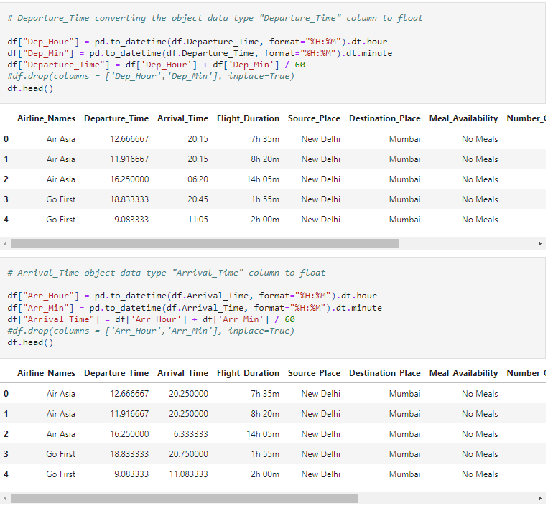

Slide 12
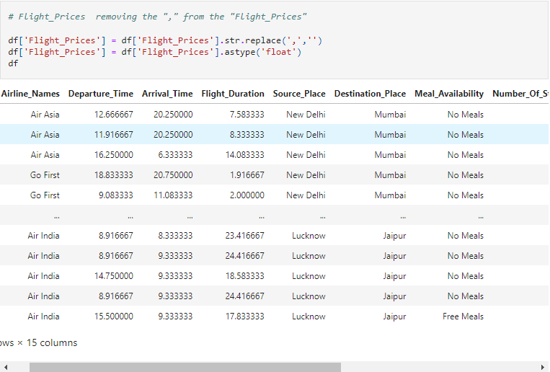
Removing ‘,’ from flight_prices.

Slide 13
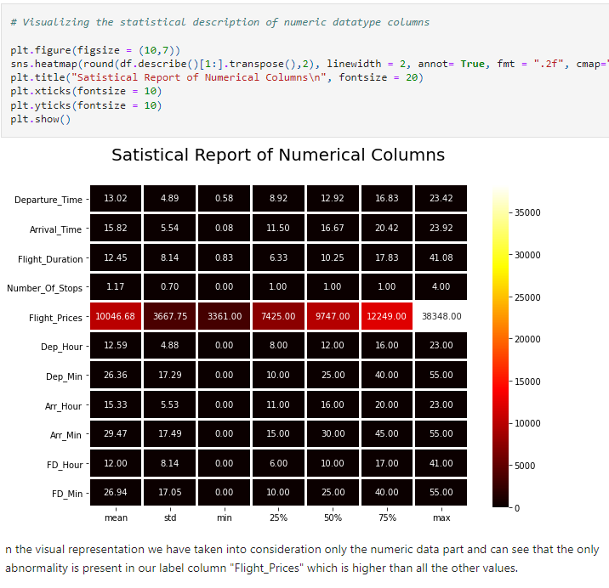
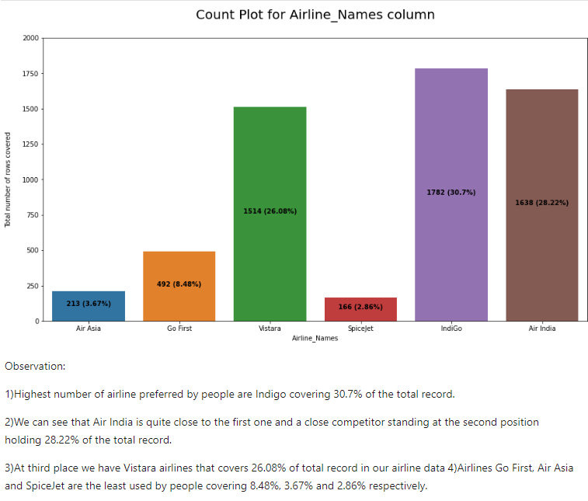
Visualizing Statistical reports of Numerical Columns

Slide 14
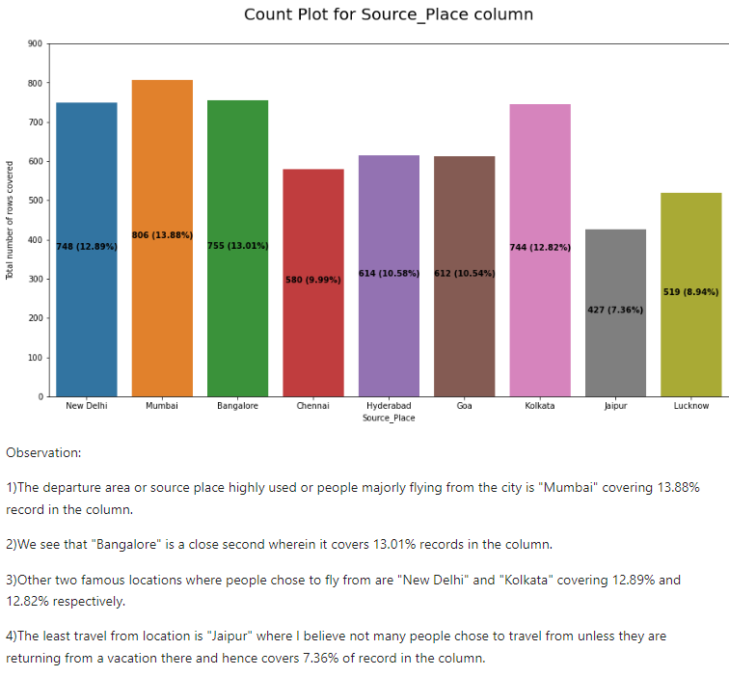
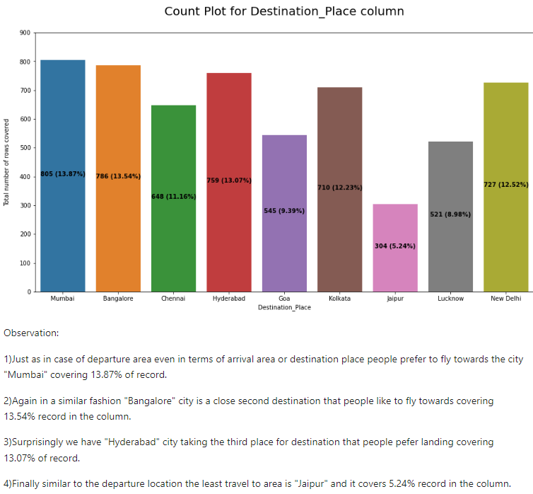

Slide 15
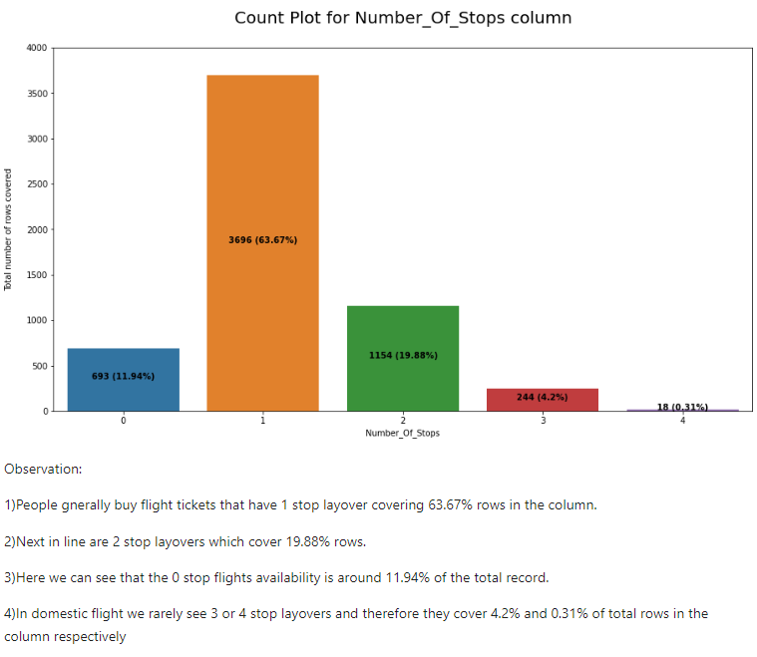

Slide 16
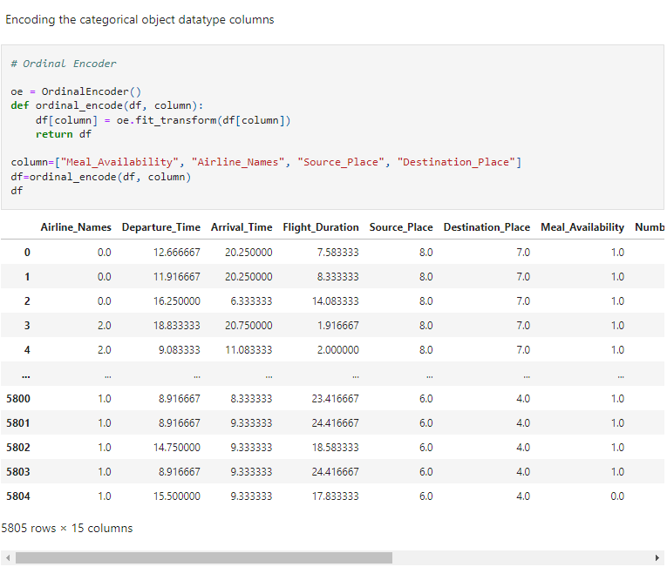
Encoding Categorical Column

Slide 17
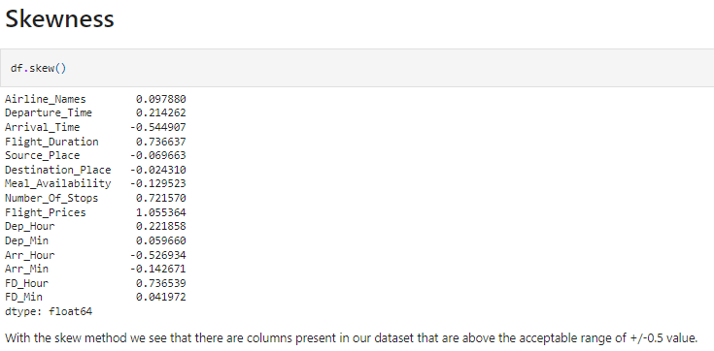
Checking for skewness
Skewness in the dataset:

Slide 18
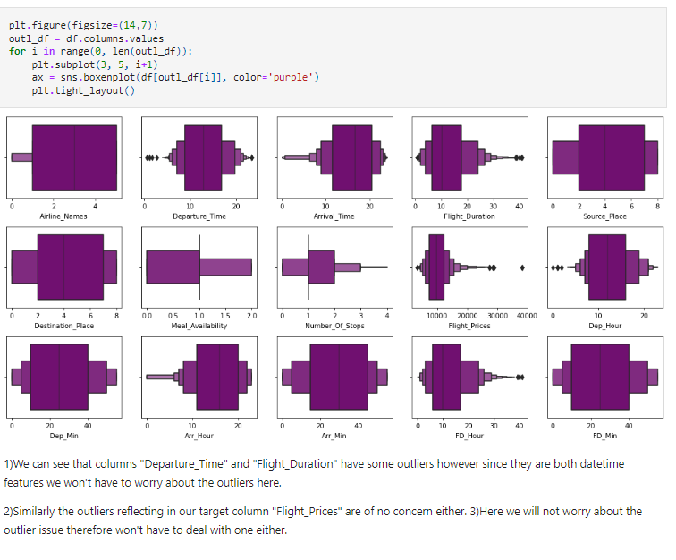
Checking for outliers

Slide 19
Hardware and Software Requirements and Tools Used:

Slide 20
Statistical Summary & Correlation Table

Slide 21
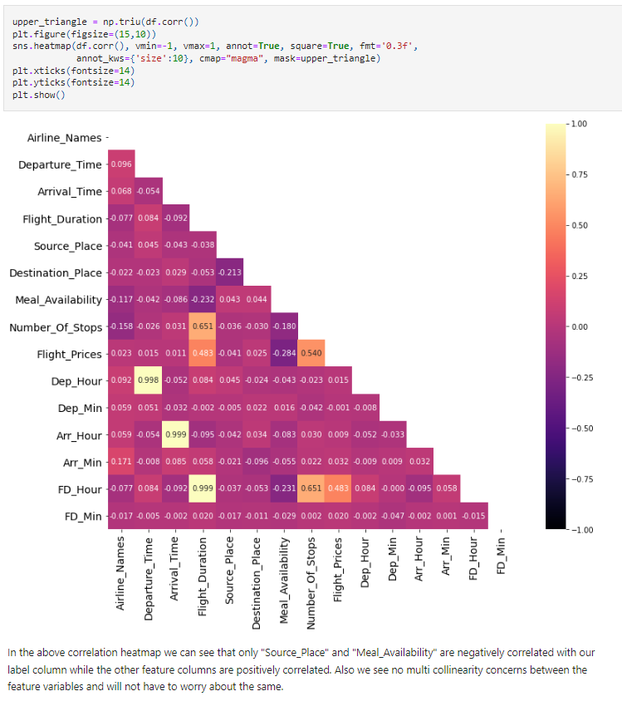

Slide 22
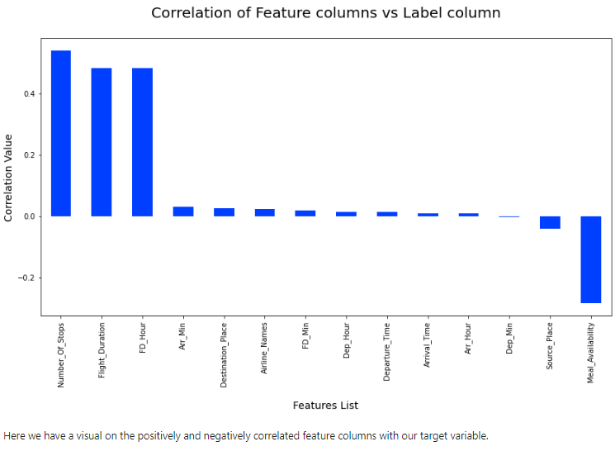
Correlation Table vs label column:

Slide 23
Model/s Development and Evaluation:
Below are the algorithms which we used for the training and testing:
Logistic Regression.
Ridge Classifier.
Lasso Classifier.
Decision Tree Classifier.
Random Forest classifier.
K Neighbors.
Gradient Boosting Regressor.

Slide 24
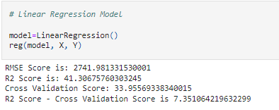
1. Logistic Regression:

Slide 25
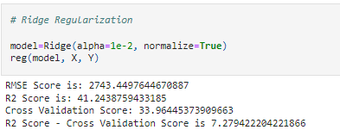
2. Ridge Classifier:

Slide 26
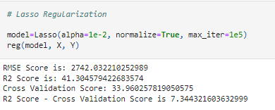
3. Lasso Classifier:

Slide 27
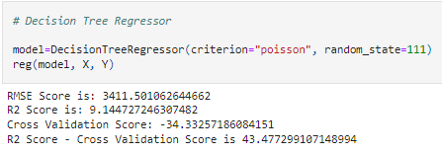
4. Decision tree Classifier:

Slide 28
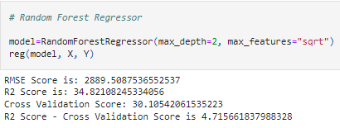
5. Random forest regressor:

Slide 29
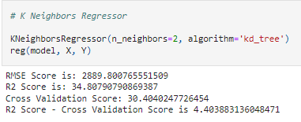
6. K neighbors:

Slide 30
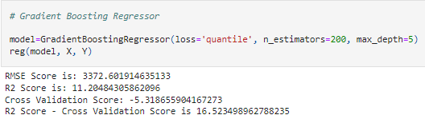
7. Gradient boosting regressor:

Slide 31
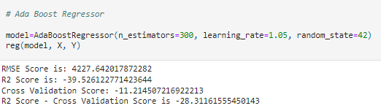
8. Ada boost regressor:

Slide 32
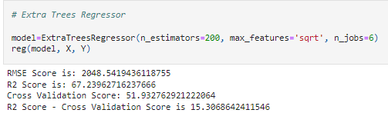
9. Extra trees regressor:

Slide 33
Conclusion:
Key Metrics for success in solving problem under consideration
The key metrics used are as follows:
RMSE Score
Confusion Matrix
Classification Report
R2 Score
Precision & Recall
Cross validation score

Slide 34
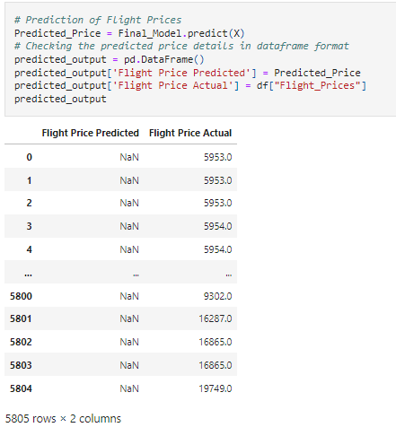
Conclusions of the Study:

Slide 35
Thank you!

