Slide 1


Shuttle
Startup
Pitch Deck
Pitching presentation
Connecting people affordably, sustainably, and seamlessly in the urban journey of life.
Presented by NAN

Slide 2




Shuttle
Let's meet our team members
who are professional and have
rich experiences.
Our team
Leader
Frontend Engineer
Backend Engineer
ASHAB ASIR
SAFAYETE NAVA
JANNATUL NIHA

Slide 3
Shuttle
Table of Contents
1
Which model we choose for our startup.
2
Use Case Diagram
3
Activity Diagram
4
Sequence Diagram
5
Conclusion

Slide 4
Shuttle
Which Process Model We Choose For Our Startup?
Incremental Model

Slide 5



Shuttle
Three Main Reason:
Time Efficient
Flexibility
Low Risk

Slide 6
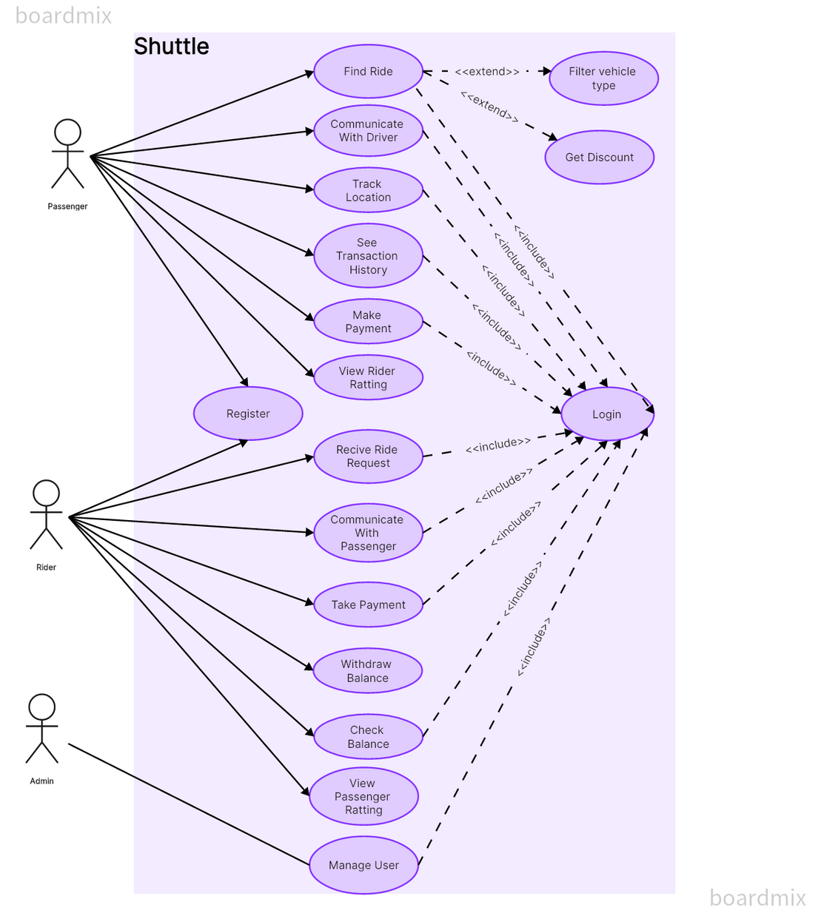
Use Case Diagram
Visualizing interactions for efficient system understanding.
Actors:
1
Passengers
2
Riders
3
Admin

Slide 7
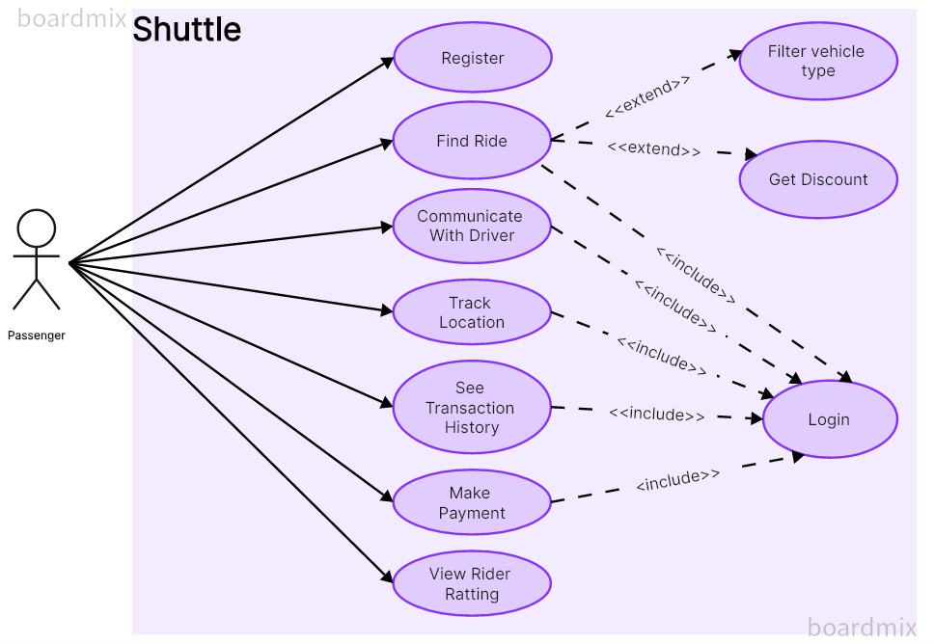
Shuttle
Actor: Passenger
Seek rides, enjoy discounts, chat with drivers, travel hassle-free.

Slide 8
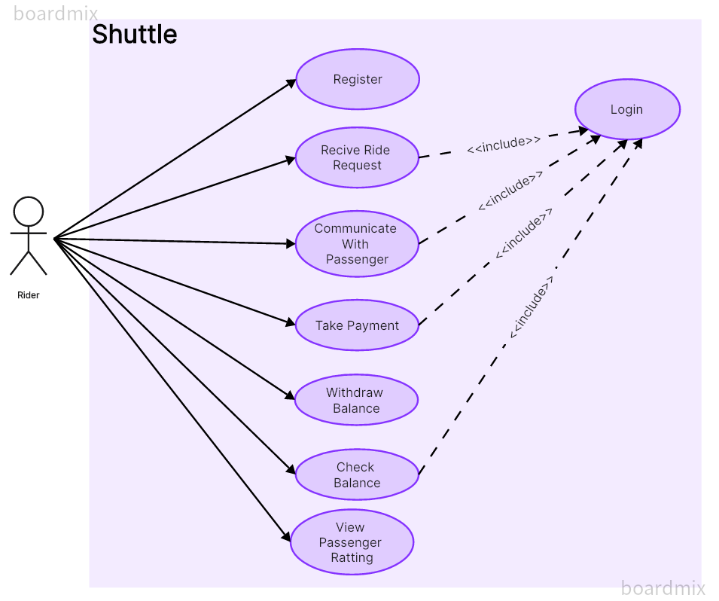
Shuttle
Actor: Rider
Make trips smooth, earning, and ensuring your journey's excellence.

Slide 9
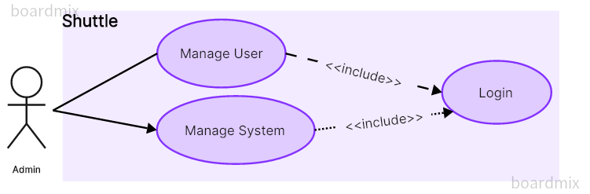
Shuttle
Actor: Admin
Manages Shuttle smoothly, ensuring a hassle-free experience for all.

Slide 10
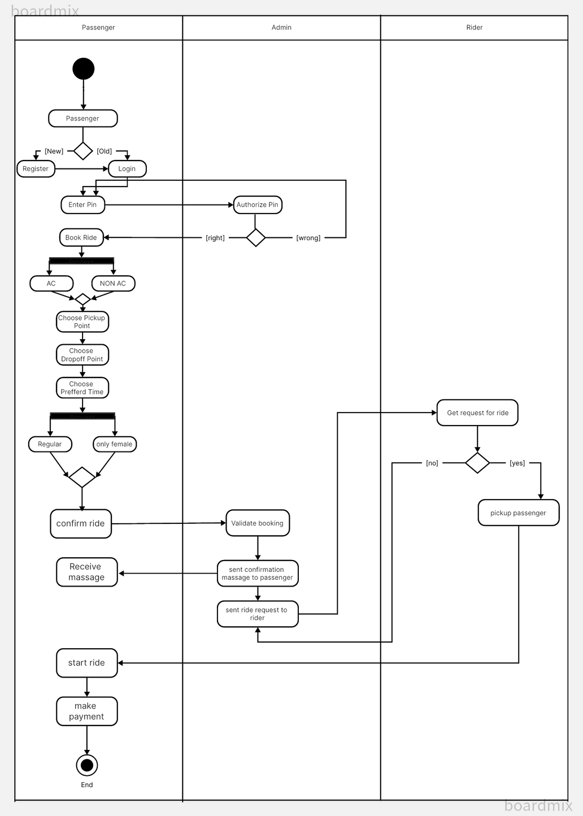
Shuttle
Activity Diagram
Model and visualize processes for system understanding and communication.

Slide 11
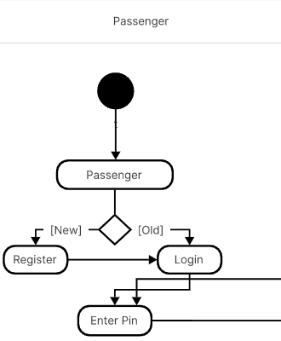
Shuttle
Activity Diagram
Step 1

Slide 12

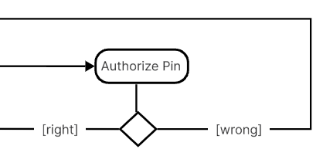
Shuttle
Activity Diagram
Step 2

Slide 13

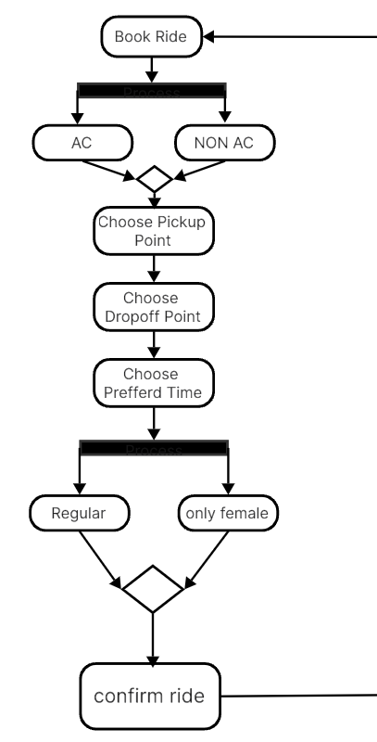
Shuttle
Activity Diagram
Step 3

Slide 14
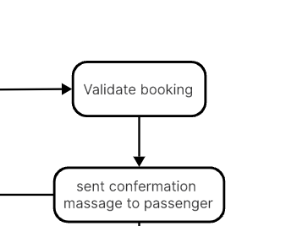
Shuttle
Activity Diagram
Step 4

Slide 15
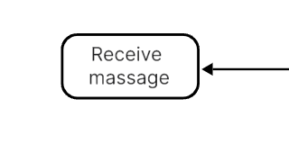
Shuttle
Activity Diagram
Step 5

Slide 16

Shuttle
Activity Diagram
Step 6

Slide 17

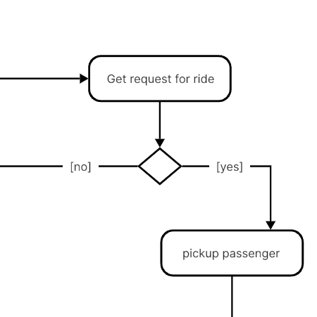
Shuttle
Activity Diagram
Step 7

Slide 18
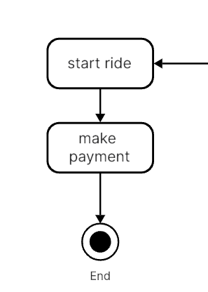
Shuttle
Activity Diagram
Step 8

Slide 19
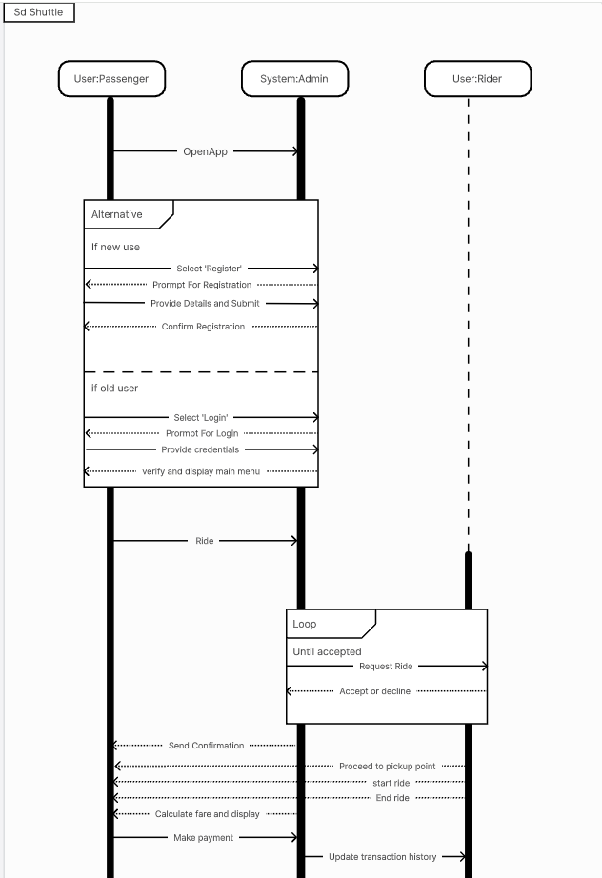
Shuttle
Sequence Diagram
Visual representation of interactions among objects in software systems.

Slide 20
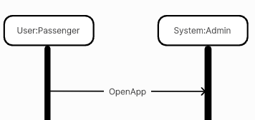
Shuttle
Sequence Diagram
Step 1

Slide 21

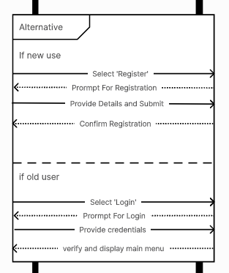
Shuttle
Sequence Diagram
Step 2

Slide 22
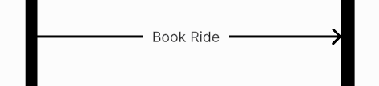
Shuttle
Sequence Diagram
Step 3

Slide 23

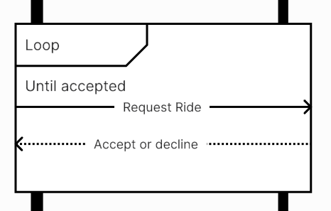
Shuttle
Sequence Diagram
Step 4

Slide 24

Shuttle
Sequence Diagram
Step 5

Slide 25




Shuttle
Sequence Diagram
Step 6

Slide 26
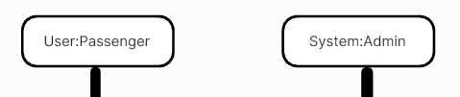

Shuttle
Sequence Diagram
Step 7

Slide 27


Shuttle
Sequence Diagram
Step 8

Slide 28
Shuttle
Conclusion

Slide 29
Shuttle
Have any Question?

Slide 30
Shuttle
Thank you

