Slide 1

Remind Me
Presented by: Supervised by:
Md. Ashad – Uz – zaman Mr. md. Abdus salim mollah
A. b. m. sayem bin bari associate professor
Subrata Dutta Dept. of computer science & engineering
Kuet

Slide 2
Objectives:
Enhance the way in which people use reminders
Create both time and location based reminders
Save users valuable time

Slide 3
Platform:
Android
SQLite
XML

Slide 4
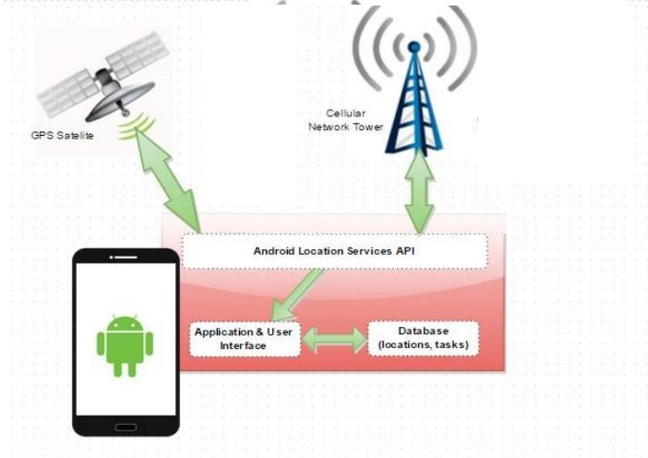
Schematic diagram:

Slide 5
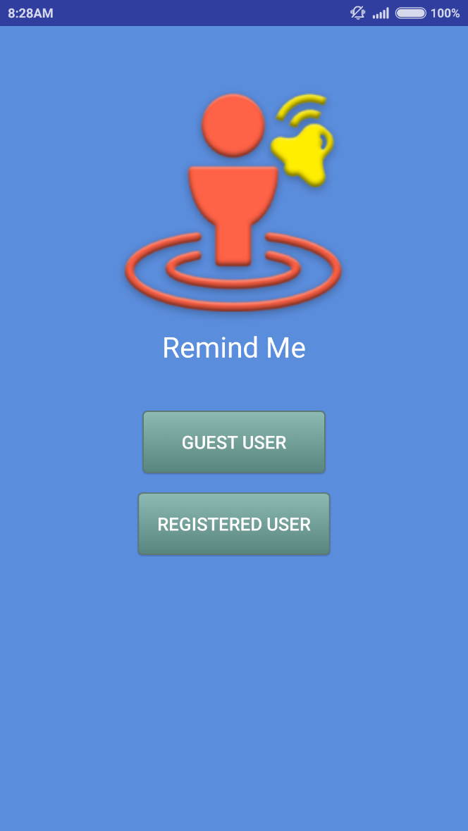
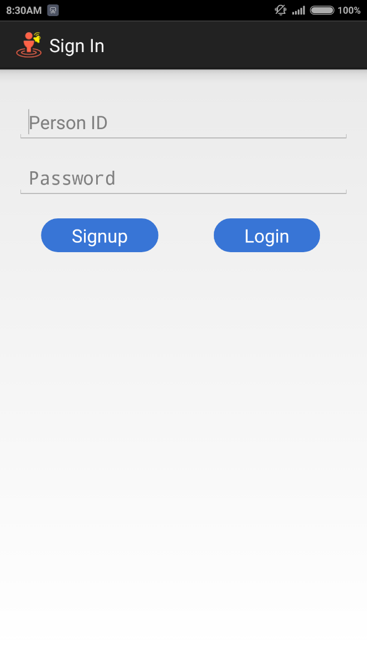
User Interface:

Slide 6
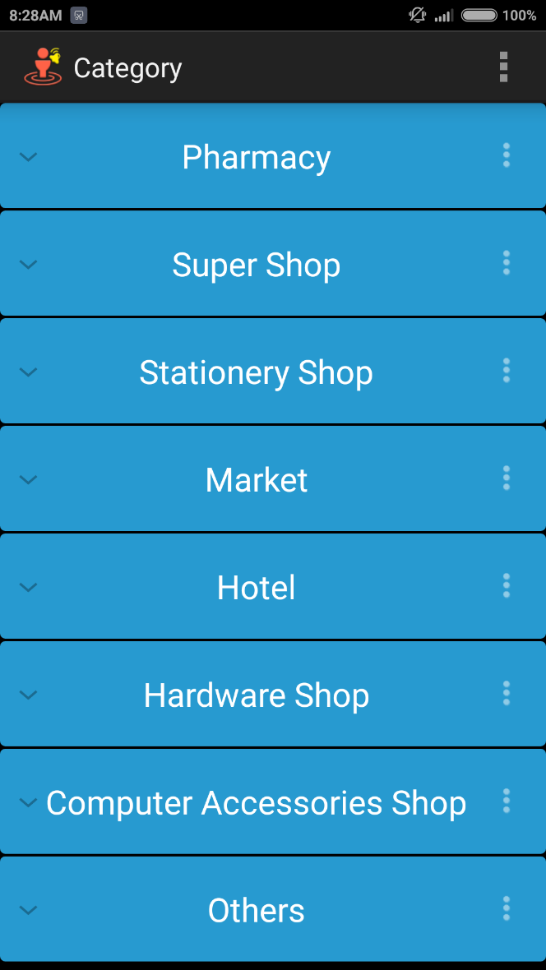
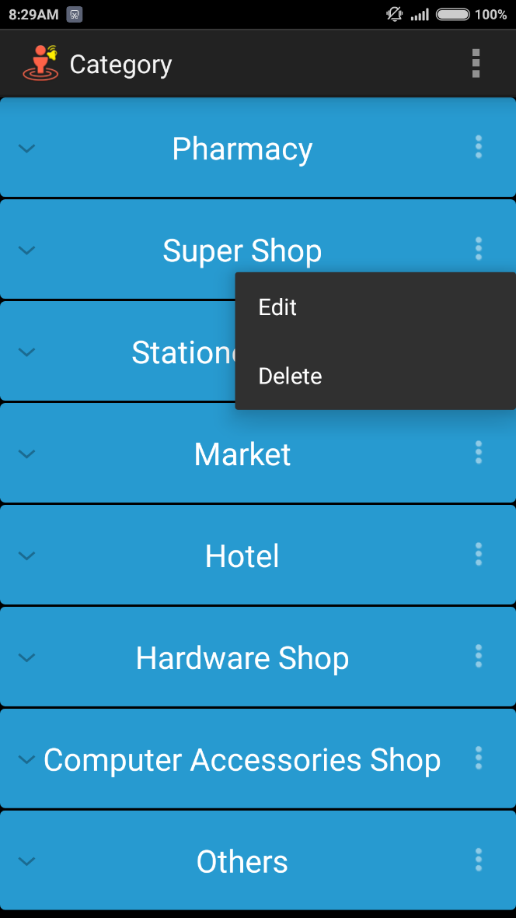
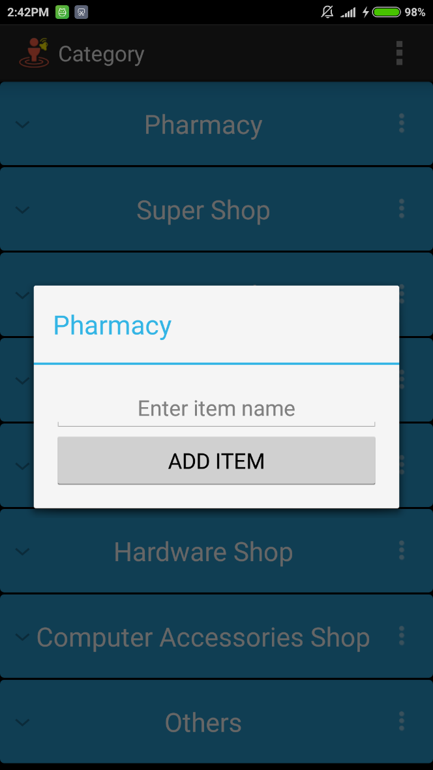
User Interfaces:

Slide 7
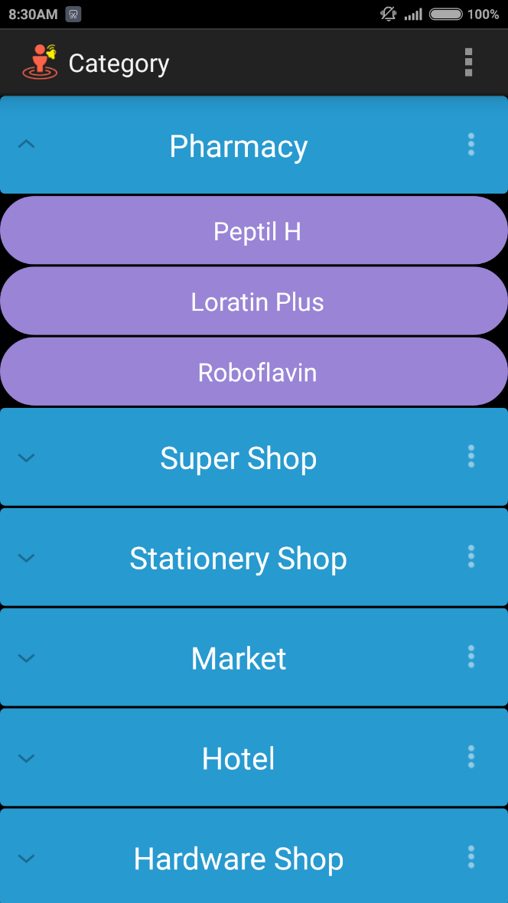
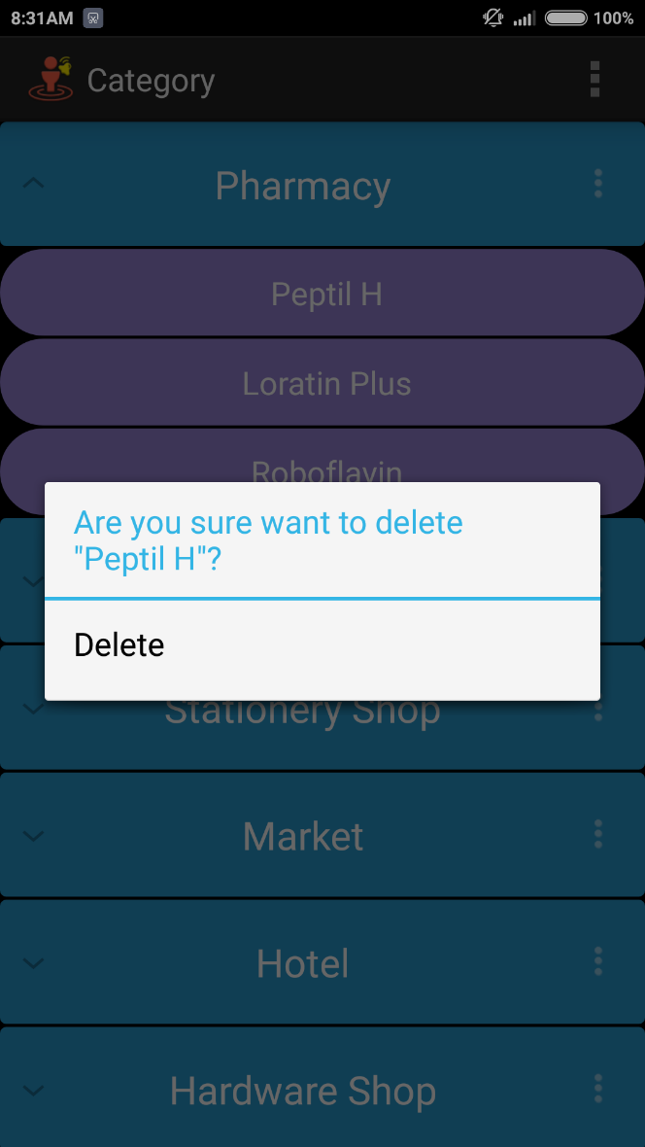
User Interfaces:

Slide 8
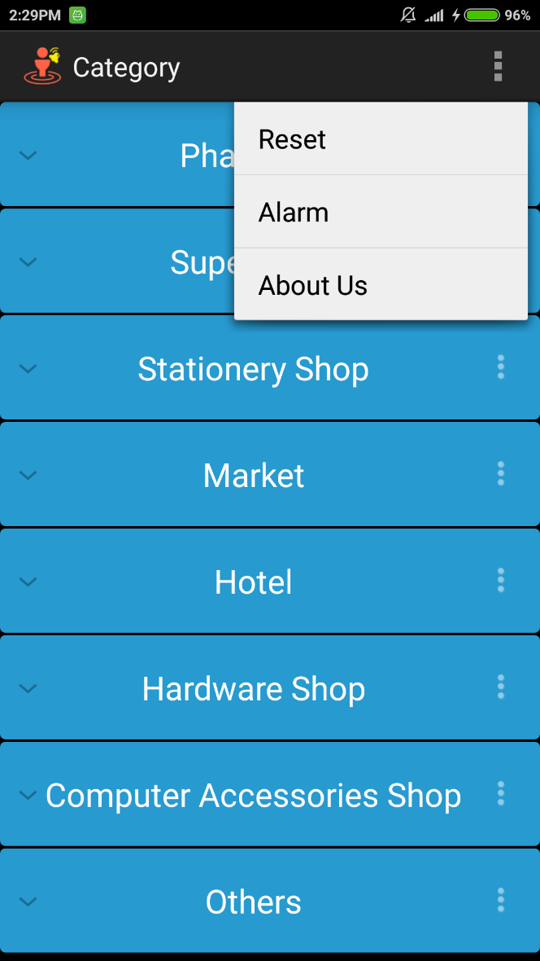
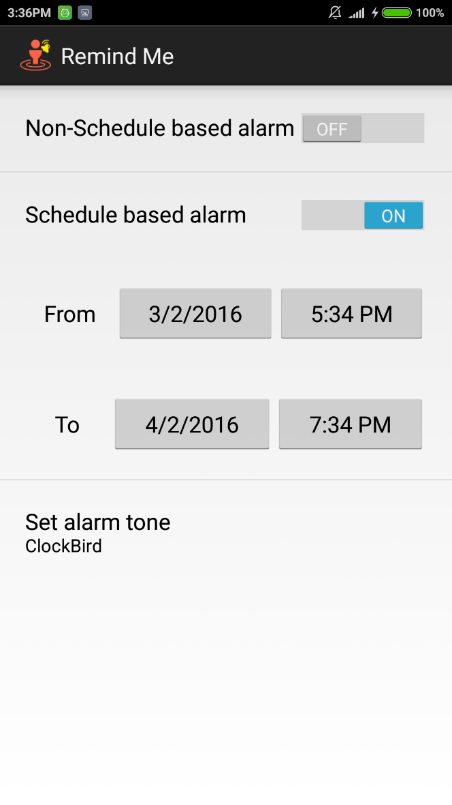
User Interfaces:

Slide 9
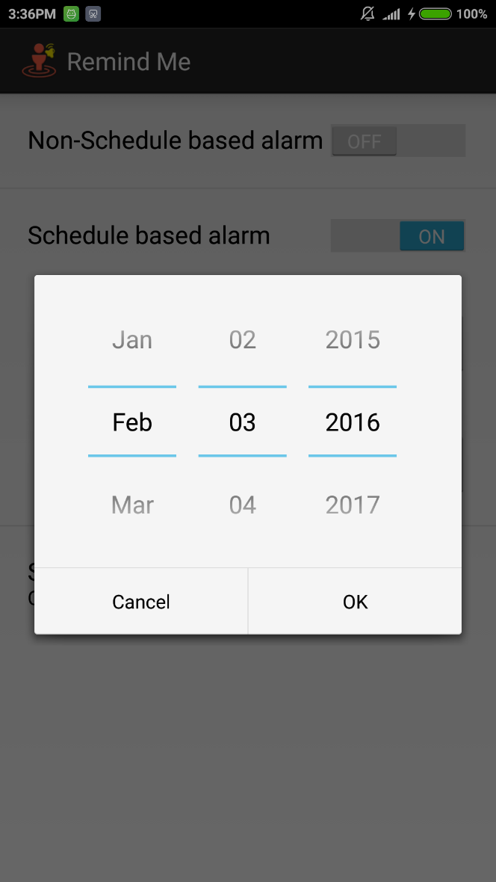
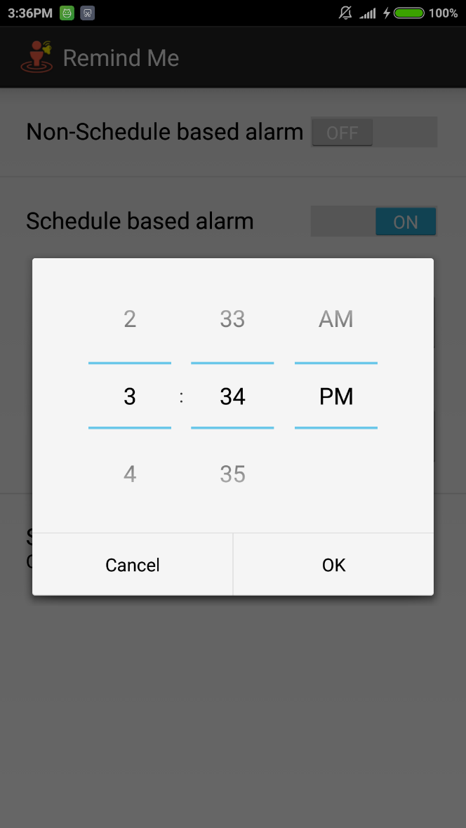
User Interfaces:

Slide 10
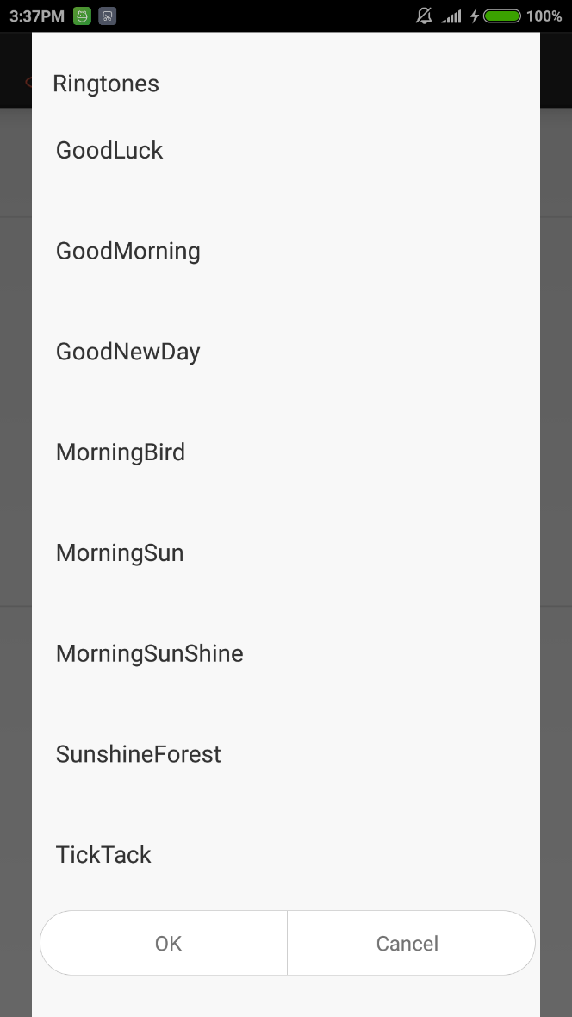
User Interfaces:

Slide 11
Future Thinking:
Want to add normal time based scheduling
Extend usable features like cloud storage etc.
Make supported for iOS/windows

Slide 12
THANK YOU

