Slide 1

LABORATORY No 10
The stack and LIFO Data Structure
Pushing data
and
Popping data

Slide 2
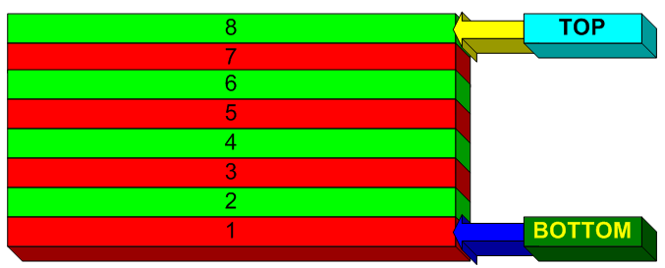
PUSHING AND POPPING DATA

Slide 3
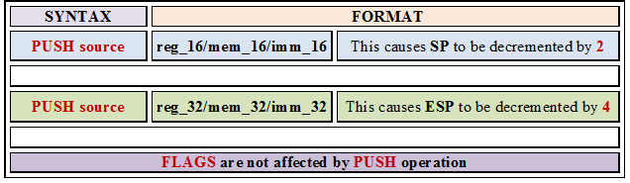
PUSHING DATA

Slide 4
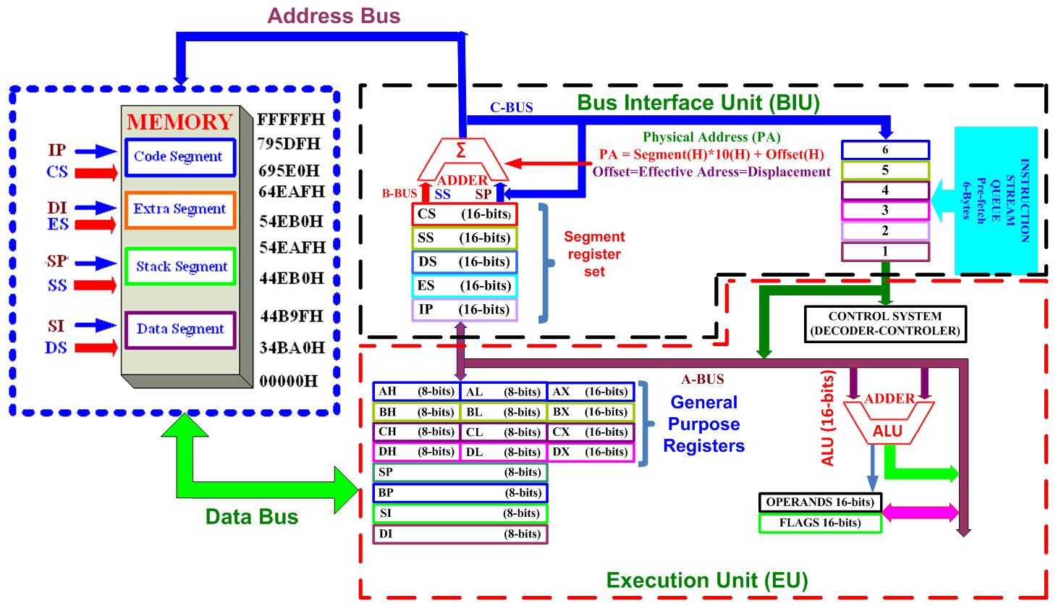
8085 MICROPROCESSOR

Slide 5
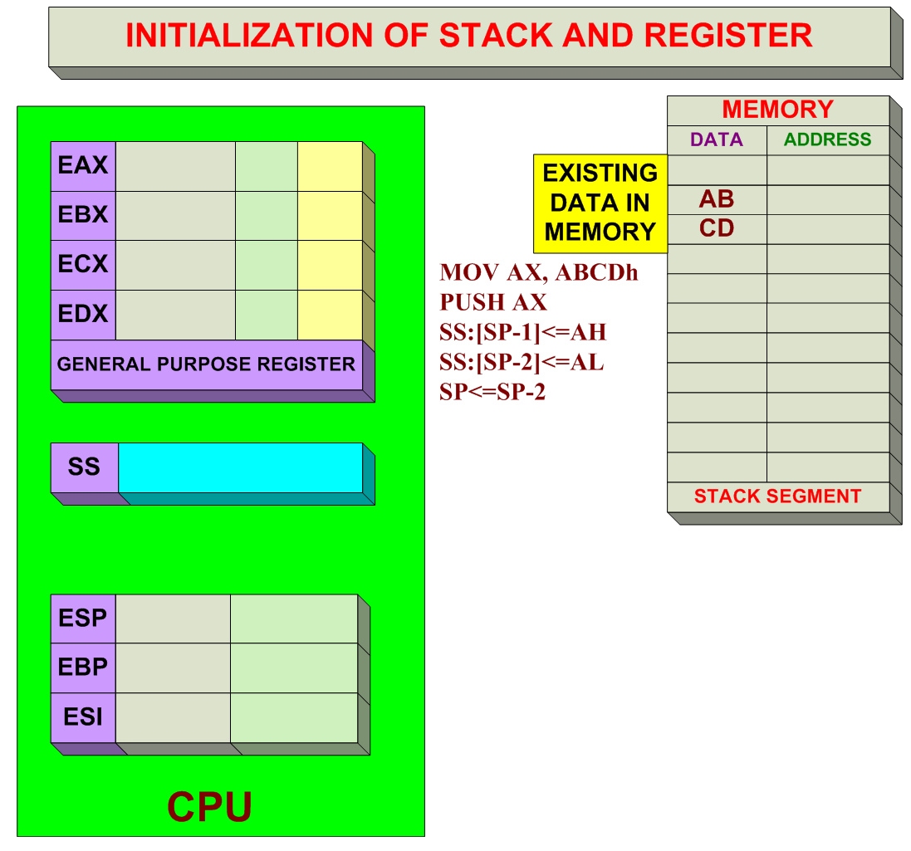
PUSHING DATA FROM 16-BIT REGISTER TO MEMORY

Slide 6
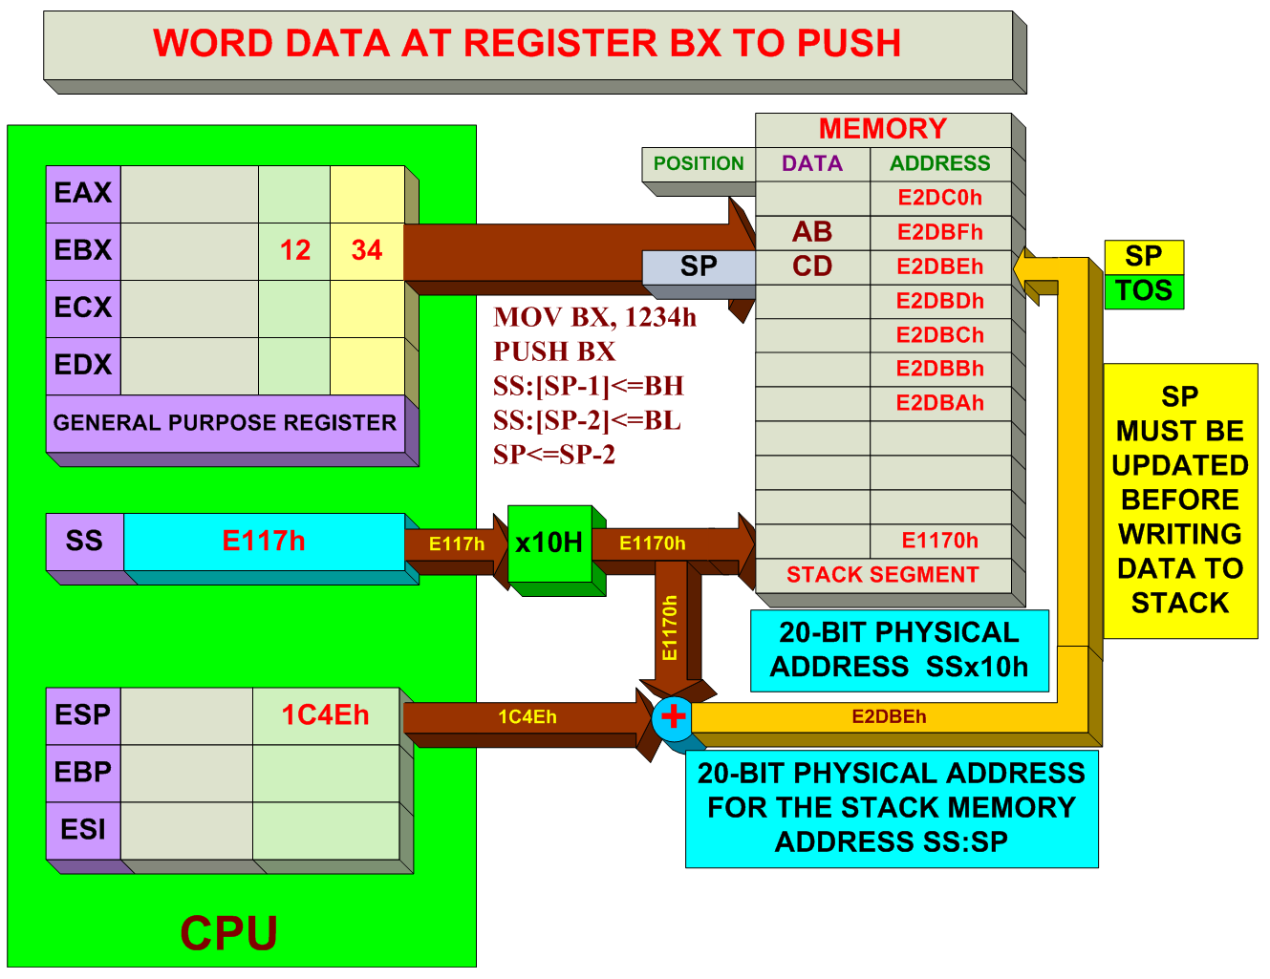
PUSHING DATA FROM 16-BIT REGISTER TO MEMORY

Slide 7
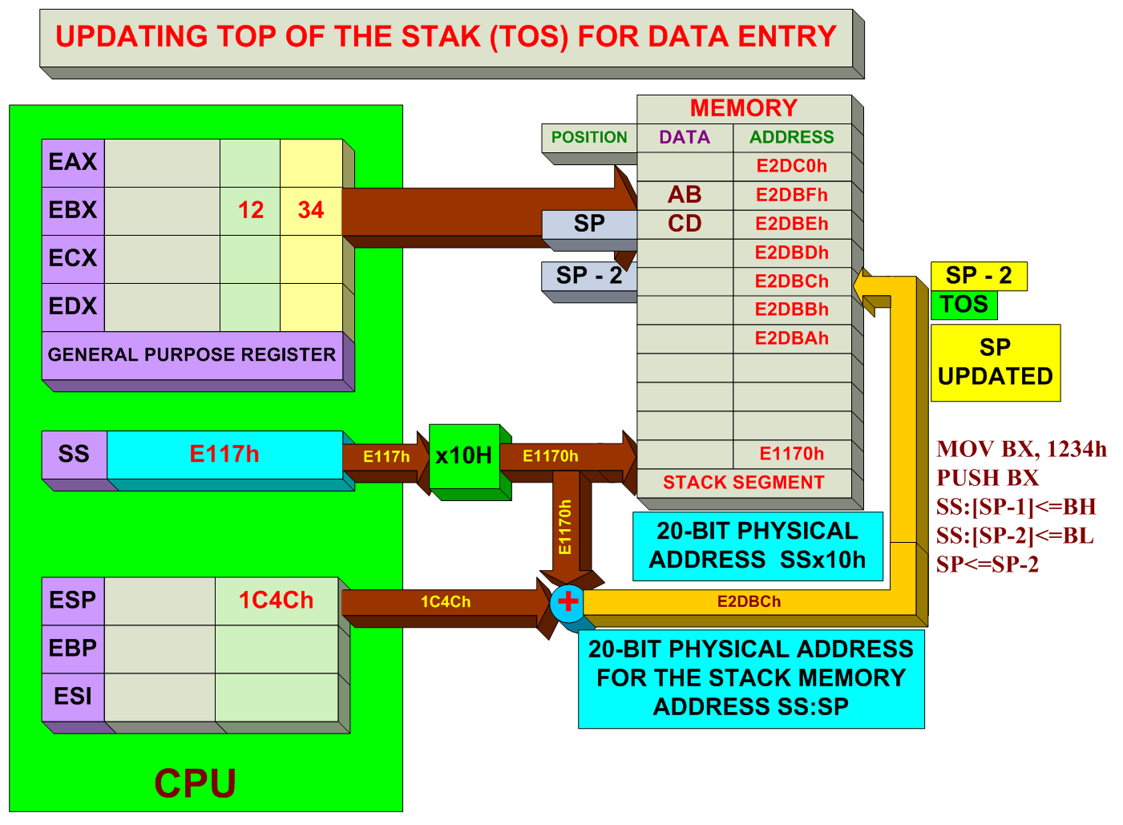
PUSHING DATA FROM 16-BIT REGISTER TO MEMORY

Slide 8
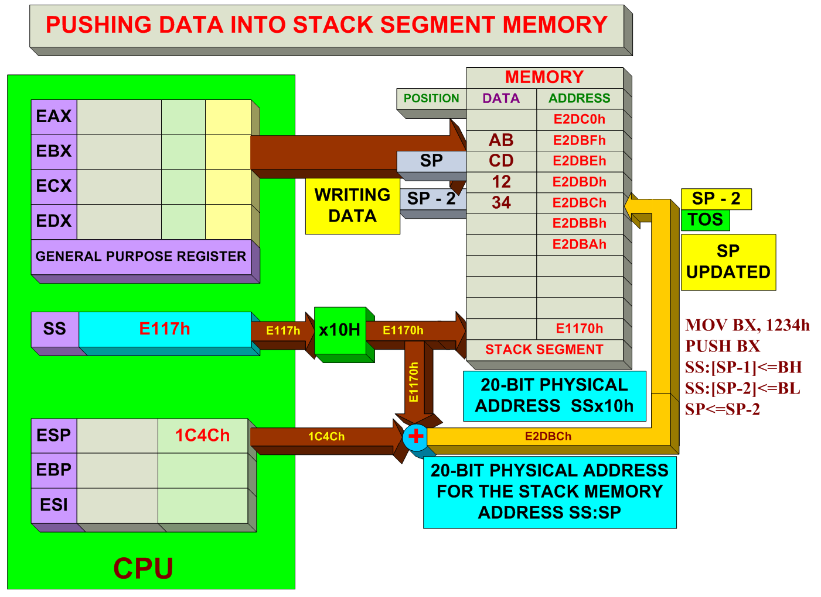
PUSHING DATA FROM 16-BIT REGISTER TO MEMORY

Slide 9
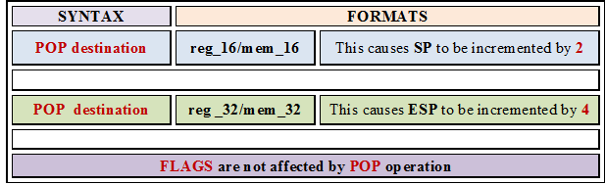
POPPING DATA

Slide 10
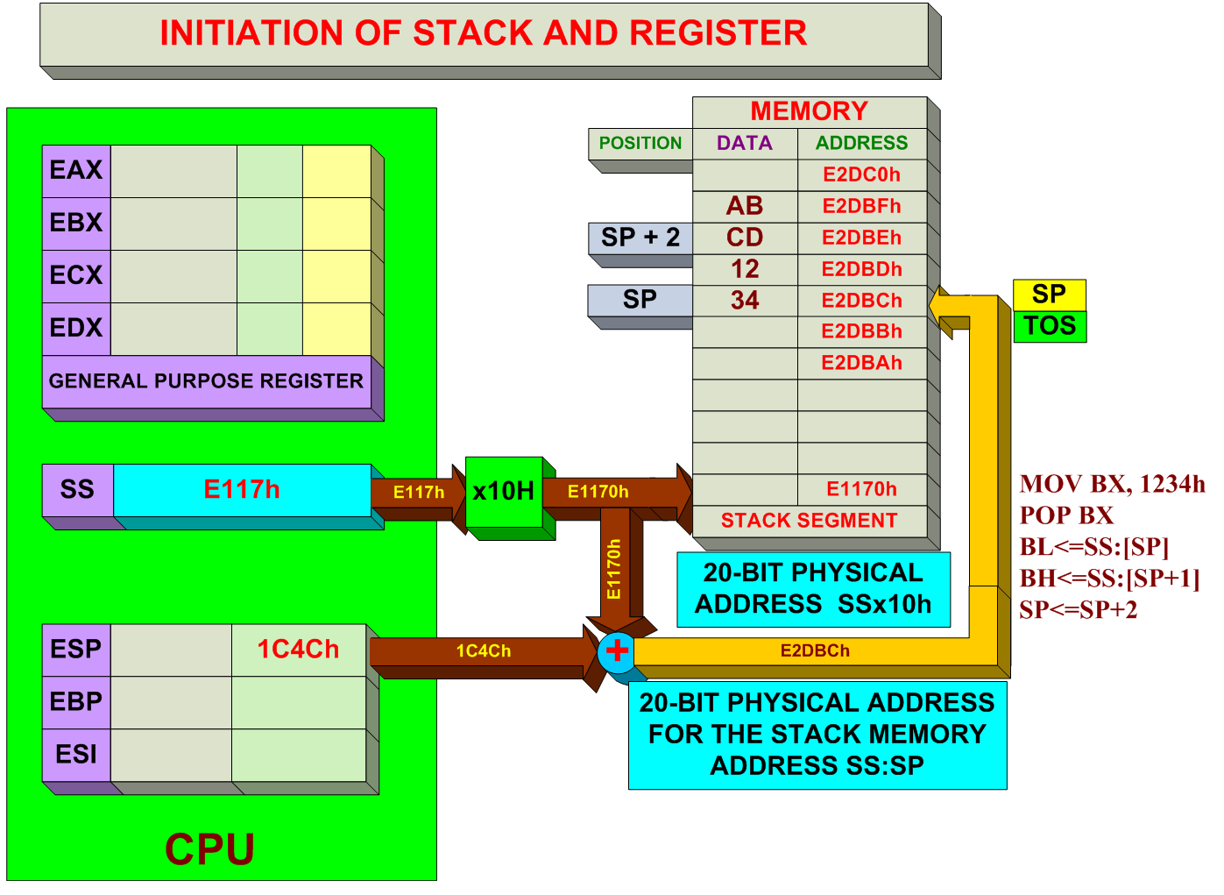
POPPING DATA FROM MEMORY TO 16-BIT REGISTER

Slide 11
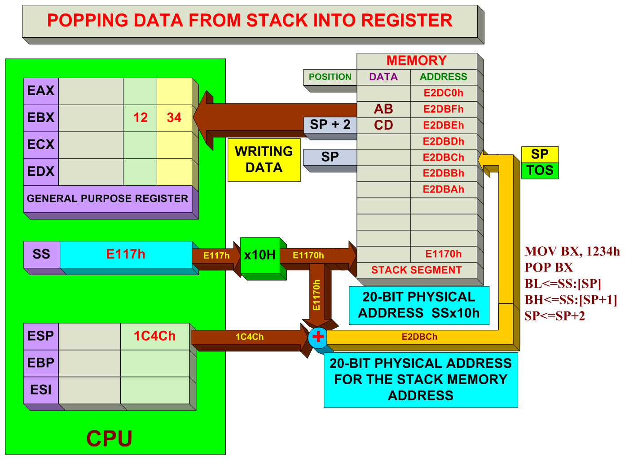
POPPING DATA FROM MEMORY TO 16-BIT REGISTER

Slide 12
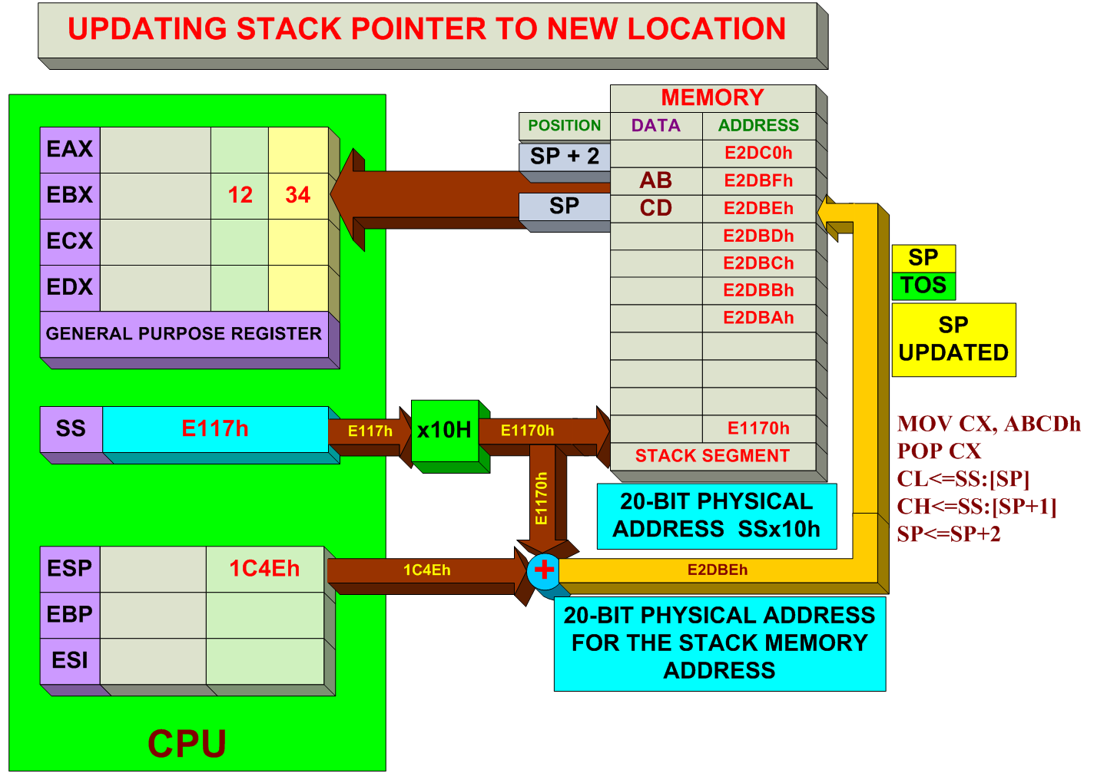
POPPING DATA FROM MEMORY TO 16-BIT REGISTER

Slide 13
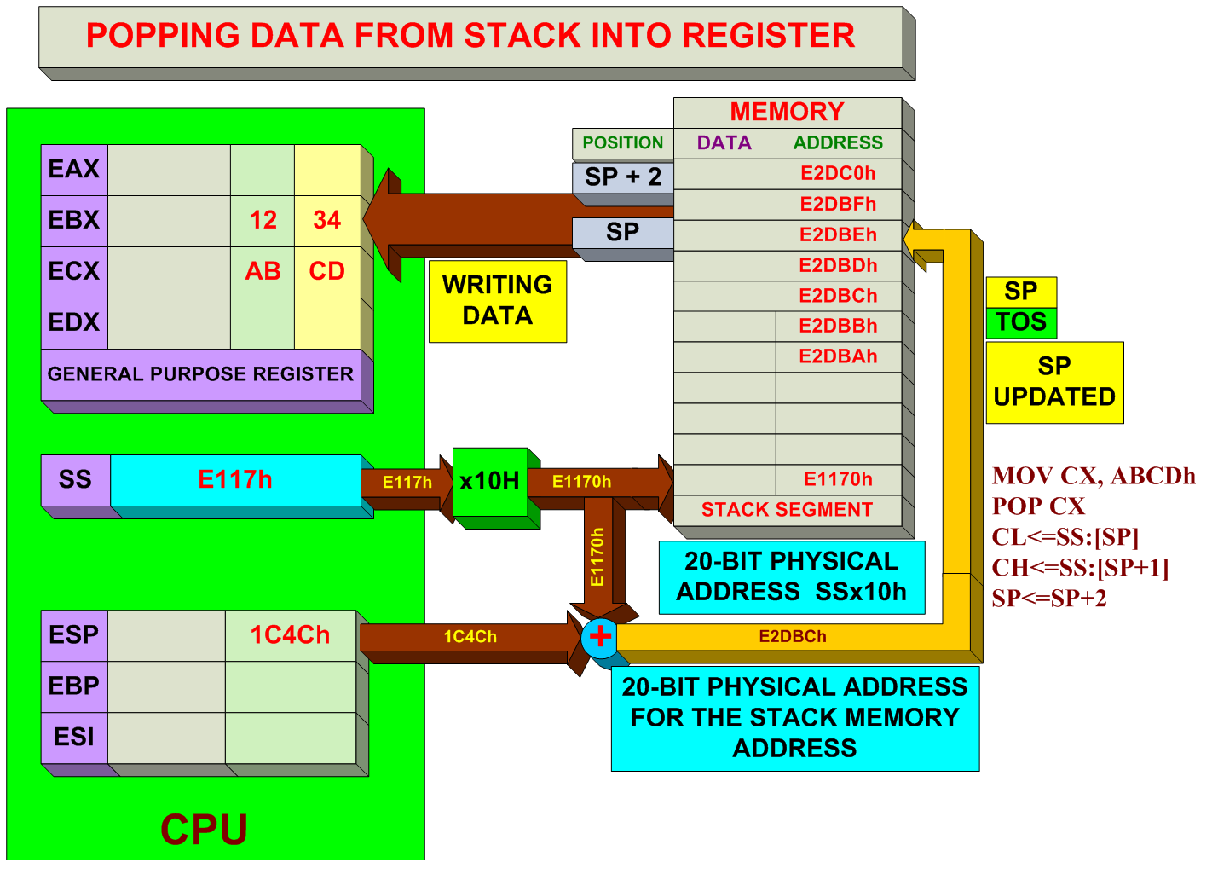
POPPING DATA FROM MEMORY TO 16-BIT REGISTER

Slide 14
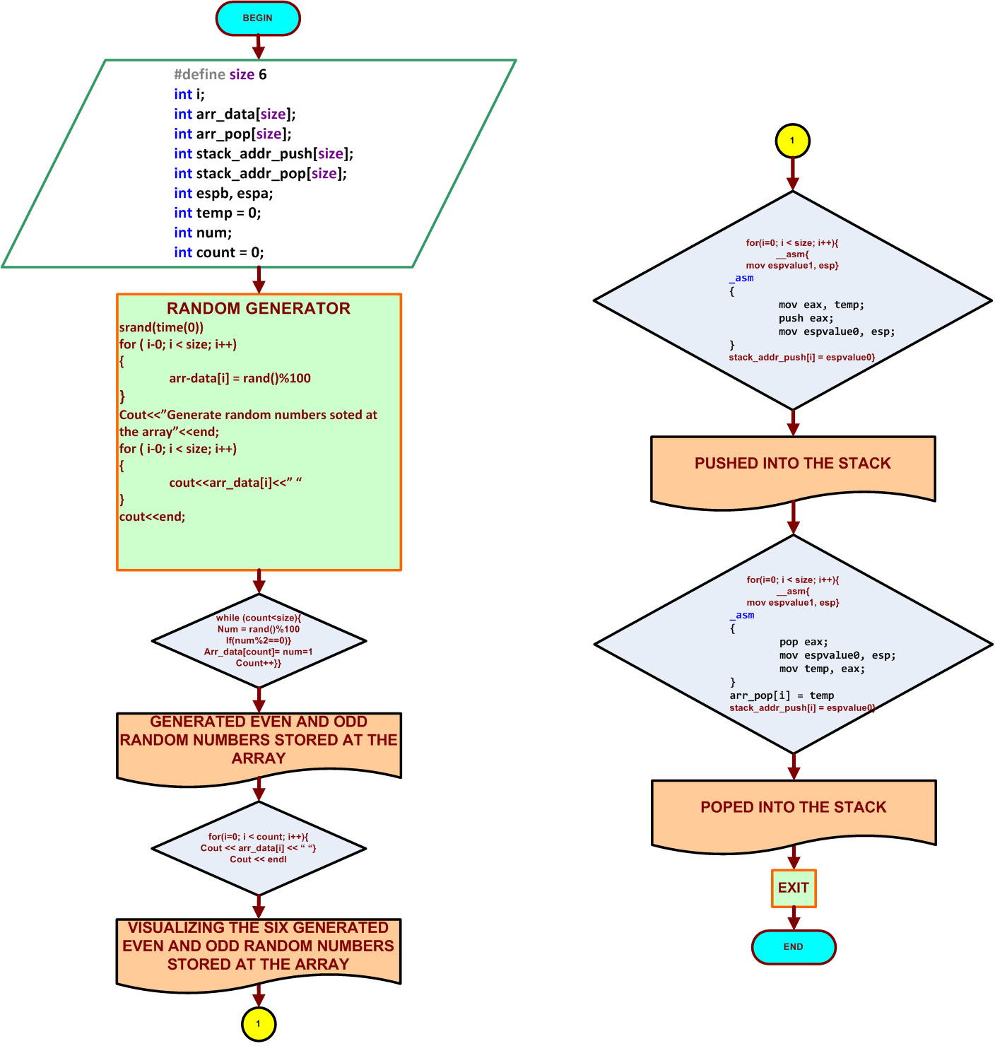
FLOWCHART FOR LABORATORY 10 EXAMPLE 10.1

Slide 15
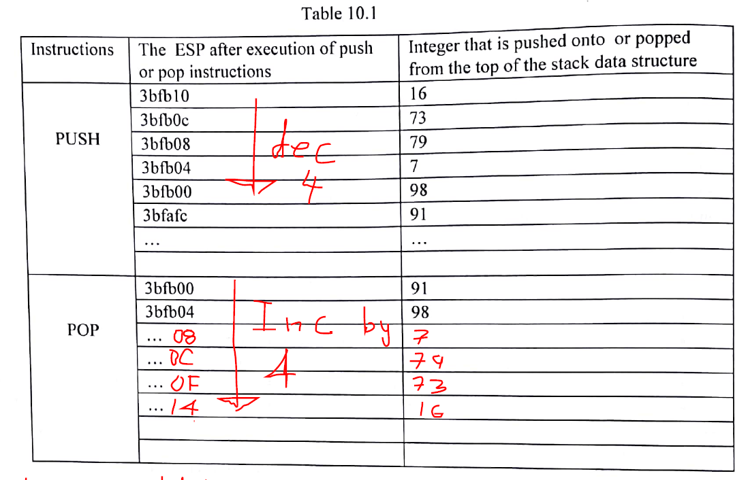
HOW TO FILL IN THE TABLE FOR 32-BITS

Slide 16
STUDENTS’S ASSIGNMENT
FOR LABORATORY EXAMPLE 10.1 FOR 32-BITS
The students should get ONE console output result operations for PUSH and POP data.
One to display for PUSH and POP for 32-bits
ONE TABLES TO FILL IN 10.1 EVEN AND ODD RONDOM NUMBERS
Total of 1output
You must run your program Example 10.1 for EVEN and ODDS ROMDOM numbers.

Slide 17


Slide 18
Thanks

