Slide 1
LABORATORY No 6
Extending Signed and Unsigned Numbers

Slide 2
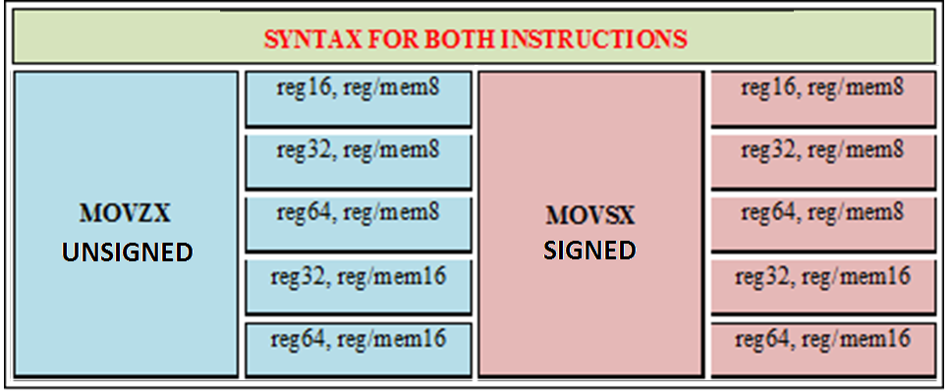
MOVE EXTENDING UNSIGNED AND SIGNED INSTRUCTIONS

Slide 3
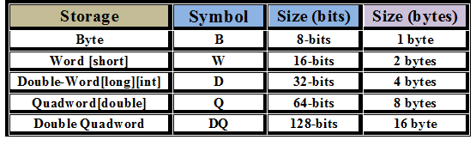
MOVE EXTENDING UNSIGNED AND SIGNED INSTRUCTIONS

Slide 4
EXTENDING UNSIGNED AND SIGNED NUMBERS
MOV AX, 0xA12F
MOVZX EAX, AX , WHERE AX = 0xA12F
MOV us32, EAX , WHERE EAX IS:
0000_0000_0000_0000_1010_0001_0010_111
MOV BX, 0xA12F
MOVSX EBX, BX , WHERE BX = 0xA12F
MOV s32, EBX , WHERE EBX IS:
1111_1111_1111_1111_1010_0001_0010_111

Slide 5
POSITIVE AND NEGATIVE SIGNED NUMBERS
0x0000A12F THIS SIGNED NUBER IS POSITIVE (0 MSb)
0000_0000_0000_0000_1010_0001_0010_111
0xA12F THIS SIGNED NUMBER IS NEGATIVE (1 MSb)
1111_1111_1111_1111_1010_0001_0010_111
MSb STAND FOR MOST SIGNIFICANT BIT

Slide 6
UNSIGNED AND SIGNED INSTRUCTIONS
16-bits to 32-bits
unsigned short int us16 = 0xfffd;
signed short int s16 = 0xfffd;
unsigned int us32;
signed int s32;
_asm
{
MOV AX, us16;
MOVZX EAX, AX;
MOV us32, EAX;
}
_asm
{
MOV BX, s16;
MOVSX EBX, BX;
MOV s32, EBX;
}
16-bits to 32-bits
Unsigned
and
Signed
Numbers

Slide 7
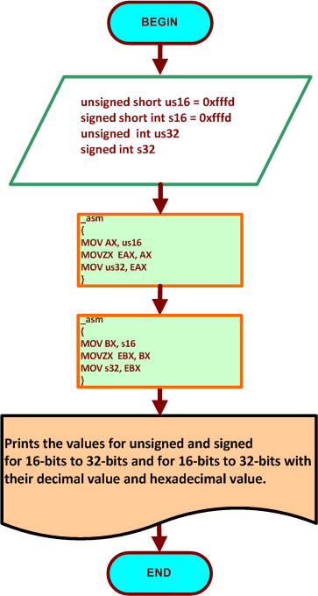
FLOWCHART FOR THE EXAMPLE 6.1
16-BITS TO 32-BITS
AND
16-BITS TO 32-BITS UNSIGNED/ SIGNED

Slide 8
STUDENTS’S ASSIGNMENT
EXAMPLE 6.1 FOR 16-BITS TO 32-BITS ONLY
UNSIGNED AND SIGNED NUMBERS
USING MOVZX and MOVSX
The students should get one output console result
for unsigned and signed integer numbers.
Unsigned- Signed integer from 16-bits to 32-bits:
Unsigned 16-bits to 32-bits using MOVZX
Signed 16-bits to 32-bits using MOVSX
Total of 1 output console result use 0xfffd as your data.

Slide 9


Slide 10
Thanks

