Slide 1

LABORATORY No 4
Memory Address

Slide 2
DATA TRANSFER
Objective:
To Move instructions involving data transfer:
Register to Register …………………..MOV EAX, EBX
Immediate data to Register……….MOV EAX, 'd'
Direct memory to Register……….. MOV EAX, j
Indirect memory to Register……..MOV EAX, [EBX]
Register to Memory…………………. MOV j, EAX
Immediate data to Memory…….. MOV [EAX], 34
Remember MOV is not actually “moving data”
and you cannot move memory to memory.

Slide 3
LABORATORY EXAMPLE No 4.3 FOR STUDENTS TO DO FOR YOUR LABORTORY REPORT
EXAMPLE No 4.3:
Size =4
i32_arr[size] = {0x8000000, 0x0000FFFF -660000, 6600000} array with 4 element each of them 32-bits
*ivPtr0, *ivPtr1, *ivPtr2, *ivPtr3 pointers to store addresses in memory
md[4] is a 32-bit array to store each pointer
madd[4] is a 32-bit array to store the address size of each element
var[size] is an 32-bit array to store the retrieved value by indirect Memory Addressing
Mode (MOV AL, [SI]) due to direct addressing mode (MOV EAX, j) is impractical for array processing because it is not practical to use constant offsets to address more than a few array elements.
ivPtr0 = &iv32_arr[0];
ivPtr1 = &iv32_arr[1];
ivPtr2 = &iv32_arr[2];
ivPtr3 = &iv32_arr[3];
The objective is:
Find out the decimal content for each element of an 32-bit array
Find out the addresses for each element of an 32-bit array
Find out the number of bytes of the address of each element in an 32-bit array

Slide 4
FLOWCHART FOR THE EXAMPLE 4.3 FOR 32-BITS ONLY

Slide 5
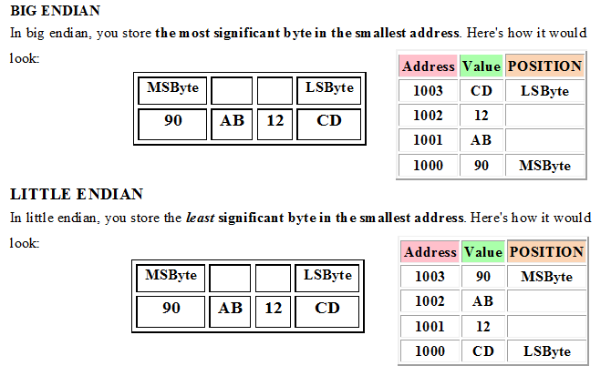
IS DATA STORED IN MEMORY AS A LITTLE ENDIAN OR AS A BIG ENDIAN?

Slide 6
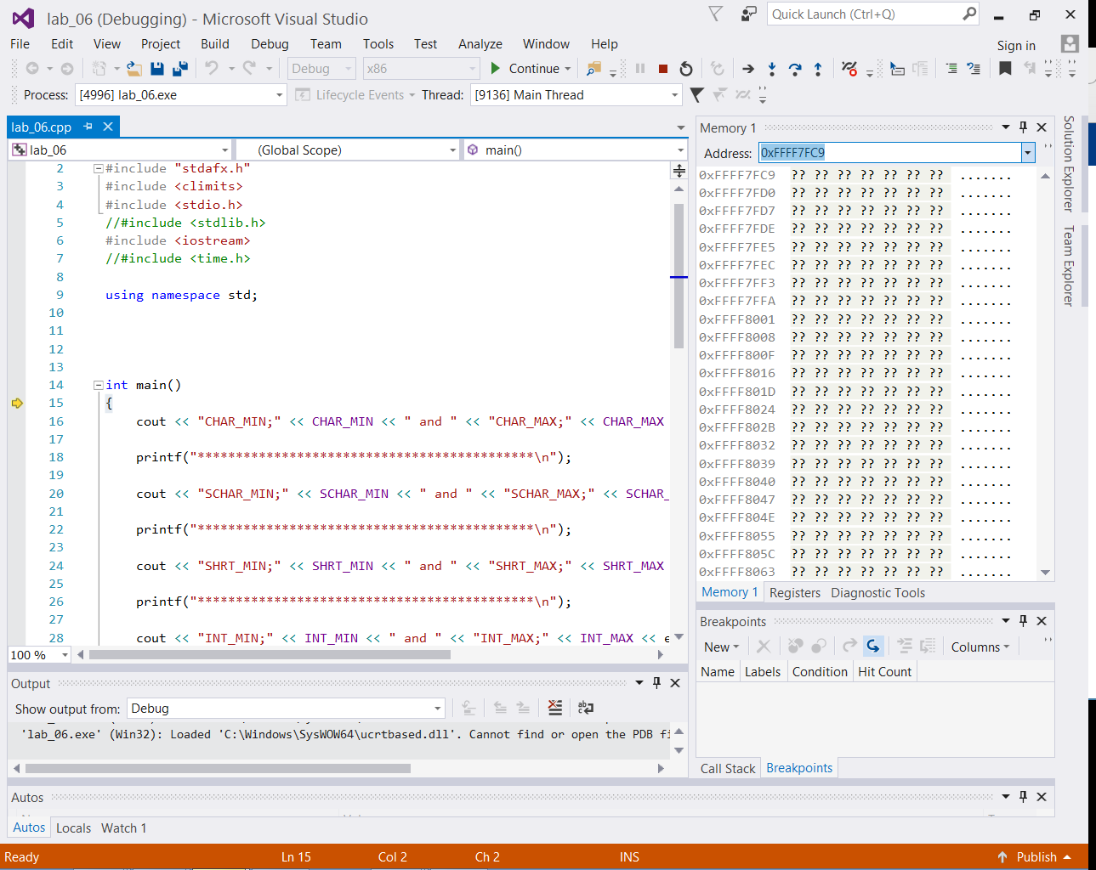
IS DATA STORED IN MEMORY AS A LITTLE ENDIAN OR AS A BIG ENDIAN?

Slide 7
IS DATA STORED IN MEMORY AS A LITTLE ENDIAN OR AS A BIG ENDIAN?
0xFFFF7FF3 ?? ?? ?? ?? ?? ?? ?? .......
0xFFFF7FFA ?? ?? ?? ?? ?? ?? ?? .......
0xFFFF8001 ?? ?? ?? ?? ?? ?? ?? .......
0xFFFF8008 ?? ?? ?? ?? ?? ?? ?? .......
0xFFFF800F ?? ?? ?? ?? ?? ?? ?? .......
0xFFFF8016 ?? ?? ?? ?? ?? ?? ?? .......
ASSUMING DATA IN POSITION GIVEN:
0xFFFF7FF3 ?? ?? AC ?? ?? ?? ?? .......
0xFFFF7FFA ?? ?? ?? ?? ?? ?? ?? .......
0xFFFF8001 ?? ?? ?? ?? ?? ?? ?? .......
0xFFFF8008 ?? ?? ?? ?? ?? ?? ?? .......
0xFFFF800F ?? ?? ?? ?? ?? ?? ?? .......
0xFFFF8016 ?? ?? ?? ?? ?? ?? ?? .......
FIND THE ADDRESS LOCATION FOR DATA AC
LOWER ADDRESS IS 0xFFFF7FF3
3 + 4 = 7
7 + 4 = 11 WHICH IS B IN HEXADECIMAL
11 + 4 = 15 WHICH IS F
THEREFORE THE ADDRESS LOCATION FOR DATA AC IS 0xFFFF7FFF

Slide 8
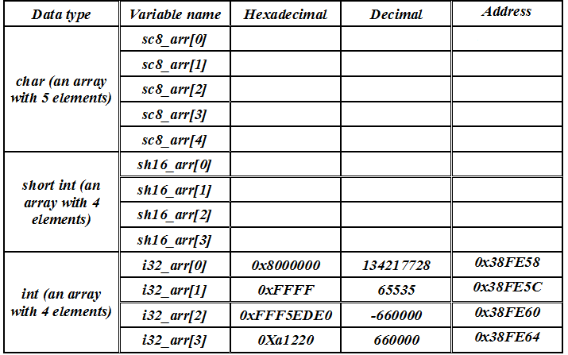
Is data store as a little Endian or as a big Endian?
FILL IN THE TABLE No 4.3

Slide 9
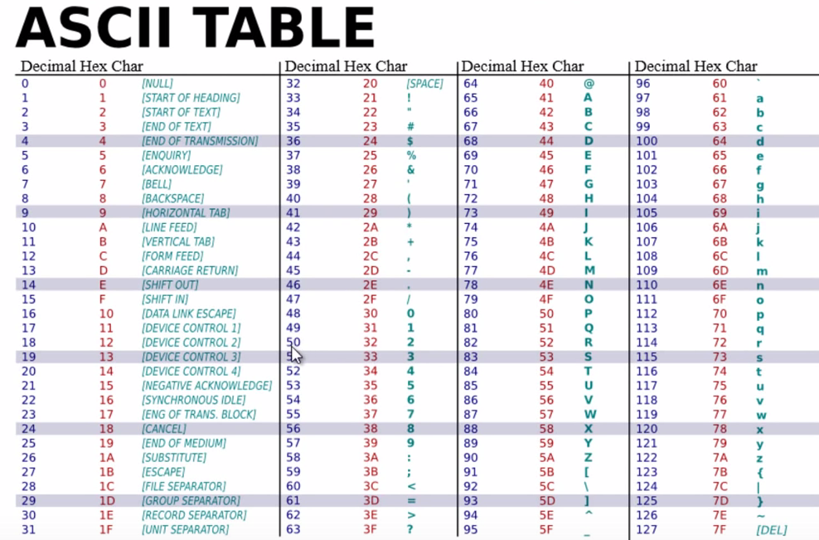
APPENDIX LECTURE CHAPTER No 02

Slide 10
STUDENTS’S ASSIGNMENT RESULT
EXAMPLE 4.3 FOR 32-BITS ONLY.
The students should get one output result operation
Console result contains: 32-bit Dimensional array
One array to store pointer
One array to store addresses
Total of 1 output console result for 32-bit only

Slide 11


Slide 12
Thanks

