Slide 1
LABORATORY No 7
Integer Arithmetic Operation :
Addition: ADD, INC
Subtraction :SUB, DEC, NEG
Multiplication: MUL, IMUL
Division: DIV, IDIV

Slide 2
LABORATORY No 7
7.1 Signed Integers:
7.1 unsigned Integers :
BY USING A MENU AND A SUBMENU

Slide 3
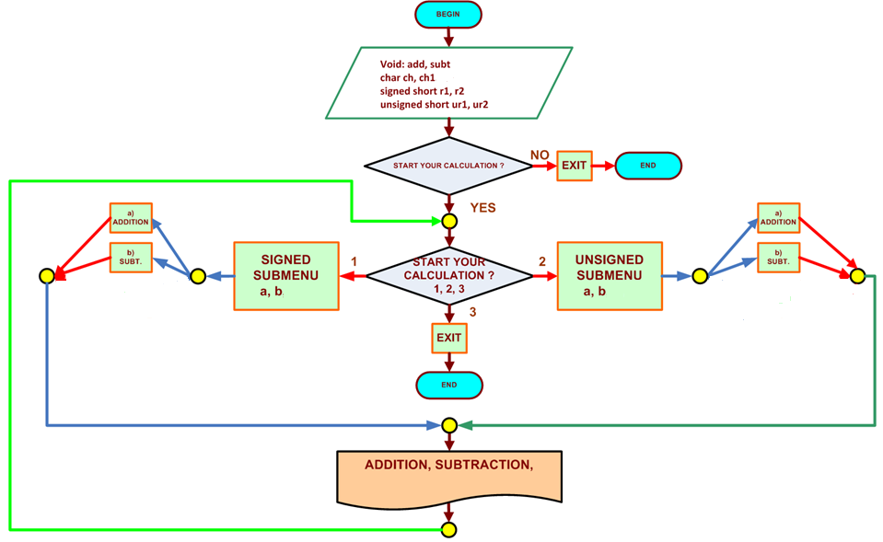
FLOWCHART FOR THE EXAMPLE 7.1 UNSIGNED/SIGNED

Slide 4
STUDENTS’S ASSIGNMENT
EXAMPLE 7.1 FOR 16-BITS
BEFORE YOU SUBMIT YOU LABORATORY REPORT MAKE
SURE TO CHECK FOR THE FOLLOWING:
MAKE SURE YOUR OUTPUT CONSOLE IS CLEAR AND NOT
BLURRY FOR YOUR PROFESSOR TO SEE.
IF YOU SUBMIT A BLURRY-UNCLEAR CONSOLE RESULT, I WILL
NOT CHECK YOUR RESULT AND YOUR REPORT WILL BE
50 POINTS LOWER.
MAKE SURE NOT TO COPY THE OUTPUT CONSOLE RESULT
FROM YOUR LABORATORY MANUAL TO YOUR LABORATORY
REPORT, OTHERWISE, YOU REPORT WILL BE 60 POINTS
LOWER.

Slide 5
STUDENTS’S ASSIGNMENT
EXAMPLE 7.1 FOR 16-BITS
The students should get one output for operation
Signed integer: One for addition -36, -5
One for subtraction -36, -5
Unsigned integer: One for addition 36, 5
One for subtraction 36, 5
Total of 1outputs
You must use those numbers showed above, if you do
not use the suggested numbers 40 point will be deducted
from you laboratory report grade.

Slide 6


Slide 7
Thanks

