Slide 1

LABORATORY No 5
Addressing Modes

Slide 2
REVIEW FROM PREVIOUS LABORATORY
LABORATORY No_03: Data were transferred from memory to register and vice-versa.
MOV BL, 'a';
MOV BH, 'A';
MOV r1, BL;
MOV r2, BH;
MOV r, BX;
MOV temp, BH;
MOV BH, BL;
MOV BL, temp
MOV r1, BL;
MOV r2, BH;
MOV r, BX;

Slide 3
REVIEW FROM PREVIOUS LABORATORY
LABORATORY No_04: Data were transferred from CPU to memory to assign address
and data by using pointers. Pointers are used to store addresses
for a particular data.
svPtr0 = &sh8_arr[0];
svPtr1 = &sh8_arr[1];
svPtr2 = &sh8_arr[2];
svPtr3 = &sh8_arr[3];
svPtr0 = &sh16_arr[0];
svPtr1 = &sh16_arr[1];
svPtr2 = &sh16_arr[2];
svPtr3 = &sh16_arr[3];
ivPtr0 = &i32_arr[0];
ivPtr1 = &i32_arr[1];
ivPtr2 = &i32_arr[2];
ivPtr3 = &i32_arr[3];

Slide 4
LABORATORY No 05 EXAMPLE 5.1 NOT FOR SUBMISSION
LABORATORY No_05: Data are transferred by addressing modes in conjunction
with pointers such as:
register addressing mode MOV EDI, EBX;
register direct addressing mode MOV EBX, uPtr;
register indirect addressing mode MOV AX, [EBX];
register relative addressing mode MOV AX, [EBX + 2H];
Objective: Example 5.2 data transferred in 32-bit unsigned array increased by 4H.
Example 5.2 data transferred in 32-bit signed array increased by 4H.
EXAMPLE 5.2
unsigned int u32_arr[n] = { 0x00000041, 0x00000052, 0xabcd1169, '1234', 'aABc' };
unsigned int u0, u1, u2, u3, u4;
unsigned int *uPtr;
int u0_addr, u1_addr, u2_addr, u3_addr, u4_addr;
int i;
//EBX holds the address of element 0 in the array from the direct addressing mode
MOV EBX, uPtr;

Slide 5
LABORATORY No 05 EXAMPLE 5.2 FOR SUBMISSION
//u1 holds the retrieved value resulted from the indirect addressing mode contained
in register EBX
MOV EAX, [EBX];
MOV u1, EAX;
MOV u1_addr, EBX;
//EBX is increased by 4 due to u32_arr is an unsigned int array (4 bytes)
EBX holds the address of element 1 in the array from the immediate addressing mode.
MOV ECX, 4H;
ADD EBX, ECX;
//u1 holds the retrieved value from the indirect addressing mode contained
in register EBX
MOV EAX, [EBX];
MOV u1, EAX;
MOV u1_addr, EBX;
//EBX + 4H holds the address of element 2 in the array , u2 holds the retrieved value from
the register relative addressing mode.
MOV EAX, [EBX + 4H];
MOV u2, EAX;

Slide 6
LABORATORY No 05 EXAMPLE 5.2 FOR SUBMISSION
//EDI holds the address of element 2 in the array within register addressing mode
MOV EDI, EBX;
ADD EDI, 4H;
MOV u2_addr, EDI;
//EBX + 8H holds the address of element 3 in the array, u3 holds the retrieved value from
the register relative addressing mode
MOV EAX, [EBX + 8H];
MOV u3, EAX;
//EDI holds the address of element 3 in the array within register addressing mode
MOV EDI, EBX;
ADD EDI, 8H;
MOV u3_addr, EDI;
//EBX + 12H holds the address of element 4 in the array, u4 holds the retrieved value from
the register relative addressing mode
MOV EAX, [EBX + 12H];
MOV u4, EAX;

Slide 7
HOW TO WRITE INSTRUCTIONS
MOVING DATA: MOV EAX, EBX
MNEMONIC (OPERAND DESTINATION), (OPERAND SOURCE)
DESTINATION SOURCE
Mnemonic MOV instruction copies an operand
source 32-bit EBX register to an operand destination
32-bit EAX register.
The same way when using 8-bits and 16-bits registers
as operands.

Slide 8
HOW TO WRITE INSTRUCTIONS
MOVING DATA: MOV EAX, J
MOV AX, ‘A’
MNEMONIC (OPERAND DESTINATION), (OPERAND SOURCE)
DESTINATION SOURCE
Mnemonic MOV instruction copies an operand
source MEMORY variable J to an operand destination
32-bit EAX register.
Mnemonic MOV instruction copies an operand
source MEMORY character ‘A’ to an operand destination
32-bit EAX register.

Slide 9
HOW TO WRITE INSTRUCTIONS
MOVING DATA: MOV EAX, [EBX]
MOV EAX, [EBX + 10H]
MOV EBX, 34
MNEMONIC (OPERAND DESTINATION), (OPERAND SOURCE)
DESTINATION SOURCE
Mnemonic MOV instruction copies an operand source DATA MEMORY
IN ADDRESS 32-bits EBX register to an operand destination 32-bit EAX
register.
Mnemonic MOV instruction copies an operand source DATA MEMORY
IN ADDRESS 32-bits EBX register DISPLACED 10H to an operand
destination 32-bit EAX register.
Mnemonic MOV instruction copies an operand source MEMORY
number 34 to an operand destination 32-bit EBX register.

Slide 10
LABORATORY No 05 EXAMPLE 5.2 FOR SUBMISSION
//EBX + 8H holds the address of element 3 in the array, u3 holds the retrieved value from
the register relative addressing mode
MOV EAX, [EBX + 8H]; MOV EAX,
MOV u3, EAX;
ASSUMING DATA IN POSITION GIVEN:
0xFFFF7FF3 AF 23 AC 6D 11 00 CA .......
0xFFFF7FFA ?? ?? ?? ?? ?? ?? ?? .......
0xFFFF8001 ?? ?? ?? ?? ?? ?? ?? .......
0xFFFF8008 ?? ?? ?? ?? ?? ?? ?? .......
0xFFFF800F ?? ?? ?? ?? ?? ?? ?? .......
0xFFFF8016 ?? ?? ?? ?? ?? ?? ?? .......
EXAMPLE: MOV EAX, [EBX + 8H] ASSUMING FROM PREVIOUS SLICE THAT THE ADDRESS FOR
EBX IS 0xFFFF7FF3 THEN ADDING 8 TO THE LEAST SIGNIFICANT NIBLLE WOULD
BE 3 + 8=11, BUT 11 IN HEXADECIMAL IS B THE NEW ADDRESS FOR THE NEW
LOCATION DATA WOULD BE 0xFFFF7FFB THEREFORE THE DATA IS 23.
0xFFFF7FF3 AF 23 AC 6D 11 00 CA ...... SO EAX = 23.

Slide 11
LABORATORY No 05 EXAMPLE 5.2 FOR SUBMISSION
//EBX + 15H holds the address of element 4 in the array, u4 holds the retrieved value from
the register relative addressing mode
MOV AX, [EBX + 15H];
MOV u4, EAX;
ASSUMING DATA IN POSITION GIVEN:
0xFFFF7FF3 AF 23 AC 6D 11 00 CA .................................... 56(0xFFFF8002)
0xFFFF7FFA ?? ?? ?? ?? ?? ?? ?? .......
0xFFFF8001 ?? ?? ?? ?? ?? ?? ?? .......
0xFFFF8008 ?? ?? ?? ?? ?? ?? ?? .......
0xFFFF800F ?? ?? ?? ?? ?? ?? ?? .......
0xFFFF8016 ?? ?? ?? ?? ?? ?? ?? .......
EXAMPLE: MOV EAX, [EBX + 15H] ASSUMING FROM PREVIOUS SLICE THAT THE ADDRESS FOR
EBX IS 0xFFFF7FF3 THEN ADDING 15 TO THE LEAST SIGNIFICANT NIBLLE WOULD
BE 3+15=18, BUT 18 IN HEXADECIMAL IS 18 -16 = 2 CARRY ONE THE NEW ADDRESS
FOR THE NEW LOCATION DATA WOULD BE 0xFFFF8002 THEREFORE THE DATA IS 56.
0xFFFF7FF3 AF 23 AC 6D 11 00 CA .................................... 56

Slide 12
LABORATORY No 05 EXAMPLE 5.2 FOR SUBMISSION
MOV EBX, uPtr; you must use this for 16-bits .
MOV BX, uPtr; for 16-bit creates size conflict
NOTE: As you can see this is for a 16-bit register, but I cannot change the 32-bit
registers EBX, ECX, EDI by BX, CX, DI due to when the program runs
MOV BX, uPtr will detect a conflict in size.
HEADERS TO USE:
#include "stdafx.h“ In some version this is not needed.
#include <stdio.h> This probably not needed.
#include <iostream> This is needed.

Slide 13
LABORATORY No 05 EXAMPLE 5.2 UNSIGNED 32-BITS FOR SUBMISSION
// For unsigned data 32-bit
const int n = 5;
unsigned int u32_arr[n] = { 0x00000041, 0x00000052, 0xabcd1169, '1234', 'aABc' };
unsigned int u0, u1, u2, u3, u4;
unsigned int *uPtr;
int u0_addr, u1_addr, u2_addr, u3_addr, u4_addr;
int i;

Slide 14
LABORATORY No 05 EXAMPLE 5.2 SIGNED 32-BITS FOR SUBMISSION
// For signed data 32-bit
const int n = 5;
signed int i32_arr[n] = { 0x00000041, 0x00000052, 0xabcd1169, '1234', 'aABc' };
signed int i0, i1, i2, i3, i4;
signed int *iPtr;
int i0_addr, i1_addr, i2_addr, i3_addr, i4_addr;

Slide 15
FLOWCHART FOR THE EXAMPLE 5.2 FOR 32-BITS UNSIGNED AND SIGNED NUMBES

Slide 16
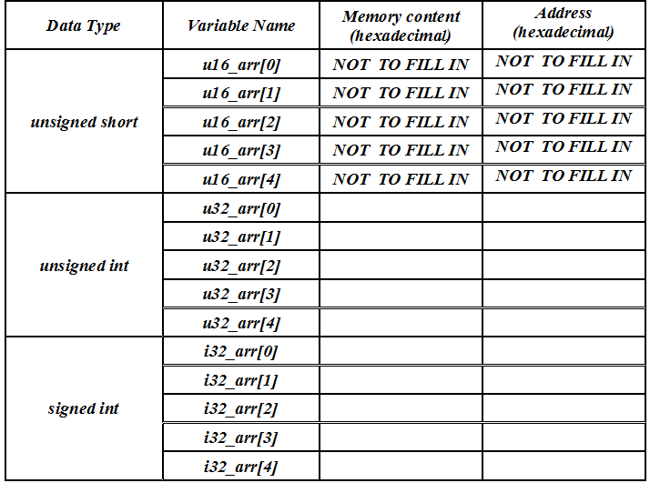
FILL IN TABLE 5.2 FOR 32-BITS UNSIGNED AND SIGNED ARRAY DATA ONLY USING DIRECT ADDRESSING MODE
Output from
5.1 unsigned
Output from
5.2 unsigned
and signed

Slide 17
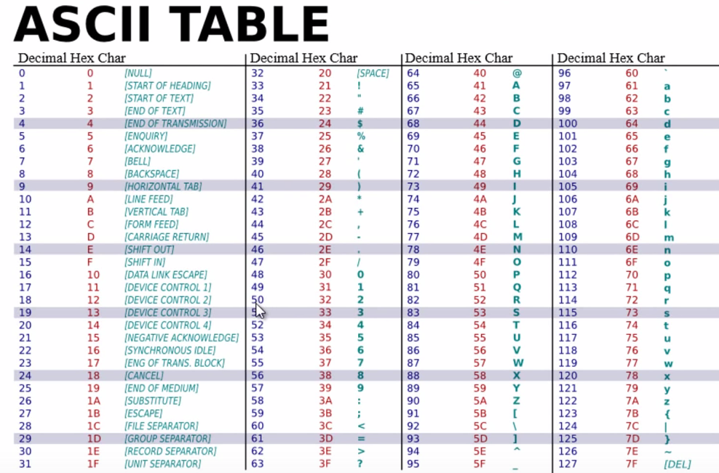
APPENDIX LECTURE CHAPTER No 02

Slide 18
STUDENTS’S ASSIGNMENT
EXAMPLE 5.2 FOR 32-BITS ONLY
The students should get one output console result for 32-bit
for unsigned and signed integer numbers.
Unsigned- Signed integer for 32-bits:
Hexadecimal and its bytes
Hexadecimal and its addresses
Total of 1 output console result.

Slide 19


Slide 20
Thanks

