Slide 1

LABORATORY No 3
Data Movement using General Purpose Registers and Memory(RAM)

Slide 2
STUDENTS’S ASSIGNMENT
EXAMPLE 3.3 FOR 8-BITS ONLY
ASSIGNING DATA BYTES AND THEN SWAPPING DATA BYTES USING temp MEMORY IN TWO GENERAL REGISTERS BL, BH USING LETTERS a, A.
ASSIGNING DATA BYTES AND THEN SWAPPING DATA BYTES USING XCHG IN TWO GENERAL REGISTERS OF BL, BH USING LETTERS a, A.
ASSIGNING DATA BYTES AND THEN SWAPPING DATA BYTES USING XCHG WITH CORRECTIONS IN TWO GENERAL REGISTERS OF AL, AH USING LETTERS b, B.

Slide 3
TO MAKE CORRECTION TO THE SECOND EXCHANGE “XCHG”
INSTRUCTION FOR
EXAMPLE 3.3 FOR 8-BITS, 16-BITS
_asm
{
XXX XX, XX;
XXX XX, XX;
XCHG AL, AH;
MOV r1, AL;
MOV r2, AH;
MOV r, AX;
}

Slide 4
DATA TRANSFER - REGISTER ADDRESSING
Objective:
Moving instructions involving data transfer and register addressing modes:
Register to Register …………………..MOV EAX, EBX
Immediate data to Register……….MOV EAX, 'd'
Direct memory to Register……….. MOV EAX, j
Indirect memory to Register……..MOV EAX, [EBX]
Register to Memory…………………. MOV j, EAX
Immediate data to Memory…….. MOV [EAX], 34
Remember MOV is not actually “moving data”
and you cannot move memory to memory.

Slide 5
HOW TO WRITE INSTRUCTIONS LAB_No_01
MOVING DATA: MOV EAX, EBX
MNEMONIC (OPERAND DESTINATION), (OPERAND SOURCE)
DESTINATION SOURCE
Mnemonic MOV instruction copies (loads) an operand
source 32-bit EBX register to an operand destination
32-bit EAX register.
The same way when using 8-bits and 16-bits registers
as operands.

Slide 6
HOW TO WRITE INSTRUCTIONS LAB_No_01
MOVING DATA: MOV EAX, J
MOV EAX, ‘A’
MNEMONIC (OPERAND DESTINATION), (OPERAND SOURCE)
DESTINATION SOURCE
Mnemonic MOV instruction copies (loads) an operand
source MEMORY variable J to an operand destination
32-bit EAX register.
Mnemonic MOV instruction copies (loads) an operand
source MEMORY character ‘A’ to an operand destination
32-bit EAX register.

Slide 7
HOW TO WRITE INSTRUCTIONS LAB_No_01
MOVING DATA: MOV EAX, [EBX]
MOV EBX, 34
MNEMONIC (OPERAND DESTINATION), (OPERAND SOURCE)
DESTINATION SOURCE
Mnemonic MOV instruction copies (loads) an operand
source MEMORY 32-bits EBX register to an operand
destination 32-bit EAX register.
Mnemonic MOV instruction copies (loads) an operand
source MEMORY number 34 to an operand destination
32-bit EBX register.

Slide 8
STUDENTS’ ASSIGNMENT
1. The students must find the missing AX = AH+AL and BX = BH+BL in the output results of examples 3.1 and 3.2 to use them in example 3.3.
2. The students must use letters a and b instead of i and j in example 3.3. The students must use the exchange format with the memory “temp” from the example 3.1 into example 3.3, by placing the instructions at the beginning.
4. Work on your laboratory report by showing your code without comments, code descriptions, flow chart, output console results, comments, and conclusion illustrating an real life application (for 20 points) using a template report posted on Blackboard, do not unlock the original report, otherwise, you lose 40 points.

Slide 9
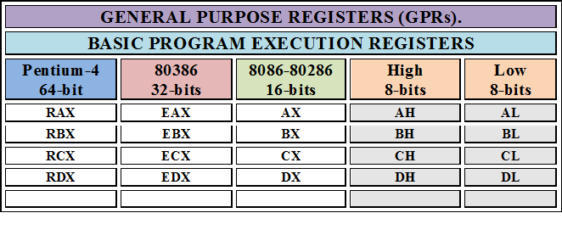
GENERAL PURPOSE REGISTERS

Slide 10
REGISTER ADDRESSING DATA
GPRs | Reg. to Reg. | Imm. to Reg. | Dir. Mem. to Reg.
EAX,EBX,ECX,EDX | MOV EAX, EBX | MOV EAX, 44 | MOV EAX, j | a, b, …,j A, B,….J
AX,BX,CX,DX | MOV AX, BX | MOV AX, 44h | MOV AX, A
AL,BL,CL,DL | MOV AL, BL | MOV AL, ‘a’ | MOV AL, temp | a, b, …,j
AH,BH,CH,DH | MOV AH, BH | MOV AH, ‘A’ | MOV BH, temp | A, B,….J
GPRs | Reg. to Mem. | Imm. to Mem | Mem to Mem[No]
EAX,EBX,ECX,EDX | MOV A, ECX | MOV [ECX], 21 | MOV a, 21 | a, b, …,j A, B,….J
AX,BX,CX,DX | MOV [a], CX | MOV [EBX], 41h | MOV [AX], [BX]
AL,BL,CL,DL | MOV temp, AL |  | MOV temp, [AH] | a, b, …,j
AH,BH,CH,DH | MOV temp, AH |  | MOV temp, 0xAC | A, B,….J

Slide 11
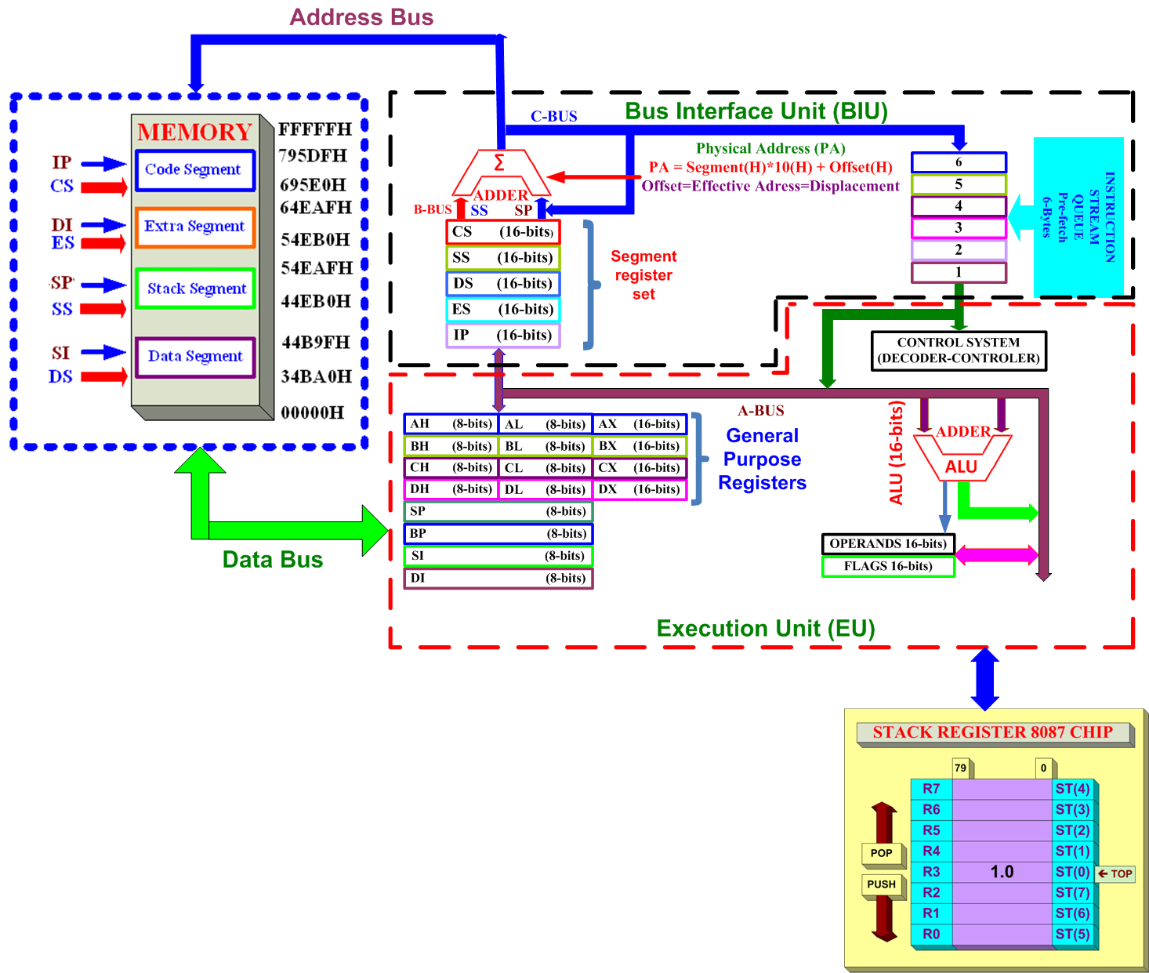
CPU ARCHITECTURE

Slide 12
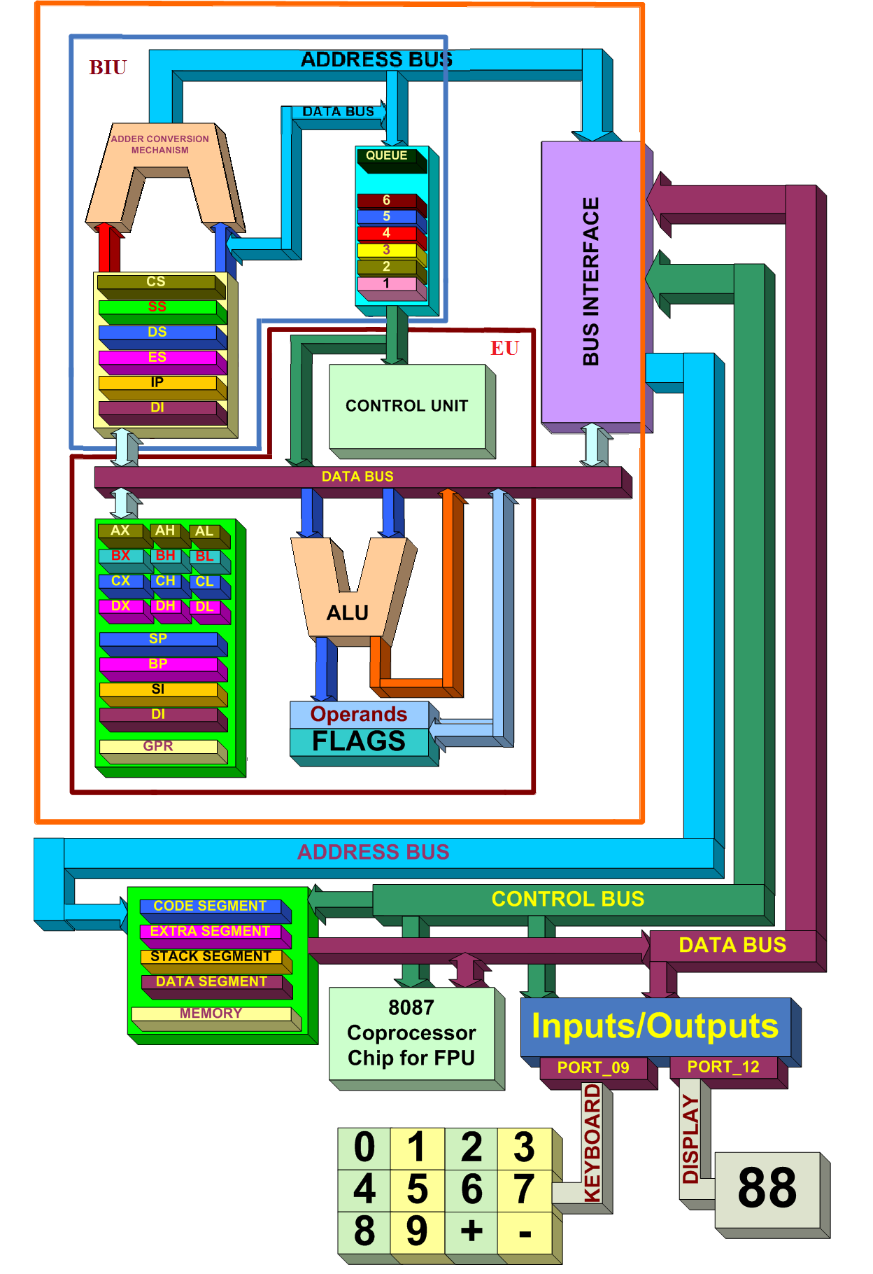
CPU ARCHITECTURE

Slide 13
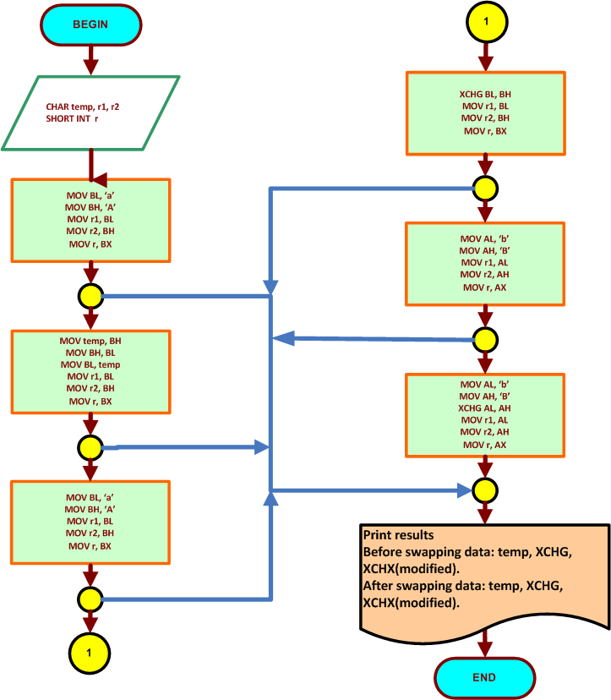
FLOWCHART FOR THE EXAMPLE 3.3 FOR 8-BITS ONLY

Slide 14
STUDENTS’S ASSIGNMENT RESULT
EXAMPLE 3.3 FOR 8-BITS ONLY.
The students should get one output result operation
Console result contains: One for temp
One for XCHG
One for XCHG with Corrections
Total of 1 outputs

Slide 15


Slide 16
Thanks

