Slide 1

LABORATORY No 9
Bit Manipulation and Mask Design using bitwise AND, OR, XOR, NOT, SHL, SHR, ROL, and ROR to pack and unpack bit strings

Slide 2
Bitwise instructions to manipulate bits
Bitwise AND operation CLEAR bits.
Bitwise OR operation SET bits.
Bitwise XOR operation INVERT bits.
Bitwise NOT operation TOGGLE or EXTRACT bits.
Bitwise SHL operation shift bits left.
Bitwise SHR operation shift bits right.
Bitwise ROL operation rotate bits left.
Bitwise ROR operation rotate bits right.

Slide 3
x86 family overlays bits registers:
The 64-bit register overlays with the 32-bit registers
The 32-bit register overlays with the 16-bit registers
The 16-bit register overlays with the 8-bit registers

Slide 4
Comparison operators in C++
  == equal
  != not equal
  < less than
  > greater than
  <= less than or equal
  >= greater than or equal
Boolean operators in C++
  && and
  || or
  ! not

Slide 5
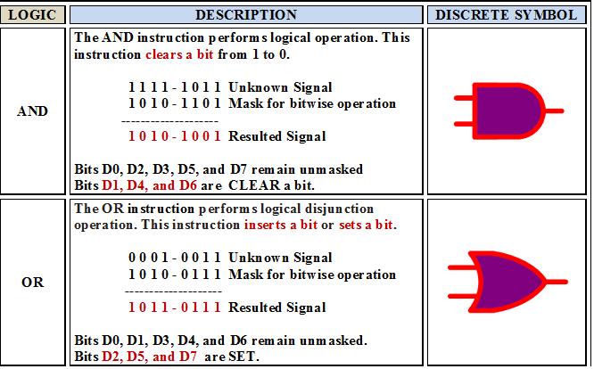

Slide 6
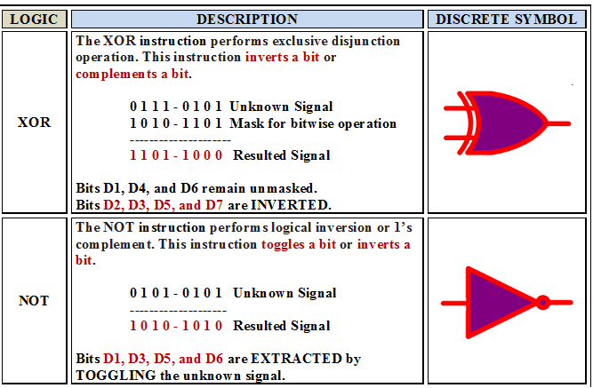

Slide 7
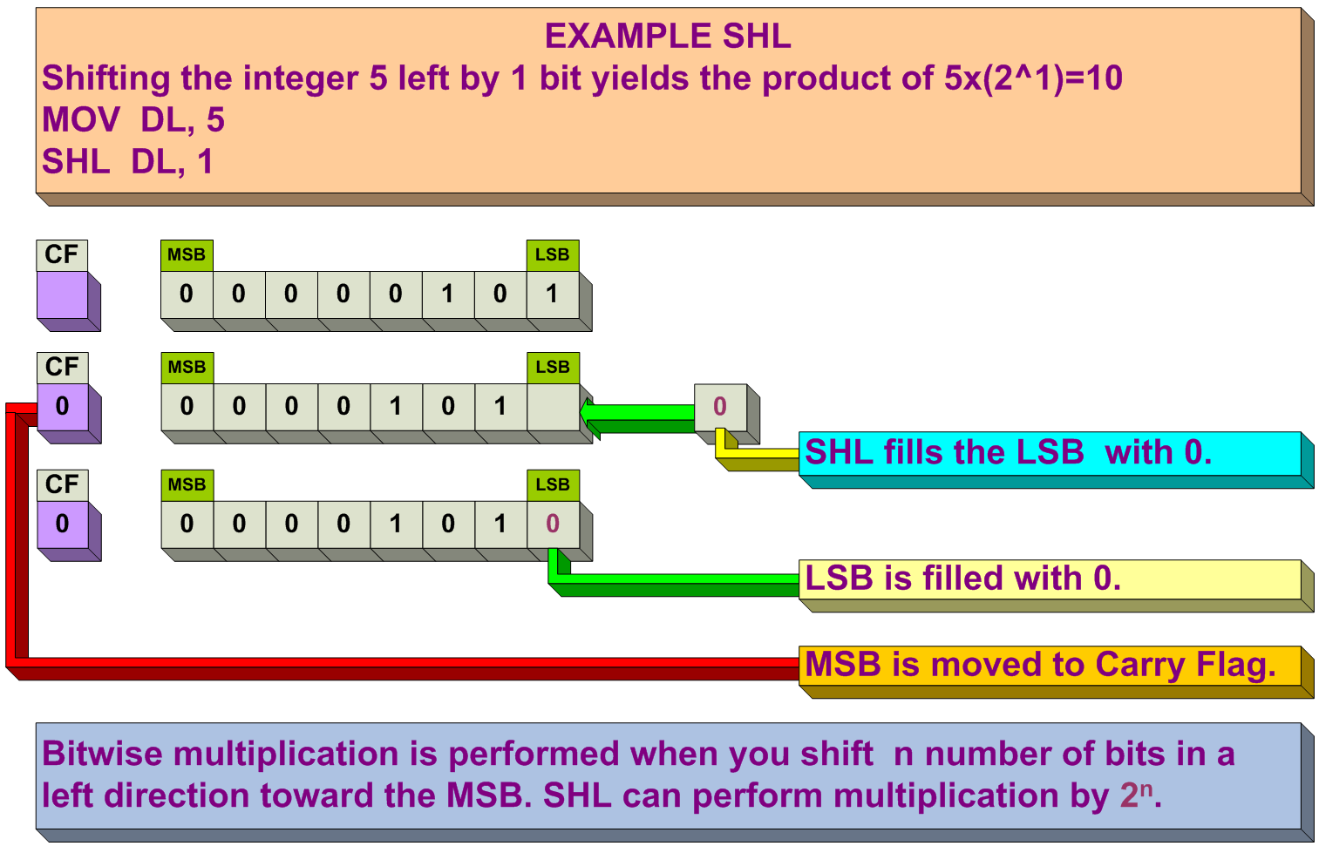

Slide 8
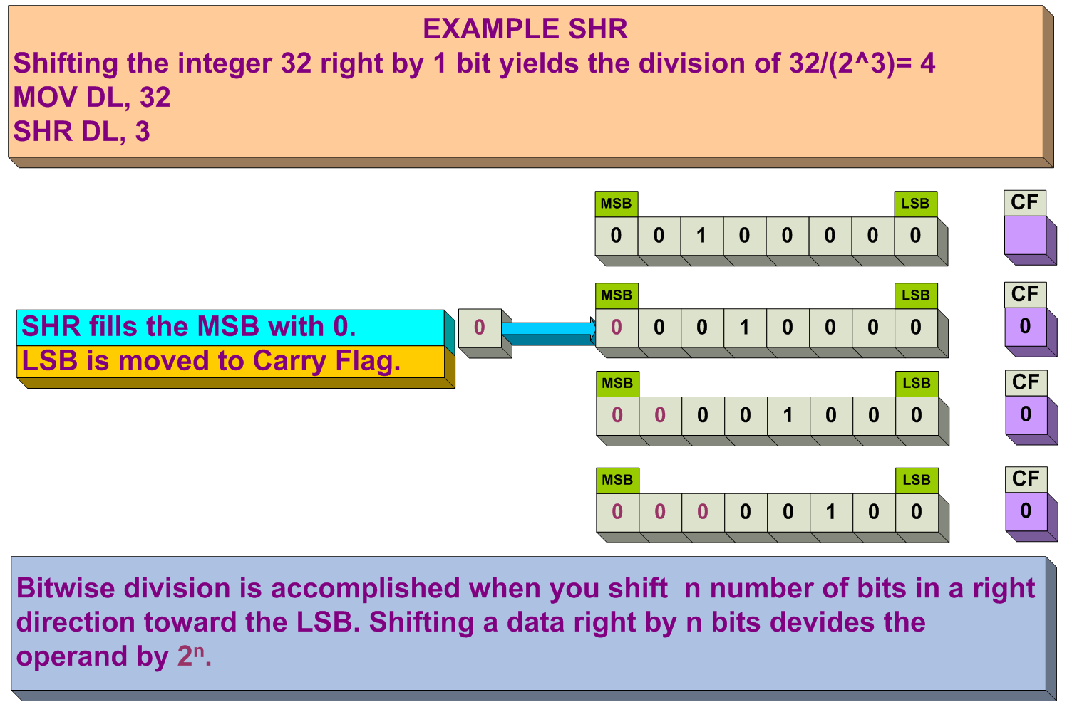

Slide 9
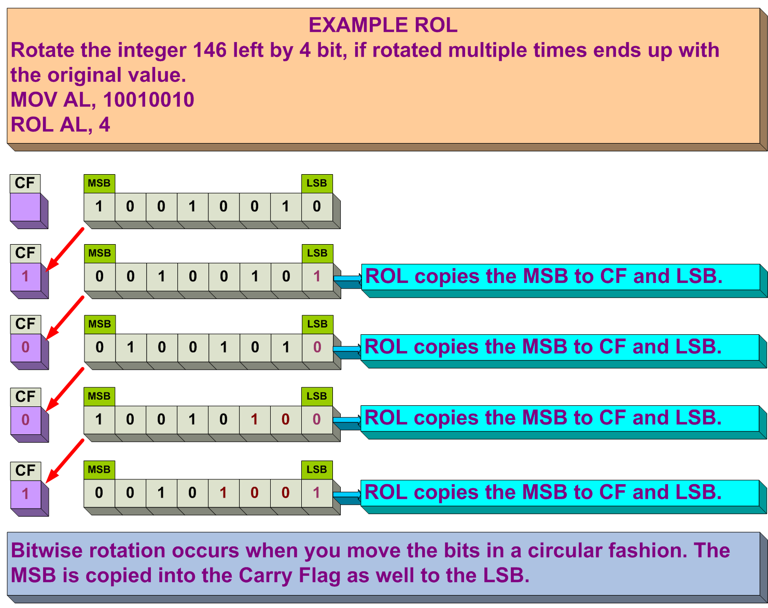

Slide 10
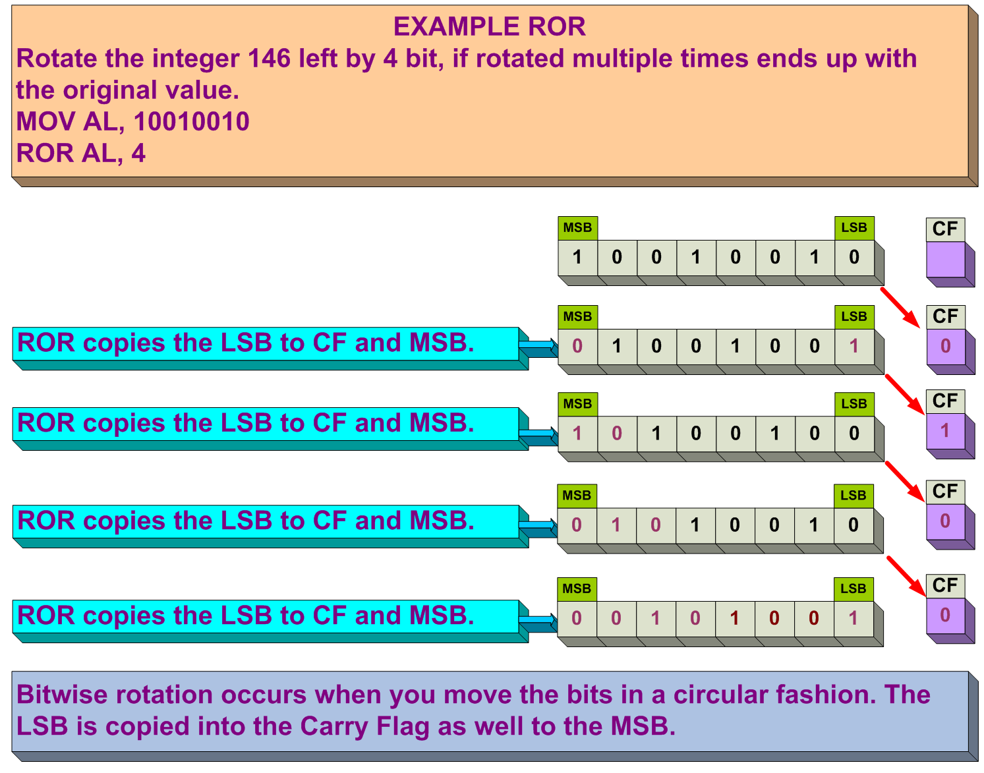

Slide 11
LAB No 09 EXAMPLE No 9.1
For your final report presentation:
The example 9.1 is to be developed by the students in order to display month, day, and year.
Example 9.1 is for 16-bit register to determine month, day, and year.

Slide 12

For your final report presentation:
Example 9.1 is for 16-bit registers for moth, day, year

Slide 13
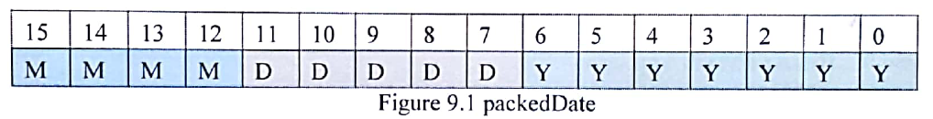
LABORATORY No 9 EXAMPLE 9.1 FOR 16-BIT MOTH, DAY, YEAR
bitset<8> monthBits(month); //Convert month to an 8-bits binary to store
cout << "month bits: \t" << monthBits << endl; //Displays the value in binary
bitset<8> dayBits(day); //Convert day to an 8-bits binary to store
cout << "day bits: \t" << dayBits << endl; //Displays the value in binary
bitset<8> yearBits(year); //Convert year to an 8-bits binary to store
cout << "year bits: \t" << yearBits << endl; //Displays the value in binary

Slide 14
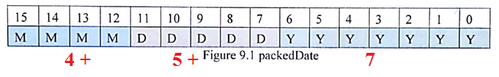
LABORATORY No 9 EXAMPLE 9.1 FOR 16-BIT MOTH, DAY, YEAR
TO PACK THE INFORMATION FOR DATE 4/15/99 ONLY
_asm
{
mov EBX = 0 //To initialize 32-bit EBX register to zero
mov BL, month; //loads memory variable month into 8-bit BL
shl BX, 5; //shifts left 5 times in 32-bit BX register
or BL, day; //perform OR logic operation with variable day
shl BX, 7; //shift left 7 times in 32-bit BX register
or BL, year; //perform OR logic operation with memory variable year
mov packedDate, BX; //loads BX register to packedDate variable.
}

Slide 15
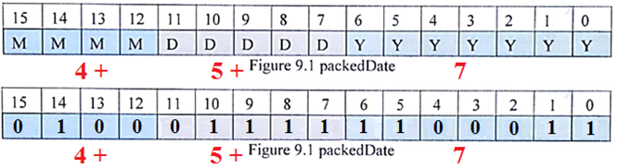
LABORATORY No 9 EXAMPLE 9.1 FOR 16-BIT MOTH, DAY, YEAR
PACKING THE INFORMATION FOR DATE AS 4/15/99 IN A 16-BIT FORMAT
_asm
{
mov month, X; X = …………….0000_0000_0000_0100 = 0004
mov day, Y; Y = …………….0000_0000_0000_1111 = 000F
mov year, Z; Z = …………….0000_0000_0110_0011 = 0063
mov EBX, 0 EBX = …………….0000_0000_0000_0000 = 0000
mov BL, month; EBX = …………….0000_0000_0000_0100 = 0004
shl BX, 5; EBX = …………….0000_0000_1000_0000 = 0080
mov day, Y; Y = …………….0000_0000_0000_1111 = 000F
or BL, day; EBX = …………….0000_0000_1000_1111= 008F
shl BX, 7; EBX = ……………..0100_0111_1000_0000 = 4780
mov year, Z; Z = …………...0000_0000_0110_0011 = 0063
or BL, year; EBX = …………….0100_0111_1110_0011 = 47E3
mov packedDate, BX; EBX = …………….0100_0111_1110_0011 = 47E3 .
}

Slide 16
LABORATORY No 9 EXAMPLE 9.1 FOR 16-BIT MOTH, DAY, YEAR
UNPACKING THE INFORMATION FOR A DATE AS 4/15/99
_asm
{
mov EAX, 0 //To initialize 32-bit EAX register to zero
mov AX, packedDate; //loads packedDate into 16-bit AX register
and AX, 0xf000; //perform AND logic operation with variable 0xf000 and AX
rol AX, 4; //rotates the value in 16-bit AX register 4 times to the left
mov months, AL; //loads 8-bit AL register to memory variable months
mov AX, packedDate; //loads packedDate into 16-bit AX register
and AX, 0x0f80; //perform AND logic operation with variable 0x0f80 and AX
ror AX, 7; //rotates the value in 16-bit AX register 7 times to the left
mov days, AL; //loads 8-bit AL register to memory variable days
mov AX, packedDate; //loads packedDate into 16-bit AX register
and AX, 0x007f; //perform AND logic operation with variable 0x007f and AX
mov years, AL; //loads 8-bit AL register to memory variable years
}

Slide 17
LABORATORY No 9 EXAMPLE 9.1 FOR 16-BIT MOTH, DAY, YEAR
UNPACKING THE INFORMATION FOR DATE AS 4/15/99
_asm
{
mov EAX, 0 EAX = …………….0000_0000_0000_0000
mov AX, packedDate; EAX = …………….0100_0111_1110_0111 = 47E3
and AX, 0xf000; EAX = …………….0100_0000_0000_0000 = 4000 AND CLEAR
rol AX, 4; EAX = …………….0000_0000_0000_0100 = 0004
mov months, AL; EAX = …………….0000_0000_0000_0100 = 0004 = 4 MONTH
mov AX, packedDate; EAX = …………….0100_0111_1110_0111 = 47E3
and AX, 0x0f80; EAX = …………….0000_0111_1000_0000 = 0780 AND CLEAR
ror AX, 7; EAX = …………….0000_0000_0000_1111 = 000F
mov days, AL; EAX = …………….0000_0000_0000_1111 = 000F = 15 DAY
mov AX, packedDate; EAX = …………….0100_0111_1110_0111 = 47E3
and AX, 0x007f; EAX = …………….0000_0000_0110_0011 = 0063
mov years, AL; EAX = …………….0000_0000_0110_0011 = 0063 = 99 YEAR
}

Slide 18
LABORATORY No 9 EXAMPLE 9.1 FOR 16-BIT MOTH, DAY, YEAR
UNPACKING THE INFORMATION FOR DATE AS 4/15/99
mov AX, packedDate; EAX = …………….0100_0111_1110_0011 = 47E3
0xf000; EAX = …………….1111_0000_0000_0000 = F000
and AX, 0xf000; EAX = …………….0100_0000_0000_0000 = 4000 AND CLEAR
rol AX, 4; EAX = …………….0000_0000_0000_0100 = 0004
mov months, AL; EAX = …………….0000_0000_0000_0100 = 0004
mov AX, packedDate; EAX = …………….0100_0111_1110_0011 = 47E3
0x0f80; EAX = …………….0000_1111_1000_0000 = 0F80
and AX, 0x0f80; EAX = …………….0000_0111_1000_0000 = 0780 AND CLEAR
ror AX, 7; EAX = …………….0000_0000_0000_1111 = 000F
mov days, AL; EAX = …………….0000_0000_0000_1111 = 000F = 15 DAY
mov AX, packedDate; EAX = …………….0100_0111_1110_0011 = 47E3
0x007f; EAX = …………….0000_0000_0111_1111 = 007F
and AX, 0x007f; EAX = …………….0000_0000_0110_0011 = 0063 AND CLEAR
mov years, AL; EAX = …………….0000_0000_0110_0011 = 0063 = 99 YEAR

Slide 19
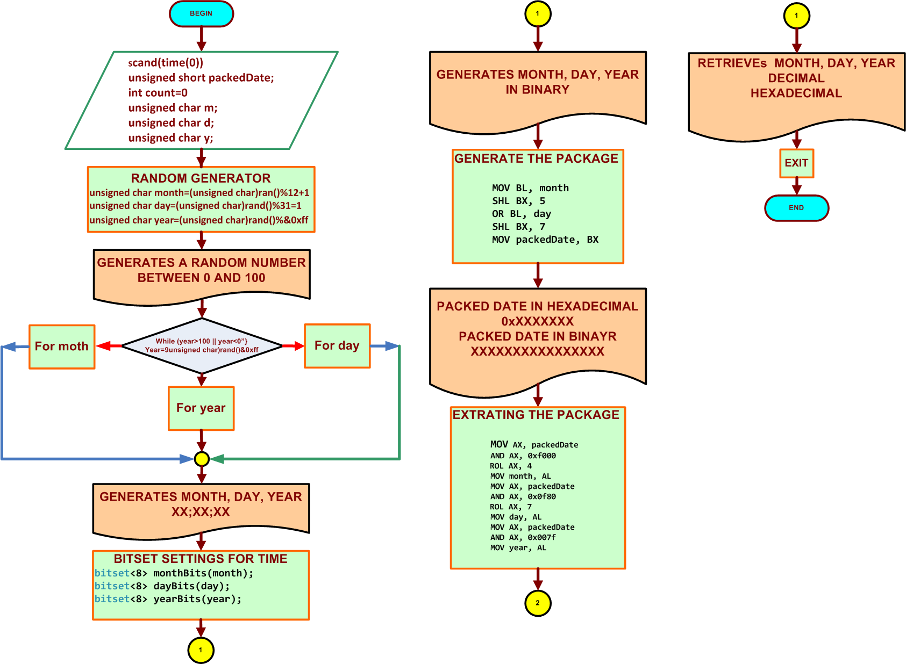
FLOWCHART FOR LABORATORY 9 EXAMPLE 9.1

Slide 20
STUDENTS’S ASSIGNMENT
FOR LABORTORY 9.1 MANIPULATION AND MASK DESIGN
The students should get ONE console output result operations using :
Bitwise AND, OR, XOR, NOT
Bitwise SHL, SHR, ROL, ROR
Total of 1 outputs

Slide 21
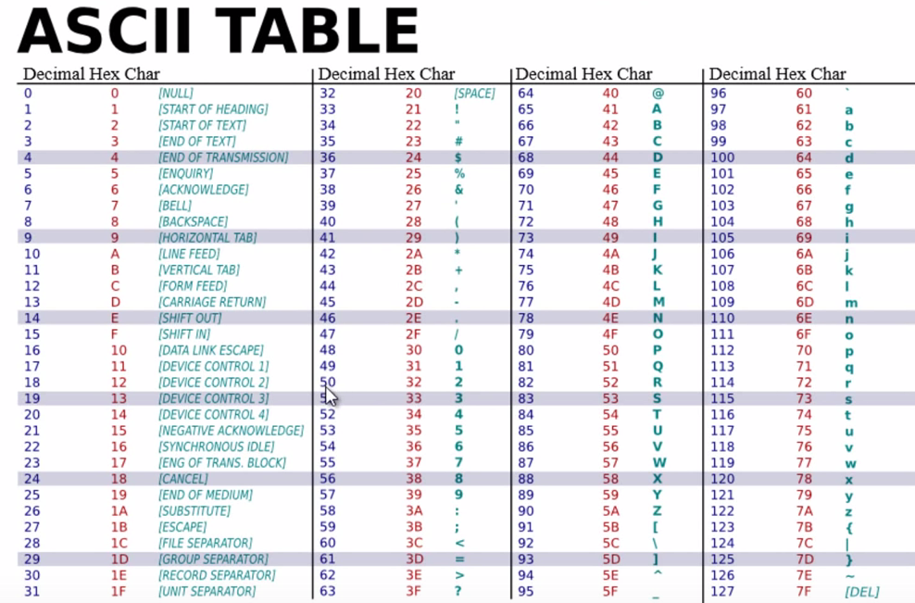

Slide 22


Slide 23
Thanks

