Slide 1
HACKATHON 2021
Project: Random Story Generator
CH. Asha Jyothi

Slide 2
Project Overview
The project aims to generate a random story each time the user runs the program. The story is constructed from predefined lists of components like characters, settings, and situations.

Slide 3
Technology Stack
1. Python for story generation
2. HTML for front-end (if applicable)
3. Google Colab for running the code
4. Random module to select story parts
5. If-else statements for story logic

Slide 4
Process
1. Story parts (characters, settings, etc.) are stored in lists.
2. User inputs their name and chooses whether they want another story.
3. The random module selects story parts to generate a complete story.
4. The program outputs the story with the user's name and asks if they want to hear another.

Slide 5
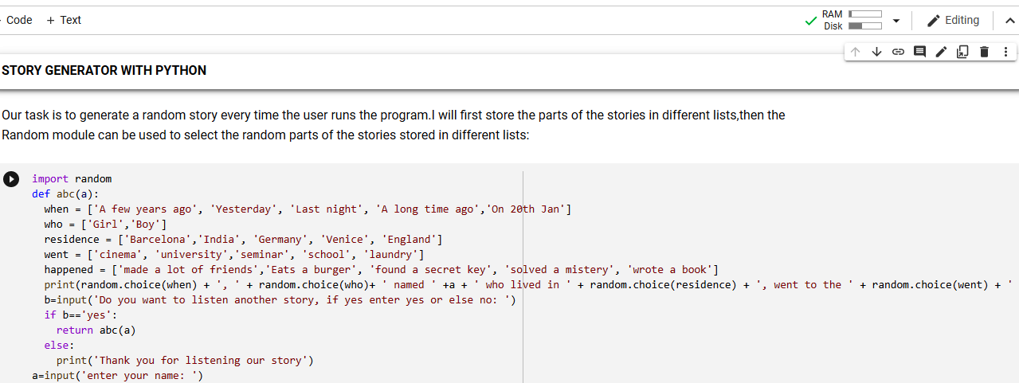

Slide 6
Sample Output
Here is an example of a story generated by the program:
'Once upon a time, John traveled to a mystical forest and encountered a wise old owl. They embarked on an exciting adventure.'

Slide 7
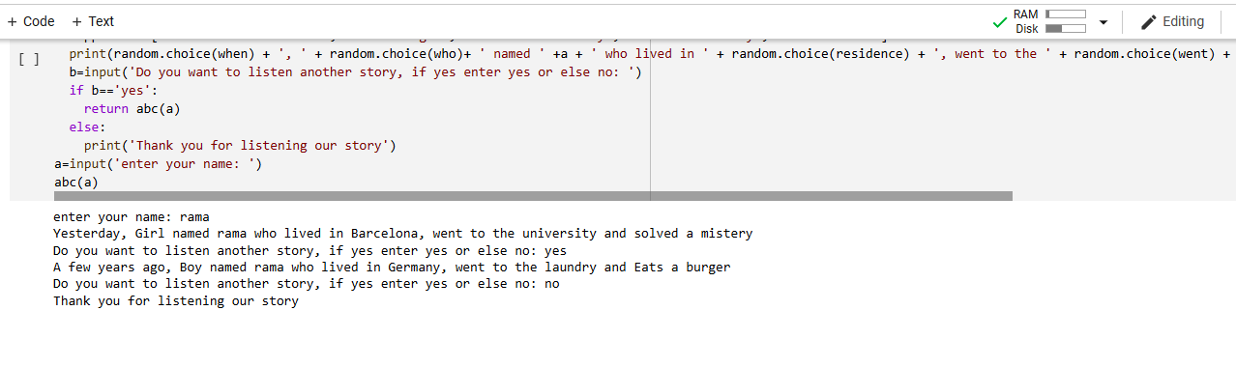

Slide 8
Thank You

