Slide 1
Rails assignment
And fun ways to give up

Slide 2
What is my app
Irritating
Language Exchange
Connects users via chatrooms
Send text messages and images
Satisfying to complete

Slide 3
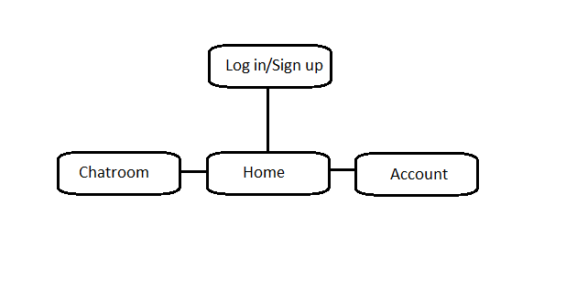
Sitemap

Slide 4
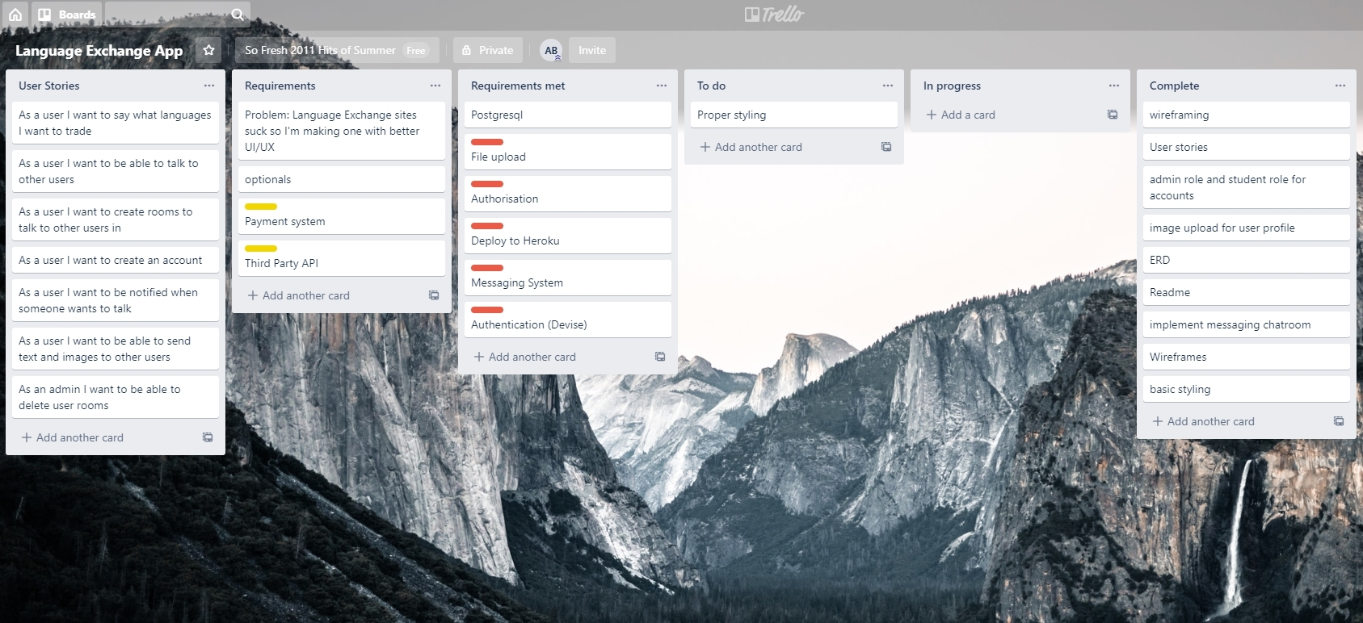
Trello

Slide 5
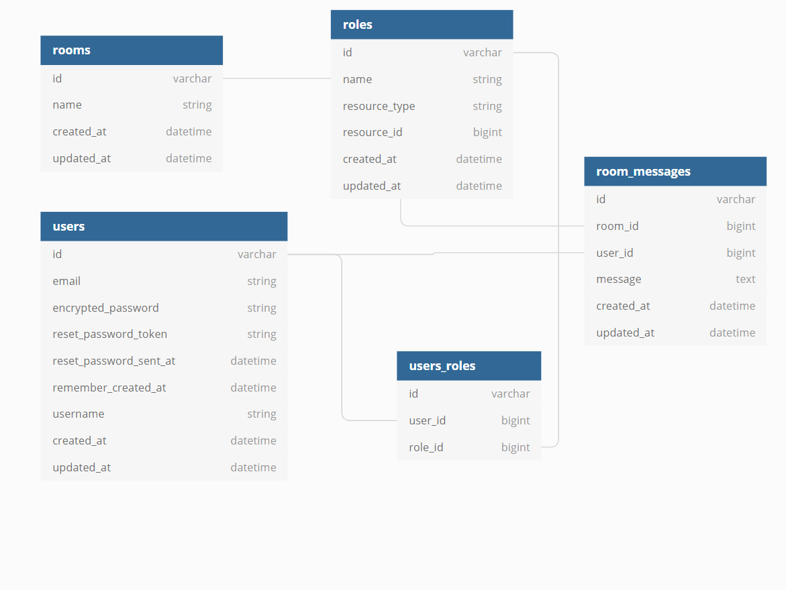
erd

Slide 6
Bulma vs bootstrap vs sanity
I used a combination of bulma and bootstrap to ruin everything
I gave up
Sorry
:(

