Slide 1

Using Digital Tools
to Improve My
Learning Workflow
Student Name: MK. Ashan Virantha
Student ID: PSBUC/DIP/ICT/SL/26/LC/0020
Diploma in ICT | Assignment 01
March 2026
ICT Diploma | Luxway Campus

Slide 2
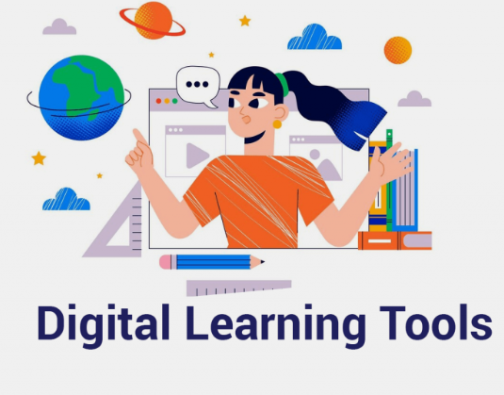
Introduction
Slide 2 of 8
What Is This Presentation About?
In this presentation I will explain: • What digital tools I use for studying
• How I organise my learning workflow
• A comparison of the main tools
• Benefits and challenges I found
• How I used AI tools responsibly
• My personal recommendations
ICT Foundations & Digital Productivity | Assignment 01

Slide 3




My Learning Workflow
Slide 3 of 8
4 Steps I Follow Every Time I Have an Assignment
1
Plan
2
Research
3
Write
4
Submit
Use Notion &
Google Calendar
to set deadlines
Google Scholar,
AI tools to
understand topics
Microsoft Word,
Grammarly to
produce the work
ZIP file, upload
to student portal,
cloud backup
ICT Foundations & Digital Productivity | Assignment 01

Slide 4
Tools Comparison
Slide 4 of 8
Digital Tools I Use and Why
Tool | What I Use It For | Cost | My Rating
Microsoft Word | Writing reports & assignments | Paid (MS365) | ⭐⭐⭐⭐⭐
Google Docs | Group work & sharing with class | Free | ⭐⭐⭐⭐
Notion | Planning & organising notes | Free | ⭐⭐⭐⭐⭐
Canva, Photoshop, Illustrator | Making posters & slides | Free / Subscription | ⭐⭐⭐⭐
Grammarly, | Checking grammar in my writing | Free / Subscription | ⭐⭐⭐⭐
Claude , ChatGPT, Gemini, Deepseek, Grok, Perplexity | Understanding difficult topics | Free / Subscription | ⭐⭐⭐⭐
GitHub | Storing, Hosting & sharing my code | Free | ⭐⭐⭐
ICT Foundations & Digital Productivity | Assignment 01

Slide 5
Benefits
Slide 5 of 8
How Digital Tools Help Me Study Better
📅
Stay Organised
✍️
Write Better
I never miss a deadline because I use Notion and Google Calendar to track everything.
Grammarly catches my grammar mistakes automatically before I submit.
🤝
Work Together
💡
Learn Faster
Google Docs lets me collaborate with classmates in real time from anywhere.
AI tools like Claude help me understand complex topics quickly and clearly.
☁️
Access Anywhere
🎨
Look Professional
Cloud storage means my files are always backed up and available on any device.
Canva and PowerPoint help me create designs that look polished and well-structured.
ICT Foundations & Digital Productivity | Assignment 01

Slide 6
Challenges
Slide 6 of 8
Problems I Faced & How I Solved Them
⚠️ Challenges
✅ My Solutions
✗ Too many apps can be confusing
✓ Stick to 3-4 main tools only
✗ Some tools cost money (subscriptions)
✓ Use free versions wherever possible
✗ AI can give wrong answers sometimes
✓ Always check AI answers with sources
✗ Need internet for most tools to work
✓ Download files & work offline when needed
✗ Easy to get distracted by notifications
✓ Turn off notifications while studying
ICT Foundations & Digital Productivity | Assignment 01

Slide 7

Responsible AI Use
Slide 7 of 8
How I Used AI Tools in This Assignment
What I DID and DID NOT Do
✓ Used AI to understand difficult concepts
✓ Rewrote everything in my own words
✓ Verified AI answers with real sources
✓ Declared my AI use honestly
✗ Copy-pasted AI text directly
✗ Submitted AI work as my own
ICT Foundations & Digital Productivity | Assignment 01

Slide 8
Key Takeaways
1
Digital tools make studying more organised and efficient
2
The right tools help produce professional, high-quality work
3
AI is a helpful assistant — but the thinking must be your own
4
Cloud storage keeps work safe and accessible anywhere
5
Developing these skills now prepares me for an ICT career
Thank You
Ashan Virantha

