Slide 1







HYPER-LOCAL
AVIATION WEATHER FORECAST VERIFICATION SYSTEM FOR SRI LANKAN MONSOON PATTERNS
30°C
MAX. 31°C - MIN.15°C
SLIIT
Faculty of Computing
R26-IT-132
20%
15 KM/H
WEST
1023.0 MB

Slide 2
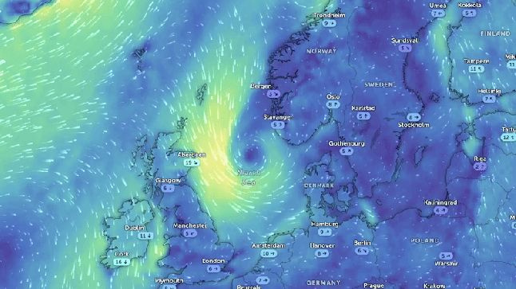
BACKGROUND
Weather forecasting plays a critical role in aviation safety and operational decision-making. Pilots depend on aviation weather reports such as TAF and METAR to obtain atmospheric conditions before take-off and landing
PROBLEM
Most aviation weather forecasting systems rely on global models such as GFS and ECMWF, which provide large-scale forecasts but often miss local airport weather variations.
30°C
SLIIT
Faculty of Computing
MAX. 31°C - MIN.15°C
R26-IT-132
20%
15 KM/H
WEST
1023.0 MB

Slide 3
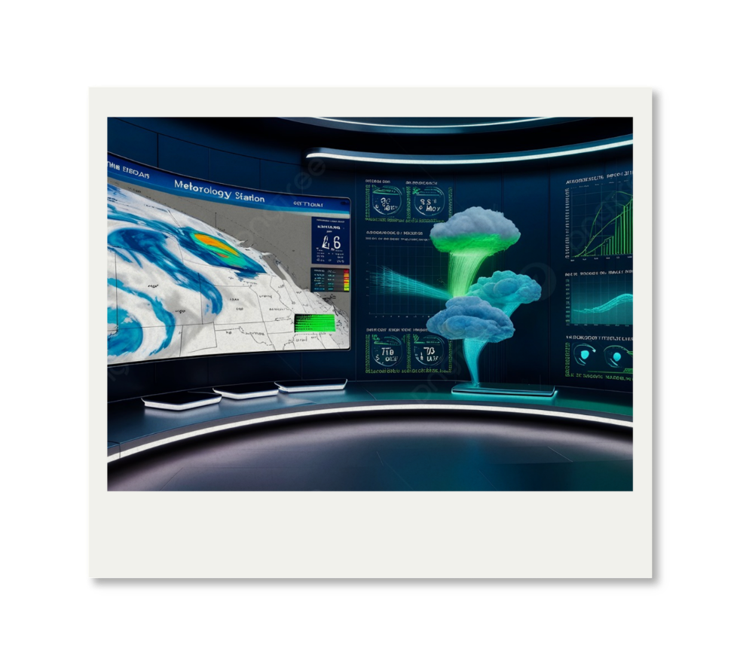
THE PROPOSED SOLUTION
  Microclimate aviation weather prediction system
  Predict the next 3 hours weather data
  This system works as an aviation weather verification system
  Provides automated weather verification
support for forecasters and pilots
SLIIT
Faculty of Computing
R26-IT-132

Slide 4
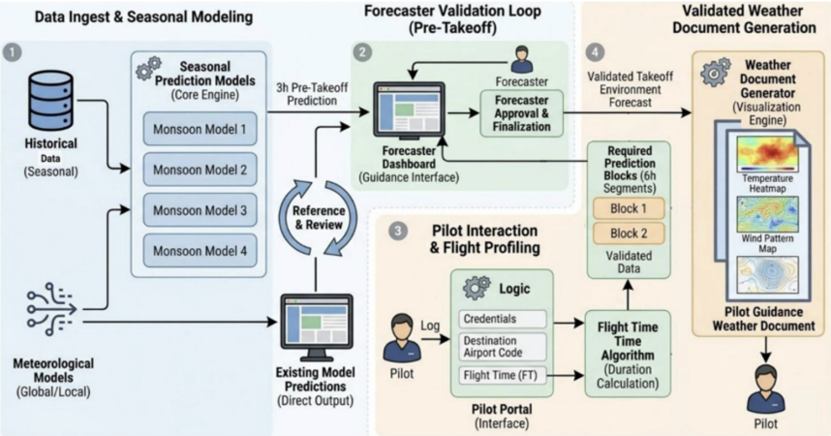
SYSTEM ARCHITECTURE
SLIIT
Faculty of Computing
R26-IT-132

Slide 5

SANKADEEPA W.D.I
IT22113986
Pressure-Temperature Coupled Prediction Model
NORTH EAST MONSOON
SLIIT
Faculty of Computing
R26-IT-132
Specialization: Information Technology

Slide 6
PRESSURE-TEMPERATURE COUPLED PREDICTION MODEL
Sub Problem
Solutions
Existing large-scale forecasting systems are Fail for Larage scale prediction for temperature and pressure during North-East Monsoon conditions at BIA airport.
  Uses AI-based coupled prediction for 3-hour temperature and pressure forecasting.
  Uses hyper-local microclimate aviation weather data.
  Integrates METAR and TAF verification support.
  Supports short-term aviation weather forecasting.
User Requirements
Design Excellence / Contribution
  Accurate 3-hour weather prediction
  Reliable forecast verification
  Short-term aviation weather monitoring
  Better operational decision-making
  Applied hyperparameter tuning to improve prediction accuracy
  Implemented a coupled prediction mechanism for temperature and pressure
  Performed feature engineering using lag-based and rolling statistical features
  Integrated METAR and TAF based forecast verification support
SLIIT
Faculty of Computing
IT22113986
Sankadeepa W.D.I
R26-IT-132

Slide 7
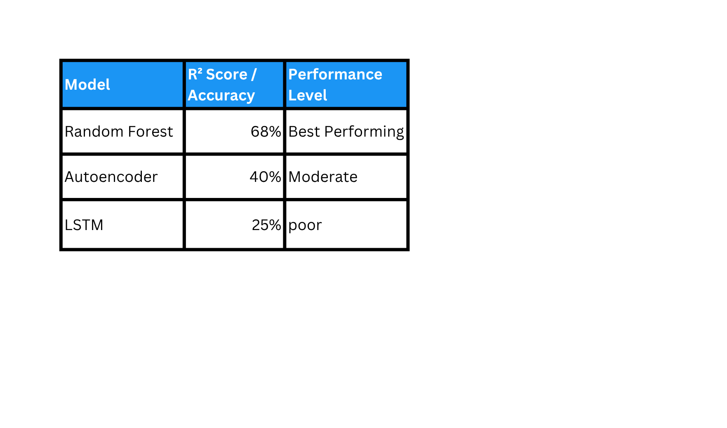

PRESSURE-TEMPERATURE COUPLED PREDICTION MODEL
User Feedback on Prototype
  The prototype improved understanding of temperature and pressure trend analysis during North-East Monsoon conditions.
  Users suggested integrating live aviation weather data in future versions.
  System improved view of Temp and pressure trend analysis
  Prototype demonstrated practical support for forecast verification
Technologies
  Python
  Scikit-Learn
  TensorFlow/Keras
  Random Forest
  LSTM
  Pandas & NumPy
SLIIT
Faculty of Computing
IT22113986
Sankadeepa W.D.I
R26-IT-132

Slide 8

Ranasinghe R.A.A.D.
IT22269720
Wind Pattern Prediction Model for
Southwest Monsoon
SLIIT
Faculty of Computing
Specialization: Information Technology
R26-IT-132

Slide 9
Wind Pattern Prediction Model
(speed and direction)
Solutions
Sub Problem
Global models fail to detect rapid wind speed and direction changes at Bandaranaike International Airport, affecting aviation safety under changing climate conditions.
  train ML models to predict short-term wind direction and speed using Micro Climate data
  Converts predicted wind data into headwind and crosswind components.
  Provides runway-oriented aviation weather guidance.
User Requirements
Design Excellence
  short-term wind speed and wind direction prediction
  Runway-oriented headwind and crosswind calculetion
  Forecast verification using METAR and TAF aviation weather reports
  Real-time monitoring of rapidly changing wind conditions
  create automating weather report generation and delivery process
  implement the different model using the different algorithms.
  Applied hyperparameter tuning to improve wind prediction accuracy and model performance (using GridSearchCV/RandomizedSearchCV)
  use formulas for calculete wind prediction mechanism for crosswind and headwind analysis
  Develop an automatic model retraining pipeline
SLIIT
Faculty of Computing
IT22269720
Ranasinghe R.A.A.D.
R26-IT-132

Slide 10
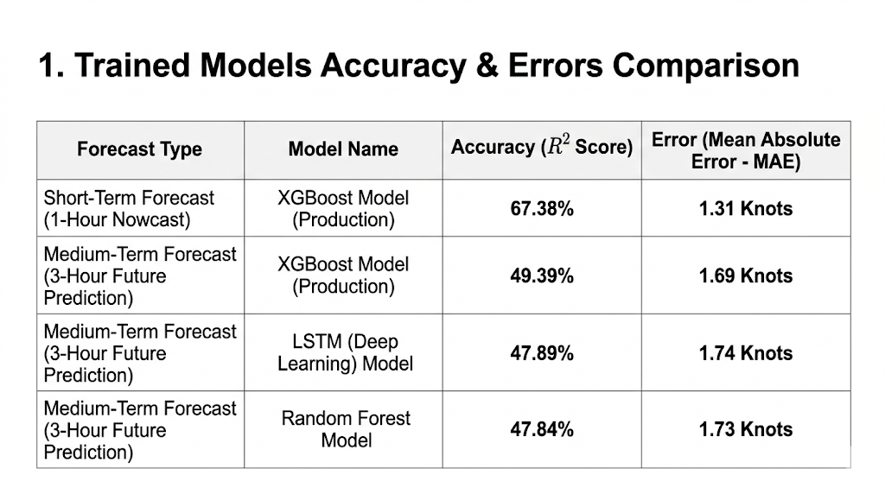
Wind Pattern Prediction Model
(speed and direction)
User Feedback on Prototype
  requested clearer visualization of wind speed ,crosswind and hedwind individual colums
  Users suggested integrating live aviation weather data APi.
  suggested creating an automated pipeline to retrain ML model monthly
  Prototype demonstrated practical support for forecast verification
  suggested using the last 3-6h data as input for the prediction models.
Technologies Used
PERFORMANCE BENCHMARK METRICS
  Python
  Scikit-Learn (random forest)
  Random Forest
  LSTM
  Pandas & NumPy
  mstplotlib
SLIIT
Faculty of Computing
IT22269720
Ranasinghe R.A.A.D.
R26-IT-132

Slide 11

Jayawardhana H.M.S.I
IT22619976
Cloud and Visibility Prediction Model for aviation Safety
First Inter-Monsoon period
SLIIT
Faculty of Computing
R26-IT-132

Slide 12
CLOUD AND VISIBILITY PREDICTION MODEL FOR AVIATION SAFETY-FIRST INTER MONSOON PERIOD.
Solution Addresses the Sub-Problem / Prototype
Sub Problem
Solutions
  Uses models to predict visibility and cloud conditions.
  Analyzes METAR weather data to identify rapid weather changes.
  Helps pilots and make safer take-off decisions.
  Provides early warnings for low visibility conditions.
  Improves local airport weather prediction accuracy.
Rapid visibility and cloud changes during the
First Inter-Monsoon period
are difficult to predict accurately at BIA airport.
User Requirements
Design Excellence / Contribution
  Accurate visibility and cloud prediction
  Real-time weather monitoring support
  Safer take-off operations at BIA
  Better local weather forecasting
  Compared Random Forest, XGBoost, and Decision Tree models
  Used weather factors like RH%, Temperature, and QNH
  Applied automated data cleaning and preprocessing
  Improved prediction accuracy using AI techniques
SLIIT
Faculty of Computing
IT22619976
Jayawardhana H.M.S.I
R26-IT-132

Slide 13
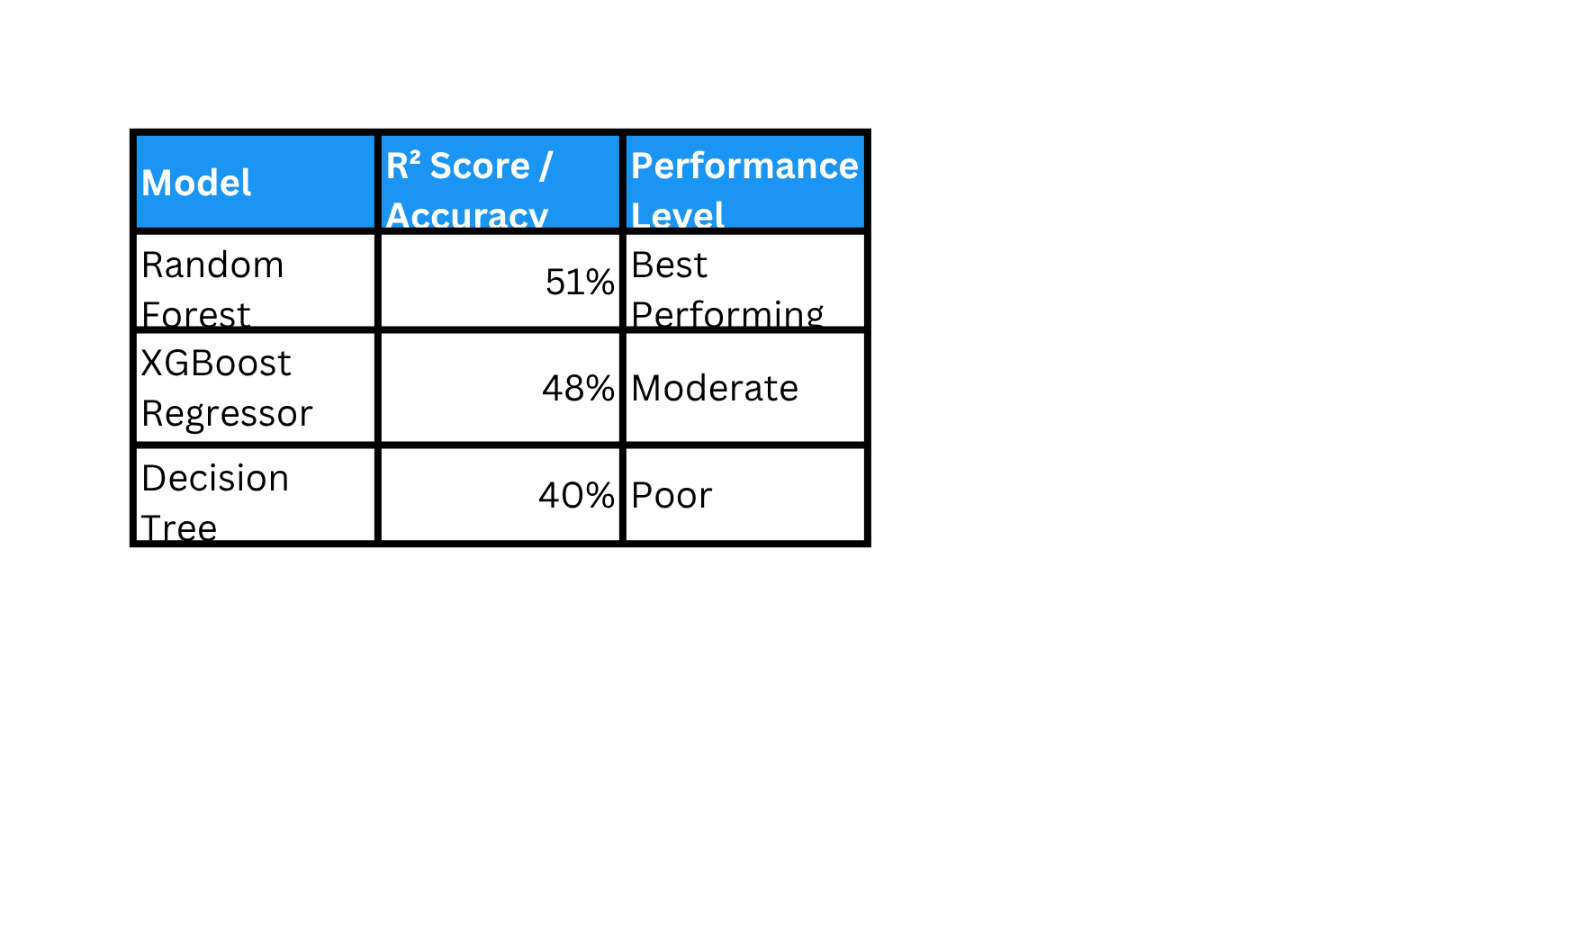
CLOUD AND VISIBILITY PREDICTION MODEL FOR AVIATION SAFETY-FIRST INTER MONSOON PERIOD.
User Feedback on Prototype
  The system helped identify sudden weather changes
  It improved visibility and cloud analysis
  Users found the AI verification useful
  Suggested adding live METAR data in future versions
Technologies
  Python
  Scikit-Learn
  XGBoost
  Random Forest
  Pandas & NumPy
SLIIT
Faculty of Computing
IT22619976
Jayawardhana H.M.S.I
R26-IT-132

Slide 14

Jayathilaka P.K.V.K
IT22069504
Relative Humidity & QNH Stability Prediction Model
Second Inter-Monsoon
SLIIT
Faculty of Computing
R26-IT-132

Slide 15
RELATIVE HUMIDITY & QNH STABILITY PREDICTION MODEL FOR AVIATION SAFETY-SECOND INTER MONSOON PERIOD.
Solution Addresses the Sub-Problem / Prototype
Sub Problem
Solutions
  Uses AI models to predict QNH and RH conditions.
  Analyzes METAR weather data to identify rapid weather changes.
  Helps pilots and make safer take-off decisions.
  Provides early warnings for low visibility conditions.
  Improves local airport weather prediction accuracy.
Relative Humidity and QNH changes during the
Second Inter-Monsoon period
are difficult to predict accurately at BIA airport.
User Requirements
Design Excellence / Contribution
  Accurate RH and QNH prediction
  Real-time 3-Hour Predictions
  Safer take-off operations at BIA
  Better local weather forecasting
  Improved decision-making for pilots and airport authorities
  Compared Random Forest, XGBoost, and LightGBM
  Feature Engineering to create a custom Stability Index. By calculating the ratio between humidity and pressure
  Applied automated data cleaning and preprocessing
  Improved prediction accuracy using AI techniques
SLIIT
Faculty of Computing
IT22069504
Jayathilaka P.K.V.K.
R26-IT-132

Slide 16
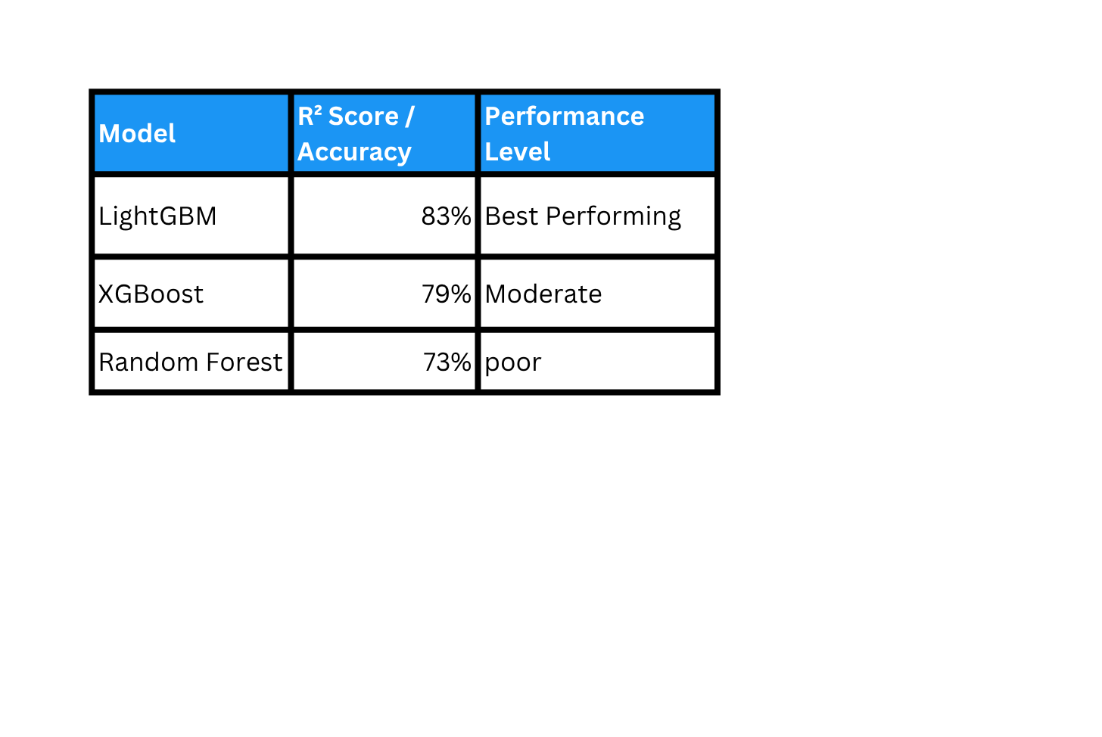
RELATIVE HUMIDITY & QNH STABILITY PREDICTION MODEL FOR AVIATION SAFETY-SECOND INTER MONSOON PERIOD.
User Feedback on Prototype
  Users found the prediction dashboard easy to understand
  Forecast outputs were useful for aviation weather monitoring
  System improved visibility of weather trend analysis
  Prototype demonstrated practical support for forecast verification
Technologies & AI Models Used
  Python
  Scikit-Learn
  TensorFlow/Keras
  Random Forest
  LSTM
  Pandas & NumPy
SLIIT
Faculty of Computing
IT22069504
Jayathilaka P.K.V.K.
R26-IT-132

Slide 17
  https://epicflightacademy.com/metar/
  https://skybrary.aero/articles/meteorological-aerodrome-report-metar
  https://meteo.gov.lk
  Federal Aviation Administration (2023). Pilot’s Handbook of Aeronautical Knowledge (FAA-H-8083-25C). Chapter 11: Aircraft Performance. U.S. Department of Transportation.
  Key Focus: Mathematical derivation of crosswinds and trigonometric applications.
Link: https://www.faa.gov/sites/faa.gov/files/13_phak_ch11.pdf

Slide 18
Hyper-Local
Aviation Weather Forecast Verification System for Sri Lankan Monsoon Patterns
Commercialization & Sustainability
Market Size
  Global smart airport market: ~$25 billion by 2030
  High demand in South Asia (Sri Lanka, India, Maldives)
  Focus: Airports affected by monsoon weather delays
  BIA handles 40,000+ flights per year
Customer Persona
  Primary: Airport Authorities (e.g., AASL)
& Air Traffic Control (ATC) units.
  Secondary: Airline Flight Operations
Departments (Dispatchers).
  End-Users: Commercial Pilots
(Decision Support) and Meteorological Forecasters.e.
Unique Selling Point (USP)
Cost & Revenue Model
  Built for Sri Lanka’s Main Airport (BIA
  Uses real weather physics (pressure, temperature, wind)
  Not just prediction — understands weather relationships
  Human-in-the-loop system for expert verification
  Subscription model for airports (SaaS)
  Saves airlines fuel cost ($2,000–$5,000 per avoided delay/diversion)
  Premium API for flight planning systems

Slide 19

Thank You
SLIIT
Faculty of Computing
R26-IT-132

