Slide 1

HYPER-LOCAL
AVIATION WEATHER FORECAST VERIFICATION SYSTEM FOR SRI LANKAN MONSOON PATTERNS
30°C
MAX. 31°C - MIN.15°C
SLIIT
Faculty of Computing
R26-IT-132
20%
15 KM/H
WEST
1023.0 MB

Slide 2
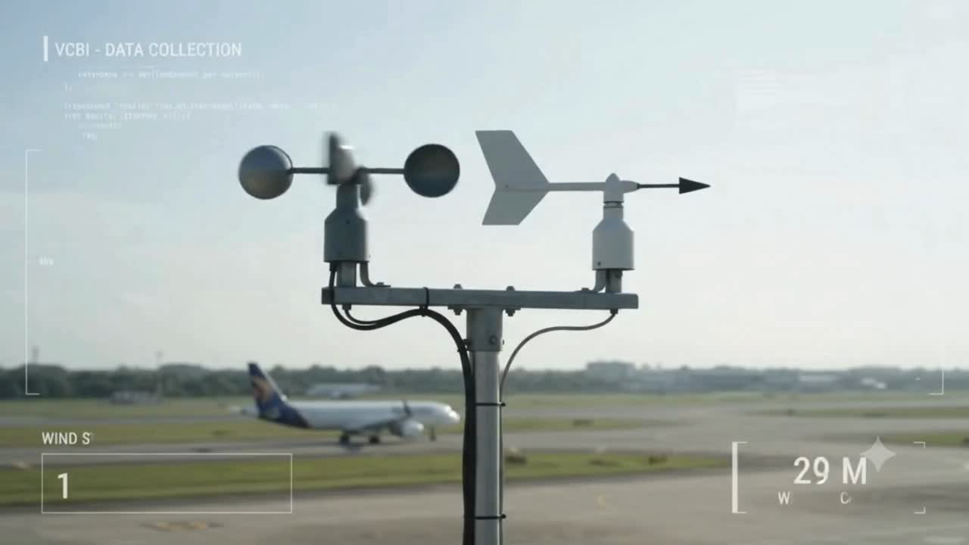
SLIIT
Faculty of Computing
R26-IT-132
MAX. 31°C - MIN.15°C
20%
15 KM/H
WEST
1023.0 MB

Slide 3

PROBLEM
  Global weather models provide regional-scale forecasts (Ex: GFS and ECMWF)
  Airport weather conditions can change rapidly within a small area
  Monsoon-related variations are difficult to capture at airport level
  Existing forecasts may not accurately represent hyper-local conditions at VCBI
STAKEHOLDERS
  Pilots – weather information for flight decisions
  Air Traffic Controllers (ATC) – operational and safety decisions
  Airport Meteorological Officers – monitoring and forecasting
  Airport Operations – operational planning
  Civil Aviation Authorities – aviation safety and weather standards
30°C
SLIIT
Faculty of Computing
R26-IT-132
MAX. 31°C - MIN.15°C
20%
15 KM/H
WEST
1023.0 MB

Slide 4
TEMPERATURE -PRESSURE COUPLED PREDICTION MODEL
RESEARCH GAP
identified is that global weather models like GFS, ECMWF do not provide the hyper-local accuracy required for VCBI, and they lack automated adaptability to changing local patterns.
SOLUTION OVERVIEW
  Predict Temperature and Pressure at VCBI.
  Generate short-term T+3 hour predictions.
  Use a Hybrid LSTM + Random Forest Architecture.
  Calculate Pressure Altitude and Density Altitude, and classify conditions as Normal, Elevated, or High
  Support forecasters with human-readable aviation weather information.
OBJECTIVE
  Forecast Temperature, Pressure at vcbi
  Predict weather conditions for the next 3 hours
  Model the coupled relationship between the weather parameters
  Calculate Density Altitude
  Improve hyper-local aviation weather assessment at Bandaranaike International Airport
SLIIT
Faculty of Computing
IT22113986
Sankadeepa W.D.I
R26-IT-132

Slide 5
Wind Pattern Prediction Model
(speed and direction)
RESEARCH GAP
identified is that global weather models like GFS, ECMWF do not provide the hyper-local accuracy required for VCBI, and they lack automated adaptability to changing local patterns.
SOLUTION OVERVIEW
  Predict Wind Speed and Wind Direction at VCBI.
  For aviation operations,wind prdiction model is usable if its prediction error is less than 2.5 knots.
  Generate 1-hour and 3-hour short-term predictions use XGBOOST and TFT (Temporal Fusion Transformer) coupled prediction
  Continues learning Automated MLOps retraining using newly collected weather data
  Capture non-linear relationships between meteorological parameters.
  Provide runway-oriented headwind and crosswind information.
OBJECTIVE
  Predict Wind Speed and Wind Direction at VCBI.
  Generate 1-hour and 3-hour short-term predictions.
  Capture non-linear relationships between meteorological parameters.
  Provide runway-oriented headwind and crosswind information.
  Support forecasters with human-readable aviation weather information.
SLIIT
Faculty of Computing
IT22619976
Ransinghe R.A.A.D
R26-IT-132

Slide 6
CLOUD AND VISIBILITY PREDICTION MODEL
RESEARCH GAP
SOLUTION OVERVIEW
  dentified is that global weather models like GFS, ECMWF do not provide the hyper-local accuracy required for VCBI, and they lack automated adaptability to changing local patterns.
  Evaluated Decision Tree, Random Forest, and XGBoost
  XGBoost selected as the final model
  Separate models for Cloud Status and Visibility
  Uses METAR observations and engineered meteorological features
  Real-time prediction through Flask API
  Automated MLOps retraining using newly collected weather data
  Provides predictions in a human-readable aviation format (Cloud - FEW, SCT,BKN)
OBJECTIVE
  Predict Cloud Status and Visibility
  Generate short-term airport-level predictions
  Capture non-linear relationships between meteorological parameters
  Provide human-readable aviation weather information
SLIIT
Faculty of Computing
IT22619976
Jayawardhana H.M.S.I
R26-IT-132

Slide 7
QNH, DEWPOINT AND RH PREDICTION MODEL
RESEARCH GAP
Traditional numerical weather prediction models lack the hyper-local precision required for safe aviation operations, making them unreliable in the face of Sri Lanka’s highly volatile and rapidly shifting monsoon patterns, particularly when forecasting critical parameters like Atmospheric Pressure (QNH) and Dewpoint.
SOLUTION OVERVIEW
  Use LightGBM for fast and accurate weather forecasting
  Derive Relative Humidity using the August-Roche-Magnus formula
  Apply advanced feature engineering for weather patterns
  Use monthly automated MLOps retraining with live SQLite data
  Verify prediction accuracy through real-time monitoring
OBJECTIVE
  Forecast QNH and Dewpoint accurately
  Predict weather conditions for the next 3 hours
  Calculate Relative Humidity from predicted weather parameters
SLIIT
Faculty of Computing
IT22069504
JAYATHILAKA P.K.V.K.
R26-IT-132

Slide 8

SYSTEM INTEGRATION
  Historical VCBI weather data → Preprocessing & Feature Engineering
  Monsoon-specific ML/DL components → 3 Hour Forecasting
  Forecast outputs → METAR / TAF Verification
  Verification results → Error & Reliability Analysis
  Integrated outputs → Pilot Weather Guidance /
Decision Support
COMPLETION STATUS
  Individual prediction components developed
  Model outputs integrated into the common forecasting framework
  Forecast verification workflow integrated
  Overall system testing, validation and performance evaluation ongoing
30°C
SLIIT
Faculty of Computing
R26-IT-132
MAX. 31°C - MIN.15°C
20%
15 KM/H
WEST
1023.0 MB

Slide 9

EVALUATION EVIDENCE
  Real VCBI weather data used
  Forecast compared with METAR/SPECI observations
  MAE, RMSE & R² used for evaluation
  Monsoon-specific model performance evaluated
  Forecast errors used for reliability assessment
NON-FUNCTIONAL REQUIREMENTS
  Accuracy – reliable T+3 forecasts
  Performance – fast forecast generation
  Reliability – consistent forecast & verification
  Usability – clear Pilot Weather Guidance
  Scalability – support future VCBI data
  Maintainability – continuous model retraining
  Security – protect stored forecast records
30°C
SLIIT
Faculty of Computing
R26-IT-132
MAX. 31°C - MIN.15°C
20%
15 KM/H
WEST
1023.0 MB

Slide 10
COMMERCIALIZATION & DEPLOYMENT POTENTIAL
  Internal Airport Use – Localized weather monitoring and forecasting for airport operations.
  Airline Operations – Support for flight planning and operational decision-making.
  Operational Decision Support – Help pilots, dispatchers, and airport staff make weather-related decisions.
  Future Deployment – Potential integration with the Department of Meteorology, subject to validation and approval.
30°C
SLIIT
Faculty of Computing
R26-IT-132
MAX. 31°C - MIN.15°C
20%
15 KM/H
WEST
1023.0 MB

Slide 11

Thank You
SLIIT
Faculty of Computing
R26-IT-132

