Slide 1










AI-BASED HYPER-LOCAL
AVIATION WEATHER FORECAST VERIFICATION SYSTEM FOR SRI LANKAN MONSOON PATTERNS
30°C
MAX. 31°C - MIN.15°C
MONDAY, MARCH 16
SLIIT
Faculty of Computing
R26-IT-132
20%
15 KM/H
WEST
1023.0 MB

Slide 2
AI-BASED HYPER-LOCAL
AVIATION WEATHER FORECAST VERIFICATION SYSTEM FOR SRI LANKAN MONSOON PATTERNS

Slide 3
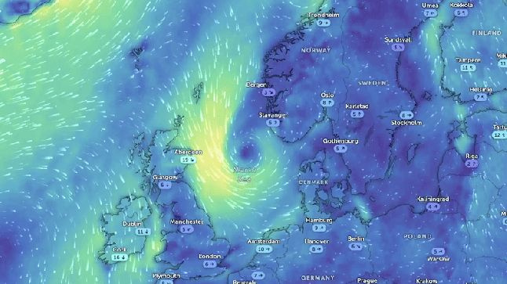
BACKGROUND
Weather forecasting plays a critical role in aviation safety and operational decision-making. Pilots depend on aviation weather reports such as TAF and METAR to obtain atmospheric conditions before take-off and landing
PROBLEM
Most aviation weather forecasting systems rely on global models such as GFS and ECMWF, which provide large-scale forecasts but It fail on Localize weather variations.
30°C
SLIIT
Faculty of Computing
MAX. 31°C - MIN.15°C
R26-IT-132
MONDAY, MARCH 16
20%
15 KM/H
WEST
1023.0 MB

Slide 4

USERS & STAKEHOLDERS
PRIMARY USERS
• Pilots
• Air Traffic Controllers
• Aviation Meteorological Officers
• Airport Operations Managers
STAKEHOLDERS
  Airport authorities (Bandaranaike International Airport)
  Civil Aviation Authority of Sri Lanka
  Airline operation management teams
  Aviation safety organizations
30°C
SLIIT
Faculty of Computing
MAX. 31°C - MIN.15°C
R26-IT-132
MONDAY, MARCH 16
20%
15 KM/H
WEST
1023.0 MB

Slide 5

USERS AND STAKEHOLDERS
How they interact with the system
  Pilots receive visibility and weather alerts before takeoff and landing
  Meteorologists verify forecasts using the AI system
  Airport authorities use the system for operational planning
SLIIT
Faculty of Computing
R26-IT-132

Slide 6

USERS AND STAKEHOLDERS
Impact of the Problem to Users and Society
  Sudden weather changes can reduce pilot visibility.
  Low cloud ceilings can affect safe aircraft landing.
  Can cause flight delays and flight diversions.
  Affects passenger travel and airline operations.
SLIIT
Faculty of Computing
R26-IT-132

Slide 7
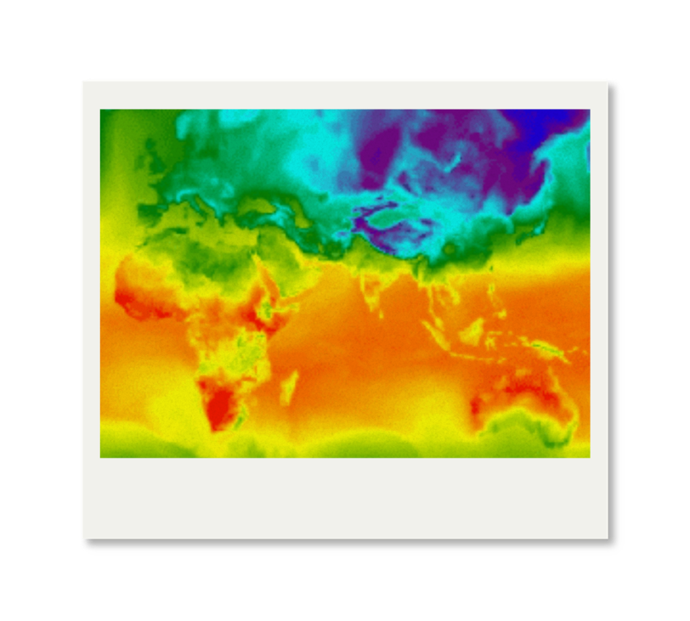
EXISTING SOLUTIONS
AND THEIR LIMITATIONS
Existing Solutions
  Global Forecast System (GFS)
  ECMWF weather prediction
models
  TAF and METAR reports
Limitations
  Difficult to detect rapid local weather changes.
  Limited accuracy for airport-level predictions.
  Cant find Past data
SLIIT
Faculty of Computing
R26-IT-132

Slide 8
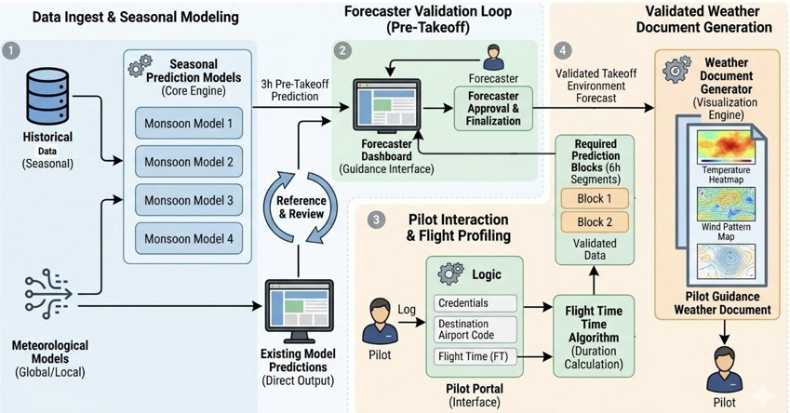
SYSTEM DIAGRAM

Slide 9
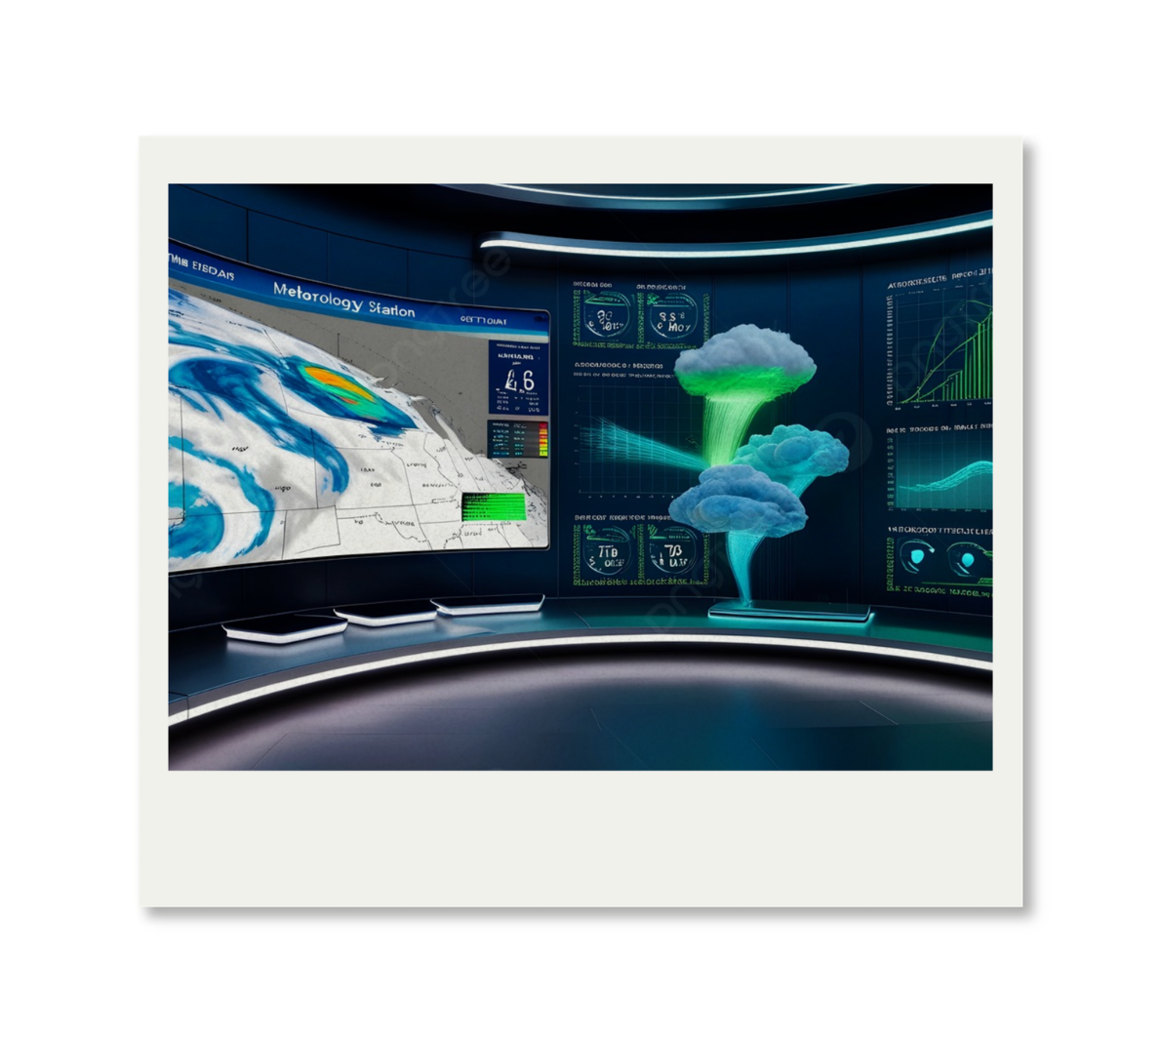
THE PROPOSED SOLUTION
  Hyper-local AI-based aviation weather prediction system for monsoon pattons
  Uses machine learning to
analyze weather data.
  Detects rapid weather
changes near airports.
  Generates alerts for dangerous
aviation weather conditions.
SLIIT
Faculty of Computing
R26-IT-132

Slide 10
TEAM MEMBER CONTRIBUTIONS
Student | Component
Sankadeepa W.D.I | Pressure-Humidity-Temperature Prediction Model
Ranasingha R.A.A.D | Wind Pattern Prediction Model
Jayawardhana H.M.S.I | Cloud and Visibility Prediction Model for aviation Safety
Jayathilaka P.K.V.K | Relative Humidity & QNH Stability Model
SLIIT
Faculty of Computing
R26-IT-132

Slide 11

SANKADEEPA W.D.I
IT22113986
Pressure-Humidity-Temperature Coupled Prediction Model
NORTHEAST MONSOON
SLIIT
Faculty of Computing
R26-IT-132

Slide 12
PRESSURE-HUMIDITY-TEMPERATURE COUPLED PREDICTION MODEL
Contribution to Overall Solution
Novelty
  Pressure-Humidity-Temperature
Coupled Prediction Model
  predict on North east monsoon
  temperature, pressure, and humidity interact with each other at airport level
  Support hyper-local aviation weather forecasting
  Develop a hybrid weather prediction model
  (Multilinear regression- parameter relationship & LSTM- weather pattern )
SLIIT
Faculty of Computing
R26-IT-132

Slide 13

PRESSURE-HUMIDITY-TEMPERATURE COUPLED PREDICTION MODEL
Problem
Objective
  Northeast Monsoon causes sudden weather changes.
  Large Global model falling(gef, ecmwf)
  Fail to capture Localized data.
  Grid cell represent about 20KM and applied same prediction in all areas .
Develop a hyper localized model that predicts temperature, humidity and pressure together.
Aviation safety and decision Making
Sub-Objectives
  Collect airport weather data
  Train a multi-variable ML model
  Perform forecast verification
  Visualize validated weather patterns
(heatmap , wind patterns)
SLIIT
Faculty of Computing
IT22113986
Sankadeepa W.D.I
R26-IT-132

Slide 14
PRESSURE-HUMIDITY-TEMPERATURE COUPLED PREDICTION MODEL
Methodology
Technologies
  Multiple Linear Regression
  LSTM (best for weather time series)
  Neural Network
  Aviation meteorology analysis
  Time-series machine learning
  Multi-linear regression
Validation and Evaluation
Data Availability & Ethics
  Compare predictions with METAR aviation weather reports
  Test the model using historical weather data
  Compare predicted results with actual weather data
  Compare results with METAR and TAF forecasts
  Historical meteorological data will be used.
  Dataset includes temperature, humidity, and atmospheric pressure.
  Data obtained from meteorological or airport weather observation sources.
  No personal or sensitive information is included.
SLIIT
Faculty of Computing
IT22113986
Sankadeepa W.D.I
R26-IT-132

Slide 15
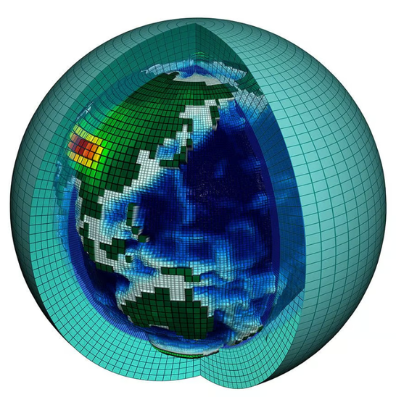

PRESSURE-HUMIDITY-TEMPERATURE COUPLED PREDICTION MODEL
System Overview
  Input → Weather Data
  Process → ML Prediction Model
  Output → Forecast Temperature, Pressure, Humidity
Dependencies
  Airport weather datasets
  Forecast verification module
  Visualization component
SLIIT
Faculty of Computing
IT22113986
Sankadeepa W.D.I
R26-IT-132

Slide 16

Ranasinghe R.A.A.D.
IT22269720
Wind Pattern Prediction Model for
Southwest Monsoon
SLIIT
Faculty of Computing
R26-IT-132

Slide 17
WIND PATTERN PREDICTION MODEL FOR SOUTHWEST MONSOON
Contribution to Overall Solution
  Predict wind speed and wind direction
  Identify wind variations affecting aviation operations
  Support runway wind analysis
Novelty
  Convert wind predictions into crosswind and headwind components
  Provides runway-specific aviation guidance
SLIIT
Faculty of Computing
IT22269720
Ranasinghe R.A.A.D.
R26-IT-132

Slide 18
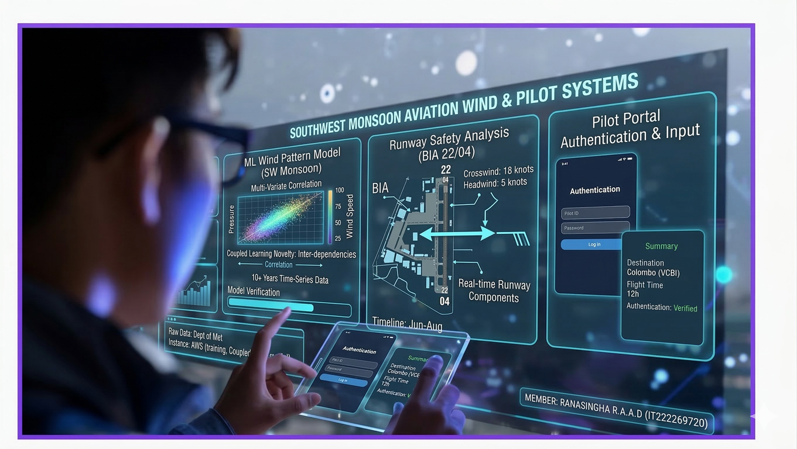
WIND PATTERN PREDICTION MODEL FOR SOUTHWEST MONSOON
Problem Definition
Objective
Develop a machine learning model for wind pattern prediction during the Southwest Monsoon.
  Wind is a critical factor in aircraft take-off and landing
  Sudden wind changes create aviation hazards
  Existing forecasts models low accuracy to predict specific wind prediction
Sub-Objectives
  Analyze historical wind patterns
  Train ML models for wind prediction
  Evaluate wind forecast accuracy
  Develop pilot interaction platfome
SLIIT
Faculty of Computing
IT22269720
Ranasinghe R.A.A.D.
R26-IT-132

Slide 19
WIND PATTERN PREDICTION MODEL FOR SOUTHWEST MONSOON
Methodology
Validation
  Compare with official aviation weather forecasts
  Time-series wind pattern analysis
  Machine learning based forecasting
  Aviation wind hazard assessment
Technologies
  Python
  Machine Learning models
  Data visualization tools
Data availability & Ethics
  Historical wind datasets
  Meteorological data only
  No personal data usage
SLIIT
Faculty of Computing
IT22269720
Ranasinghe R.A.A.D.
R26-IT-132

Slide 20

WIND PATTERN PREDICTION MODEL FOR SOUTHWEST MONSOON
System Overview
Input → Wind data
Process → ML Wind Model
Output → Runway wind prediction
Dependencies
  Pilot portal module
  Weather dataset
  Prediction engine
SLIIT
Faculty of Computing
IT22269720
Ranasinghe R.A.A.D.
R26-IT-132

Slide 21

Jayawardhana H.M.S.I
IT22619976
Cloud and Visibility Prediction Model for aviation Safety
First Inter-Monsoon period.
SLIIT
Faculty of Computing
R26-IT-132

Slide 22
Cloud and Visibility Prediction Model for aviation Safety
Contribution to Overall Solution
  Detect sudden weather changes that can affect aviation operations
  Monitor cloud ceiling and visibility reduction
  Improve aviation weather safety
Novelty
  Specialized model for First Inter-Monsoon
  Detect fog and low cloud conditions which are the main reasons for visibility reduction in aviation
SLIIT
Faculty of Computing
IT22619976
Jayawardhana H.M.S.I
R26-IT-132

Slide 23

Cloud and Visibility Prediction Model for aviation Safety
Objective
Develop a ML model to detect sudden atmospheric
changes.
Problem Definition
  Rapid weather changes reduce pilot visibility
  Fog and low clouds can disrupt flight operation
Sub-Objectives
  Analyze visibility patterns using historical weather data
  Detect fog formation & sudden visibility reduction
  Train ML detection models
  Process flight time inputs that can analyze weather conditions during the relevant flight period
SLIIT
Faculty of Computing
IT22619976
Jayawardhana H.M.S.I
R26-IT-132

Slide 24
Cloud and Visibility Prediction Model for aviation Safety
Methodology
Validation
  Compare predictions with actual weather observations
  Cloud ceiling analysis to monitor how cloud height changes over time
  Visibility pattern detection
  Machine learning classification
Technologies
  Python
  Machine Learning models
  Data preprocessing tools
Data availability & Ethics
  Aviation weather dataset
  No personal data
SLIIT
Faculty of Computing
IT22619976
Jayawardhana H.M.S.I
R26-IT-132

Slide 25
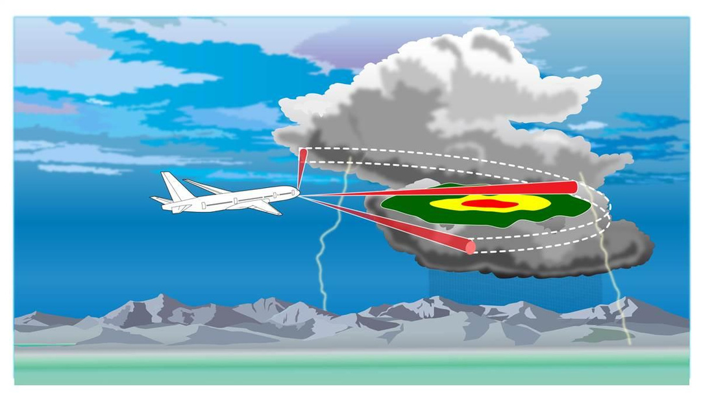
Cloud and Visibility Prediction Model for aviation Safety
System Overview
Input → Cloud & visibility data
Process → ML detection model
Output → Weather hazard alerts
Dependencies
  Flight time processing module
  Weather data
SLIIT
Faculty of Computing
IT22619976
Jayawardhana H.M.S.I
R26-IT-132

Slide 26

Jayathilaka P.K.V.K
IT22069504
Relative Humidity & QNH Stability Prediction Model
Second Inter-Monsoon
SLIIT
Faculty of Computing
R26-IT-132

Slide 27
RELATIVE HUMIDITY & QNH STABILITY PREDICTION MODEL
Contribution to Overall Solution
  Develop a machine learning model that Predict atmospheric stability
  Analyze relative humidity and QNH variations
  Generate pilot weather guidance documents
Novelty
  Develop RH & QNH stability model
  Generate reliability scoring based on pressure trends
SLIIT
Faculty of Computing
IT22069504
Jayathilaka P.K.V.K
R26-IT-132

Slide 28
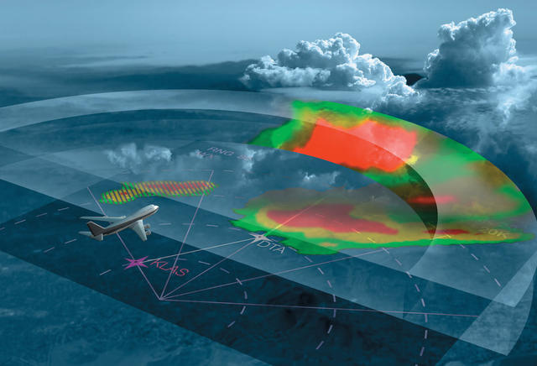
RELATIVE HUMIDITY & QNH STABILITY PREDICTION MODEL
Problem Definition
Objective
Develop a predictive model to analyze humidity peaks and pressure drops.
  High humidity and QNH changes influence local weather instability
  Aviation systems lack localized pressure trend prediction
Sub-Objectives
  Analyze humidity and QNH correlations using historical weather data
  Train ML models to predict rh & QNH variations
  Generate structured pilot weather guidance reports
SLIIT
Faculty of Computing
IT22069504
Jayathilaka P.K.V.K.
R26-IT-132

Slide 29
RELATIVE HUMIDITY & QNH STABILITY PREDICTION MODEL
Methodology
Validation
  Compare predictions with METAR and TAF aviation reports
  Time-series atmospheric analysis
  Machine learning prediction
  Data correlation modeling
Technologies
  Python
  TensorFlow / Scikit-Learn
  Pandas / NumPy
Data availability & Ethics
  Historical weather datasets
  Meteorological data only
  Ethical compliance ensured
SLIIT
Faculty of Computing
IT22069504
Jayathilaka P.K.V.K.
R26-IT-132

Slide 30

RELATIVE HUMIDITY & QNH STABILITY PREDICTION MODEL
System Overview
Input → historical Weather data
Process → Stability prediction model
Output → Pilot weather guidance document
Dependencies
  Forecast verification module
  Weather document generation system
SLIIT
Faculty of Computing
IT22069504
Jayathilaka P.K.V.K.
R26-IT-132

Slide 31
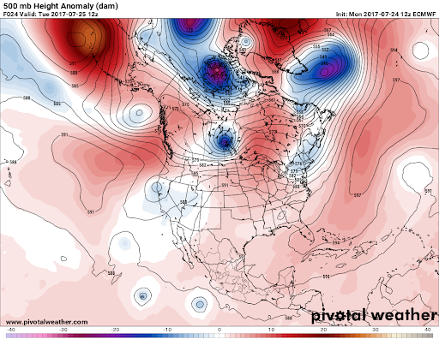
AI-BASED HYPER-LOCAL
AVIATION WEATHER FORECAST VERIFICATION SYSTEM FOR SRI LANKAN MONSOON PATTERNS
Ability of Commercialization
  Can be used by airports and aviation authorities for weather monitoring.
  Supports safer flight operations by providing early weather alerts.
  Can be integrated with airport meteorological systems.
Material / Technical Cost
  Cloud computing resources
  Data storage and system maintenance
Labour Cost
  AI model development
  Data analysis and system development
SLIIT
Faculty of Computing
R26-IT-132

Slide 32
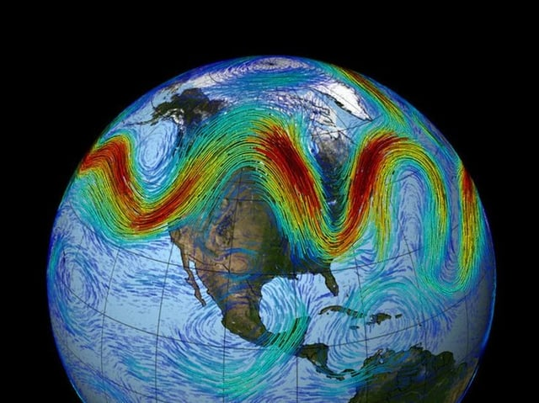

AI-BASED HYPER-LOCAL
AVIATION WEATHER FORECAST VERIFICATION SYSTEM FOR SRI LANKAN MONSOON PATTERNS
Cost Recovery / Pricing
  Software subscription for airports and airlines
  Licensing for aviation authorities
  Integration service for aviation weather systems
Target Market
  Airports in Sri Lanka
  Aviation meteorology departments
SLIIT
Faculty of Computing
R26-IT-132

Slide 33


AI-BASED HYPER-LOCAL
AVIATION WEATHER FORECAST VERIFICATION SYSTEM FOR SRI LANKAN MONSOON PATTERNS
Value Proposition
  Early detection of hazardous weather conditions
  Improved aviation safety and operational planning
  More accurate airport-level weather analysis
Intellectual Property Rights
  Machine learning model architecture
  Weather prediction algorithms
  Software system design
SLIIT
Faculty of Computing
R26-IT-132

Slide 34
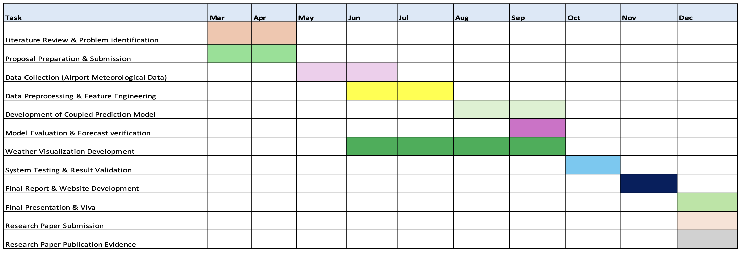
AI-BASED HYPER-LOCAL
AVIATION WEATHER FORECAST VERIFICATION SYSTEM FOR SRI LANKAN MONSOON PATTERNS
GANTT CHART
SLIIT
Faculty of Computing
R26-IT-132

Slide 35
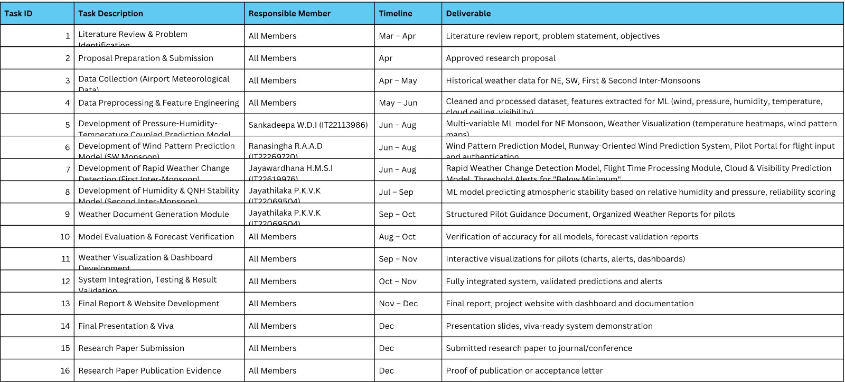
AI-BASED HYPER-LOCAL
AVIATION WEATHER FORECAST VERIFICATION SYSTEM FOR SRI LANKAN MONSOON PATTERNS
Work Breakdown Structure
SLIIT
Faculty of Computing
R26-IT-132

Slide 36
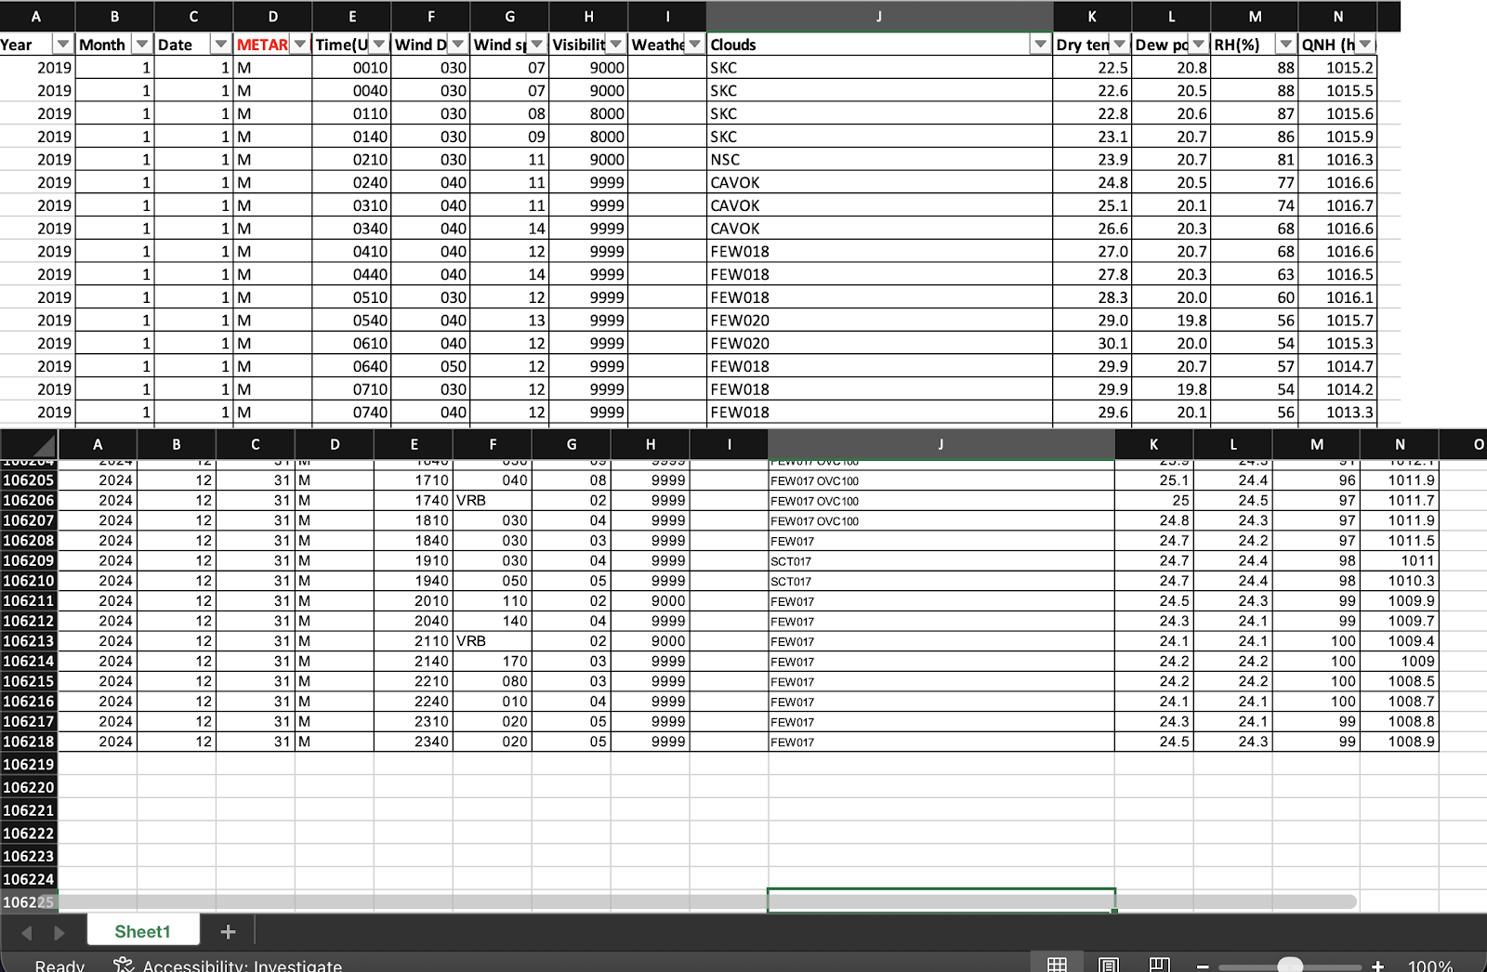
AI-BASED HYPER-LOCAL
AVIATION WEATHER FORECAST VERIFICATION SYSTEM FOR SRI LANKAN MONSOON PATTERNS
Collected Data set So far

Slide 37

Thank You
SLIIT
Faculty of Computing
R26-IT-132

