Slide 1
Read Me
Link to the setup
https://drive.google.com/drive/folders/19dOUECXcTrWk5c-C9TSBhUwdPM-eACEe?usp=sharing

Slide 2
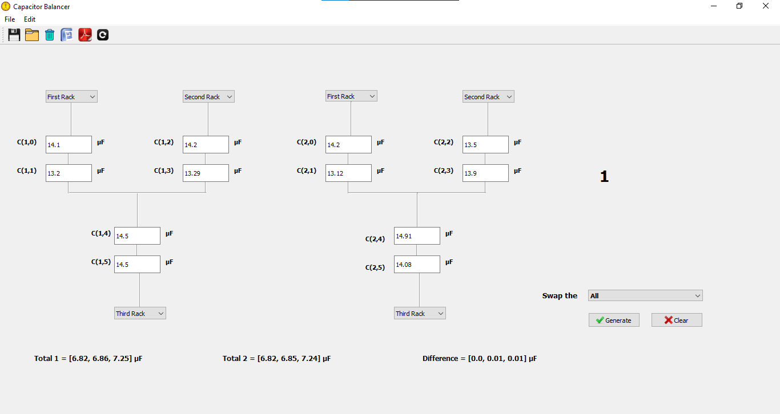
Reset to original
Not yet implemented
Arrangement number
Only the option “All” has implemented
The best 10 arrangements will be displayed.

Slide 3
Functionality
Fill the C(1,0) to C(2,5) with capacitor values
Click “Generate”
best 10 combinations will be displayed on the same window
Click on reset to “restore” the original arrangement
The tool still not showing the optimum solution (optimum means the arrangement we can obtain from lesser number of shuffles. But it shows the best* arrangement)

Slide 4
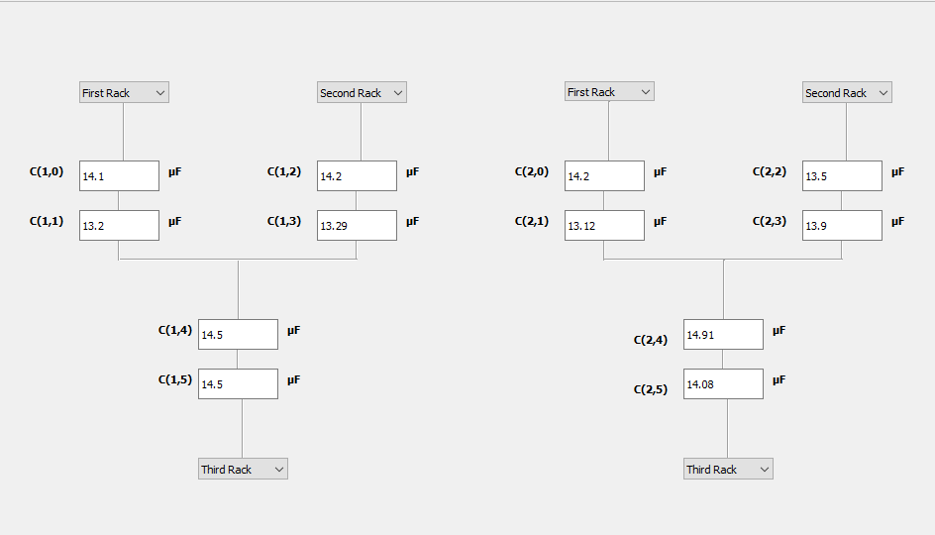




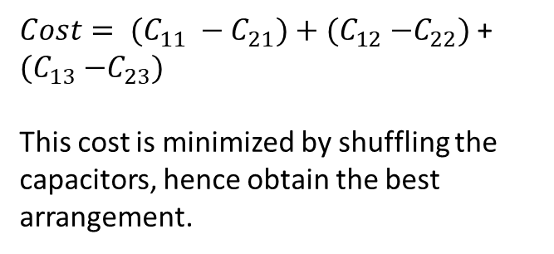




Algorithm
$C_{11}= \frac{C\left(1,0\right)×C(1,1) }{C\left(1,0\right) + C(1,1) }$
$$C_{12}$$
$$C_{21}$$
$$C_{22}$$
$$C_{11}$$
Capacitors are shuffled such a way that $C_{11}≅C_{21}$ , $C_{12}≅C_{21}$ and $C_{13} ≅C_{23}$
${Cost= (C}_{11} −C_{21})+$ ${(C}_{12} −C_{22})$ + ${(C}_{13} −C_{23})$
This cost is minimized by shuffling the capacitors, hence obtain the best arrangement.
$$C_{13}$$
$$C_{23}$$

Slide 5
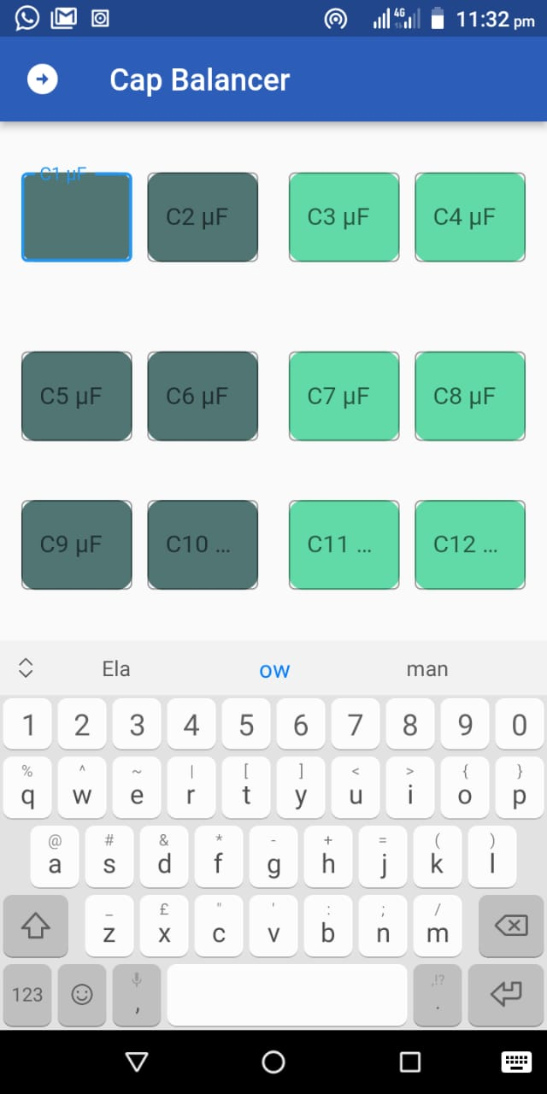
Mobile app
Still under development

