Slide 1
Implementation of Minimax, Alpha-Beta Pruning, and Random Agent in Slime Volleyball
TEAM: ASHANT KUMAR (CS24M113)
Submission Date: 30/04/2025
Course Name: AI
Instructor Name: Ajin George Joseph
GitHub Repo: https://github.com/Ashantfet/AI_3.git

Slide 2
Problem Overview & Environment
Problem Statement:
Implementing Minimax and Alpha-Beta Pruning algorithms to control agents in the Slime Volleyball environment.
Comparing algorithmic performance with a random agent.
Environment:
Slime Volleyball Environment (SlimeVolley-v0).
Two players (agents) interact to try to score by hitting the ball over the opponent's slime.
The environment involves physics (e.g., movement, jumping, ball behavior).
Key Goals:
Develop intelligent agents that perform well in this dynamic environment.
Evaluate and compare Minimax, Alpha-Beta Pruning, and a Random Agent.

Slide 3
Algorithms Implemented
Minimax Algorithm:
A classic decision-making algorithm that evaluates all possible moves up to a certain depth.
Evaluation Function: Distance between the ball and the player (closer to the ball is better).
Depth of search: 3
Alpha-Beta Pruning:
Optimized version of Minimax with pruning to eliminate branches that do not need to be explored.
Evaluation Function: Same as Minimax, but the pruning reduces computation time.
Depth of search: 3.
Random Agent:
Chooses actions randomly from the possible action set.
Used as a baseline for comparison.

Slide 4
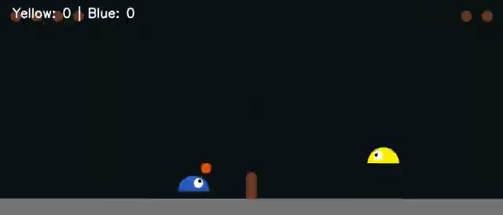
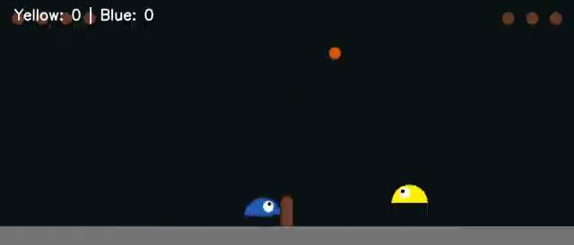
Experimental Setup & Results
Total Score (Yellow vs. Blue):
Minimax: Yellow 0 - Blue 3
Alpha-Beta: Yellow 0 - Blue 13
Number of Frames Played: 900 frames per game iteration (30 seconds with 30 FPS).
Execution Time:
Minimax: 227.23 seconds
Alpha-Beta: 109.13 seconds
Observations:
Minimax and Alpha-Beta Pruning perform better compared to the Random Agent due to their strategic decision-making.
Alpha-Beta executed nearly twice as fast as Minimax (109.13s vs 227.23s), showcasing the benefit of pruning redundant branches.
MINIMAX VIDEO PLAY
Note: Blue is the maximizing player (controlled by Minimax/AlphaBeta)
ALPHA-BETA VIDEO PLAY

Slide 5
Conclusion & Performance Analysis
Key Takeaways
Minimax vs. Alpha-Beta Pruning Alpha-Beta Pruning achieves the same results as Minimax while being significantly faster by eliminating irrelevant branches during the search.
Random Agent Behavior As expected, the Random Agent performs poorly, showing no strategic behavior or consistency.
Evaluation Function A simple heuristic based on the distance to the ball proves effective for basic agent control and decision-making in the game.
Challenges
Search Depth Limitation Both Minimax and Alpha-Beta are constrained by the search depth, limiting their foresight and long-term planning.
Dynamic Game Environment The fast-paced game mechanics (ball physics, opponent actions) make it difficult to predict and adapt accurately using deterministic planning alone.

