Slide 1
Comparative study between SARS-COV-2(covid-19) and its variant omicron
Comparative study for SARS-Cov-2 (COVID-19) and its variant Omicron
Comparative study for SARS-Cov-2 (COVID-19) and its variant Omicron
Comparative study for SARS-Cov-2 (COVID-19) and its variant Omicron

Slide 2
Data
10 sequences for the SARS-Cov-2 Omicron variant from italy
Case sequence
Fasta file extension
10 SARS-Cov-2 sequences from italy
Reference sequence
Fasta file extension
Both were obtained from GISAID from italy
The objective of this simple study is :
Make a simple comparison between both sequences to notice any differences and similarities that could lead us to a conclusion of how they are related.

Slide 3
Analysis Pipeline

Slide 4
Pipeline
Data preprocessing
Multiple alignment on both sequences separately
Consensus sequences on the reference sequences
Phylogenetic tree
Multiple alignment on the 20 sequences together
Apply neighbor joining method
Comparison methods between both sequences
Average percentage
Dissimilar Regions

Slide 5
Tools
MEGA11 software :
Concatenating sequences
Analyze sequences
Apply alignments
Generating the Phylogenetic tree

Slide 6
Multiple Alignment
Applied on both sequences separately.

Slide 7
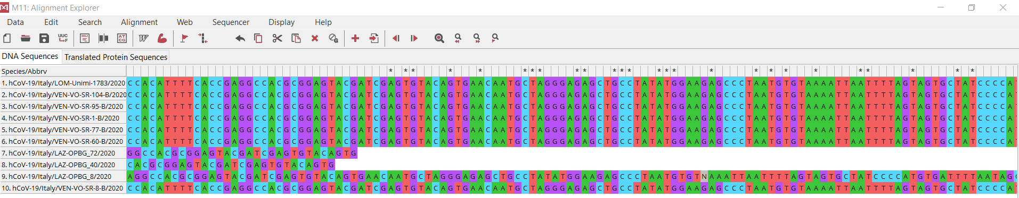
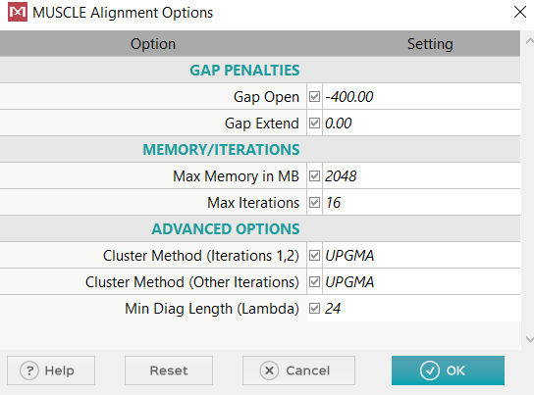
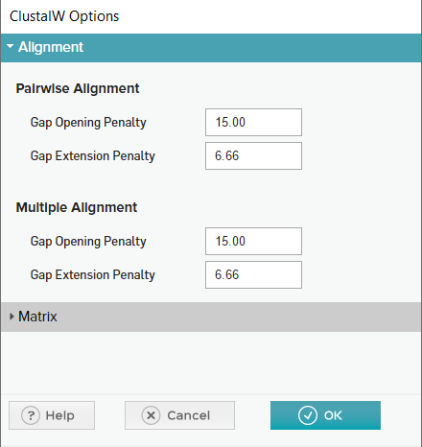


Multiple Alignment

Slide 8
Consensus sequence
Applied on reference sequences only.

Slide 9
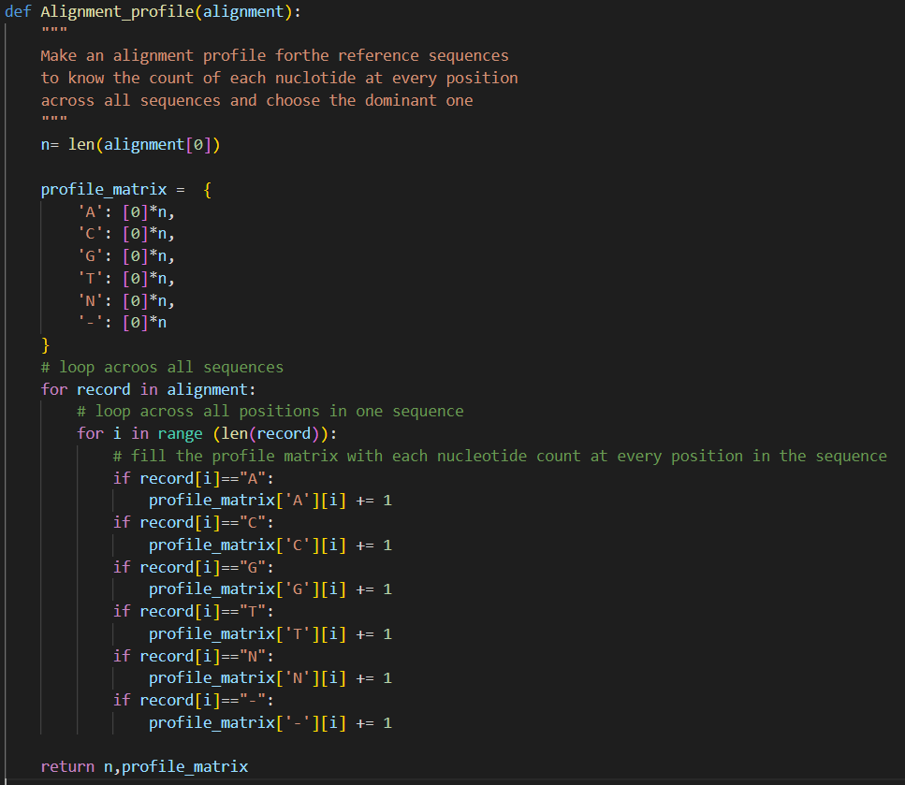
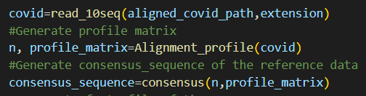
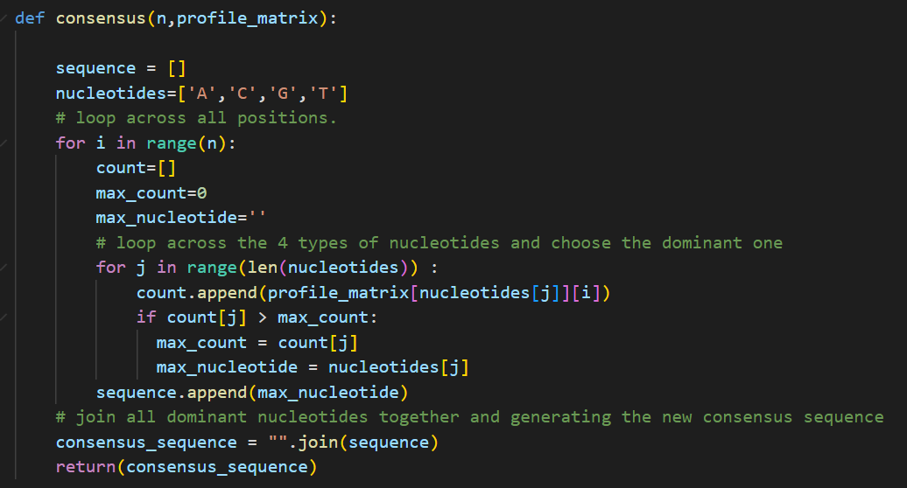
Consensus sequence

Slide 10
Phylogenetic Tree
Generated by the alignment of the 20 sequences together and applying neighbor joining method.

Slide 11
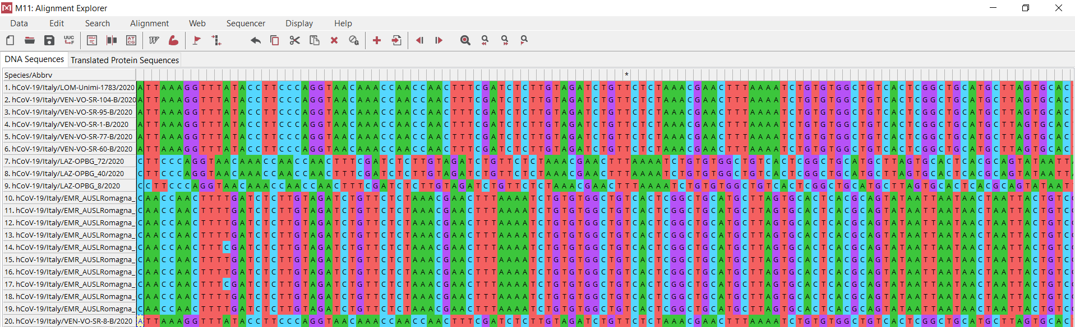
Phylogenetic Tree

Slide 12
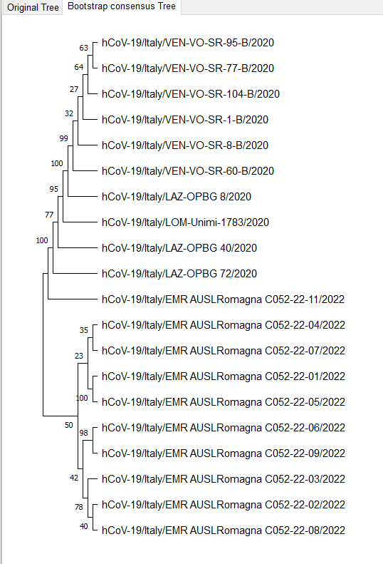
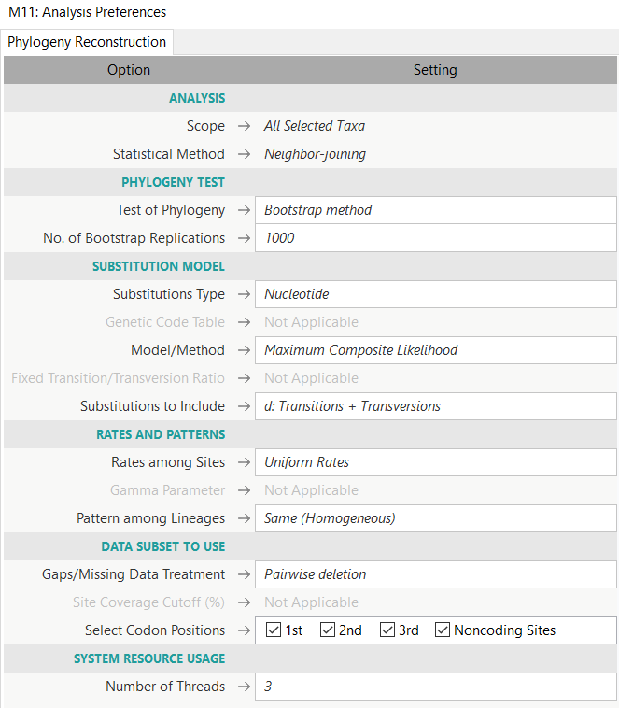
Phylogenetic Tree parameters

Slide 13
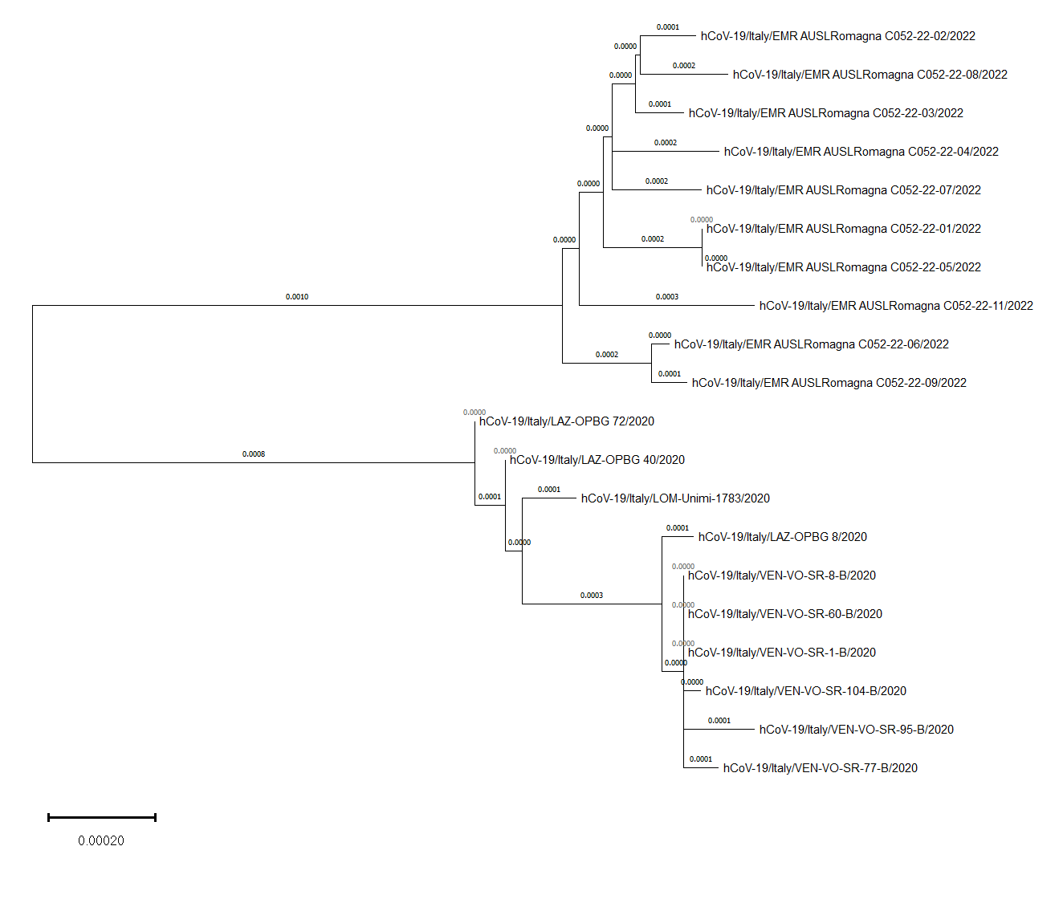
Neighbor joining

Slide 14
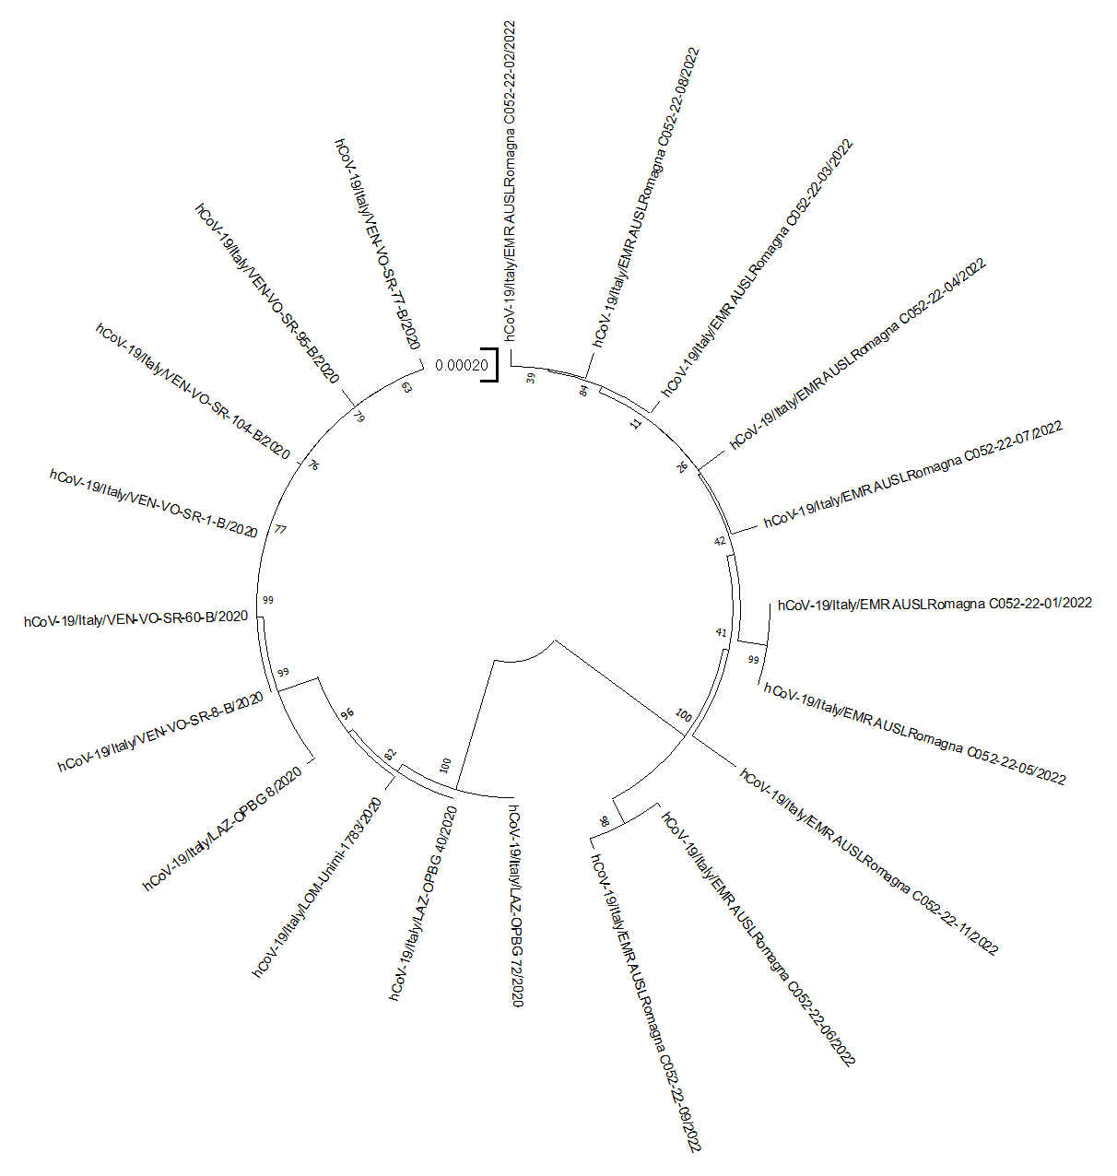
Neighbor joining

Slide 15
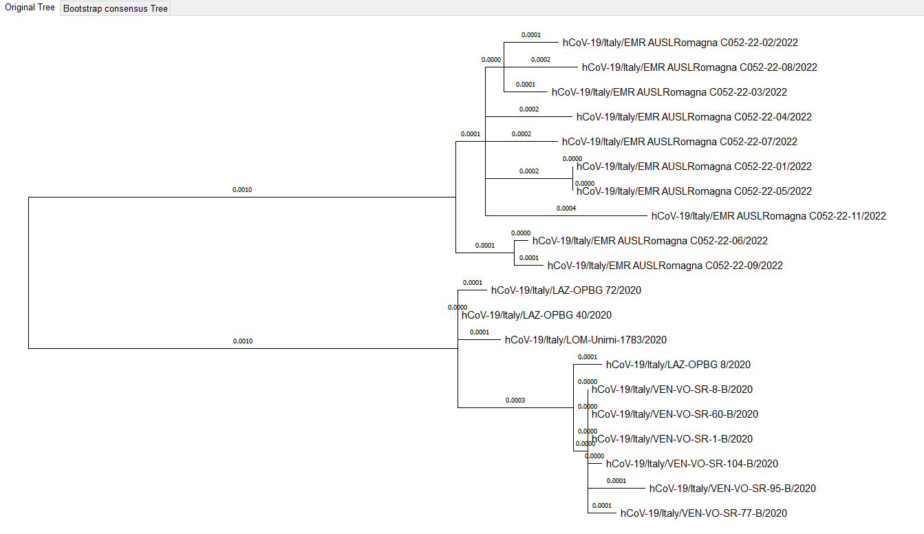
Maximum likelihood

Slide 16
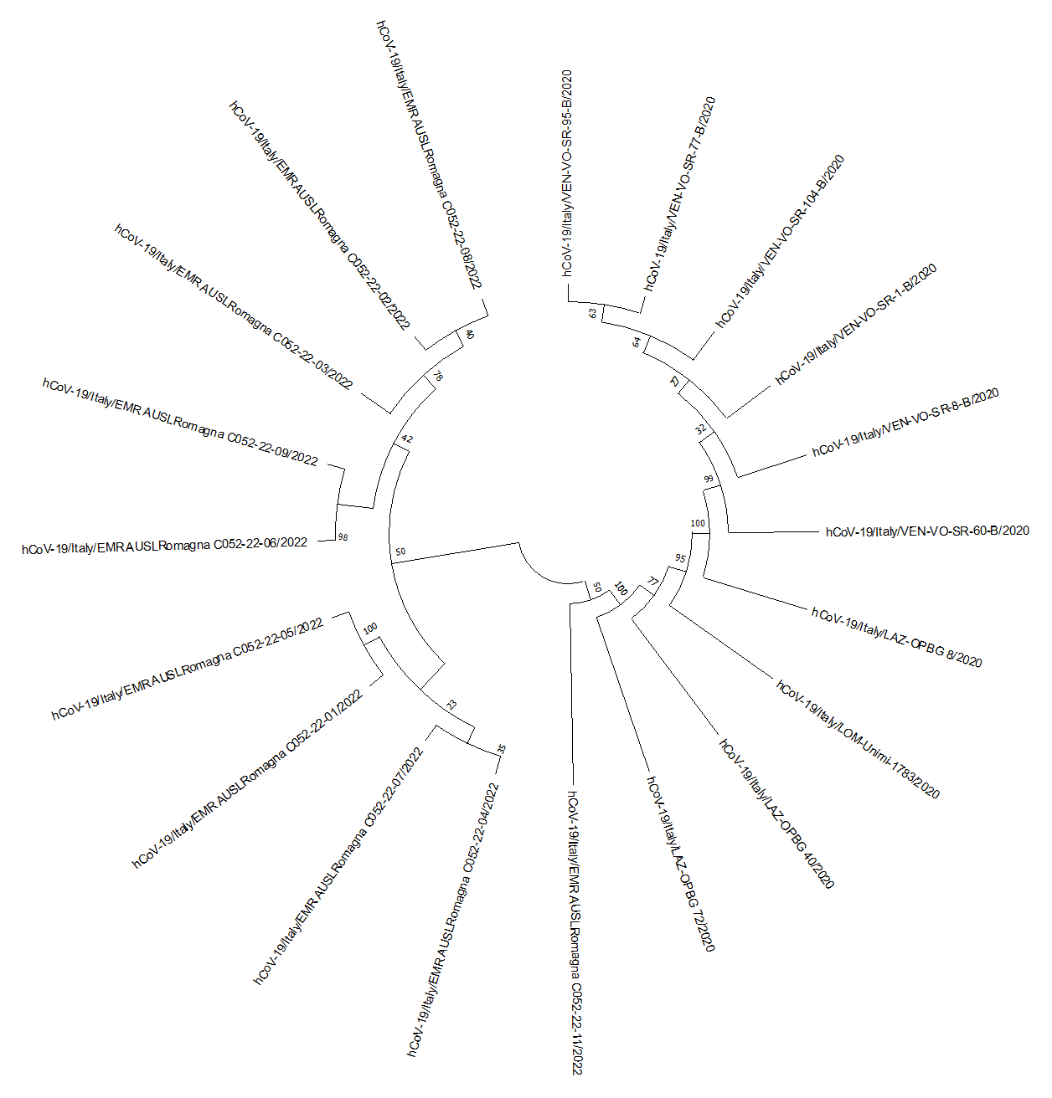
Maximum likelihood

Slide 17
Average percentage of the chemical constituents
Comparison methods between both sequences

Slide 18
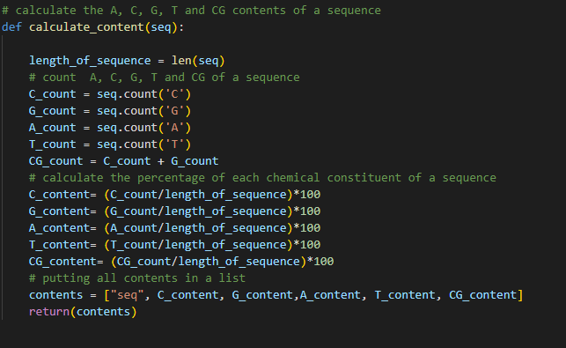
chemical constituents

Slide 19

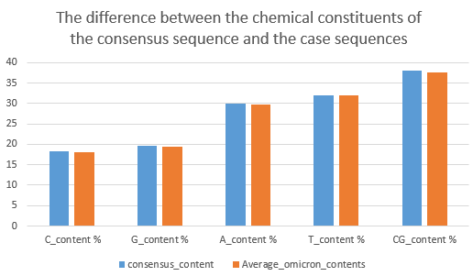
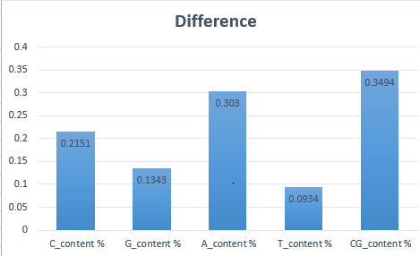
chemical constituents
Results

Slide 20
Dissimilar Regions
Comparison methods between both sequences

Slide 21
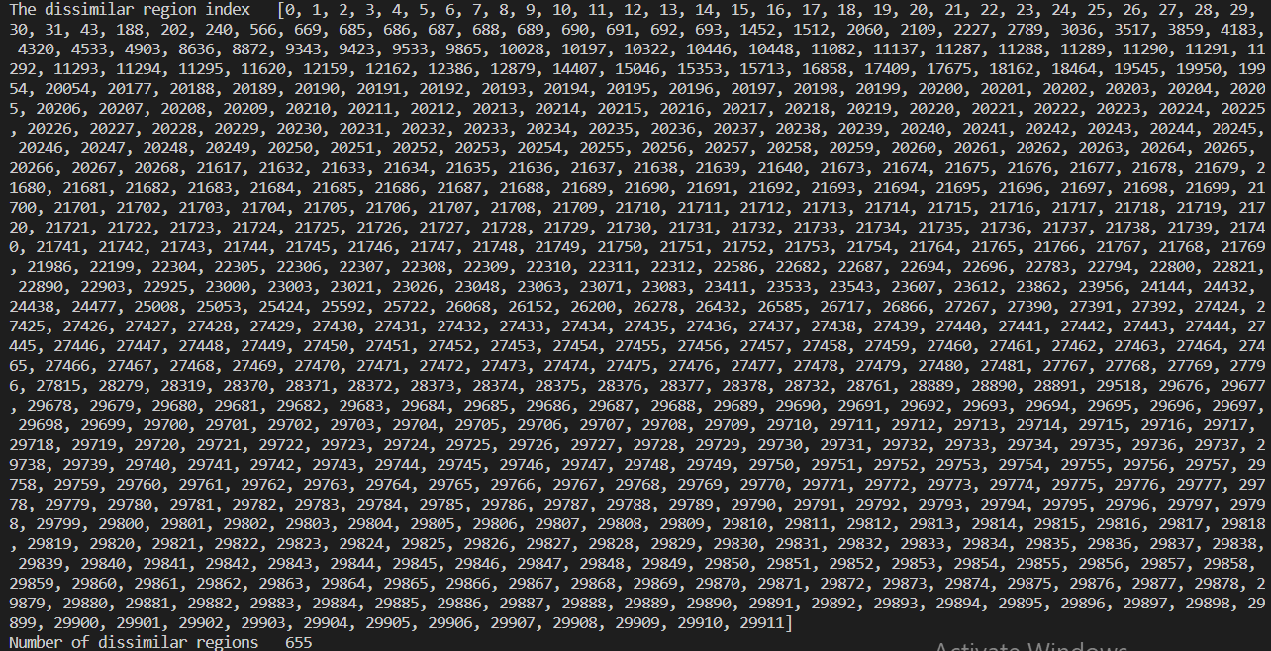
Dissimilarity Indicies

Slide 22
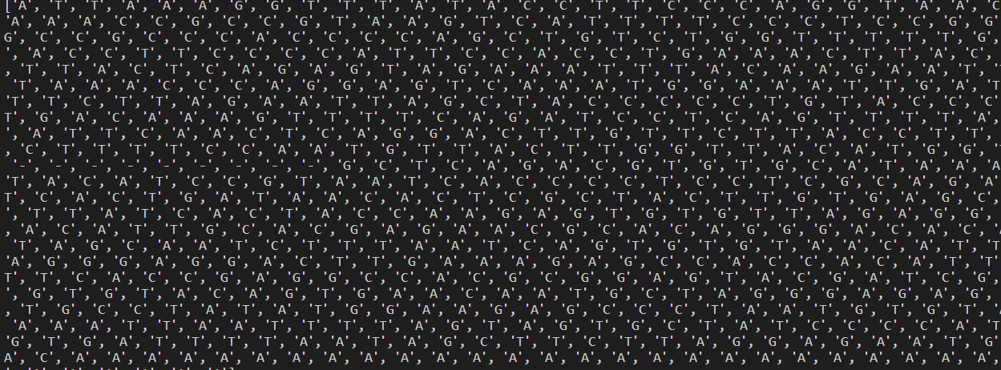
Dissimilarity Regions

Slide 23
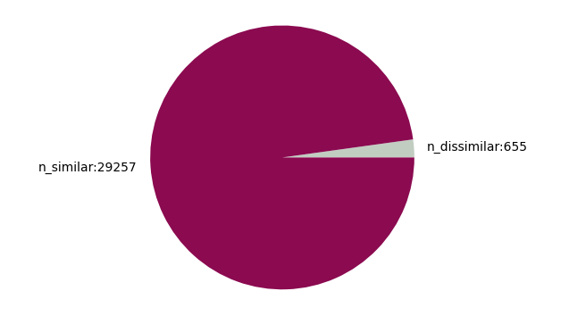
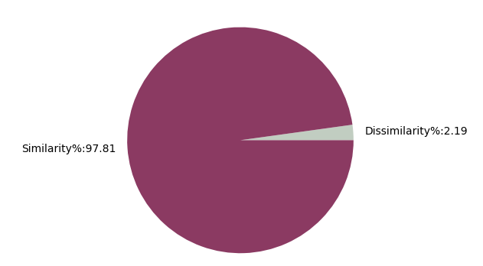
Dissimilarity Percentage
Results

Slide 24
EXTRA RESOURCES

Slide 25
