Slide 1

Forces: Equilibrium Examples
Physics 101: Lecture 02
Today’s lecture will cover Textbook Sections 2.1-2.7
Phys 101 URL:
http://online.physics.uiuc.edu/courses/phys101
Read the course description & FAQ!
Office hours start this Friday; see web page for locations & times.
Notes:
Could add the truck example/demo, or the dog on leash example.

Slide 2
Physics 101 is now on
Illinois COMPASS!
Bring Discussion Problems Book to your Discussion session!

Slide 3
Overview
Last Lecture
  Newton’s Laws of Motion
    Inertia
    ΣF=ma
    Pairs
  Free Body Diagrams
    Draw coordinate axis, each direction is independent.
    Simple Picture
    Identify/draw all forces
  Friction: kinetic f = μ_{k}N; static f ≤ μ_{s} N
  Gravity W = m g (near Earth’s surface!)
Today
  Contact Force---Springs
  Contact Force---Tension
  2-D Examples

Slide 4


Free Body Diagrams
Choose Object (book)
Label coordinate axis
Identify All Forces
  Hand (to right)
  Gravity (down)
  Normal (table, up)
  Friction (table, left)
Normal
friction
hand
Gravity
y
Physics
x

Slide 5
Book Pushed Across Table
Calculate force of hand to keep the book sliding at a constant speed, if the mass of the book is 1 Kg, μ_{s} = .84 and μ_{k}=.75.
Constant Speed => ΣF=0
x-direction: ΣF=0
F_{hand}-F_{friction} = 0
F_{hand}=F_{friction}
F_{hand}=μ_{k} F_{Normal}
Combine:
F_{hand}=μ_{k} F_{Normal} F_{hand}=0.75 x 9.8 N
F_{hand}=7.3 Νewtons
y-direction: ΣF=0
F_{Normal}-F_{Gravity} = 0
F_{Normal} = F_{Gravity}
F_{Normal} =1x 9.8=9.8 N
Normal
friction
hand
y
Physics
x
Gravity
Notes:
Key idea here is we can do each direction independently!

Slide 6
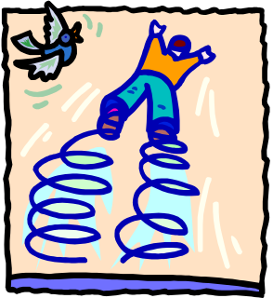
Contact Force: Springs
Force exerted by a spring is directly proportional to its displacement x (stretched or compressed). F_{spring} = -k x
Example: When a 5 kg mass is suspended from a spring, the spring stretches 8 cm. If it is hung by two identical springs, they will stretch
A) 4 cm B) 8 cm C) 16 cm
F₁
F₂
F₁ +F₂ - F_{gravity} = 0
F₁ +F₂ = F_{gravity}
k₁x₁ + k₂x₂= m g
2 k x = mg
x = m g / (2k)
= (½ m) g / k
We know mg/k = 8 cm.
So: ½ mg /k = 4 cm.
F_{gravity}
y
x
Notes:
Maybe simple demo, add twice as much mass, get twice the stretching before showing the slide. Also make note that this is NOT as big a deal as Newton’s laws. Just an example of a contact force.

Slide 7
Contact Force: Springs
Force exerted by a spring is directly proportional to its displacement (stretched or compressed). F_{spring} = -k x
Example: When a 5 Kg mass is suspended from a spring, the spring stretches 8 cm. If it is hung by two identical springs, they will stretch
A) 4 cm B) 8 cm C) 16 cm
y
x
Notes:
Maybe simple demo, add twice as much mass, get twice the stretching before showing the slide. Also make note that this is NOT as big a deal as Newton’s laws. Just an example of a contact force.
First solve for k = 5*9.8/8 = 6.125
Then FBD

Slide 8
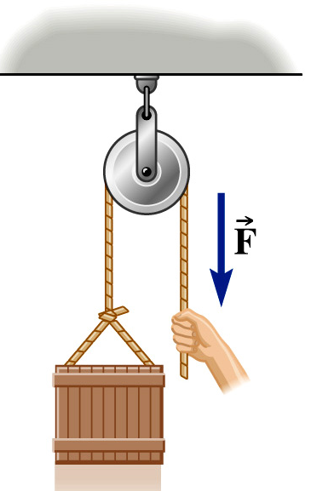
Contact Force: Tension
Tension in an Ideal String:
  Magnitude of tension is equal everywhere.
  Direction is parallel to string (only pulls)
Example : Determine force applied to string to suspend 45 kg mass hanging over pulley: Answer:
  FBD
  ΣF = ma
From Prelecture
F = mg
= 440 Newtons

Slide 9
Pulley ACT
Two boxes are connected by a string over a frictionless pulley. In equilibrium, box 2 is lower than box 1. Compare the weight of the two boxes.
A) Box 1 is heavier
B) Box 2 is heavier
C) They have the same weight
T
1
ΣF = m a
1) T - m₁ g = 0
2) T – m₂ g = 0
=> m₁ = m₂
T
1
2
m₁g
2
m₂g

Slide 10
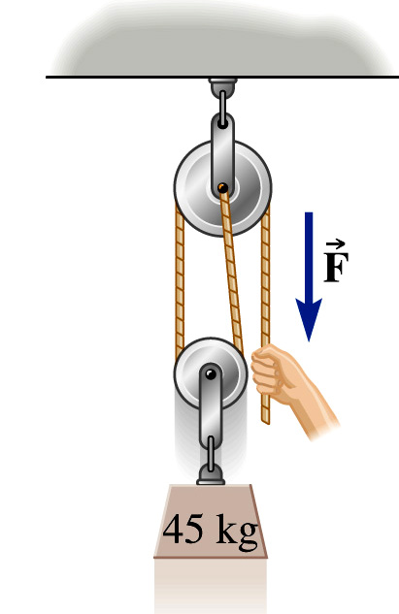
Tension Example:
Determine the force exerted by the hand to suspend the 45 kg mass as shown in the picture.
A) 220 N B) 440 N C) 660 N
D) 880 N E) 1100 N
y
T
x
T
ΣF = m a
T + T – W = 0
2 T = W
T = m g / 2
= (45 kg x (9.8 m/s²)/ 2
= 220 N
W
Remember the magnitude of the tension is the same everywhere along the rope!

Slide 11
Tension ACT II
Determine the force exerted by the ceiling to suspend pulley holding the 45 kg mass as shown in the picture.
y
A) 220 N B) 440 N C) 660 N
D) 880 N E) 1100 N
F_{c}
x
ΣF = m a
F_{c} -T - T – T = 0
F_{c} = 3 T
F_{c} = 3 x 220 N = 660 N
T
Remember the magnitude of the tension is the same everywhere along the rope!

Slide 12
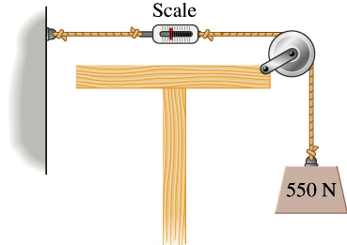
Springs Preflight
What does scale 1 read? (91% got correct!)
A) 225 N B) 550 N C) 1100 N
The magnitude of tension in a ideal string is equal everywhere.
1

Slide 13
Excused absences
You must have appropriate documentation (in writing) in order to have a valid excuse from a class. If you are too sick to get out of bed you should call Dial-a-Nurse. Please complete the ABSENCE FORM and take it along with the appropriate documentation relating to your absence to Room 231/233 Loomis as soon as you return to class. The deadline for submitting an excuse is within TWO weeks of the absence. (Excuses from the emergency dean must be turned in within ONE week of the date on the letter.) .
Excuses need to be taken to Loomis room 231/233 in person.
(An EX means that the absence will not count against your grade, but an AB becomes a zero.) Please be sure to indicate your section(s) and TA name(s) of the classes you missed on the ABSENCE FORM.

Slide 14
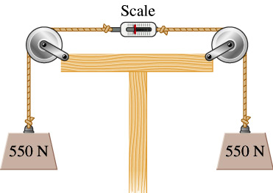
Springs ACT
Scale 1 reads 550 Newtons. What is the reading on scale 2?
A) 225 N B) 550 N C) 1100 N
In both cases the NET FORCE on the spring is zero, and the force to the right is 550N. Therefore the force to the left is also 550 N.
1
2

Slide 15
Forces in 2 Dimensions: Ramp
Calculate tension in the rope necessary to keep the 5 kg block from sliding down a frictionless incline of 20 degrees.
1) Draw FBD
2) Label Axis
N
T
Note, weight is not in x or y direction! Need to decompose it!
W
y
x
θ
Notes:
Tell them any choice is OK, but this way only have 1 force to decompose

Slide 16
Forces in 2 Dimensions: Ramp
Calculate force necessary to keep the 5 kg block from sliding down a frictionless incline of 20 degrees.
N
T
W
W sin θ
y
θ
W cos θ
x
θ
W
Notes:
T = W sin(theta) = 16.8 N

Slide 17
Forces in 2 Dimensions: Ramp
Calculate force necessary to keep the 5 kg block from sliding down a frictionless incline of 20 degrees.
x- direction
W sinθ – T = 0
T = W sinθ
= m g sinθ = 16.8 Newtons
N
y
T
x
θ
W
Notes:
Tell them any choice is OK, but this way only have 1 force to decompose

Slide 18
Normal Force ACT
What is the normal force of ramp on block?
A) F_{N} > mg B) F_{N} = mg C) F_{N} < mg
In “y” direction
ΣF = ma
N – W cos θ = 0
N = W cos θ
N
W sin θ
T
y
θ
W cos θ
W
x
N = m g cos θ
W
θ

Slide 19
Force at Angle Example
A person is pushing a 15 kg block across a floor with μ_{k}= 0.4 at a constant speed. If she is pushing down at an angle of 25 degrees, what is the magnitude of her force on the block?
x- direction: ΣF_{x} = ma_{x}
F_{push} cos(θ) – F_{friction} = 0
F_{push} cos(θ) – μ F_{Normal} = 0
F_{Normal} = F_{push} cos(θ) / μ
Combine:
(F_{push} cos(θ) / μ)–mg – F_{Push} sin(θ) = 0
F_{push} ( cos(θ) / μ - sin(θ)) = mg
F_{push} = m g / ( cos(θ)/μ – sin(θ))
y- direction: ΣF_{y} = ma_{y}
F_{Normal} –F_{weight} – F_{Push} sin(θ) = 0
F_{Normal} –mg – F_{Push} sin(θ) = 0
F_{push} = 80 N
Normal
Pushing
y
θ
x
θ
Friction
Weight
Notes:
Could do this on over head to help people work through it.

Slide 20
Summary
Contact Force: Spring
  Can push or pull, force proportional to displacement
  F = k x
Contact Force: Tension
  Always Pulls, tension equal everywhere
  Force parallel to string
Two Dimensional Examples
  Choose coordinate system
  Analyze each direction is independent
Notes:
hhh

