Slide 1
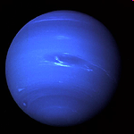
Kinematics + Dynamics
Exam I
Physics 101: Lecture 04
Today’s lecture will cover Textbook Chapter 4
iclicker scores have been
imported again – please check!
If you are new to the course,
please read the course description
on the course web page (and email policy from Lecture 1 note)!
neptune

Slide 2
What’s Most Difficult
I am finding vectors as the most difficult problems in class right now.
The concept with the kinetic and static forces.
Trying to remember the formulas and im rusty with trig so all the sin, cos, and tan is tricky for me.
Tension / setting up problem / vectors / free body diagrams.
pulley problems
remembering to do the prefilghts / Staying awake.

Slide 3
You can review vectors using the textbook!!!
Pages 28-35 of Textbook
This also includes trigonometry
Also see course web site.

Slide 4
Discussion book answers are posted online before the session!
Quiz answers posted too but after the session.

Slide 5
Review
Kinematics : Description of Motion
  Position
  Displacement
  Velocity v = Δx / Δt
    average
    instantaneous
  Acceleration a = Δv / Δt
    average
    instantaneous
  Relative velocity: v_{ac} = v_{ab} + v_{bc}

Slide 6
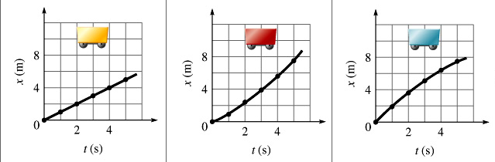
Preflight 4.1
…interpreting graphs…
(A) (B) (C)
Which x vs t plot shows positive acceleration?
89% got this correct!!!!
“This shows that more distance is being covered per second as the graph proceeds. This means that the speed of the car is increasing which means a positive acceleration.
”

Slide 7
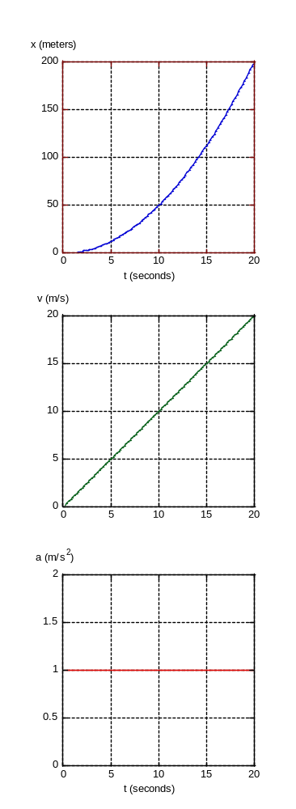


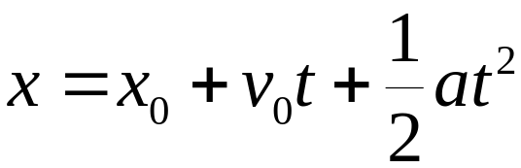
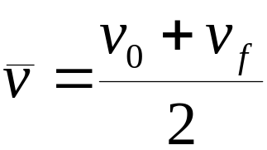
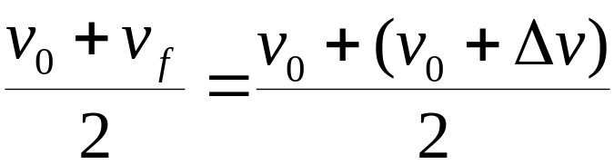
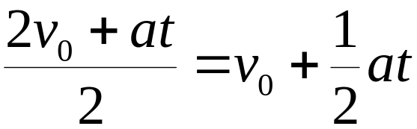
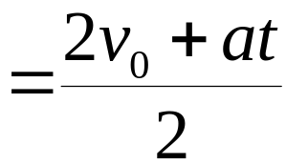
Equations for Constant Acceleration
(text, page 113-114)
x = x₀ + v₀t + 1/2 at²
v = v₀ + at
v² = v₀² + 2a(x-x₀)
Δx = v₀t + 1/2 at²
Δv = at
v² = v₀² + 2a Δx
14
Notes:
X = x_o + v_avg t
V_avg = ½ (v_o+v_f)

Slide 8
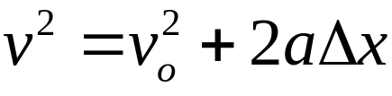
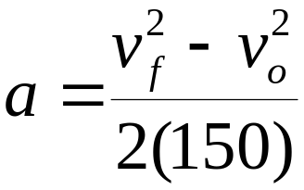
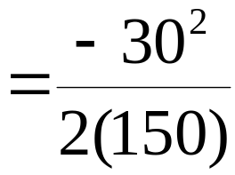
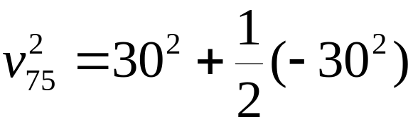
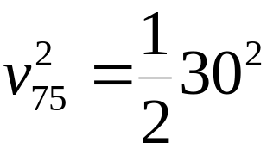
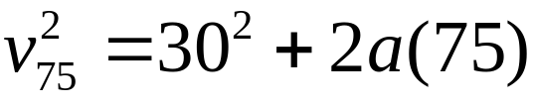
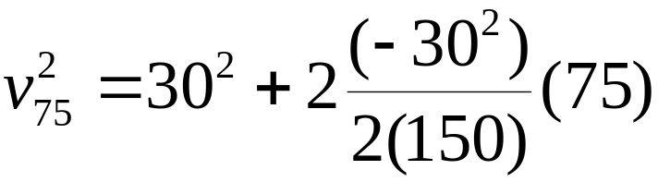
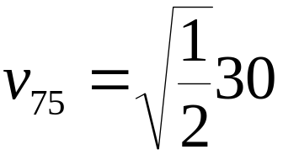

Kinematics Example
A car is traveling 30 m/s and applies its breaks to stop after a distance of 150 m.
How fast is the car going after it has traveled ½ the distance (75 meters) ?
A) v < 15 m/s B) v = 15 m/s C) v > 15 m/s
Notes:
V^2=v^2+2ax
A = v@-v^2 / (2 x)
= -30^2 / 300 = -3
V^2 = V^2 + 2 a (x)
= 30^2 + 2 (-3)(75)
= 21 m/s

Slide 9
Acceleration ACT
A car accelerates uniformly from rest. If it travels a distance D in time t then how far will it travel in a time 2t ?
A. D/4
B. D/2
C. D
D. 2D
E. 4D
Demo…
Correct x=1/2 at²
Follow up question: If the car has speed v at time t then what is the speed at time 2t ?
A. v/4
B. v/2
C. v
D. 2v
E. 4v
Correct v=at

Slide 10
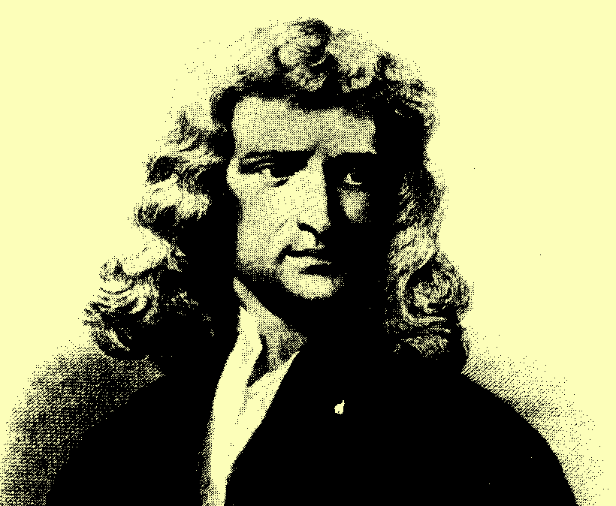
Newton’s Second Law ΣF=ma
position and velocity depend on history
Net Force determines acceleration

Slide 11
ACT
A force F acting on a mass m₁ results in an acceleration a₁.The same force acting on a different mass m₂ results in an acceleration a₂ = 2a₁. What is the mass m₂?
m₁
m₂
F
a₁
F
a₂ = 2a₁
(A) 2m₁ (B) m₁ (C) 1/2 m₁
F=ma
F= m₁a₁ = m₂a₂ = m₂(2a₁)
Therefore, m₂ = m₁/2
Or in words…twice the acceleration means half the mass

Slide 12

Example:
A tractor T (m=300Kg) is pulling a trailer M (m=400Kg). It starts from rest and pulls with constant force such that there is a positive acceleration of 1.5 m/s². Calculate the horizontal thrust force on the tractor due to the ground.
y
x
F_{Th} = 1050 N
X direction: Tractor
ΣF = ma
F_{Th} – T = m_{tractor}a
F_{Th} = T+ m_{tractor}a
N
N
T
F_{Th}
T
W
W
Combine:
F_{Th} = m_{trailer}a + m_{tractor}a
F_{Th} = (m_{trailer+}m_{tractor} ) a
X direction: Trailer
ΣF = ma
T = m_{trailer}a
Notes:
Do this on overhead!

Slide 13
Net Force ACT
Compare F_{tractor} the net force on the tractor, with F_{trailer} the net force on the trailer from the previous problem.
A) F_{tractor} > F_{trailor}
B) F_{tractor} = F_{trailor}
C) F_{tractor} < F_{trailor}
ΣF = m a
F_{tractor} = m_{tractor} a
= (300 kg) (1.5 m/s²)
= 450 N
F_{trailer} = m_{trailer} a
= (400 kg) (1.5 m/s2)
= 600 N

Slide 14
Pulley Example
Two boxes are connected by a string over a frictionless pulley. Box 1 has mass 1.5 kg, box 2 has a mass of 2.5 kg. Box 2 starts from rest 0.8 meters above the table, how long does it take to hit the table.
y
Compare the acceleration of boxes 1 and 2
  A) |a₁| > |a₂| B) |a₁| = |a₂| C) |a₁| < |a₂|
x
1) T - m₁ g = m₁ a₁
2) T – m₂ g = -m₂ a₁
2) T = m₂ g -m₂ a₁
1) m₂ g -m₂ a₁ - m₁ g = m₁ a₁
a₁ = (m₂ – m₁)g / (m₁+m₂)
T
1
T
1
2
2
m₁g
m₂g
Notes:
Do this on transparency

Slide 15
Pulley Example
Two boxes are connected by a string over a frictionless pulley. Box 1 has mass 1.5 kg, box 2 has a mass of 2.5 kg. Box 2 starts from rest 0.8 meters above the table, how long does it take to hit the table.
y
Compare the acceleration of boxes 1 and 2
  A) |a₁| > |a₂| B) |a₁| = |a₂| C) |a₁| < |a₂|
x
a₁ = (m₂ – m₁)g / (m₁+m₂)
a = 2.45 m/s²
Δx = v₀t + ½ a t²
Δx = ½ a t²
t = sqrt(2 Δx/a)
t = 0.81 seconds
T
1
T
1
2
2
m₁g
m₂g

Slide 16
Summary of Concepts
Constant Acceleration
x = x₀ + v₀t + 1/2 at²
v = v₀ + at
v² = v₀² + 2a(x-x₀)
F = m a
  Draw Free Body Diagram
  Write down equations
  Solve
Next time: textbook section 4.3, 4.5

