Slide 1

E-Commerce Data Analysis of Rechargeable Lint Removers
A data-driven approach to enhance consumer electronics purchasing decisions on e-commerce platforms.

Slide 2


The Problem: Navigating E-Commerce Complexity
1
Overwhelming Choices
Customers face a vast array of rechargeable lint removers on sites like Flipkart, making product selection difficult.
2
Varied Product Attributes
Significant differences in price, ratings, discounts, brand reputation, stock, and delivery times create confusion.
3
Lack of Easy Comparison
Without objective comparison tools, buyers struggle to make informed decisions, leading to potential dissatisfaction.
4
The Need for Clarity
There is a clear demand for a data-driven solution to objectively analyze and compare products.

Slide 3
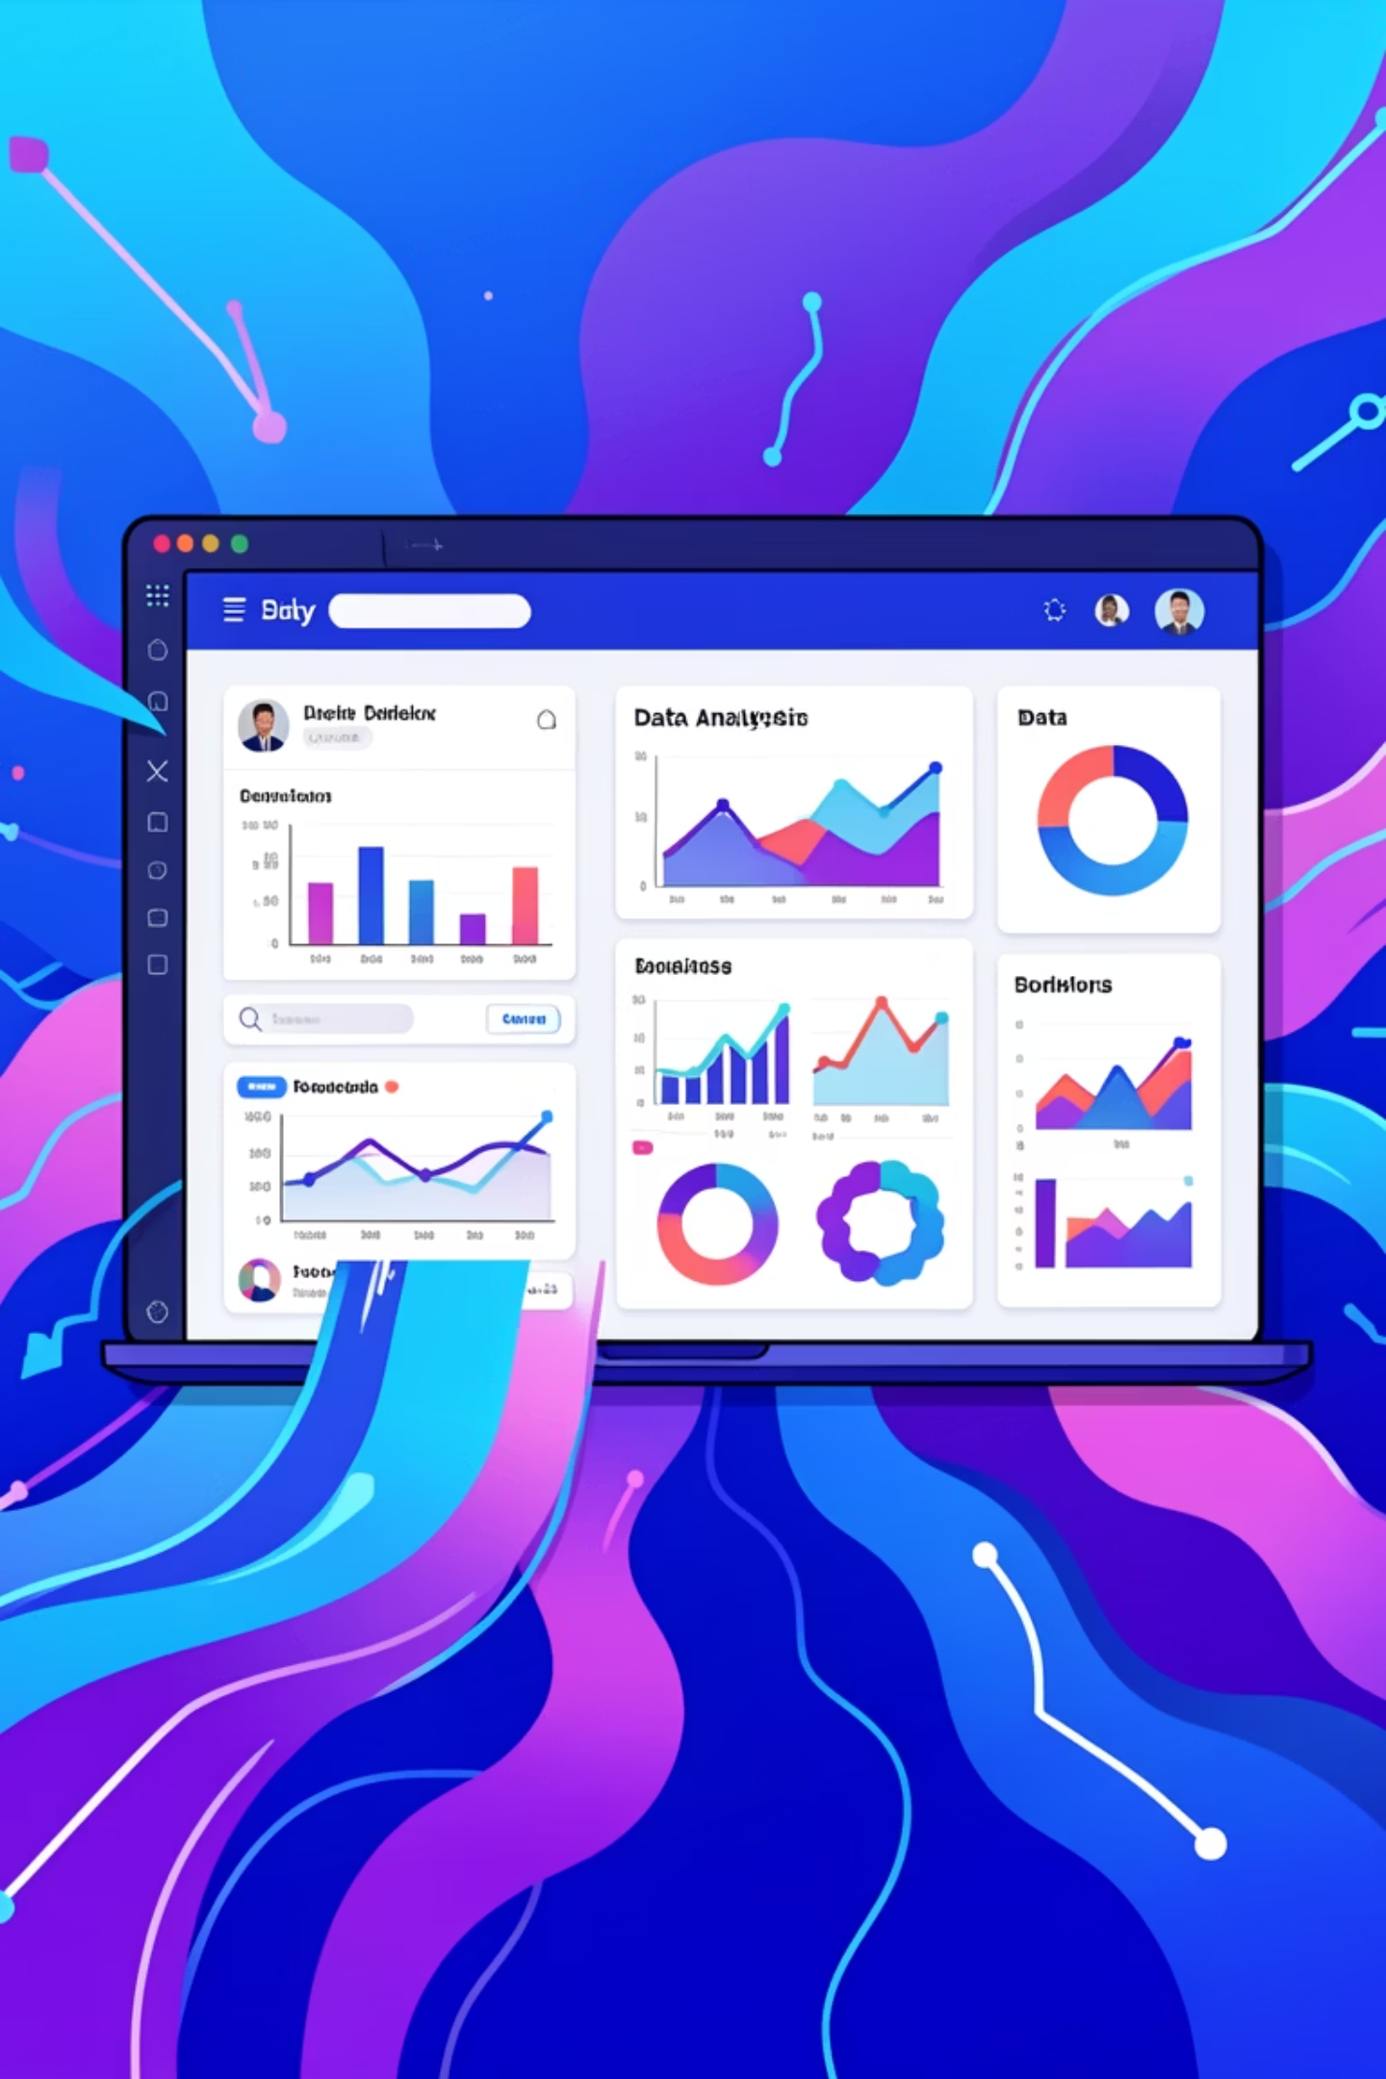



Our Data-Driven Solution
Web Scraping
Automated extraction of product data from Flipkart using Python and BeautifulSoup.
Data Analysis
Cleaning and analysis of collected data using Pandas to uncover key insights.
Empowering Buyers
Generating actionable insights to help consumers make smarter purchasing choices.

Slide 4
Project Objectives: Guiding Our Analysis
Extract Product Details
Analyze Pricing & Affordability
Gather comprehensive information on rechargeable lint removers from Flipkart listings.
Understand price distribution and identify budget-friendly options.
Compare Ratings & Satisfaction
Study Discount Patterns
Evaluate customer feedback and satisfaction across various brands.
Uncover trends in promotional strategies and their impact.
Assess Availability & Delivery
Identify Value-for-Money
Monitor stock levels and analyze shipping timelines.
Pinpoint products offering the best combination of quality and price.

Slide 5
Methodology: Our Workflow
01
02
Data Collection
Information Extraction
Collect HTML pages from Flipkart listings for rechargeable lint removers.
Scrape product names, prices, ratings, brands, reviews, discounts, and availability.
03
04
Data Cleaning & Preprocessing
Exploratory Data Analysis (EDA)
Standardize and refine the raw data for accurate analysis.
Conduct initial analysis to discover patterns, anomalies, and test hypotheses.
05
06
Insight Generation & Visualizations
Reporting
Develop clear insights and graphical representations of findings.
Export results to CSV for easy sharing and further analysis.

Slide 6

Key Analyses Performed
Price distribution of rechargeable lint removers.
Average ratings by brand for customer satisfaction.
Relationship between discount percentages and product ratings.
Comparison of in-stock versus out-of-stock item availability.
Analysis of sponsored vs. organic product listing prevalence.
Identification of high-rated, affordably priced products.

Slide 7
Insights from Our Data
Budget-Friendly Focus
High Satisfaction
Discounts & Ratings
Most rechargeable lint removers fall within the budget to mid-range price categories.
Customer ratings are generally high, indicating strong product performance satisfaction.
The size of a discount does not significantly influence product ratings, suggesting inherent quality drives satisfaction.
Organic Dominance
Limited High-Value Options
Organic product listings are more prevalent than sponsored listings on Flipkart for this category.
While high-quality, affordable lint removers exist, their availability is relatively limited.

Slide 8
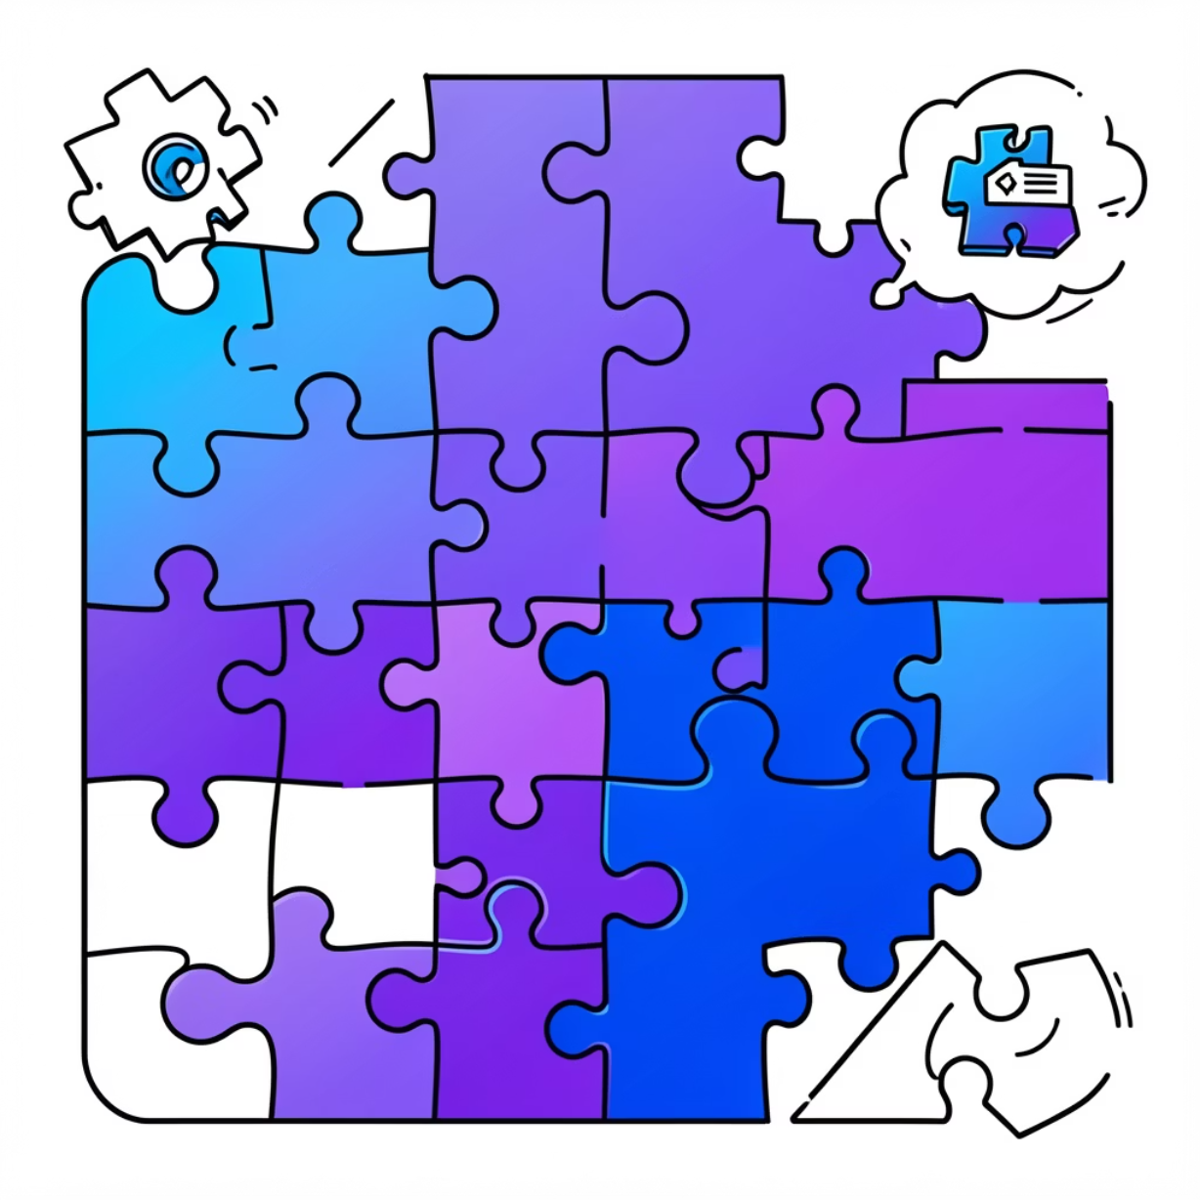
Overcoming Challenges
Challenges Faced
Solutions Implemented
Inconsistent HTML structures across product listings.
Developed robust parsing logic to handle HTML variations.
Missing review or discount information.
Employed careful handling and imputation for missing values.
Duplicate product entries from multiple pages.
Implemented deduplication algorithms to ensure data accuracy.
Limited availability of structured review data.
Documented assumptions for unavailable data transparently.

Slide 9





Tools & Technologies
Python
BeautifulSoup
Pandas
Core programming language for scripting and data manipulation.
Library for parsing HTML and XML documents.
Data analysis and manipulation library.
NumPy
Matplotlib
Jupyter Notebook
Fundamental package for numerical computing.
Library for creating static, animated, and interactive visualizations.
Interactive computing environment for analysis and visualization.
GitHub
Platform for version control and collaborative development.

Slide 10
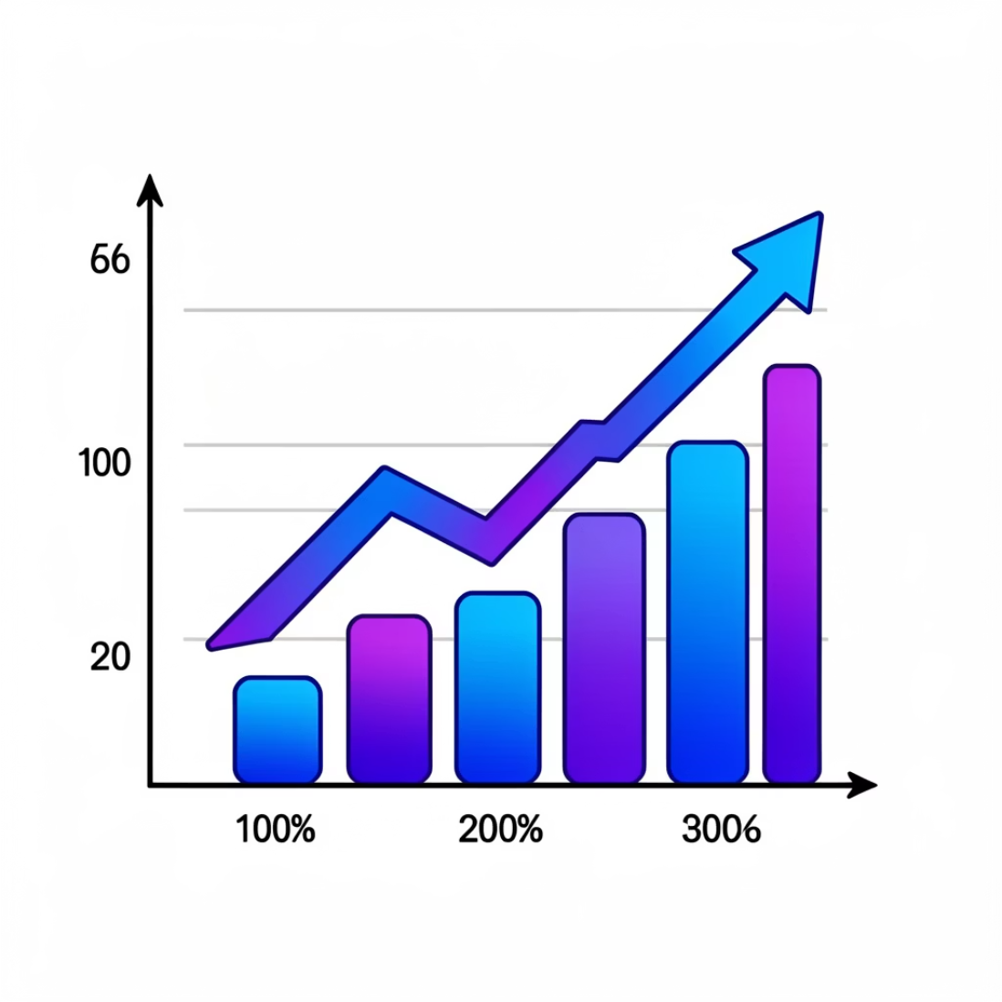
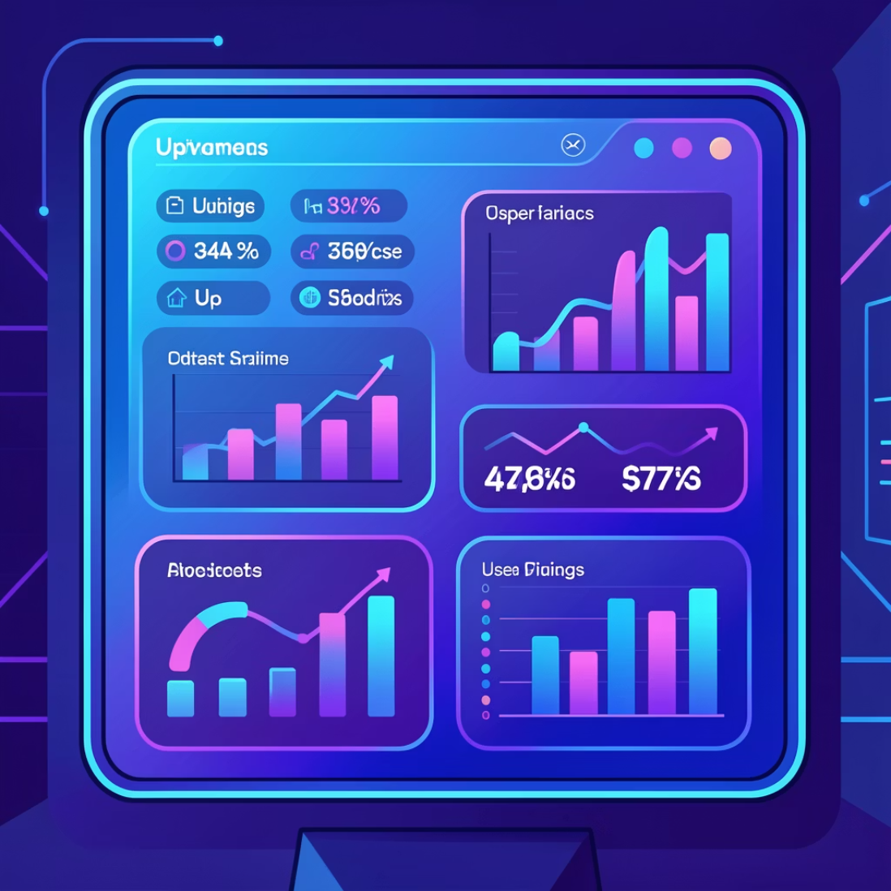
Conclusion & Future Enhancements
Conclusion
Future Enhancements
This project successfully demonstrates how data analysis can resolve real consumer dilemmas. By providing clear, data-driven insights into rechargeable lint remover products, we enable users to compare options effectively and make intelligent purchasing decisions.
Integrate Sentiment Analysis of customer reviews for deeper insights into product perception.
Develop Real-time Scraping capabilities using e-commerce APIs for up-to-the-minute data.
Implement a Recommendation System to personalize product suggestions for users.
Create Interactive Dashboards for consumers to explore data intuitively.

