Slide 1
Customer Purchase
Frequency Analysis
• Data Understanding
• Transformation
• Dashboard
• Business Insights
- Asha
1

Slide 2
Agenda
01 Problem Statement
02 Objectives & Expected Solutions
03 Data Collection & Understanding
04 Data Cleaning
05 Transformation & Rough Dashboard
06 Final Dashboard
07 Tools, Results & Future Enhancements
2

Slide 3
1. Problem Statement
• Customer purchasing behavior varies: one-time, occasional, frequent and loyal buyers.
• Customers are currently treated similarly in marketing campaigns and promotional efforts.
• Equal distribution of discounts and promotions can lead to inefficient marketing spending.
• The company needs segmentation to prioritize customers with higher long-term value.
KEYWORD
Customer Segmentation
FOCUS
Retention
Lifetime Value
3

Slide 4
2. Objective
• Analyze customer purchase frequency and understand purchasing behavior.
• Identify expected product stocking based on stock-out and purchase patterns.
• Evaluate expected discounts, product quality and availability of most-liked products.
• Use the findings to support customer retention and long-term customer value growth.
PRIMARY OUTCOME
Better retention planning
BUSINESS VALUE
Efficient marketing resources
DECISION AREA
Product & discount strategy
4

Slide 5
3. Expected Solutions
• Which customers are repeat buyers?
• Which customers purchase only once?
• How often do customers return to buy again?
• Which customers generate the highest lifetime value?
• Which products sell fast without a discount?
• Which products are frequently purchased by regular customers?
• Should additional benefits be provided to all customers?
5

Slide 6
4. Data Collection
CUSTOMER DATA
• Customer ID
• Number
• Name
• Place
• Age
• Gender
• Phone Number
• Customer Category
PURCHASE DATA
• Purchase dates
• Payment amounts
• Payment modes
• Card types
• Purchase months
• No. of Purchases
PRODUCT & SALES
• Product ID • Code • Name
• Category
• Price
• Discount
• Availability
• Stock-out
• Restock
• Sales Frequency
CUSTOMER BENEFITS
• Benefit Product
• Customer Benefit
• Discount
• Purchase Frequency
• Membership
DATASET
1,800 rows generated using ChatGPT
6

Slide 7
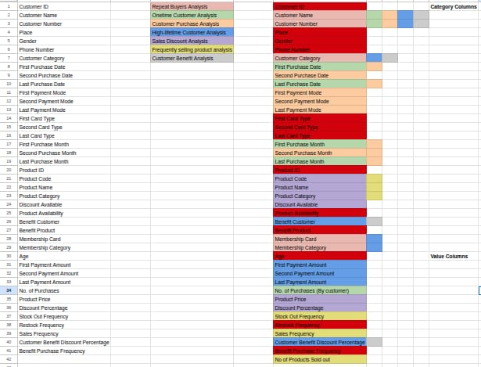
5. Data Understanding
Understanding the fields required to answer the business questions
7

Slide 8
6. Data Cleaning
• Typical cleaning activity: remove/replace null or empty records.
• Incorrect or inconsistent values may need standardization (example: C = Complete, Y = Yes).
• For this project, the generated dataset did not contain the stated mismatches, so no such corrections were required.
• The cleaned data was then prepared for transformation and analysis.
PROJECT NOTE
No major data mismatch was encountered.
8

Slide 9
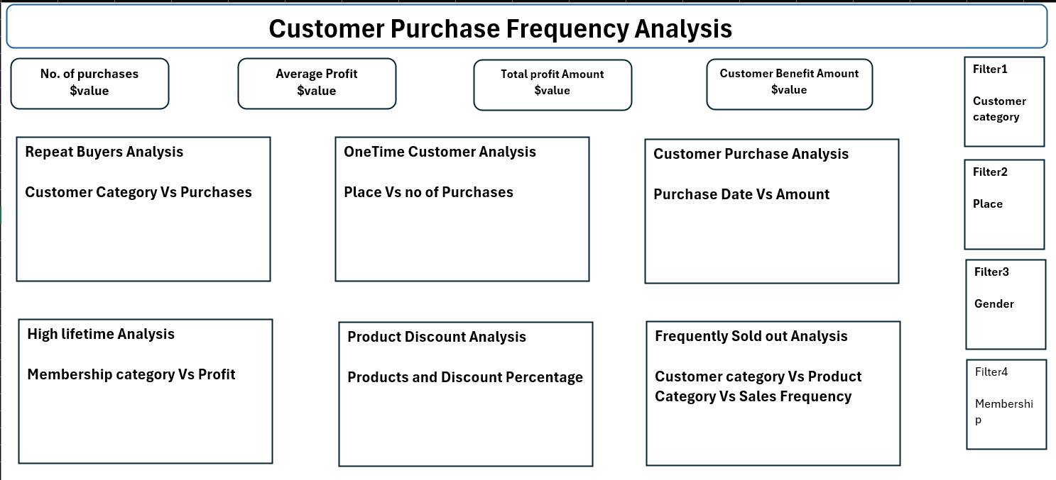
7. Data Transformation & Rough Dashboard
• Added No. of Products Sold Out to support stock-out analysis.
• Added Original Product Price to support price and discount comparisons.
• Calculated Profit and Profit Amount for business-value analysis.
• Calculated Customer Benefit Amount to evaluate customer benefits.
• Created a rough dashboard to define the final dashboard structure.
9

Slide 10
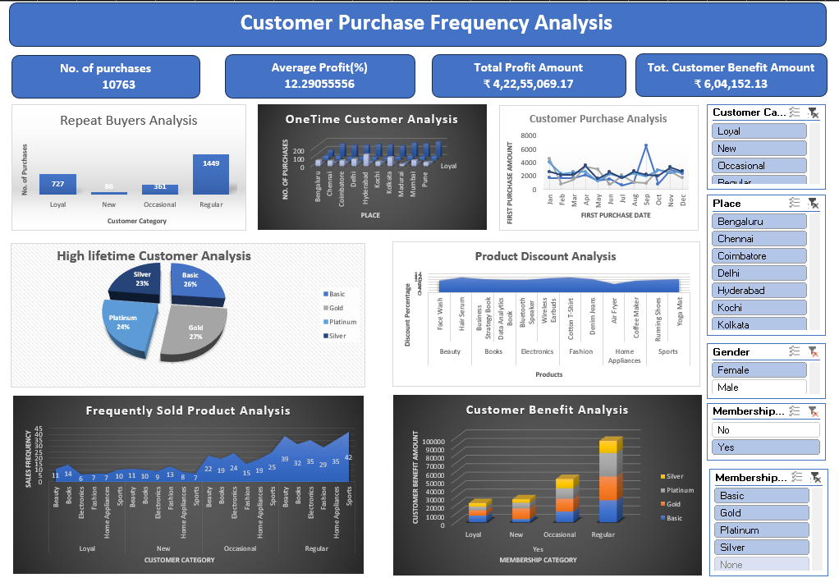
8. Final Dashboard
Final dashboard / data-understanding visuals from the report
10

Slide 11
9. Tools & System Configuration
AI TOOL
ChatGPT — Data Collection
ANALYSIS TOOL
Excel 2024
ANALYSIS METHOD
Pivot Table
OPERATING SYSTEM
Windows
SYSTEM
477GB Storage • 16GB RAM
11

Slide 12
10. Results & Business Impact
• Purchase frequency analysis identifies different customer purchasing behaviors.
• Customer categories can be used to guide retention and promotional strategies.
• Product and discount variations can be modified based on observed purchasing patterns.
• The analysis helps address major retail business problems around customers, products and benefits.
KEYWORDS
• Retention
• Customer Value
• Discounts
• Product Availability
12

Slide 13
11. Future Enhancements
MIGRATION TO ADVANCED BI
Move from Excel to Power BI or Tableau for stronger dashboard interactivity, automated refreshes and better scalability.
SENTIMENT & FEEDBACK
Add customer feedback or product-review data to examine how product quality correlates with purchase frequency.
NEXT STEP
Combine transactional behavior with richer customer and product feedback.
13

Slide 14
12. References:
https://ieeexplore.ieee.org/abstract/document/11541713
https://www.sciencedirect.com/science/article/abs/pii/S156742230900009X
https://www.sciencedirect.com/science/article/abs/pii/S016792362300180X
https://documentation.bloomreach.com/engagement/docs/purchase-frequency-segmentation
https://luthresearch.com/glossary/frequency-of-purchase-analysis-uncovering-consumer-behavior-insights/

Slide 15
Thank You
14

