Slide 1
Python in Idrisi: An Introduction to idrtools
By A.J. Shatz

Slide 2
Introduction to Python
Python is a high-level language (like C, C++, Perl, Java, and JavaScript).
Python code is executed via an interpreter – code must execute one line at a time (unlike compiled code).
Python contains numerous variable types:
Integers, floats, strings, and booleans.
Lists, tuples, and dictionaries.
Python also contains many statements and operations:
Conditional statements (if, else, and, or, elif, not)
Loops (while and for)
Python allows users to read/write text files (.txt, .csv, .rgf, .rcl, .avl, etc.)

Slide 3
Utility of Python in GIS
Allows for easier batch processing of GIS data.
Grants users the options to develop specialized research tools.
Ensures accuracy and repeatability of both batch processes and tool execution.
Fosters a greater community of users creating and sharing tools online.

Slide 4
The IDRISI Environment (using Python)
The idrtools module: allows users to access the COM server for the IDRISI API.
Before:
Now:
idrtools contains valuable tools that:
Have similar functionality to Idrisi Explorer.
Allow you to write Idrisi-specific files.
Access the Idrisi API to run modules.

Slide 5
The Project Object – Your very own Idrisi Explorer
The project object, defined by the class IdrisiExplorer(), serves the function of Idrisi Explorer by allowing users to:
Access working and resource directories.
Listing files in project directories.
Changing file type filters for file listings.
Creating and setting new projects
It begins with:
object = IdrisiExplorer(‘Project Name’)

Slide 6
Utility of the Project Object in idrtools
Add or remove resource directories:
object.addResourceDir(path) – add resource directory
object.remResourceDir(path) – remove resource directory
object.remAllResourceDir() – remove all resource directories
List working and resource directories in your workspace:
object.getProjectDirs() – creates list of project directory file paths
object.getWorkingDir() – object.getProjectDirs()[0]
object.getResourceDirs() – object.getProjectDirs()[1:]
List files in a directory:
object.ListFile(directory, wildcard, case sensitivity, filter) – lists files in a directory according to optional wildcard, case sensitivity, and file filter

Slide 7
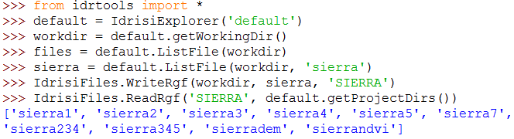
Reading and Writing files in Idrisi – IdrisiFiles()
Read and write raster group files.
Read Documentation Files (.rdc, .vdc, .adc)
Read .avl files and store values as a list and write .avl files
Write .rcl files for customized reclassifications.
Ex. IdrisiFiles.WriteRgf() and IdrisiFiles.ReadRgf():

Slide 8

Using IDRISI modules in Python – idrtools.modules
Allows for easier use of IDRISI modules while preserving traditional macro parameter values.
Ex. Composite:
Before:
Now:

Slide 9
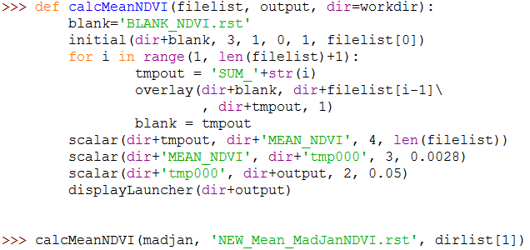
Batch processing in Python
Ex. Madagascar Mean NDVI Calculation:

Slide 10
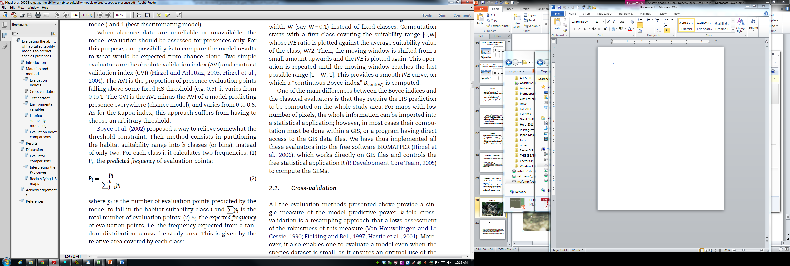
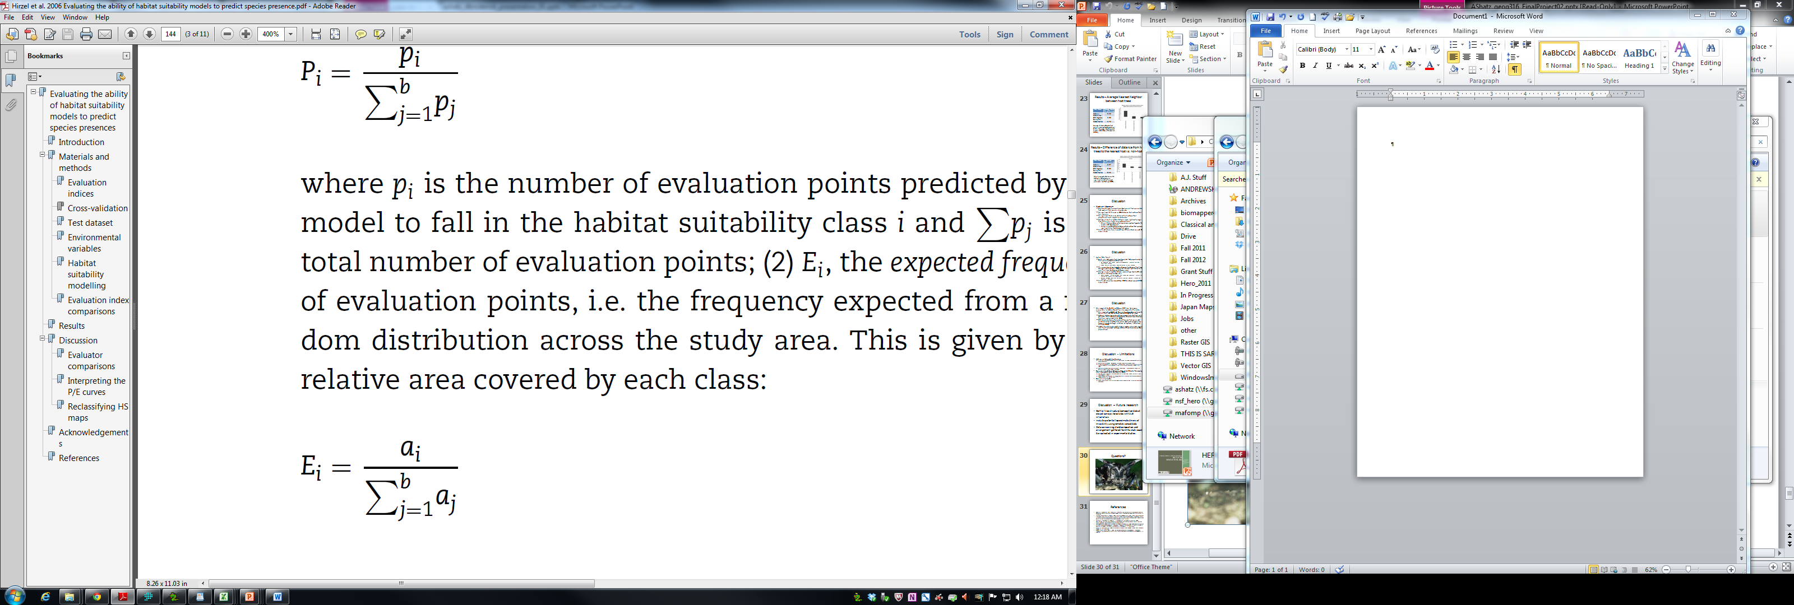
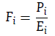
Customized Idrisi tools – Boyce Continuous Index
Divide SDM/HSM model output (0 – 1.0) into user-defined thresholds/classes (b)
Calculate Predicted Frequency
Proportion of all validation locations (p) within threshold/class (b)
Calculate Expected Frequency
Proportion of total study area (a) within the threshold /class (b)
Predicted/Expected Ratio
ratio of Predicted Frequency to Expected Frequency
Boyce Index – Spearman’s Rho of P/E ratio and average habitat suitability across all thresholds/classes.
Ranges from -1 to 1, where 1 indicates good model performance, -1 indicates poor model performance, and 0 indicates models no better than random
Boyce Continuous Index
Define window W
Calculate P/E ratio within window W
Move the window slightly and recalculate P/E for all possible windows.
(1)
(2)
(3)
0
SDM Soft Classification Values
1.0
b
W

Slide 11

The IDRISI/Python Personal Toolbox – idrtools.mytools
Ex. Boyce Continuous Index

Slide 12
Benefits of idrtools
Provides users an easier way to access IDRISI Explorer and Modules using a Python shell.
Allows for easier and more customizable batch processing and tool development.
Harbors a better environment for IDRISI tool creation and sharing online.

Slide 13
Getting idrtools for your PC
System requirements:
Python v2.7 – Version 2.7.5 is currently available at www.python.org
Pywin32 - http://sourceforge.net/projects/pywin32/files/?source=navbar

Slide 14
Getting idrtools for your PC
All files for the project are stored on GitHub:
https://github.com/Ashatz/idrtools_v0
if github_account == True: # If you have a GitHub account…
github_login() # Login
github_follow(‘Ashatz’) # and Follow me
else: #If not…
github_create_account() # create one NOW!!!

Slide 15
Getting idrtools for your PC
If you thought that the Python jokes were over…
def git_stuff(repo)
github_navigate(repo) # Follow the link posted earlier to the idrtools
repository
github_watch(repo) # Watch the repository for updates
github_fork(repo) # Fork this repository to your own
repository
github_clone(repo) # Copy the files to your desktop
Git_stuff(‘idrtools_v0’) # Do all of this before continuing please…

Slide 16
Getting idrtools for your PC
Now that we are on a roll…
def unpack_repo(repo): # Unpack the repository
unzip(repo) # Extract all files within the repo to
your desktop or directory of choice
copy_repo(repo) # Navigate to
‘C:\Python27\Lib\site-packages\
and copy the unzipped ‘idrtools’
directory here.
unpack_repo(‘idrtools_v0’)

Slide 17
Other useful packages
Numpy – Allows for mathematical computation of data.
Scipy – Allows for statistical analysis of data.
You can find all of the packages you will ever want and need here:
http://www.lfd.uci.edu/~gohlke/pythonlibs/

Slide 18
Tutorial Material
Using Idrisi with Python: An Introduction to the idrtools Package
Currently under development.
Goes over Project Object setup and Idrisi file creation.
Addresses data visualization and batch processing using Idrisi modules.

Slide 19
I need help!
If you would be interested in helping develop idrtools:
Please send me an email at ashatz.hero@gmail.com
Tell me what you would like to do
Follow me on GitHub
Experiment with the software and find bugs…there are plenty to go around.

Slide 20


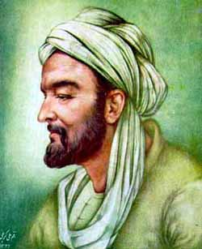
Questions?

