Slide 1
TITLE:
“E-SPEAK”
Submitted to :
Research Management Cell
Pokhara Engineering College
2025
PRESENTED BY:-
ASHBIN RAJBOMSI (21075356)
DHIREN SEN THAKURI (21075361)
SANTOSH BANIYA (21075380)
Notes:
Good morning, everyone. Its me Ashbin Rajbomsi,and my fellow friends Dhiren Sen Thakuri and Santosh Baniya,
We’re presenting our final year project titled E-Speak

Slide 2
OUTLINE:
INTRODUCTION
STATEMENT OF PROBLEM
OBJECTIVES
SCOPE OF PROJECTS
LIMITATIONS
LITERATURE REVIEW
METHODOLOGY
PROJECT SCHEDULE
EXPECTED OUTCOMES
REFERENCES

Slide 3
1.INTRODUCTION:-
In Nepal, civic issues are often reported informally, causing delays in government response. Our system provides a smart, location-based platform where citizens can report problems, engage the community, and automatically alert authorities making local governance faster, transparent, and community-driven.
Notes:
In Nepal, civic issues like road damage, sanitation problems, or broken streetlights are often reported informally through verbal complaints or social media. This leads to delays and inefficiencies in government response.
Our project offers a Progressive Web App that leverages AI and NLP to enable structured, location-based reporting and smarter interaction between citizens and authorities.

Slide 4
2.STATEMENT OF PROBLEM:-
Citizens have no structured way to report and track local civic issues.
Authorities receive delayed, duplicate, or low-priority complaints.
There's no smart system to escalate issues based on public urgency or engagement.
Notes:
In Nepal, there’s no structured system for citizens to report and track local issues. As a result, authorities often receive delayed, duplicate, or low-priority complaints and there’s no smart way to prioritize or escalate issues based on public need or engagement. Our project aims to address these gaps.

Slide 5
3.OBJECTIVES:-
Our project aims to achieve key objectives that include:
Develop a PWA for structured, AI-powered civic issue reporting.
Foster community engagement through interactive features and smart notifications.
Support efficient government response with automated alerts and real-time data insights.
Notes:
Our project focuses on three key objectives: developing a PWA for AI-powered civic issue reporting, fostering community engagement through interactive features and smart notifications, and supporting efficient government response with automated alerts and real-time insights.

Slide 6
4.SCOPE OF PROJECTS:-
This project will develop a PWA for structured, location-based civic issue reporting with AI-powered classification, sentiment analysis, and duplicate detection. It will enhance citizen participation through voting and smart notifications and enable automated alerts to authorities based on issue priority and public feedback.
Notes:
We are developing a Progressive Web App for structured civic issue reporting, using AI for classification, sentiment analysis, and duplicate detection. The platform will boost citizen participation and send automated alerts to authorities based on issue priority and public feedback.

Slide 7
5.LIMITATIONS:-
The project does have some limitations:
The PWA may have limited functionality in offline or low-bandwidth areas.
AI may misclassify issues with unclear or incomplete data, especially for local languages.
It depends on active participation from both users and government officials.
Notes:
Our project does have a few limitations. The PWA(progressive web app) may face limited functionality in offline or low-bandwidth areas. AI might misclassify issues if the data is unclear or incomplete, especially in local languages. And finally, the system depends on active participation from both citizens and government officials for it to be effective

Slide 8
6.LITERATURE REVIEW:-
With the advancement of Civic Technology, various platforms have emerged that help bridge the gap between citizens and local governments. After researching existing systems, we found several platforms that allow users to report civic issues and track government responses. Over time, these platforms and research papers have shown to improve classification, urgency detection, and community engagement forming the foundation for our project.
FixMyStreet Website: https://fixmystreet.com Developed in the UK, FixMyStreet was one of the first civic tech platforms that allowed citizens to submit reports about local problems like potholes, broken streetlights, or graffiti. Reports were geotagged and forwarded to the relevant local authorities. However, the platform relied on manual sorting of issues, which often caused delays in response. (King & Brown, 2007)
SeeClickFix Website: https://seeclickfix.com Popular in the USA, SeeClickFix is a civic engagement platform where residents can report non-emergency issues. Like FixMyStreet, it enables location-based reporting, but early versions also lacked automation. Later iterations started adding features like community voting and status updates to improve engagement and transparency. (Meier, 2015)
Notes:
FOR Literature review ,Platforms like FixMyStreet and SeeClickFix showed how Civic Tech connects citizens with local governments, but early systems were manual and slow.
Recent research shows that AI and NLP improve issue classification and urgency detection, while transparency and privacy must be carefully managed.for that
Our project builds on these insights to create a smarter, more responsive civic engagement platform.

Slide 9
Research papers:-
AI & NLP Integration:
Recent research, such as Shin & Hwang (2020), shows how AI can automate classification of civic issues (e.g., pothole vs. trash problem), while NLP techniques analyze urgency from citizen sentiment. This greatly improves prioritization and helps governments respond faster.
2. Location-Based Reporting & Privacy:
GIS-based platforms can generate heatmaps of problem areas and send targeted alerts (Batty et al., 2012), but as Perng & Kitchin (2018) highlight, privacy concerns must be addressed when using location data from users.
3. Transparency & Feedback Loops Nam & Pardo (2011) found that platforms providing status updates (e.g., issue “received,” “in progress,” “resolved”) build citizen trust and encourage ongoing participation.
4. AI Challenges;
Mehrabi et al. (2021) highlight the risks of AI bias and misclassification, especially if models are not retrained regularly. Zhou et al. (2020) emphasize the importance of handling location and sentiment data ethically to avoid privacy violations.
Summary :
Early platforms were helpful but slow and manual. AI and NLP now enable smarter, faster systems but we must address privacy, fairness, and transparency to build a trusted civic engagement platform.

Slide 10
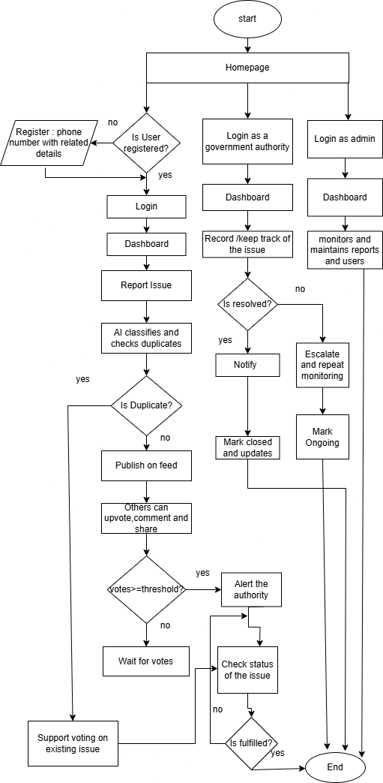
7.METHODOLOGY:-
FLOWCHART:-

Slide 11
Tools to be Used
For the dynamic front-end, strong back-end, flexible data handling, AI and NLP we will use the following tools to develop our system and the tools are given below:
1. For frontend:
a. HTML
b. CSS
c. JAVASCRIPT (React.JS)
2. For backend:
Django
3. Database
a. Mysql and PostgreSQL+ Post GIS
4. AI and NLP
TYPE | Tools/Libraries
Natural Language Processing (Text processing and Similarity) | SpaCY, NLTK, Text Blub, IndicNLP(For Nepali)
Translation | googletrans
Location Matching | Geopy, Post GIS
Classification (AI Models) | scikit-learn

Slide 12
8.PROJECT SCHEDULE
Milestones | Jun 2025 | July 2025 | Aug 2025 | Sept 2025 | Oct 2025 | Nov 2025 | Dec 2025 | Jan 2026
 | 4th week | 1st- 4th week | 1st- 4th week | 1st- 4th week | 1st- 4th week | 1st- 4th week | 1st- 4th week | 1st- 4th week
Project Planning
Literature Survey
System Designing and modeling
Front End Implementation
Back End Implementation
Documentation

Slide 13
9.EXPECTED OUTCOMES:-
Our project aims to achieve the following outcomes:
Efficient Issue Detection and Reporting
Increased Civic Participation and Awareness
Strengthened Community Collaboration
Notes:
Our project aims to deliver three key outcomes:
First, efficient issue detection and reporting through AI-powered classification and sentiment analysis.
Second, increased civic participation and awareness, encouraging citizens to engage more actively in local governance.
And third, strengthened community collaboration, where features like upvoting and commenting help drive collective action and problem-solving.

Slide 14
10.REFERENCES:-
Batty, M., Axhausen, K. W., Giannotti, F., et al. (2012). Smart cities of the future. European Physical Journal Special Topics, 214(1), 481–518.
Dey, L., Chakraborty, S., & Roy, S. (2021). NLP Techniques for Prioritization of Civic Complaints in Smart Cities. Journal of Urban Technology, 28(4), 145–162.
King, S. F., & Brown, P. (2007). FixMyStreet.com: Citizen-Government Collaboration via the Internet. Information Polity, 12(2), 145–157.
Linders, D. (2012). From e-government to we-government: Defining a typology for citizen coproduction in the age of social media. Government Information Quarterly, 29(4), 446–454.
Linders, D., & Wilson, S. C. (2014). What is civic technology? Proceedings of the 14th Annual International Conference on Digital Government Research, 171–172.
Liu, Y., Huang, H., & Yang, X. (2019). Addressing Data Biases in AI for Civic Tech Applications. AI & Society, 34(3), 635–647.
Mehrabi, N., Morstatter, F., Saxena, N., et al. (2021). A survey on bias and fairness in machine learning. ACM Computing Surveys (CSUR), 54(6), 1–35.
Meier, P. (2015). Digital Humanitarians: How Big Data Is Changing the Face of Humanitarian Response. CRC Press.Nam, T., & Pardo, T. A. (2011). Smart city as urban innovation. Proceedings of the 5th International Conference on Theory and Practice of Electronic Governance, 185–194.Perng, J., & Kitchin, R. (2018). Solutions, not solutions: Smart city rhetoric versus lived experience. Urban Studies, 55(15), 3290–3307.
Sheth, A., & Anantharam, P. (2015). The Semantic Web of Things: Smart Cities, Applications, and Challenges. IEEE Internet Computing, 19(4), 60–70.
Zhou, B., Liu, X., et al. (2020). Data privacy challenges in smart city applications. IEEE Communications Magazine, 58(6), 82–88.

Slide 15
THANK YOU EVERYONE !

