Slide 1
PROBLEM
After harvest, straw needs a buyer and a baler
A narrow window. Many fields. Scattered machinery and demand.
Farmers
Need a timely straw pickup option.
Operators
Need a clear dispatch queue.
Buyers
Need visible, traceable supply; this prototype does not establish actual demand.
Source: Parali Se Paisa concept note; operational workflow shown later is a synthetic prototype.
1
Notes:
Open with the practical coordination problem: residue has a short handling window; farmers, balers and buyers need a way to coordinate pickup. Our live evidence is satellite observation. The operating workflow is a prototype and uses synthetic records.

Slide 2
SOLUTION
One evidence-to-action workflow
Observe
Sentinel-2 field histories
Prioritize
Normalized burn risk score, not probability
Coordinate
Demo baler/buyer workflow
Record
Prototype QR metadata check
REAL DATA → RULE-BASED INTERPRETATION → DEMO/SYNTHETIC OPERATIONS → PROTOTYPE RECORD
Source: application prototype; see README for real-data and synthetic-mode boundaries.
2
Notes:
Explain the separation. Real mode is a read-only research view. The dispatch, buyer and evidence workflows are a separate synthetic prototype. No live service, verified registry, or incentive decision is claimed.

Slide 3
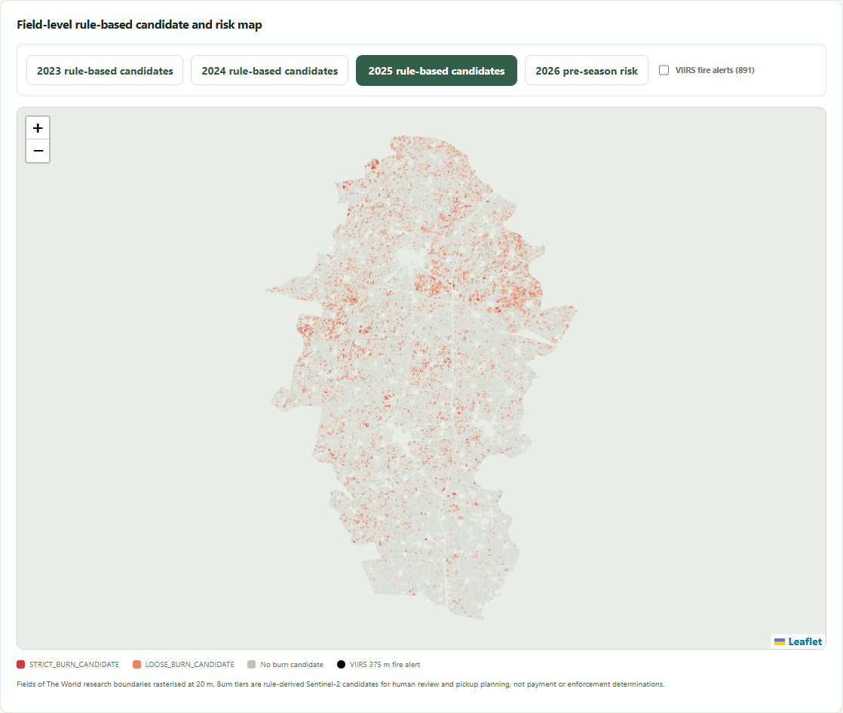
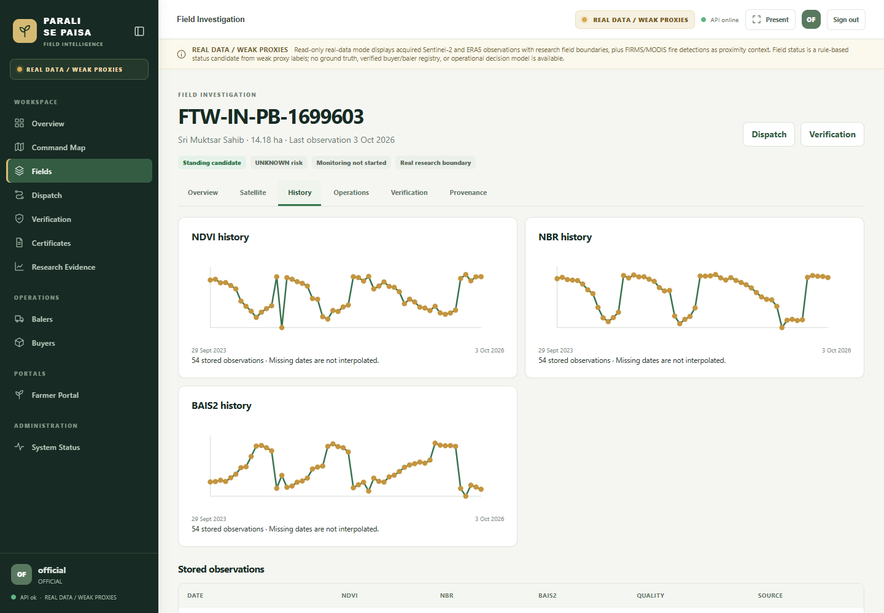
REAL DATA
Muktsar map and one field history, 2023–2026
74 Sentinel-2 scenes · 12.6 million field-date observations
REAL DATA · rule-based candidate map
REAL DATA · one field, stored observations
Source: fresh screenshots from isolated read-only real-data mode; 74 Sentinel-2 scenes, 12.6 million field-date observations; Fields of The World boundaries are model-derived.
3
Notes:
Show the district candidate map, then the selected field's dense satellite history. Missing dates are not interpolated. The field is an example, and the burn tiers are rule-based candidates, not independently validated labels.

Slide 4
REAL DATA · RULE-BASED
Candidate area depends on the rule tier
LOOSE_BURN_CANDIDATE
2023: 21,121 ha | 2024: 10,566 ha | 2025: 22,941 ha. Full-revisit, exploratory rule-based area.
STRICT_BURN_CANDIDATE
2023: 649 ha | 2024: 1,022 ha | 2025: 2,269 ha. Not a trend: haze/cloud changes clean pre-event coverage.
All outputs are RULE-BASED BURN CANDIDATES. Human review labels completed: 0.
Source: burn_candidate_summary.json and FINAL_JUDGE_EVIDENCE.md; full-revisit areas use non-overlapping 20 m pixels.
4
Notes:
The loose candidate area is exploratory and is the cross-season series shown. Strict area is precision-first but cannot be read as a year-to-year trend because clean pre-event coverage differs with haze and cloud. FIRMS/VIIRS is corroborative thermal context, not ground truth.

Slide 5
DIFFERENTIATOR
Optical candidates and thermal context answer different questions
8.8%
What the match means
About 9 in 10 strict optical burn candidates had no matched VIIRS active-fire detection within the defined matching window.
of 2025 strict optical candidates had a matched VIIRS active-fire detection within the defined window.
Interpretation
VIIRS is corroborative thermal context, not ground truth or a field-level confirmation.
Source: 2025 strict-candidate / VIIRS matching analysis; defined ≤5-day evidence window; 500 m centroid radius.
5
Notes:
In 2025, 8.8% of strict optical candidates had a matched VIIRS active-fire detection within the defined matching window. Say: About 9 in 10 strict optical burn candidates had no matched VIIRS active-fire detection within the defined matching window. Do not call this missed fires. Candidates are rule-based and VIIRS is corroborative thermal context.

Slide 6
ACTION CONTEXT
A reported straw figure needs its source
12.1 lakh tonnes
The Tribune reported this straw estimate. It is not an official statistic.
From estimate to action
The product concept connects field evidence to straw pickup planning; actual supply and buyer demand still need field confirmation.
Attribution stays with the number wherever it appears: The Tribune (reference 11 in the concept note).
Source: The Tribune, as cited in reference 11 of Parali Se Paisa Concept Note; news-reported estimate, not an official statistic.
6
Notes:
Attribute the 12.1 lakh tonne figure directly to The Tribune. It is a reported estimate and should not be represented as an official district statistic or as a measured result of our system.

Slide 7
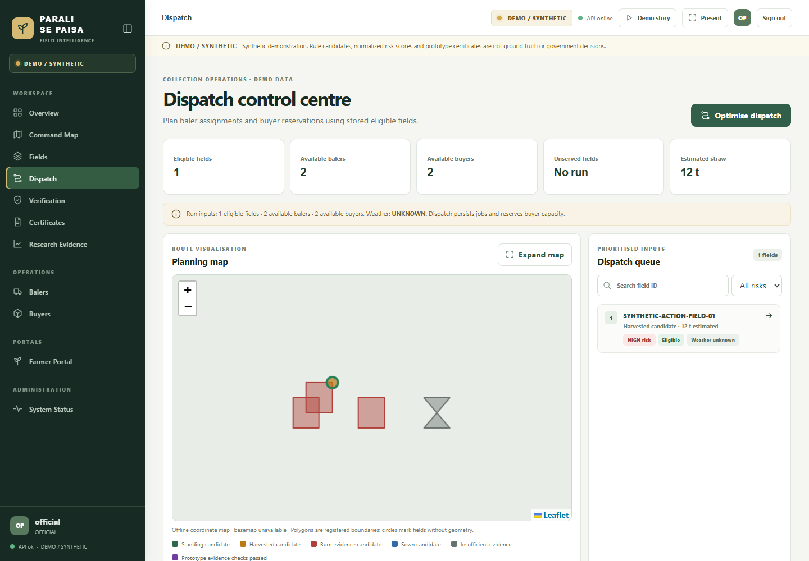
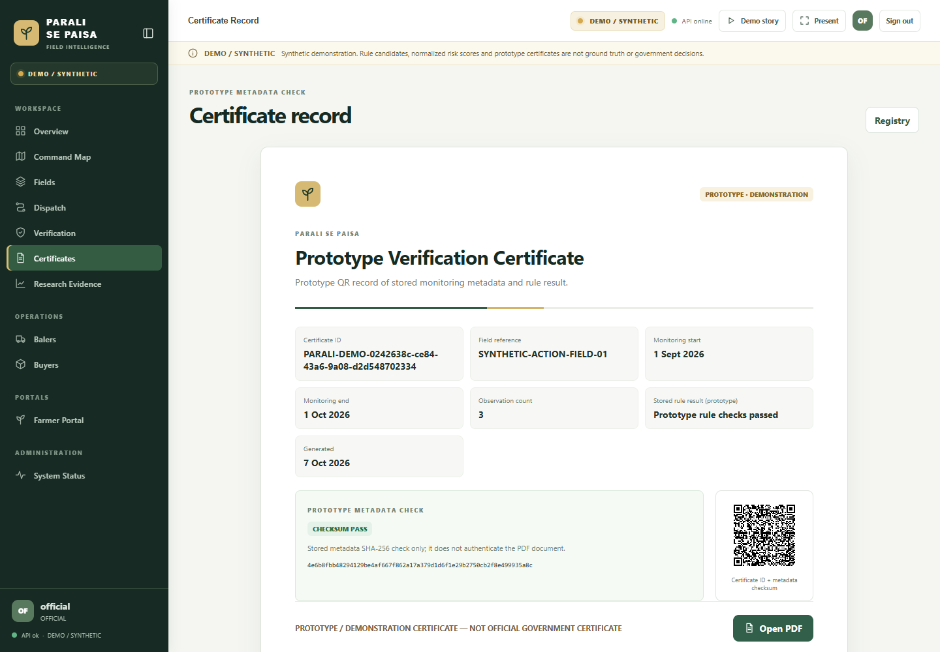
DEMO / SYNTHETIC
Dispatch is an operational prototype
DEMO/SYNTHETIC · route proxy
PROTOTYPE · QR metadata only
Source: isolated local server, synthetic demo fixtures; route is a straight-line GEODESIC_PROXY only.
7
Notes:
Clearly label every object in this segment DEMO/SYNTHETIC. Routing is a straight-line geodesic proxy and does not provide road travel time. Baler and buyer records are fixtures, not verified registries.

Slide 8
LIMITS
What the evidence can and cannot support
No human validation yet
0 completed blinded labels
No strict trend
Pre-event clarity varies by season
No ground truth claim
Thermal matches are corroborative context
No probability claim
Risk is normalized score, not probability
Source: FINAL_JUDGE_EVIDENCE.md; RESEARCH_SUMMARY.md; RESEARCH_METHODS.md.
8
Notes:
We have not completed independent human labels. Strict and loose tiers are rule outputs. Risk is a normalized score, not a probability. Optical and thermal layers have different coverage limits. This is research decision support, not enforcement evidence.

Slide 9
ACTION
Pilot the evidence-to-pickup loop
Real satellite evidence → clear limits → a prototype path from straw to value.
1 · Inspect
Muktsar real map and one field history
2 · Demonstrate
Synthetic dispatch and buyer workflow
3 · Pilot
Independent labels and local partners
Project sources: docs/RESEARCH_METHODS.md; docs/PITCH_AND_DEMO_GUIDE.md; synthetic prototype workflow.
9
Notes:
Close by inviting the judges to inspect a real Muktsar field history, then show the separate synthetic dispatch and prototype QR metadata check. The next step is a bounded pilot with independent labels and real operator/buyer participation.

