Slide 1


Academic Year 2023-24 A Mini Project Presentation on
Title of project
Presented By Seat No
Miss. Asharani Ramesh Biradar T190553009
Mr. Jitendra Balshiram Chikhale T190553011
Mr. Yash Maruti Belavalekar T190553085
Guided By
Prof. Mahesh G. Chinchole
Department of Electronics and Telecommunication Engineering,
Nutan Maharashtra Institute of Engineering and Technology, Talegaon Dabhade, Maharashtra 410507
Savitribai Phule Pune University, Pune.

Slide 2
Flow of Presentation
Problem Statement
Need of Project
Aim & Objectives of Project of project
Literature survey
Introduction
Methodologies/Techniques
Software and Hardware tools
Block diagrams
Circuit diagrams/Pin diagrams
PCB Layouts
Operations/workings/flowchart
Proposed/expected results/photos
Advantages
Limitations
Conclusion
References

Slide 3
Problem Statement:
The aim is to design and implement adaptable, secure WiFi-controlled robotic arm for pick and place tasks, utilizing wireless technology advancements to enhance remote operation capabilities and human work.
Needs:
Efficiency: Improve efficiency by eliminating the need for manual intervention in the pick and place tasks.
Safety: Prioritize safety measures to prevent accidents during operation, including emergency stop mechanisms and collision detection.
User-Friendly Interface: Develop a user-friendly interface to send commands to the robotic arm, making it accessible to users with minimal technical expertise.

Slide 4
Aim
The aim of the project is to design and implement a pick and place robotic arm system utilizing ESP8266 for connectivity and control via a Blynk app over WiFi, enabling users to remotely operate the robotic arm for various tasks like sorting, assembly, or automation.
Objective
Development of a wireless pick and place robotic hand for industrial applications
Enhancing efficiency and safety in industrial operations
Integration of IoT and robotics technologies
High-performance design

Slide 5
Literature Survey
Sr. No. | Year | Authors & Publications | Methods/Algorithm Used | Advantage | Disadvantage
1 | 2023 | Arduino Based Pick and Place Robot with Robotic Arm for Industrial Use Shazia Afroze1, Md. Jubair Hossain2 Md. Istiak Hossain Paran3 | The project focuses on developing an Arduino-based pick and place robotic system for industrial use. The system aims to automate tasks in various industries like bottle filling, packaging, and bomb disposal, reducing human error. | Reduces time for to complete the work and mimimal the human work | Increades cost
2 |  | Wireless Pick and Place Robotic Hand for Industrial Applications Mr. Najeemullah1, Shoaib Khan2, Md. Shahed hussain3, Abu Bakar4 | Pick and Place robot can assist a disabled person so that they can give instructions to the robot and get their works done. This pick and place robot can pick the objects from one place to another place. Robots are meant for making the tasks easy and safer. | Robots can replace the presence of a human and can do dangerous operations. | Need training to operate

Slide 6
INTRODUCTION
Robots are used in various environment ranging from homes to industries to provide assistant to human for a range of purpose such as operation in hazardous situations or operation in manufacturing sector. The design of a robot can be varied depending on its function, application and the environment. Robotic arm is most commonly used in industry such as manufacturing and assembling. The use of robotic arm is to overcome human inefficiency in performing repetitive task such as pick and place operation. Robotic arm is a reprogrammable and multifunctional manipulator design to assist human in various surroundings. Robotic arm is able to overcome human inefficiency in performing repetitive task such as pick and place. Thus, industry such as assembly and manufacturing have widely integrated robotic arm into their assembling line to overcome the problem of human inefficiency.
The robot can be operated wirelessly through Blynk app using WiFi. An android app coupled with a ESP3266 performs the necessary functions. WiFi is used to establish a link between the smartphone app and the robot. The user operates the robot using buttons on the app. Using the sliders in the app we can manually control the movement of each servo or axis of the robot arm. With the same button we can pause the automatic operation as well as reset or delete all steps so that we can record new ones.

Slide 7
METHODOLOGY ADOPTED

Slide 8
SOFTWARE AND HARDWARE TOOLS USED
HARDWARE COMPONENTS
• MG996R Servo Motor
• SG90 Micro Servo Motor
• HC-05 Bluetooth Module
• ESP8266 Board
SOFTWARE TOOL
BLYNK APP
ARDUINO APP

Slide 9
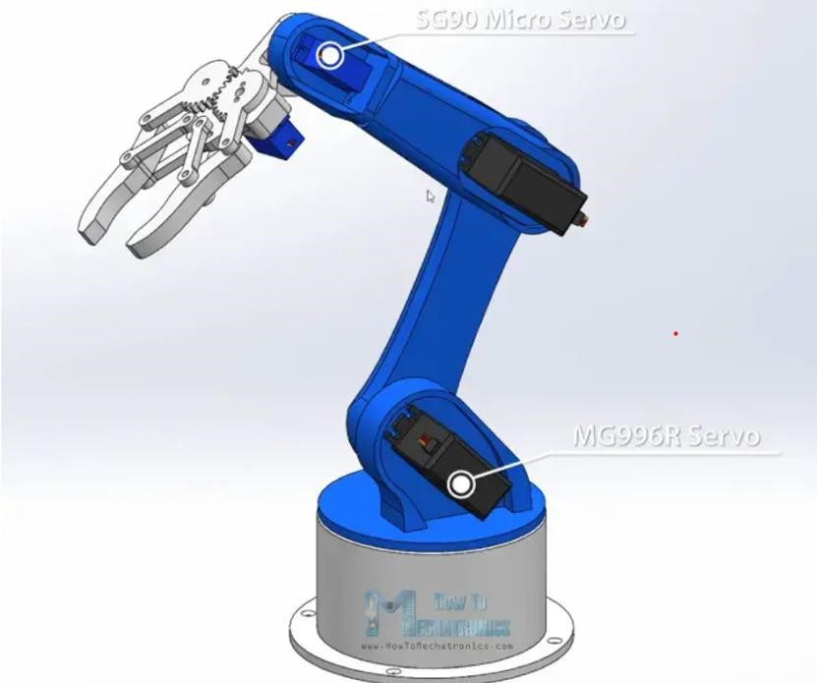
BLOCK DIAGRAM OF PROJECT
Main Block Diagram

Slide 10
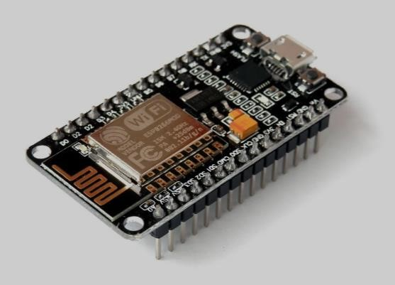
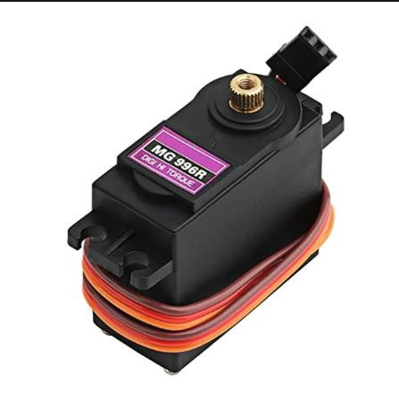
BLOCK DIAGRAM OF PROJECT
DESCRIPTION OF HARDWARE COMPONENTS
ESP8266
The robotic arm can be controlled wirelessly by connecting it to a computer or
mobile device via the ESP8266. This eliminates the need for physical connections
and allows for remote operation of the arm.ESP8266EX offers a complete
and self-contained Wi-Fi networking solution; it can be used to host the
application or to offload Wi-Fi networking functions from another application processor.
MG 996R SERVO MOTOR
The MG996R servo motor is a high-performance motor known for its exceptional
torque and precise control. Designed for robotics, automation, and other projects
requiring reliable motor movement, the MG996R delivers impressive
performance and versatility.

Slide 11
Block diagram of project
Section wise block diagrams…..
3. Pin diagrams/architecture details of all components
Requirements
Specifications
Ratings

Slide 12
Block diagram of project
Section wise block diagrams…..
2. Sensor Sections
Design Aspects/requirements
Specifications
Design equations or principals…

Slide 13
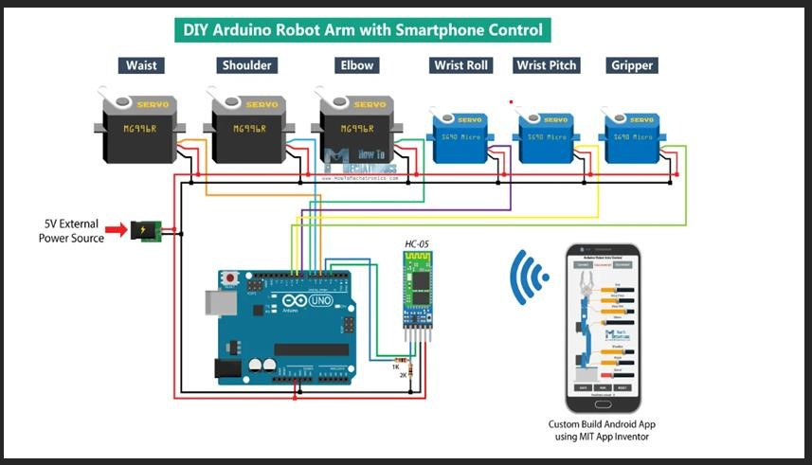
CIRCUIT DIAGRAM OF PROJECT
Main Circuit Diagram

Slide 14
Circuit diagram of project
Section wise circuit diagram

Slide 15
MAIN PCB LAYOUT WITH SECTIONS
Eg….
Base section
Tx. Section
Rx.section

Slide 16
WORKINGS/FLOWCHART/OPERATIONS:
Working Intro—

Slide 17
Workings/Flowchart/Operations:
Summarised flowcharts
Eg..
Transmitter section
Receiver section

Slide 18
Workings/Flowchart/Operations:
Summarised Operation
Eg..
Each components operation in Transmitter section
Each components operation in Receiver section

Slide 19
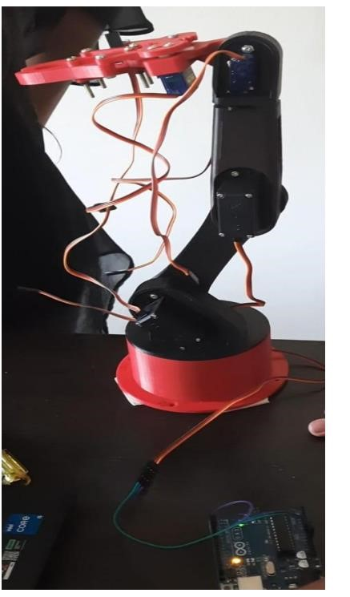
PROPOSED/EXPECTED RESULTS/PHOTOS

Slide 20
ADVANTAGES
User-Friendly Interface: Utilizes WiFi technology, which is easy to use and does not require special training, enhancing accessibility for a wider user base
• Enhanced Safety: By allowing wireless operation, the project reduces the need for human intervention in hazardous tasks, improving safety in such environments
• Potential for Adaptability: The use of WiFi technology opens up possibilities for integrating additional features and functionalities to enhance the robotic arm's capabilities in the future
Wireless Operation: Enables remote operation of the robotic arm, providing flexibility and convenience in controlling the device

Slide 21
LIMITATIONS

Slide 22
CONCLUSION
The project successfully implemented a WiFi-controlled robotic arm for pick and place tasks, showcasing the efficacy of wireless technology in robotics. The system offers effective solution for remote robot operation, emphasizing the accessibility and user-friendly nature of WiFi technology. This study highlights the potential of WiFi as an interface medium for robotics, catering to a diverse user base, including individuals with impairments. Overall, the project fulfills its objective of creating a low-priced, adaptable, and secure WiFi -controlled robotic arm. The significance of wireless technologies in enhancing robotic functionality and usability is underscored by this project

Slide 23
References
1] Arduino Based Pick and Place Robot with Robotic Arm for Industrial Use”
Shazia Afroze1, Md. Jubair Hossain2 Md. Istiak Hossain Paran3
2] Wireless Pick and Place Robotic Hand for Industrial Application
Mr. Najeemullah1, Shoaib Khan2, Md. Shahed hussain3, Abu Bakar4[1]
3] Robotic Arm Control using Internet of Things (IoT)
Amirah ‘Aisha Badrul Hisham Low Zi Han, Mohamad Hafis Izran Ishak and Nurul Hawan Idris

Slide 24
Thank you….

Slide 25
Note:
Equations should be numbered as per sequence.
Tables and figures should be numbered properly as per sequence.
Base papers mentioned in literature must brought at the time of presentation in the from of hard copies.
Must keep project log book signed by Guide, Coordinator and HOD .
There should not have any hidden graphics/styles in the presentation ppt of seminar.
Manage assigned work in to or up to 40 slides (Minimum 30 Slides) effectively and clearly.

