Slide 1
SIEM Tool
Group Members:
Roll No: CB.EN.U4CYS21010 Roll No: CB.EN.U4CYS21016 Roll No: CB.EN.U4CYS21038 Roll No: CB.EN.U4CYS21050
Arjun C Santhosh G H Hem Sagar Madhav Harikumar Nishanth S
TIFAC-CORE in Cyber Security
Amrita Vishwa Vidyapeetham, Coimbatore Campus
November 2024

Slide 2
Outline
1 Problem Statement
2
Objectives
3
Project Architecture
4
Current Status
5 Group Members’ Contributions
6 Future Work
7 Screenshots and Results
Project Presentation

Slide 3
Problem Statement
Security teams face overwhelming volumes of complex security events, leading to alert fatigue and inefficiencies.
Traditional methods struggle to deliver real-time threat detection and actionable insights.
This increases the risk of delayed responses, operational inefficiencies, and potential breaches.
Project Presentation

Slide 4
Objectives
Centralized Log Collection: Use Winlogbeat to collect logs from various sources and centralize them.
Efficient Log Transportation: Configure Kafka to ensure reliable and scalable log transportation.
Real-time Log Correlation and Analysis: Implement Apache Spark to correlate logs and detect threats in real time.
User-friendly Dashboard: Create a JavaScript-based dashboard for real-time visualization and alerting.
Scalability: Design the system to handle increasing log volume and complexity.
Testing and Validation: Conduct thorough testing and validation to ensure high accuracy and reliability in threat detection
1
2
3
4
5
6
Project Presentation
N.U4CYS21

Slide 5
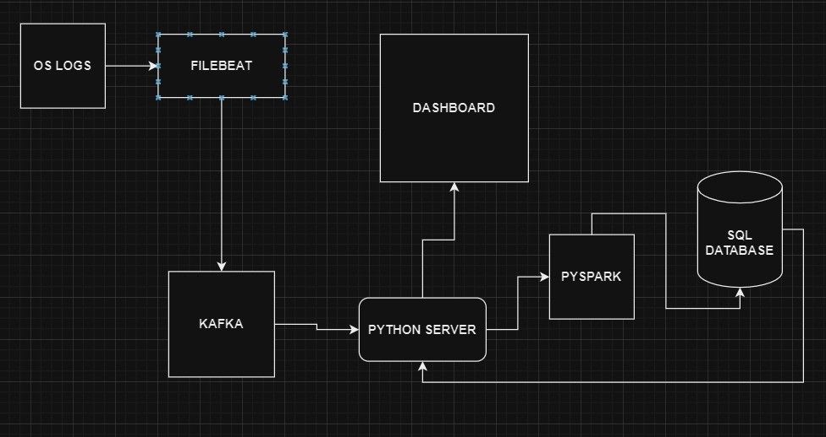
Complete Project Architecture
Figure: Project Architecture Diagram
Project Presentation
N.U4CYS21

Slide 6
Current Status
Completed Work (Overall):
Interface design and implementation. Core workflow setup.
Scalable architecture design.
Pending Work (Overall):
Interface/Dashboard refinement.
Implementation of additional correlation functions. Modularization of code.
System validation and testing.
Project Presentation

Slide 7
Group Members’ Contributions
Arjun C Santhosh: Docker config file setup Kafka setup
Pre-processor script for the logs from Kafka Correlation function for RDP attack Detection Front End UI
G H Hem Sagar:
Correlation Engine Implementation and Database-Storage Integration Reduced overhead for database operations
Madhav Harikumar:
Pyspark Setup
Correlation functions and rule engine (Scripts) implementation Simulating attacks on Windows machines to gather logs for correlation
Nishanth S:
Created a flask server for receiving processed data from kafka
Simulated various attacks in SMB and privilege escalation, and gathered logs only for privilege escalation.
Project Presentation

Slide 8
Planned Work for the Next Four Months
UI Performance Optimization: Enhance and refine UI components to improve efficiency, responsiveness, and scalability.
Development of Additional Correlation Functions: Expand the library of correlation functions to support advanced use cases.
Finalization and Maintenance of the SIEM Workflow: Complete the remaining tasks in the Security Information and Event Management (SIEM) workflow and ensure its smooth operation and upkeep.
Project Presentation

Slide 9
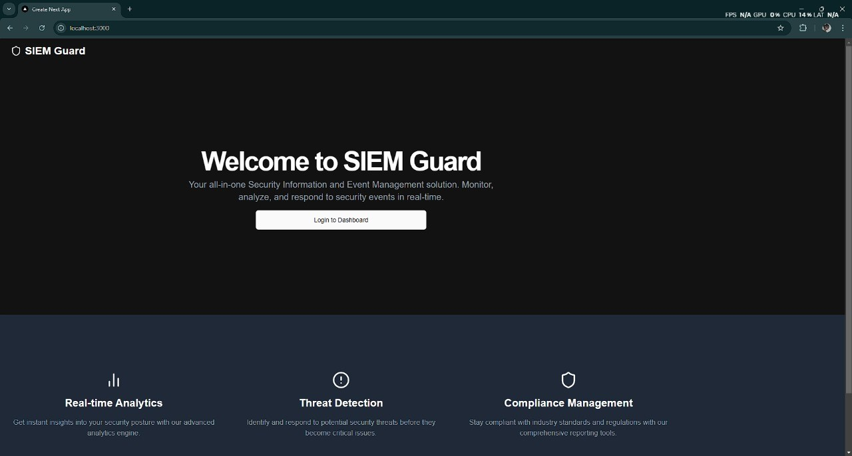
Home Page
Figure: Home Page
Project Presentation
N.U4CYS21

Slide 10
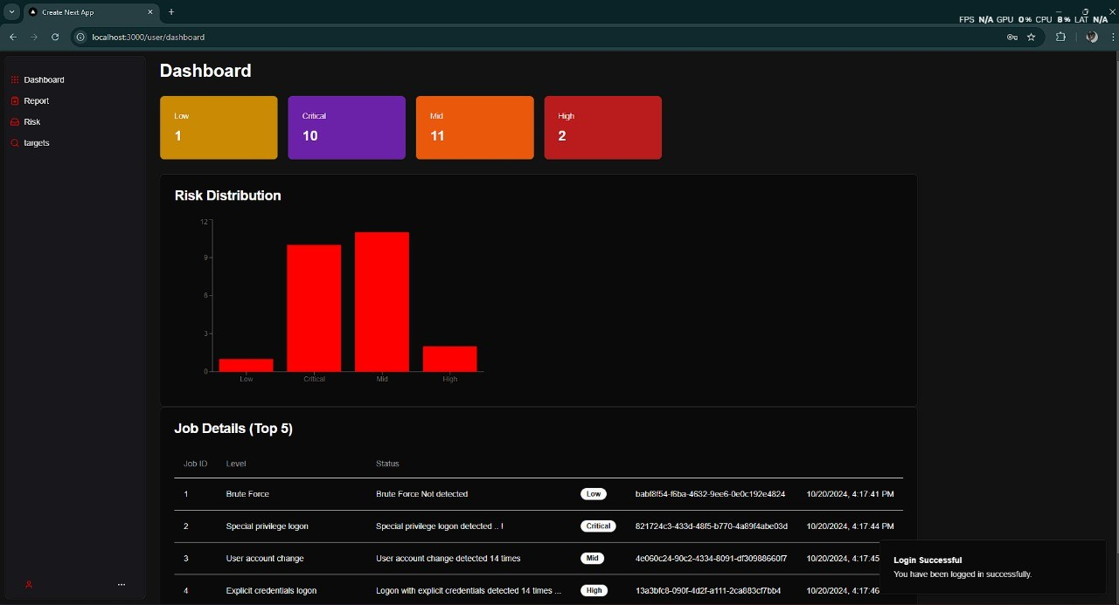
Dashboard
Figure: Dashboard
Project Presentation
10 / 11
N.U4CYS21

Slide 11
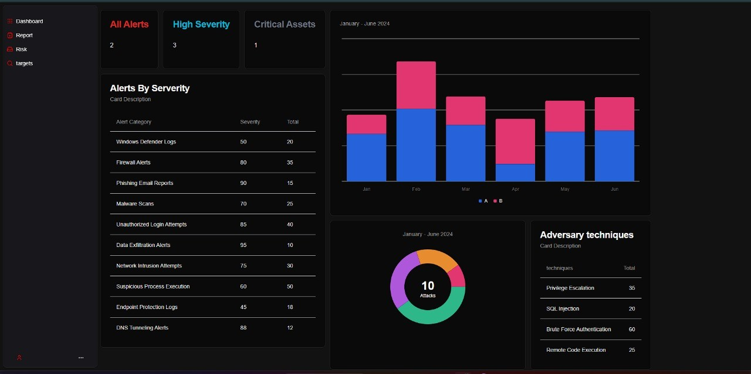
Risks Page
Figure: Risks Page
Project Presentation
10 / 11
N.U4CYS21

