Slide 1

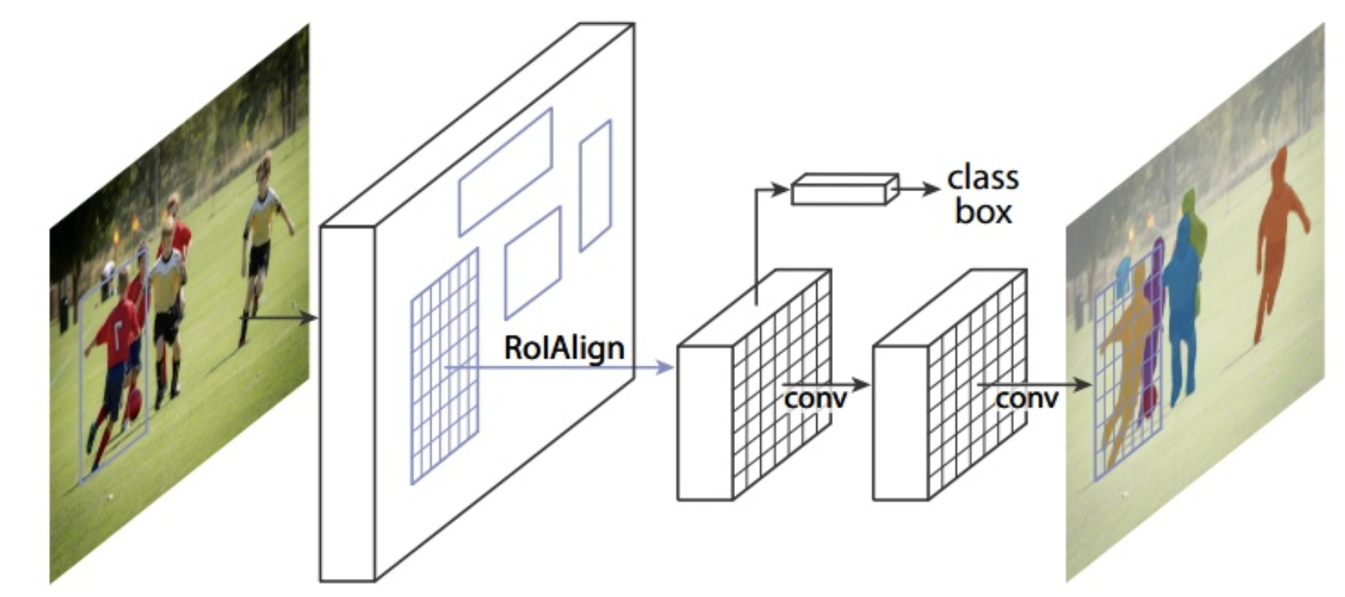
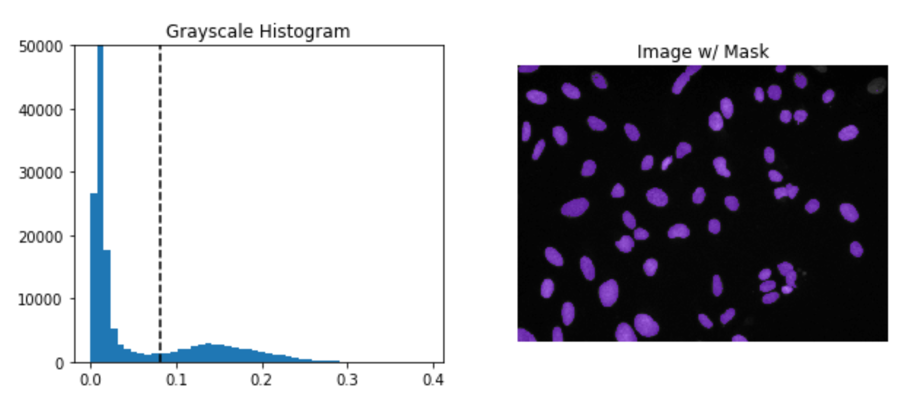
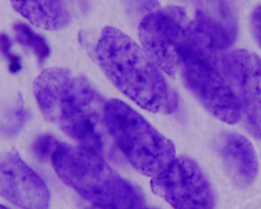
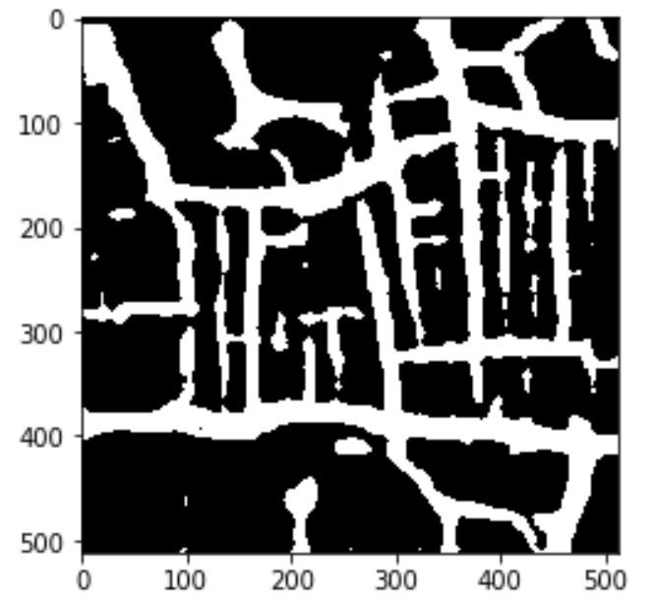
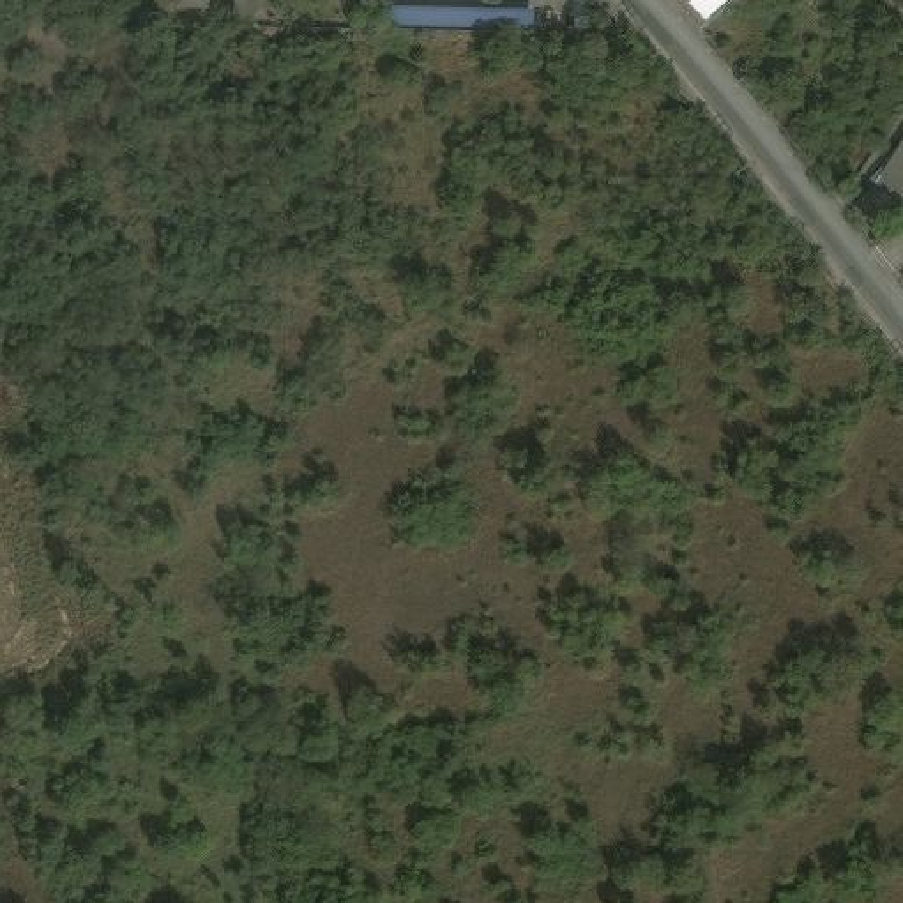
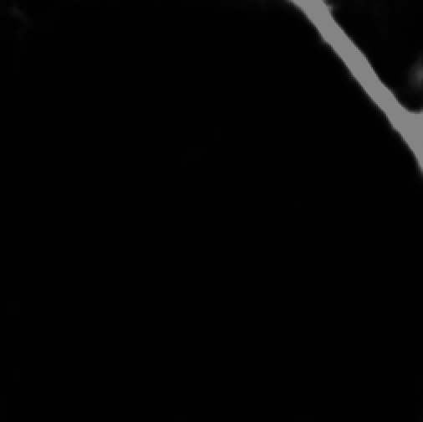
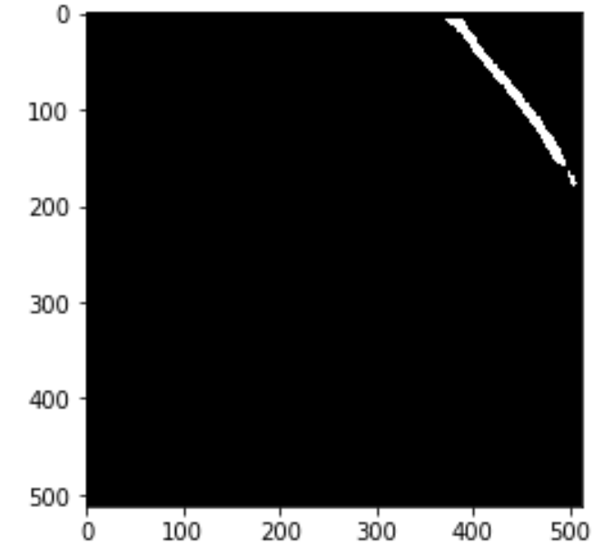
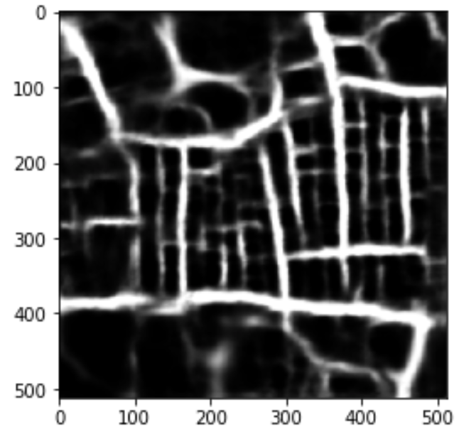
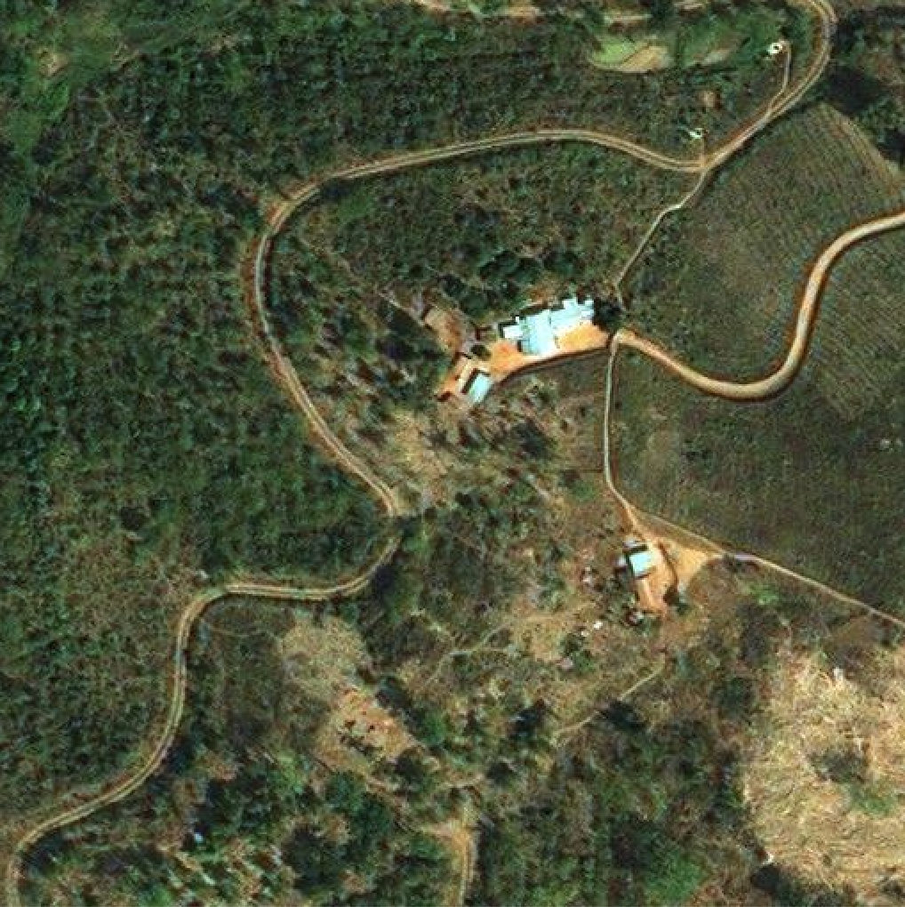
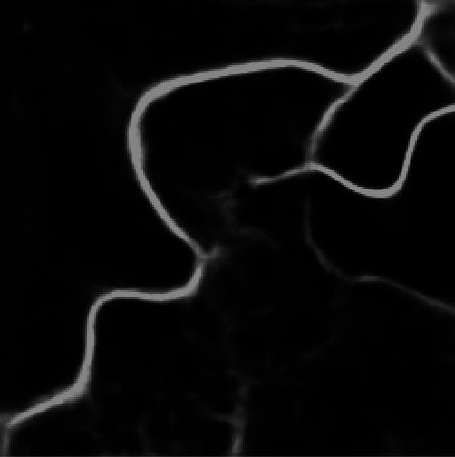
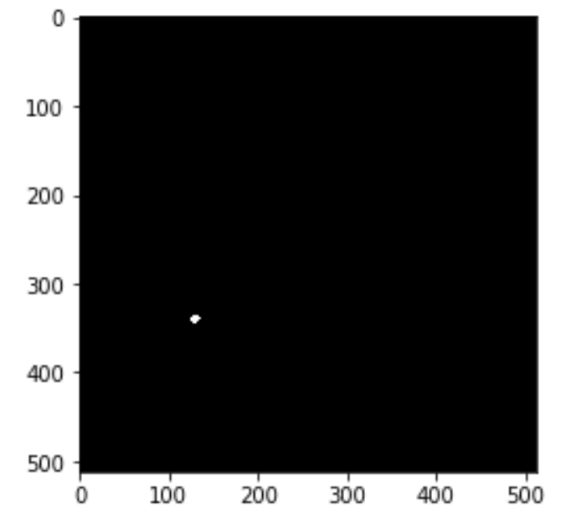
2019 Kaggle Competition
Detect roads in satellite images
Yuxuan Cui(yc110), Bidan Zhu(bz24)
Project Overview
Procedure
Problem Description
In this competition, we are asked to create a computer model that can identify a range of nuclei across varied conditions. The program should automatically identify and extract the nuclei area.
Our Work
We first analyze the data and do data exploration. We tried to classified based on size, color, shape number of nuclei, and try to identify the potential noise. We also did statistical analysis on the data. After EDA, We use CV methods and U-Net models to solve the problem. CV methods i
Data
Preprocessing
Model
Postprocessing
Output
Pre-processing: Do preprocessing to the raw data. This includes resizing the original images, image normalization, and transform the data into the desired representation. In U-Net model, transform the data into a matrix; in CV model, we also need to compute the histogram of the image.
Model: We used CV model and U-Net network model.
Post-processing: Do postprocessing to the outcome from the model. This includes resizing the masks, augmenting the masks, and line encoding the results.
Mask RCNN Model
U-Net
Set the configuration of the model
Overview
CV method is to setup a reasonable threshold and set pixels that above the threshold to 1. The CV method achieves 0.22 accuracy (stage 1 score).
How to choose a reasonable threshold
Assumption (1): Assume that the background pixels are more than nuclei pixels and remove the background based on this.
Assumption (2): Treats the image histogram as two additive distributions.
Find threshold value based on Otsu’s method.
Why it fails
The first assumption can be wrong. Some special cases that CV method will fail. Image below shows a failure case.
Initialize the dataset
Pictures: load the path, image ID and image raw data into the dataset object, process the inconsistency of the image path id and image id which model requires
Load and Normalize the masks
Process the inconsistency between mask path id and the id which corresponding image requires, normalize mask from [512, 512] to [512, 512, 1]
2 Architectures: ResNeXt-101, mask + box
3 Strengths:
Feature extraction (ResNeXt-101: includes 3 convolution layers).
Region Proposal Network(ROI Align: output fixed dimension output)
Compute Loss Function: Loss of class, box and mask (compute sigmoid on pixel)
Result and Conclusion: bad for image with convolution roads, good for simple ones. Perform well on object detection.
Create model and initialize model with COCO
Train the dataset in two step: with head layer and all layers
Evaluate the model using evaluation dataset, compute the mAP
Grayscale Histogram
After Removing Background
Reshape the mask result and apply run-length encoding, then output to csv file
Data Analysis & Augmentation
Mask RCNN Procedure
Result Comparison
Special Case for CV method
Analysis: all of the images and masks are in the same size: [512, 512, 3]. The road which is dim or within field will not have the right mask.
 | Image | U-Net | R-CNN
Good result
Bad Result (For Mask-RCNN)
Augmentation:
As for pre-process, by using cv2 package, we applied fast NlMeans Denoising, gradient descent and edge detection.
As for post-process, we applied thresholding on the output mask image to transfer RGB mask image to binary mask. We adjust the parameter of function to gain good effect of road masks. The final parameter is 40.
Comparison of U-NET and Mask R-CNN
Submitting History
We totally submit 23 times.
Running time:
For U-Net, it’s about 1 and a half day.
For Mask R-CNN, it’s about 11 hours.
Submit History & Result
From the result, Mask R-CNN works much bad than U-Net on this dataset for the performance is uneven. Because as for Mask R-CNN, it will firstly find the ROI and then produce masks on each ROI. So, there could be many circle masks on the road instead of a consistent long mask. So, Mask R-CNN doesn’t work well for segmentation of complex long shapes just like road. However, even Mask R-CNN cannot produce the precise mask, it can do the right thing on object detection.
Mask R-CNN is based on Faster RCNN and FCN. U-Net is based on FCN.
Model | Result | Parameter
U-Net | 0.46 | Epoch: 5, Batch: 20 Step: 2000
 | 0.54 | Epoch: 20, Batch: 20, Step: 500
Mask R-CNN | 0.14 | Epoch: 150, Batch: 2, Step: 200
 | 0.05 | Epoch: 50, Batch: 2, Step:30
Reference
Mask R-CNN: https://arxiv.org/pdf/1703.06870.pdf
Mask R-CNN Kernel: https://github.com/matterport/Mask_RCNN
U-Net: https://lmb.informatik.uni-freiburg.de/people/ronneber/u-net/
U-Net Kernel: https://github.com/zhixuhao/unet
OpenCV official document: https://opencv.org/
Run Length Encode Script: https://www.kaggle.com/timnonet/run-length-encoding-script-python2

