Slide 1

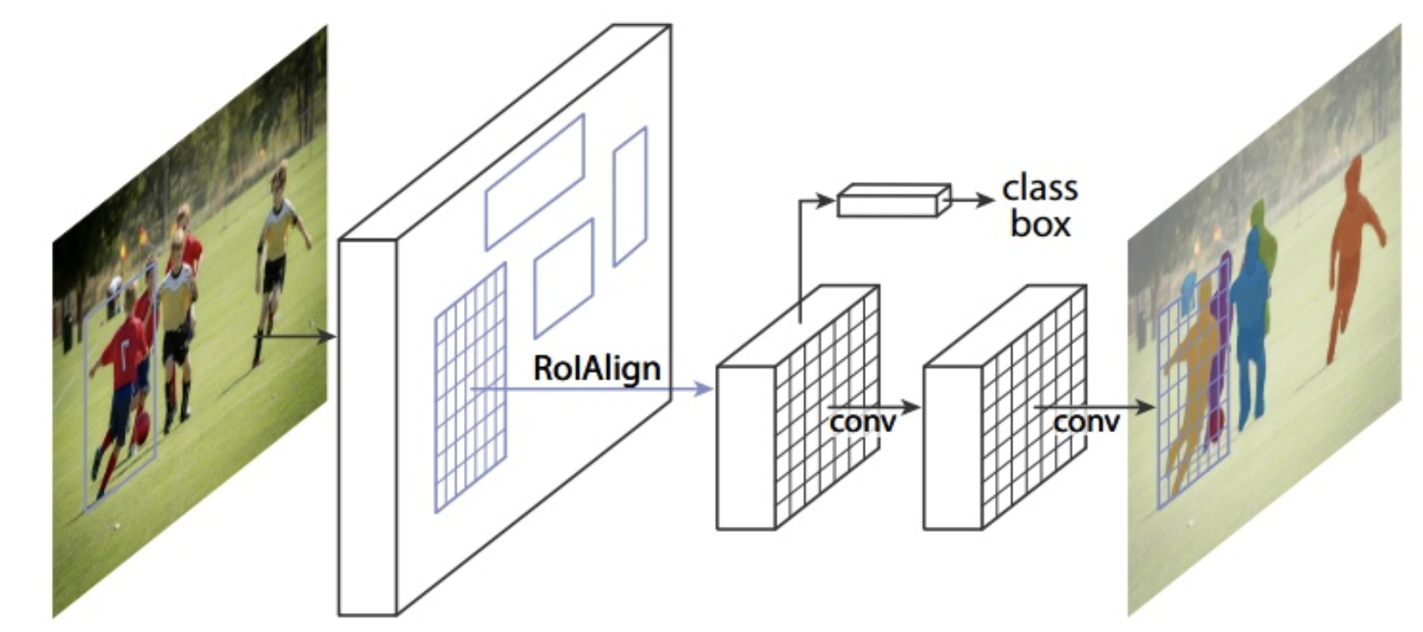
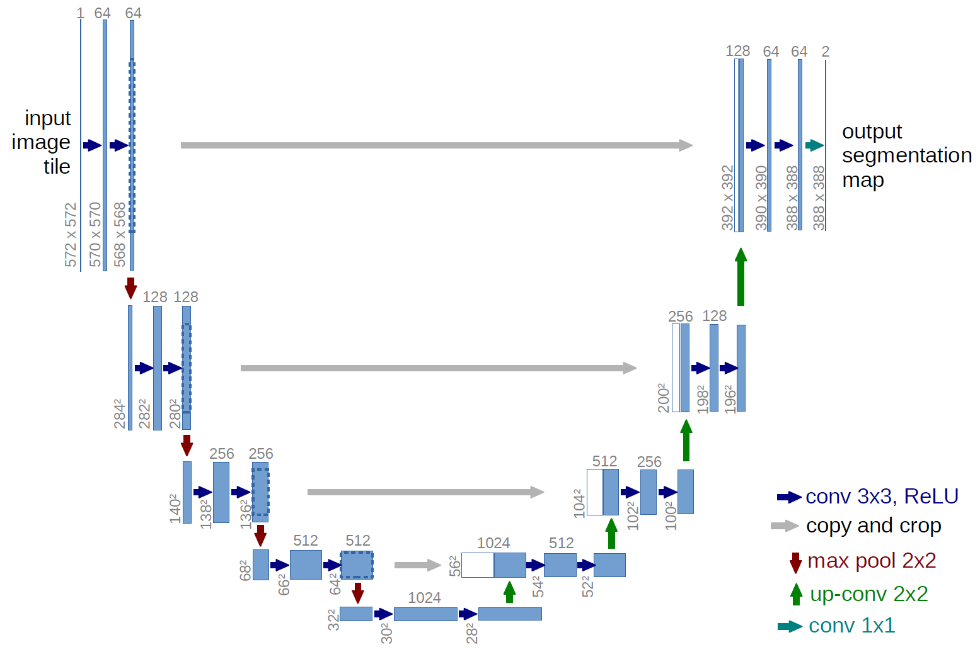
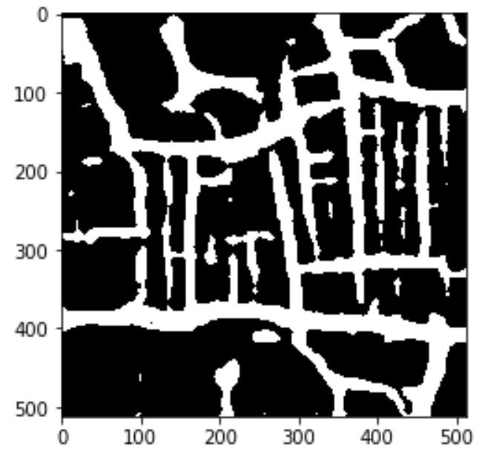
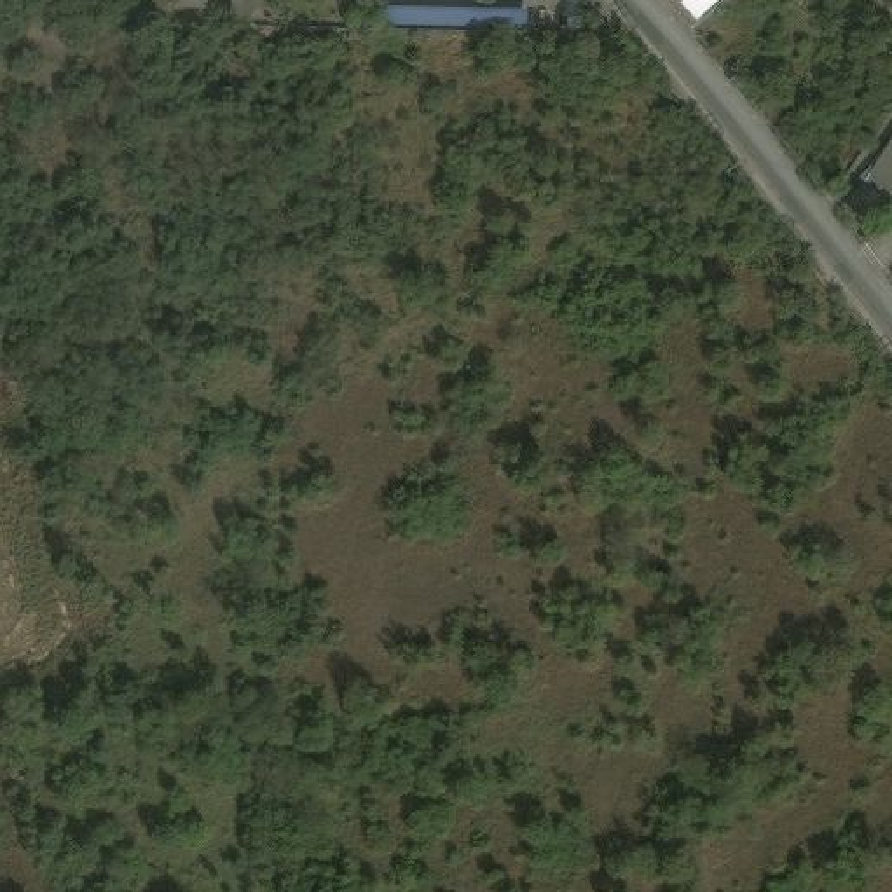
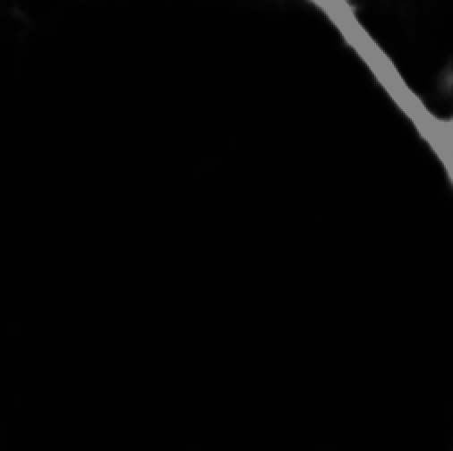
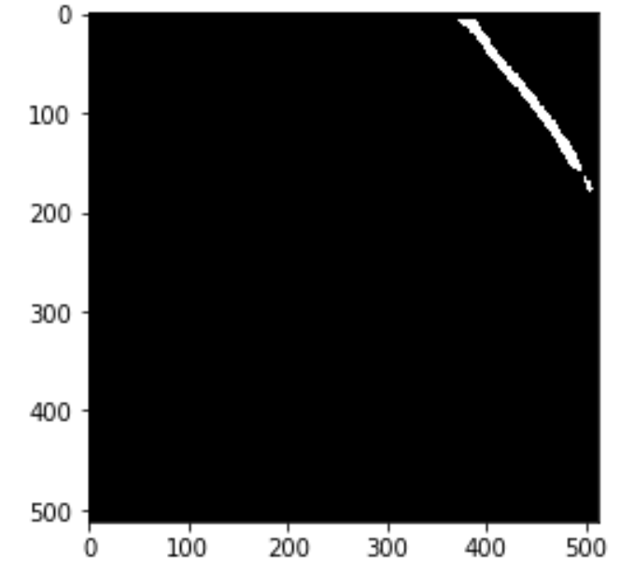
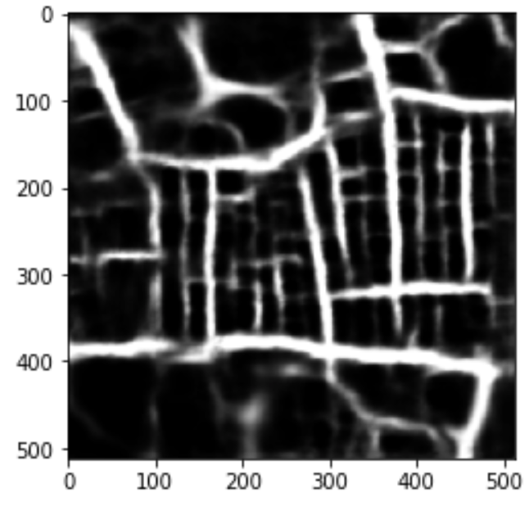
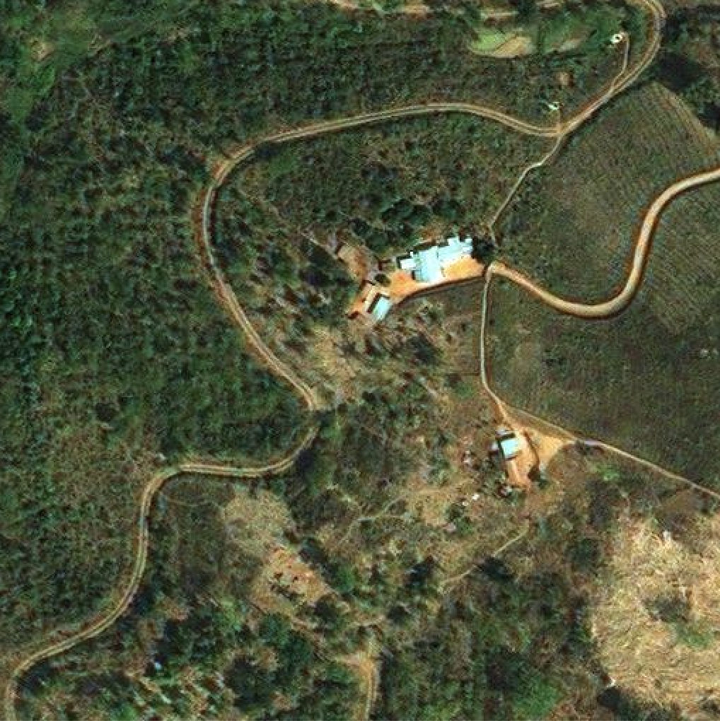
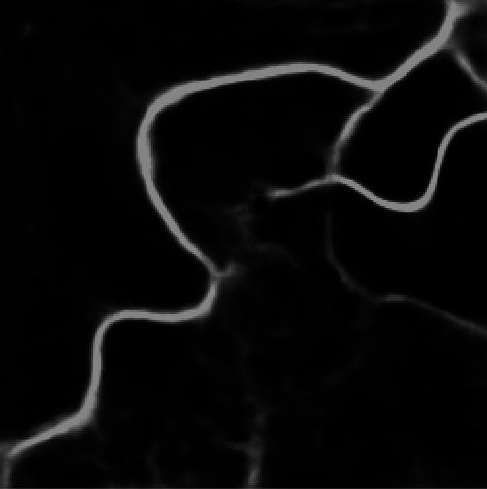
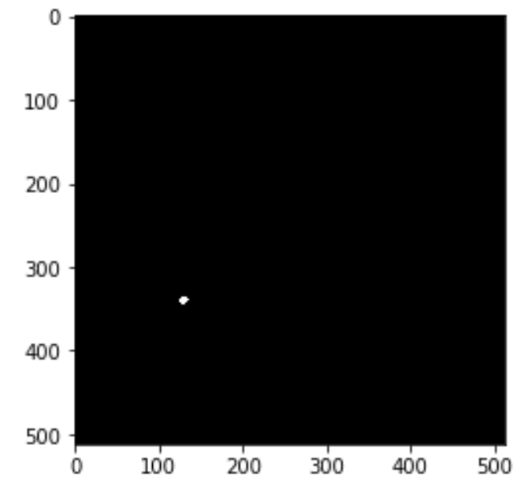
2019 Kaggle Competition
Detect roads in satellite images
Yuxuan Cui(yc110), Bidan Zhu(bz24)
Project Overview
Procedure
In this competition, we are asked to create a model that can segment satellite images to identify roads. The model could detect and label the roads. We are given 10897 training images and their corresponding masks and use the train data to construct the model. We also have 2170 test data without masks given and we can submit our results to Kaggle to get the scores of our model.
We tried two models to solve the problem. Mask RCNN and U-Net. U-Net gained a better performance on the problem with higher scores by Kaggle.
We mainly train our models and use the model to do predictions on test data on Amazon AWS platform using the p2.xlarge EC2 instances and we also use our own laptops to do some prediction which is slow.
Data
Preprocessing
Model
Postprocessing
Output
Pre-processing: Do preprocessing to the raw data. This includes image normalization, and data augmentation. We transform the RGB image and binary mask image into matrix to do calculation.
Model: We used U-Net model Mask RCNN model.
Post-processing: The post-processing contains Run Length Encoding of the results, set the threshold value of turning the gray-scale picture into binary picture only contain ‘0’ which represent road and ‘1’ which represent none-road area.
Mask RCNN Model
U-Net
Set the configuration of the model
U-Net Introduction and Features
The U-Net is a CNN model developed for biomedical image segmentation.
The network is based on fully connected network but does not have any fully connected layers and only use the valid part of each convolution.
The network consists of a contracting path containing four down sampling layers, and an expansive path containing four up sampling layers.
Optimize process: Tuning parameters(batch, number of epochs, number of iterations per epoch)
Prevent overfit: Use dropout layers, early stop
Model assessment: Kaggle scores.
Initialize the dataset
Pictures: load the path, image ID and image raw data into the dataset object, process the inconsistency of the image path id and image id which model requires
Load and Normalize the masks
Process the inconsistency between mask path id and the id which corresponding image requires, normalize mask from [512, 512] to [512, 512, 1]
2 Architectures: ResNeXt-101, mask + box
3 Strengths:
Feature extraction (ResNeXt-101: includes 3 convolution layers).
Region Proposal Network(ROI Align: output fixed dimension output)
Compute Loss Function: Loss of class, box and mask (compute sigmoid on pixel)
Result and Conclusion: bad for image with convolution roads, good for simple ones. Perform well on object detection.
Create model and initialize model with COCO
Train the dataset in two step: with head layer and all layers
Evaluate the model using evaluation dataset, compute the mAP
Reshape the mask result and apply run-length encoding, then output to csv file
Data Analysis & Augmentation
Mask RCNN Procedure
Result Comparison
Analysis: all of the images and masks are in the same size: [512, 512, 3]. The road which is dim or within field will not have the right mask.
 | Image | U-Net | R-CNN
Good result
Bad Result (For Mask-RCNN)
Augmentation:
As for pre-process, by using cv2 package, we applied fast NlMeans Denoising, gradient descent and edge detection.
As for post-process, we applied thresholding on the output mask image to transfer RGB mask image to binary mask. We adjust the parameter of function to gain good effect of road masks. The final parameter is 40.
Comparison of U-NET and Mask R-CNN
Submitting History
We totally submit 23 times.
Running time:
For U-Net, it’s about 1 and a half day.
For Mask R-CNN, it’s about 11 hours.
Submit History & Result
Mask R-CNN is based on Faster RCNN and FCN. U-Net is based on FCN. They both works well on image segmentation but they performed differently on the given problem of the Kaggle competition.
From the result, Mask R-CNN works much bad than U-Net on this dataset for the performance is uneven. Because as for Mask R-CNN, it will firstly find the ROI and then produce masks on each ROI. So, there could be many circle masks on the road instead of a consistent long mask. So, Mask R-CNN doesn’t work well for segmentation of complex long shapes just like road. However, even Mask R-CNN cannot produce the precise mask, it can do the right thing on object detection.
U-Net performs better in this case. Since the data has simple semantics and the structure of the data is not complicated, which is suitable for U-Net model. U-Net first do down sampling and then up sampling, which acts like the compress the local feature first and then unzip it to identify the boundary of the images. The boundary in the images is the road that we are going to identify.
Model | Result | Parameter
U-Net | 0.46 | Epoch: 5, Batch: 20 Step: 2000
 | 0.54 | Epoch: 20, Batch: 20, Step: 500
Mask R-CNN | 0.14 | Epoch: 150, Batch: 2, Step: 200
 | 0.05 | Epoch: 50, Batch: 2, Step:30
Reference
Mask R-CNN: https://arxiv.org/pdf/1703.06870.pdf
Mask R-CNN Kernel: https://github.com/matterport/Mask_RCNN
U-Net: https://lmb.informatik.uni-freiburg.de/people/ronneber/u-net/
U-Net Kernel: https://github.com/zhixuhao/unet
OpenCV official document: https://opencv.org/
Run Length Encode Script: https://www.kaggle.com/timnonet/run-length-encoding-script-python2

