Slide 1

Sprocket Central Pty Ltd
Data analytics approach
Asheem Akhtar

Slide 2
Agenda
Introduction
Data Exploration
Model Development
Interpretation

Slide 3
INTRODUCTION
Sprocket Central Pty Ltd provided us with a data set which contains different aspects of customers like their gender,location,age etc.
This data set also contains a sheet named “New Customer List”.
This is a list of 1000 customers and on the basis of other data sheets we have to tell which of these 1000 customers are worthy of being focused for sales purposes.
Following two parts ‘Data Exploration’ and ‘Model development’ contains our complete process of determining the desired customers on the basis of profit.

Slide 4
Data Exploration
The dataset provided by Sprocket Cetral Pty Ltd contained many inconsistencies and errors.Some of them are following:
Missing values in some columns.
Poorly labeled values.
Unneccessary Column.
Misassigned datatype.
We should remove these errors and inconsistencies in order to get useful information from this data.
We should also make other columns for Age & Profit to know which age group buys more & how much.

Slide 5
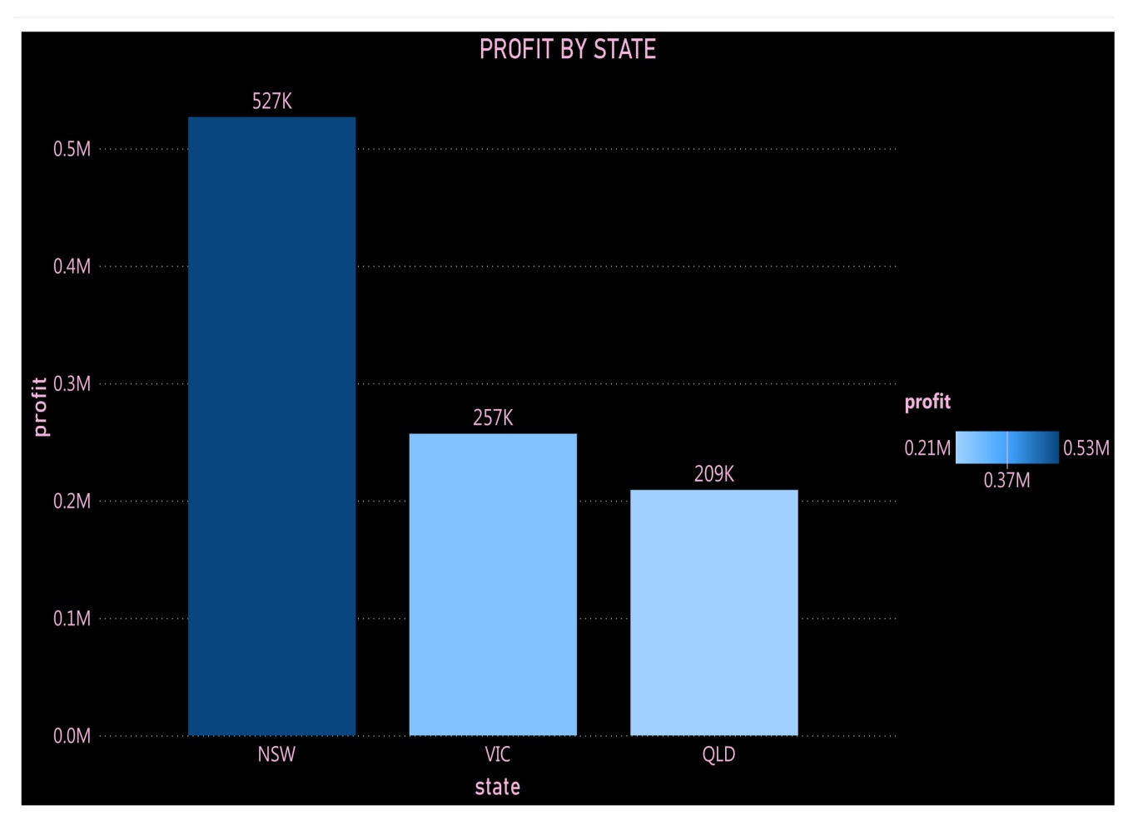
COMPARING PROFIT WITH RESPECT TO STATE
From this column graph we can clearly see that more than half of the profit was made from a single state and that is New South Wales.
We should check if there are more branches in that state & We should make NSW our main focus.

Slide 6
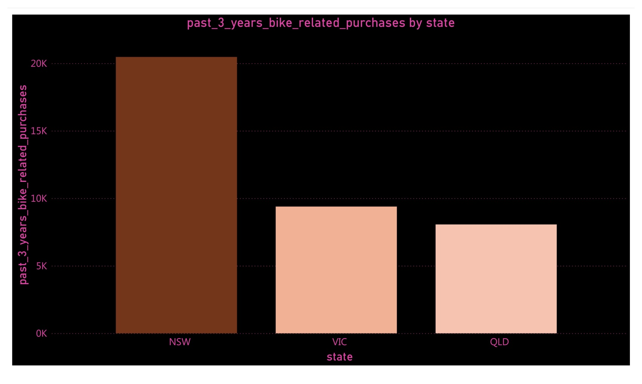
COMPARING PAST 3 YEARS’ PURCHASES WITH RESPECT TO STATE
Here we can clearly see that more than half of the bike related purchases were made in NSW in the last three years.

Slide 7
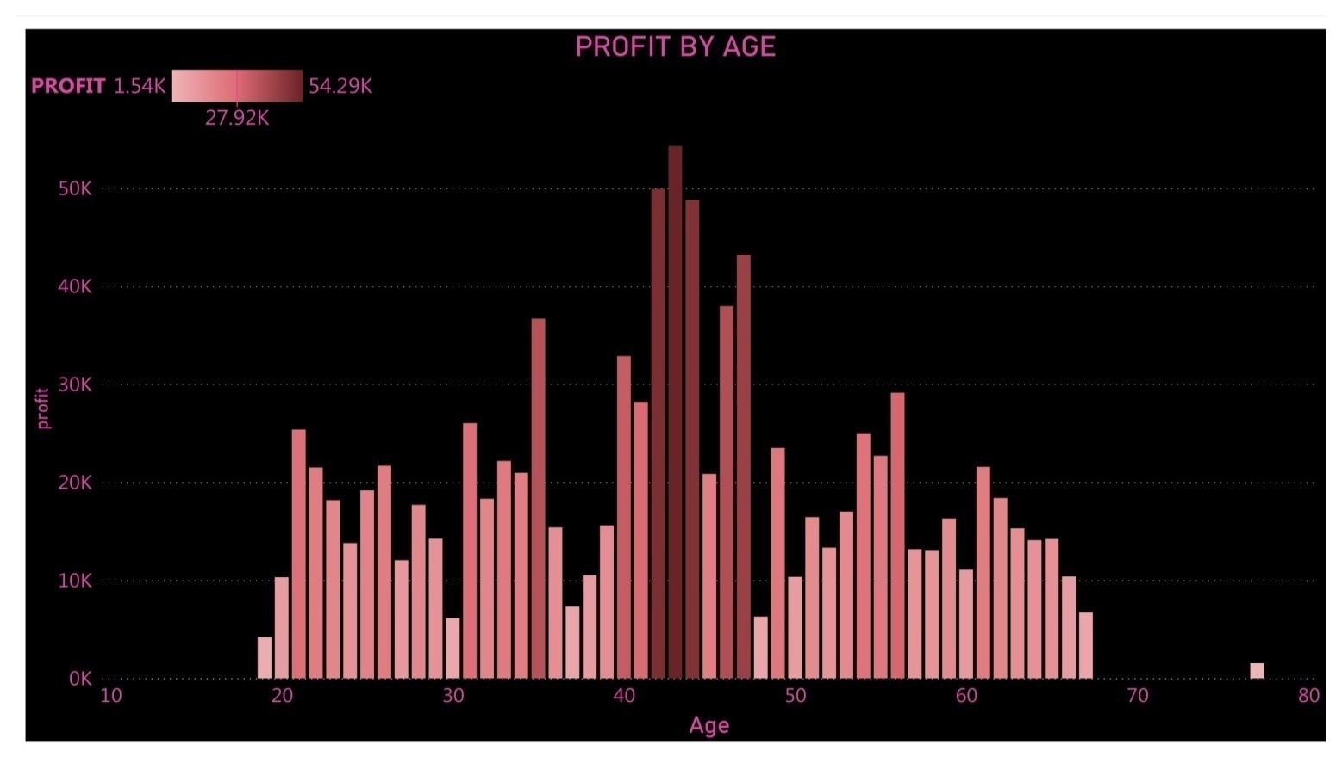
COMPARING PROFIT WITH AGE
In this graph we can clearly see that most of the profit was made with the ages between 40-50,specially between 41-45.
From this,we can conclude that we should target this age group in order to get maximum output.

Slide 8
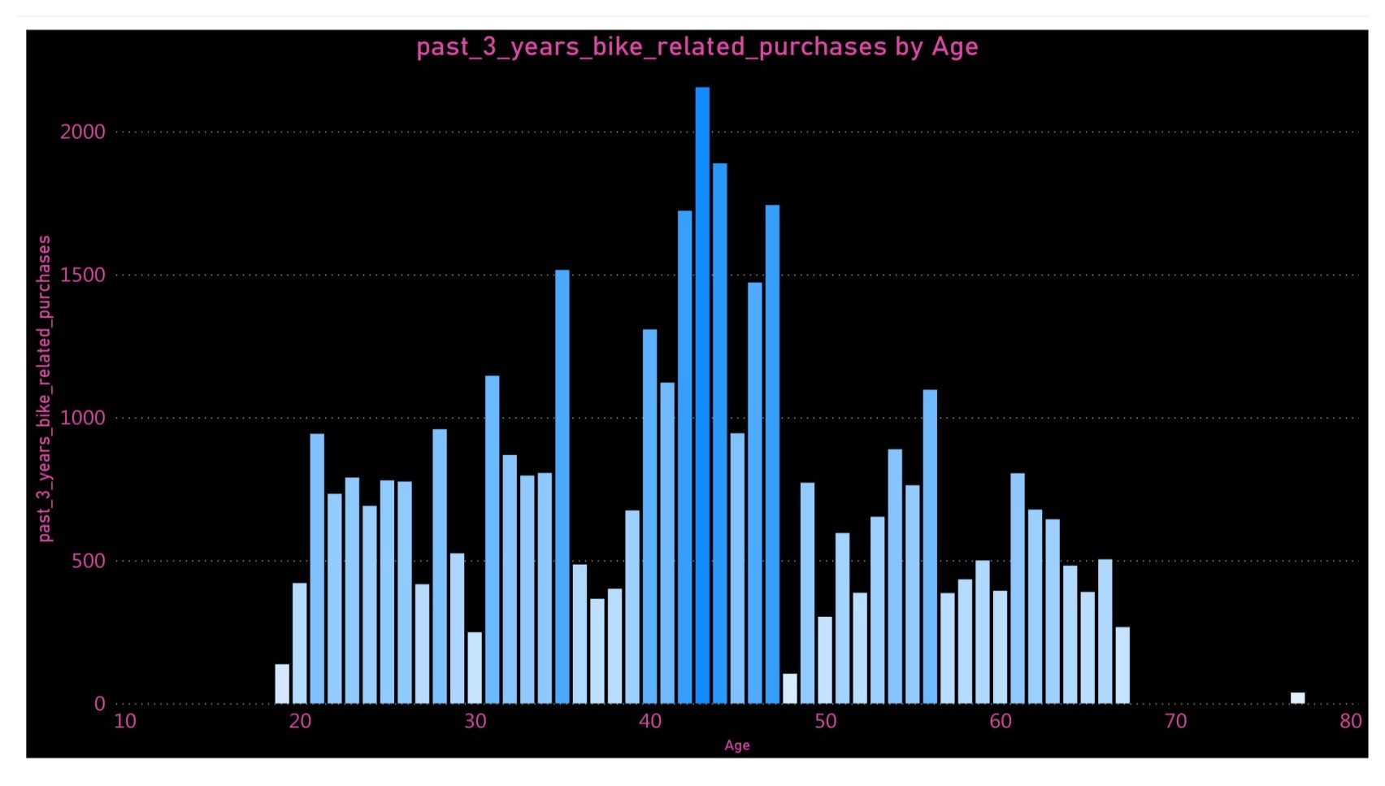
COMPARING PAST 3 YEARS’ BIKE RELATED PURCHASES WITH AGE
In this graph we can clearly see that most of the purchases were made with the ages between 40-50,specially between 41-45.
From this,we can conclude that we should target this age group in order to get maximum output.

Slide 9
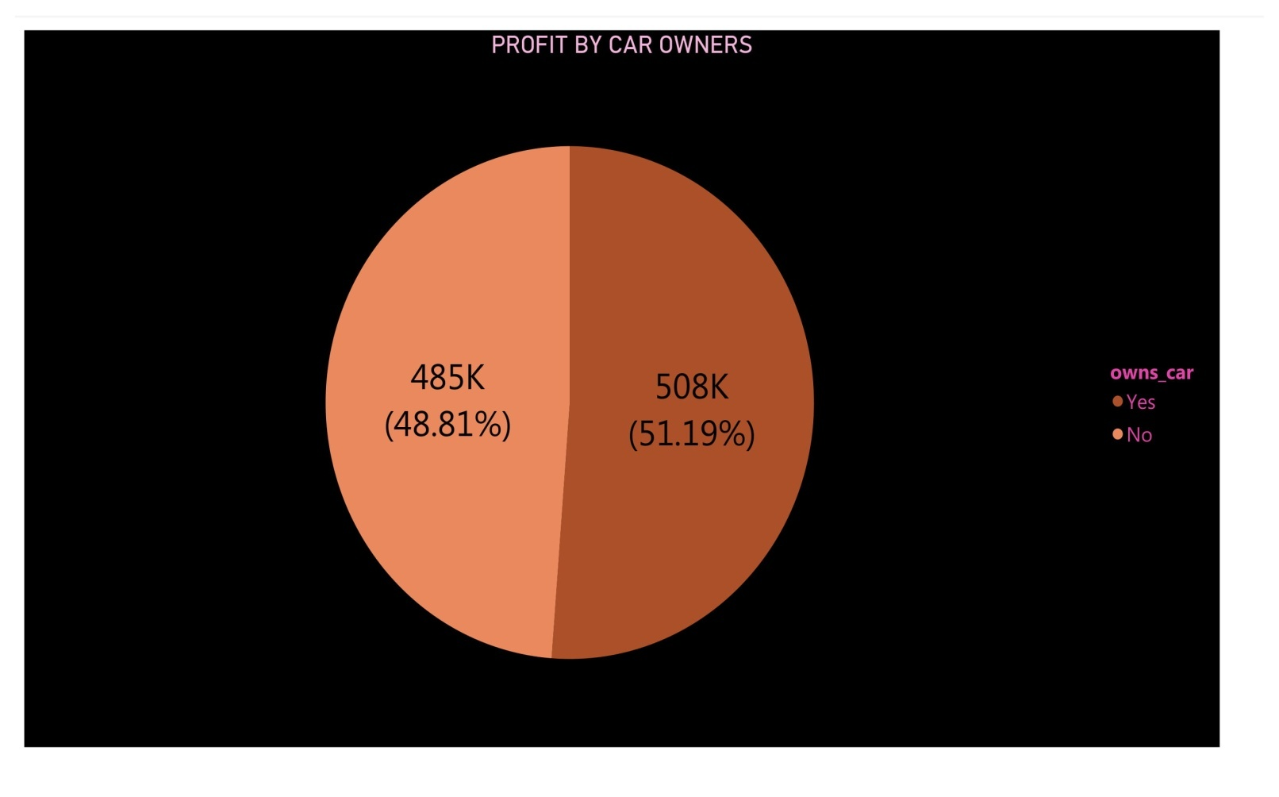
COMPARING PROFIT WITH CAR OWNERS
Here we can clearly see that we profited more from those people who got cars.But we cant be sure because they only have slight edge over non owners.

Slide 10
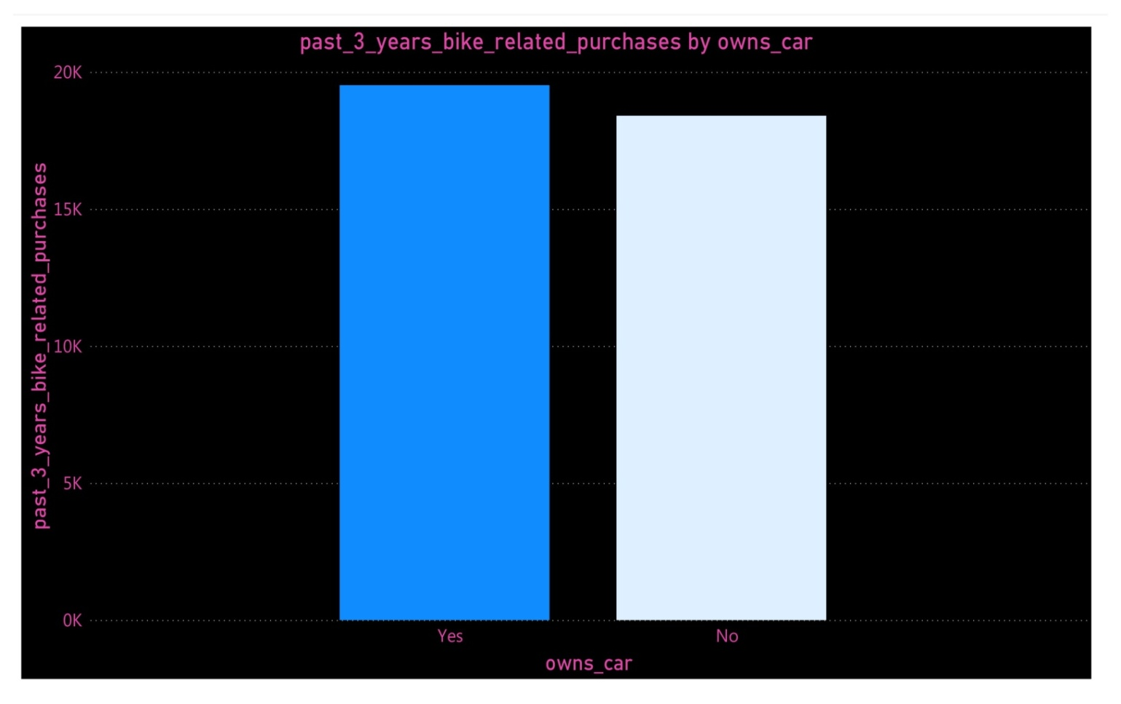
COMPARING PAST 3 YEARS BIKE RELATED PURCHASES WITH CAR OWNERS
There are more people who own car among those who purchased more in last 3 years.But we cant be sure because they only have slight edge over non owners

Slide 11
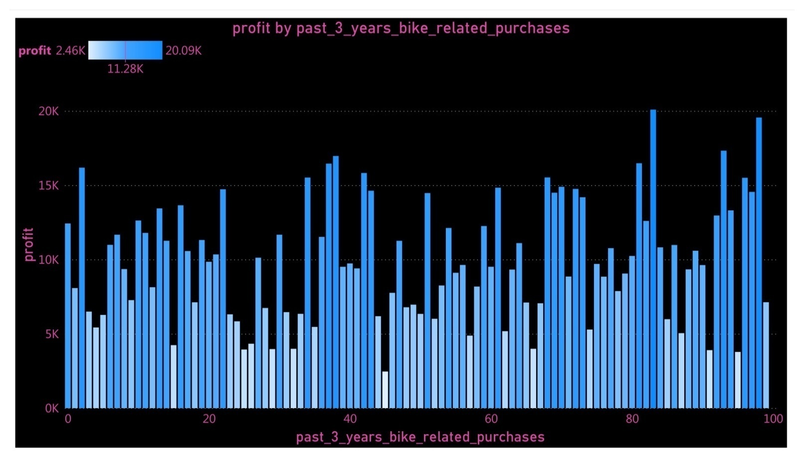
PROFIT BY PAST 3 YEARS BIKE RELATED PURCHASES
From this graph we can say that we profited more from those who purchased more that 80 times in the past three years as compare to others.

Slide 12
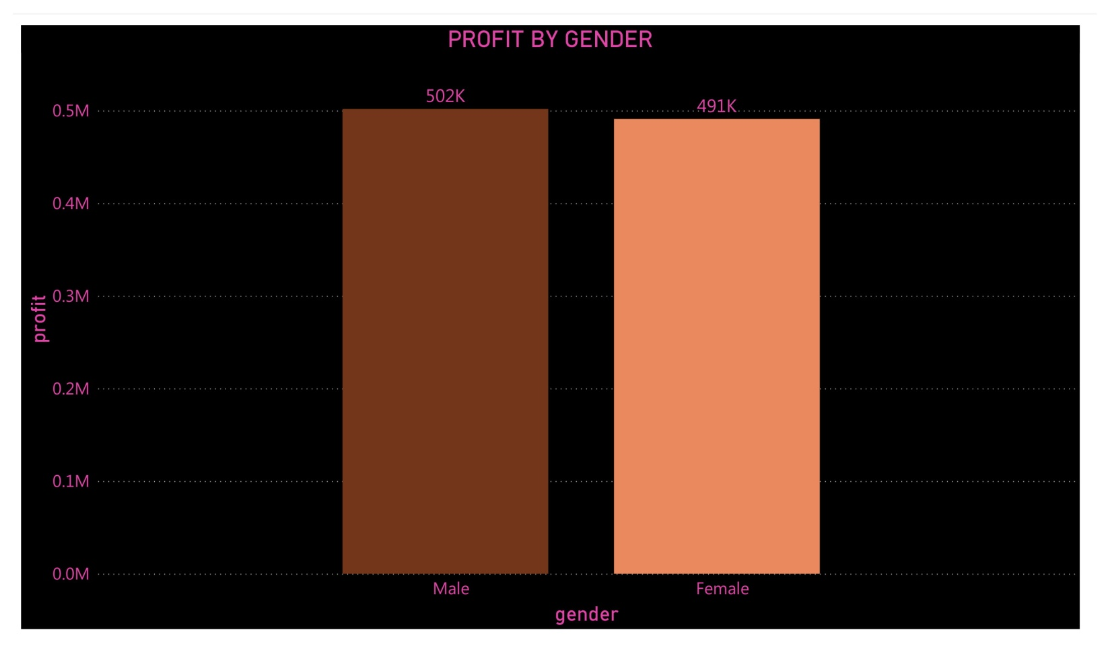
COMPARING PROFIT WITH GENDER
Although,this bar chart shows that there are more men who bought more but this is not a bigger gap and it is inconclusive.

Slide 13
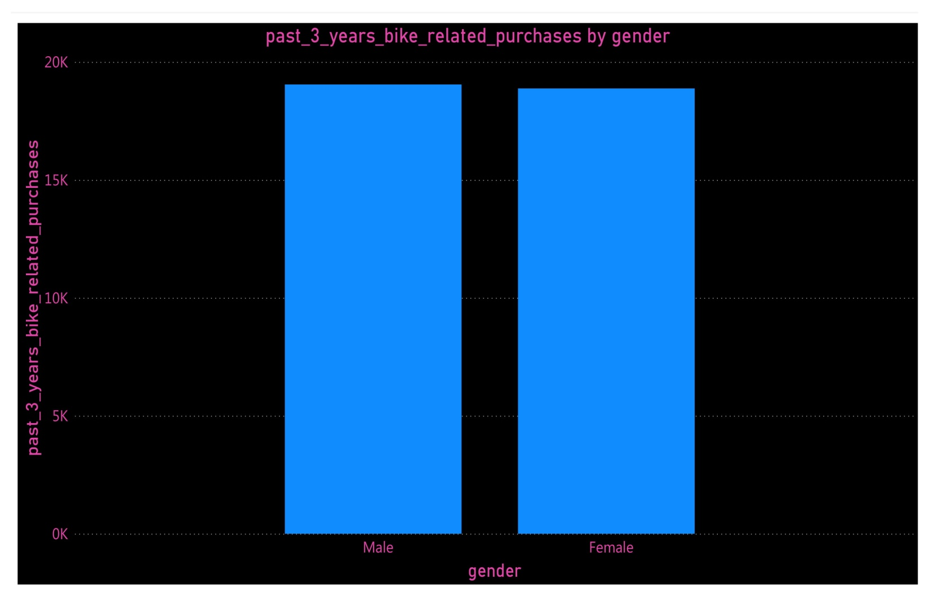
COMPARING PAST 3 YEARS’ BIKE RELATED PURCHASES WITH GENDER
Although,this bar chart shows that there are more men who purchased more but this is not a bigger gap and it is inconclusive

Slide 14


RELATIONSHIP BETWEEN NUMBER OF PURCHASES AND PROFIT
GRAPH BASED ON PROFIT GRAPH BASED ON NUMBER OF PURCHASES

Slide 15
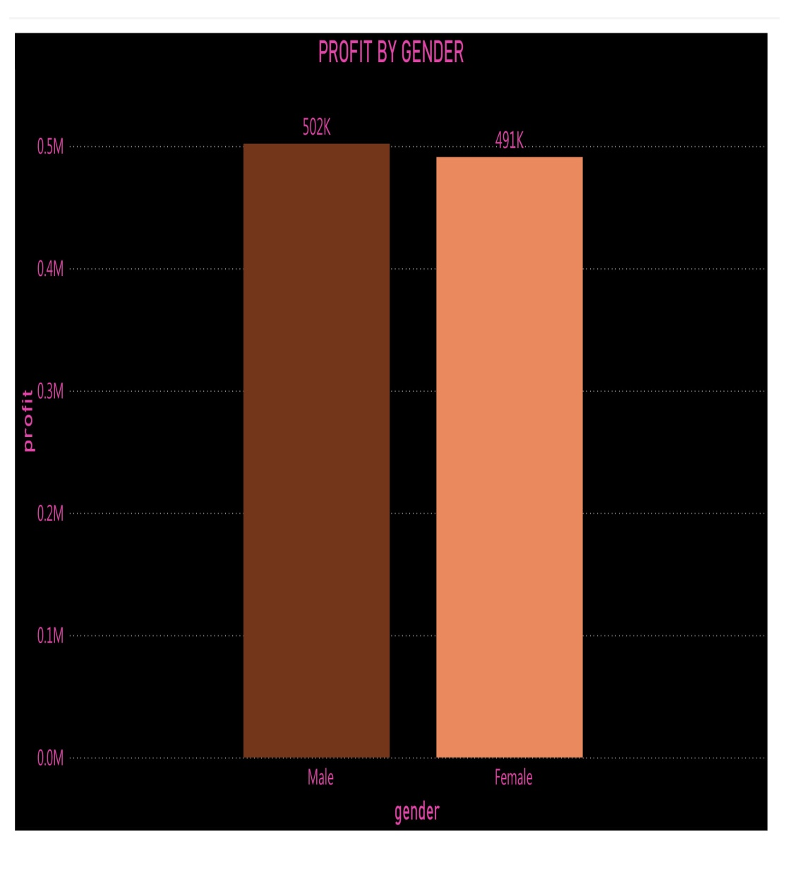


Slide 16
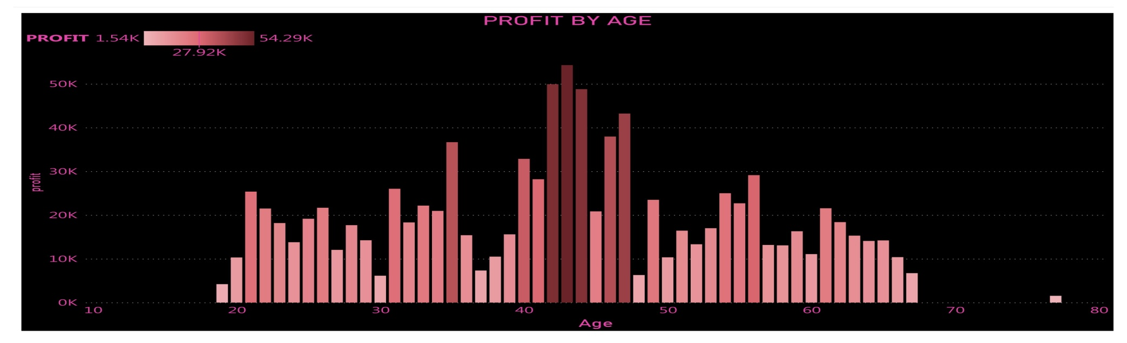


Slide 17
MAIN POINTS FROM DATA EXPLORATION
By comparing graphs of Profit and Past 3 years’ bike related purchases we proved that these two are CORRELATED.
New customer list doesn’t have column for profit that is why we will check our model by past 3 years’ bike related purchases because it is correlated with profit.
NSW has wide edge over other states.
Profit is more among males as compare to females but the difference is not wide enough to generalize it.
Profit among car owners is more but the gap is not wide enough to generalize it.
Profit is maximum among the age group between 80-100 but there are other ages which are not far behind them

Slide 18
Model Development
We now have a dateset named ‘New Customer List’.We should modify it in the following way.
By using DOB column,making another column and naming it ‘Age’.
Checking for misspelled values in cells of all columns.
Checking for missing values.
Removing non interpretable values from columns.
Checking for inconsistencies.

Slide 19

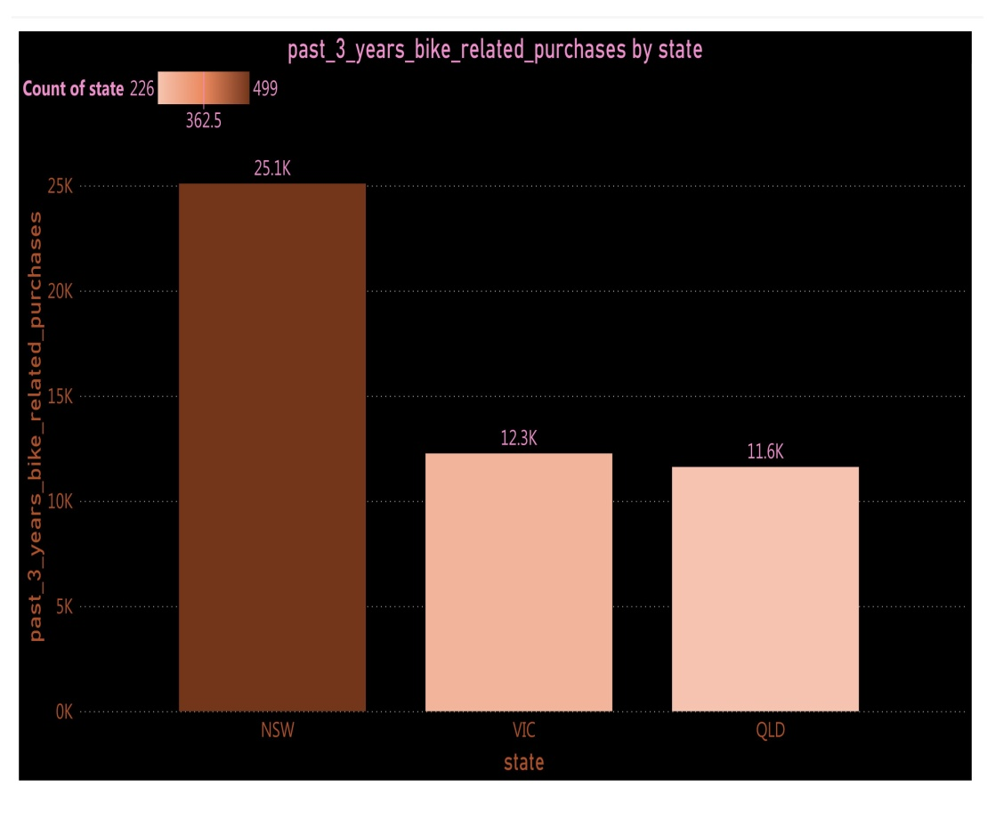
COMPARING PAST 3 YEARS BIKE RELATED PURCHASES BY STATES OF OLD AND NEW DATA OLD DATA NEW DATA

Slide 20

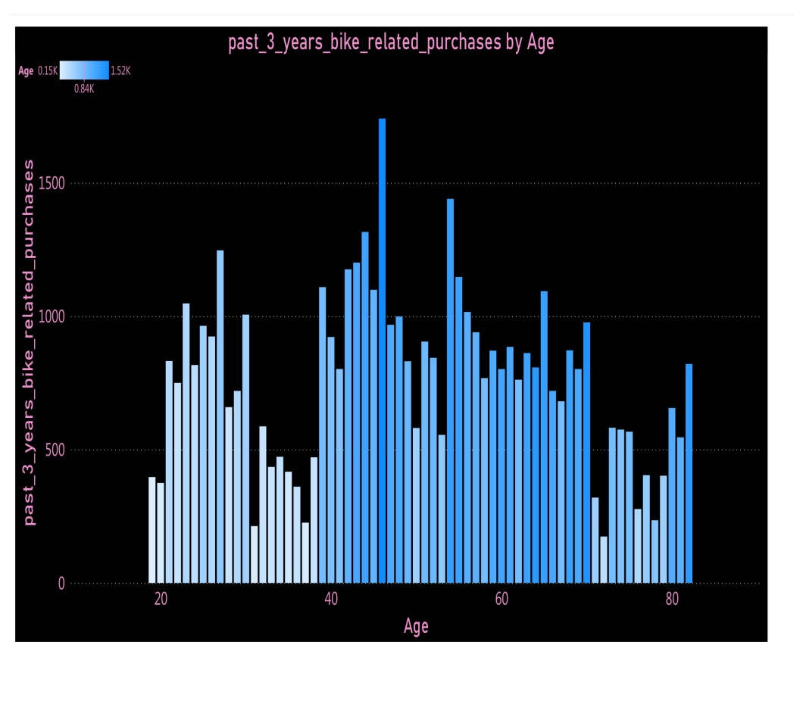
OLD DATA NEW DATA

Slide 21

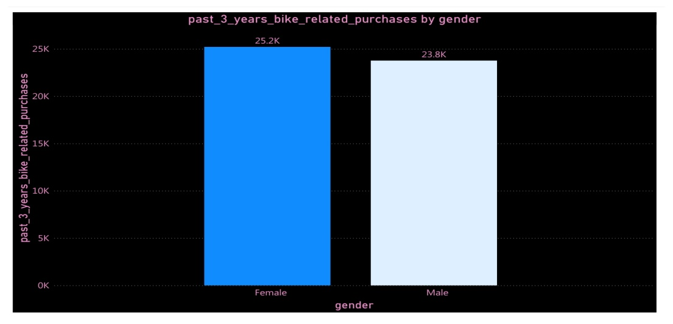
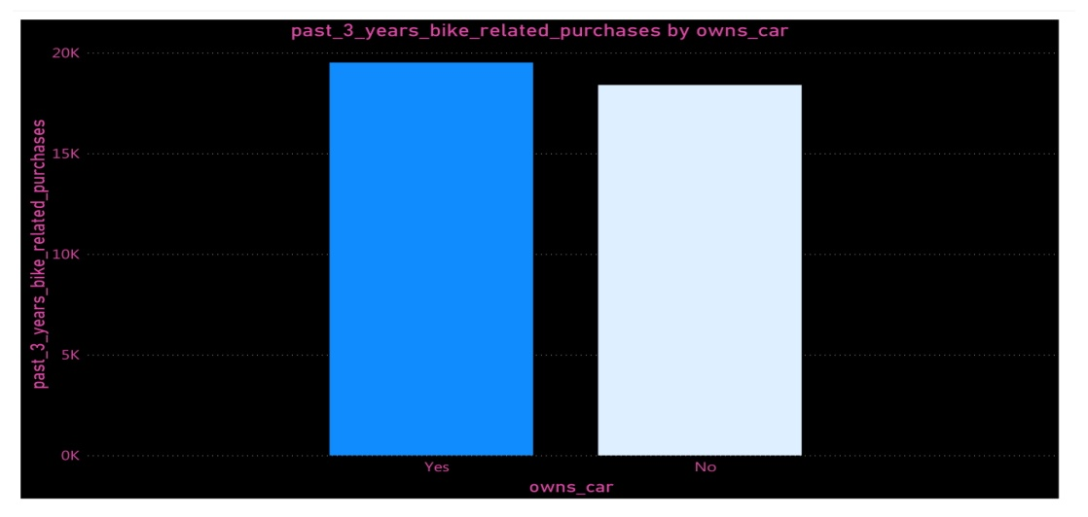
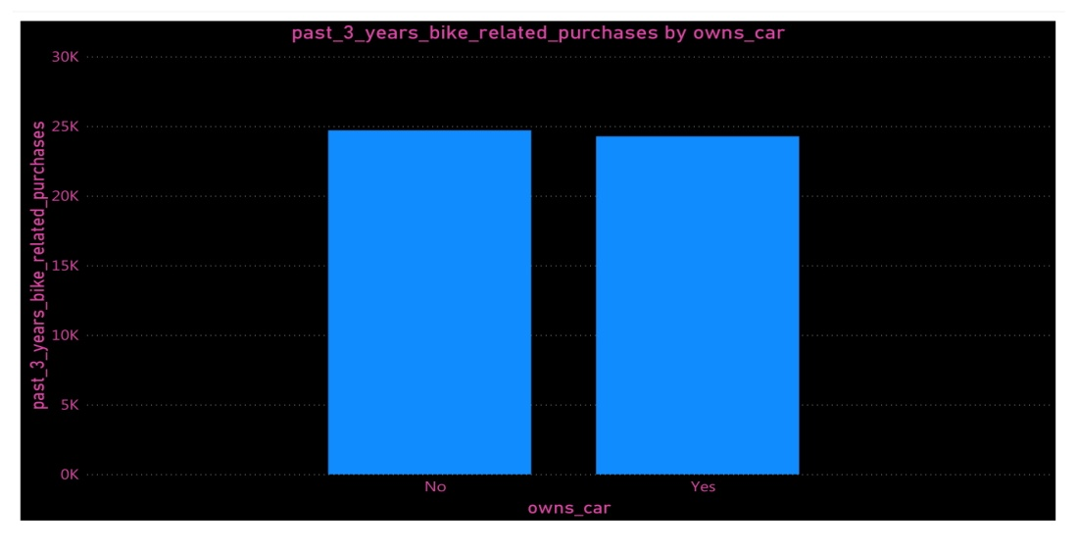
OLD DATA NEW DATA

Slide 22
CONCLUSION
From above comparisons between old and new data we conclude that as expected New South Wales is the state where most of the products were purchased from.
We also came to know that even in new data most the age group which purchased the most is between 40 to 50.
In New Customer List we found out that females purchased more than males which is opposite of the old customer data.
In New Customer List we found that those people who don’t own a car puchased more than the car owners which is also opposite of the old data.

Slide 23

Interpretation
After going through both the data sets we found out that New South Wales is the state where we should focus most as proven by the following graph
It is clear from this graph that NSW is the state where more than half of the purchases were made.
We got same result from the old data.Thats why focus of our company should be on NSW.

Slide 24
CONCLUSION
We conclude that most of the purchased were made from New South Wales that’s why main focus of our team should be New South Wales.
If there are more outlet stores of Sprocket in NSW then it is clear why our data is biased towards NSW.
If this is the case then we should focus(even if this is not the case) on the age group between 40 -50 because our data shows that this age group purchased more.
“Gender” & “if someone owns a car” data column are useless in this case because they showed opposite results in both the data sets old and new.
Hence we should be focusing primarily on those people from NSW whose ages are between 40 and 50.

Slide 25
Appendix

Slide 26
Appendix
WE CAN DO FOLLOWING THINGS TO MAXIMISE OUR SALES.
Use cookies on websites to monitor the online purchases from those areas where not enough purchases were made.
Check for patterns and notice which product type is more liked in those areas.
Advice your sales teams which are based in the low profit areas to know the interests of customers of those areas and monitor other best sold product of rival companies and make innovation accordingly and come up with even better product as compare to rival companies.
Make sure we are up to date as new advancements are being made regularly in every industry.

