Slide 1
GLUCO-VISION -The Dia Predictor
PIP2001 Capstone Project
Review-0
Batch Number : CSG-G03
Roll Number | Student Name
20211CSG0056 | ABHISHEK C B
20211CSG0071 | VISHWAS B
20211CSG0058 | RASHMI V
20211CSG0043 | THANYA PATEL R
Under the Supervision of,
Ms. Sandhya L
Assistant Professor
School of Computer Science and Engineering
Presidency University
Name of the Program: CapStone Project
Name of the HoD: Dr. Saira Banu Athem
Name of the Program Project Coordinator: Dr. Manjula H M
Name of the School Project Coordinators: Dr. Sampath A K / Dr. Abdul Khadar A / Mr. Md Ziaur Rahman

Slide 2
Content
Problem Statement
Analysis of Problem Statement
Timeline of the Project
References

Slide 3
Problem Statement Number:
Organization: Dr Reddy's Labs
Category (Hardware / Software / Both) :Software
Problem Description : Leveraging data to solve for Non-communicable
Disease diagnosis and healthcare delivery
Difficulty Level : Complex

Slide 4
Analysis of Problem Statement
Technology Stack Components:
Frontend: HTML, CSS
Backend: Flask (Python framework)
Database: MySQL
Programming Languages : Python
Machine Learning Model: Scikit-learn, Pandas
Data Source : The Pima dataset
Git Hub

Slide 5
Analysis of Problem Statement (contd...)
Software and Hardware Requirements:
﻿blinker==1.8.2 click==8.1.7 colorama==0.4.6
Flask==3.0.3 gunicorn==23.0.0 itsdangerous==2.2.0
Jinja2==3.1.4 joblib==1.4.2 MarkupSafe==2.1.5
mysql==0.0.3 mysql-connector==2.2.9 mysql-connector-python==9.0.0
mysqlclient==2.2.4 numpy==2.1.1 packaging==24.1
pandas==2.2.2 python-dateutil==2.9.0.post0 pytz==2024.1
scikit-learn==1.5.1 scipy==1.14.1 six==1.16.0
threadpoolctl==3.5.0 tzdata==2024.1 Werkzeug==3.0.4

Slide 6
Analysis of Problem Statement (contd...)
Expected Outcomes:
A functional web-based diabetes prediction tool.
Increased user awareness about diabetes risks.
Personalized recommendations for diabetes prevention.

Slide 7
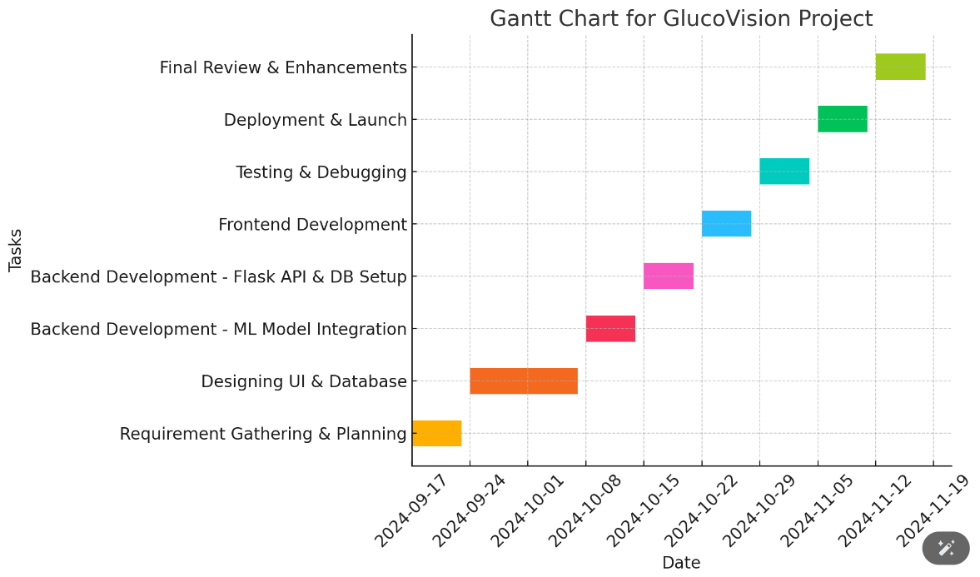
Timeline of the Project (Gantt Chart)

Slide 8
References (IEEE Paper format)
Add APA Citation for all references.
Use the below link for various APA styles :
WHO : NCD’S
https://www.who.int/india/health-topics/mobile-technology-for-preventing-ncds
Diabetes prediction using machine learning algorithms
https://www.sciencedirect.com/science/article/pii/S1877050920300557

Slide 9


