Slide 1
Project Title : Leveraging data to solve for non-communicable Disease [Diabetes]and healthcare delivery Using Machine Learning Techniques
PIP104 University Project-II
Review-1
Batch Number:
Roll Number | Student Name
20211CSG0056 20211CSG0071 20211CSG0058 20211CSG0043 | ABHISHEK CB VISHWAS B RASHMI V THANYA PATEL R
Under the Supervision of,
Dr. / Mr. / Ms. Sandhya L
Professor / Associate Professor / Assistant Professor
School of Computer Science & Engineering
Presidency University

Slide 2
Introduction
Healthcare is undergoing a transformation driven by the rapid growth of structured, semi-structured, and unstructured data. Big data analytics plays a crucial role in analyzing this data to uncover hidden patterns, relationships, trends, and patient preferences. Diabetes Mellitus (DM) is a major health concern, especially in low and middle-income countries like India. By 2018, the global diabetic population is projected to reach 629 million.
There are three main types of DM, including Type 1 (insulin-dependent diabetes), where the body does not produce enough insulin. Predictive modeling using machine learning offers a promising approach by utilizing past and current medical data to predict future diseases, allowing doctors to improve patient outcomes. Machine learning, a key part of AI, enables predictive analytics, allowing machines to learn from data and minimize errors in medical services.
While traditional tests like fasting blood sugar and oral glucose tolerance remain standard for diabetes diagnosis, they are time-consuming. In contrast, machine learning-based predictive models, such as regression and classification algorithms, offer faster and more accurate diagnosis methods, improving overall healthcare efficiency.

Slide 3
Literature Review
In recent years, diabetes has become a major public health issue, prompting efforts for early detection. Traditional diagnostic tests like fasting plasma glucose are often slow, leading to interest in using machine learning for prediction. Smith et al. (2016) developed a prediction model using decision trees and logistic regression with 80% accuracy, but their models were sensitive to data inconsistencies.
To address this, Zhang et al. (2018) used principal component analysis (PCA) to reduce dimensionality and improve feature selection in support vector machines (SVM), achieving 85% accuracy.
The complexity of SVM models limits their interpretability, making them less practical for clinical use. Enhanced domain and gradient boosting models improved diabetes prediction to 87% accuracy but didn’t address the need for rapid referrals in critical situations.

Slide 4
In 2020, a neural network-based deep learning model was proposed to predict diabetes from electronic medical records. While accurate, Kumar’s research highlighted issues with model interpretability and the need for large datasets, making these models impractical for rural clinics.
In 2021, Mishra et al. used data mining to identify patterns in diabetes, emphasizing the role of lifestyle factors like diet and physical activity. However, most existing models struggle with healthcare integration, data quality, and resource management, focusing solely on accuracy without broader healthcare implications.
The proposed model combines clinical and lifestyle data, using logistic regression, random forest, and SVM techniques, to provide accurate early diabetes detection, especially in developing countries like India.

Slide 5
Proposed Method
Algo Nest:[Proposed method]
Algo Nest is an advanced ensemble model that combines predictions from multiple machine learning algorithms to enhance accuracy and robustness. It utilizes ten distinct models, including Logistic Regression, Decision Tree, Random Forest, Support Vector Classifier, and Gradient Boosting, among others. Each model is trained on the same dataset but excels in different areas.
Algo Nest aggregates predictions using majority voting, selecting the most frequent prediction as the final result. This approach compensates for individual model errors or biases, reducing overfitting and making the model more reliable for unseen data.
Designed for high-accuracy applications such as medical diagnosis and financial forecasting, Algo Nest boosts performance by integrating diverse models. It offers flexibility for enhancements like weighted voting and hyperparameter tuning, making it ideal for complex classification tasks requiring precision.

Slide 6
Objectives
To develop an advanced machine learning model, Gluco vision, that accurately predicts the likelihood of diabetes using key health indicators such as glucose levels, BMI, insulin, and age.
To integrate multiple machine learning algorithms, including Random Forest, Gradient Boosting, and Voting Classifier, in the Glucovision model to improve prediction accuracy and reliability for early diabetes diagnosis.
To provide an intuitive, user-friendly interface in Glucovision that allows patients to input their health data and receive real-time predictions and advice on managing their diabetes risk
To contribute to public health in India by leveraging the Glucovision model as a tool for early intervention, aiming to reduce long-term treatment costs and improve patient outcomes in diabetes management

Slide 7
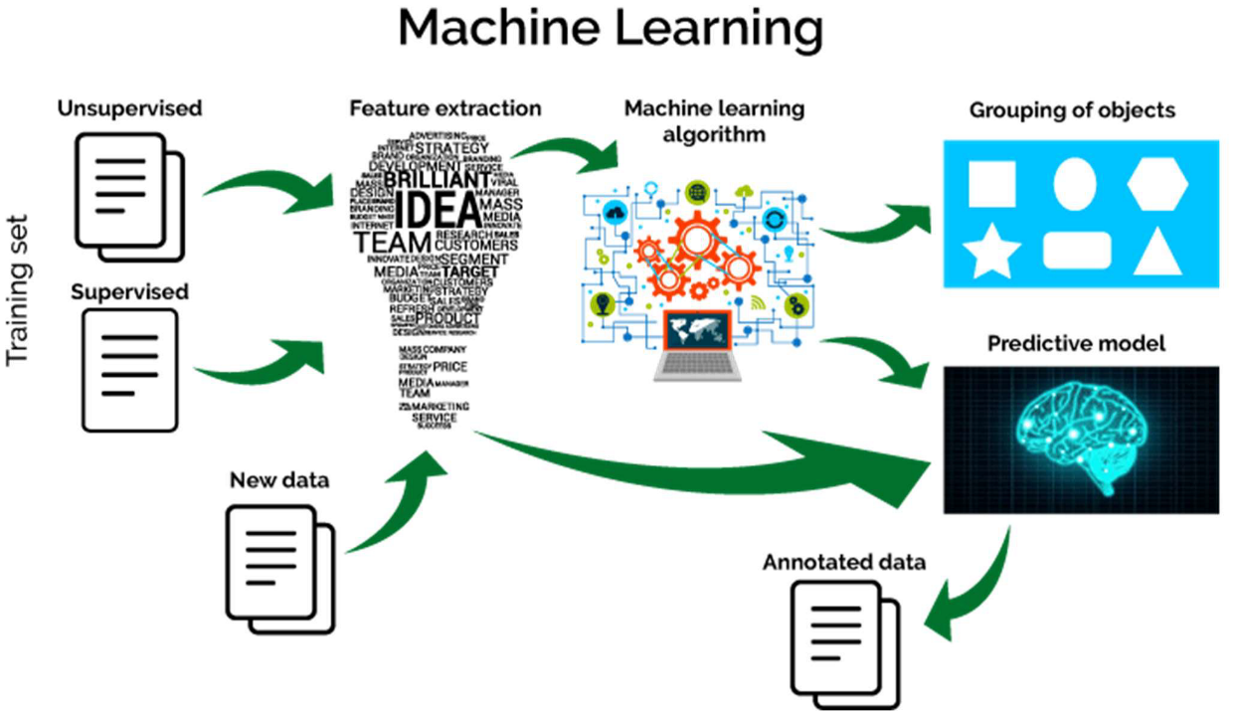
Methodology
To achieve the goal of accurately predicting blood sugar, we adopted a good methodology that includes data collection, preparatory work, sample selection, and evaluation.

Slide 8
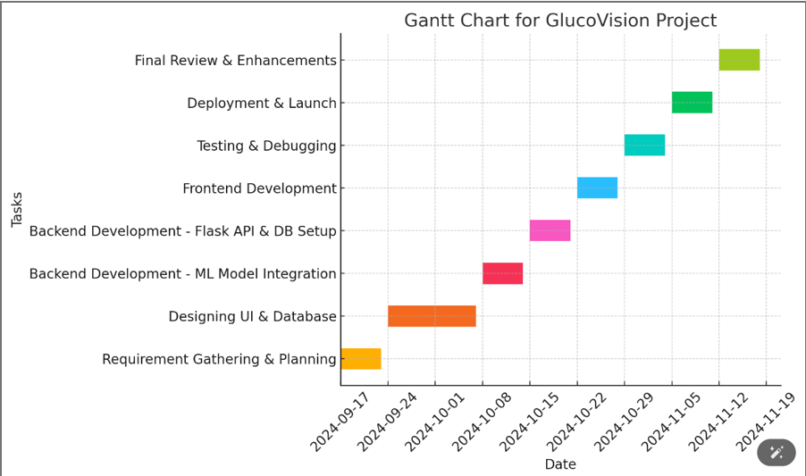
Timeline of Project

Slide 9
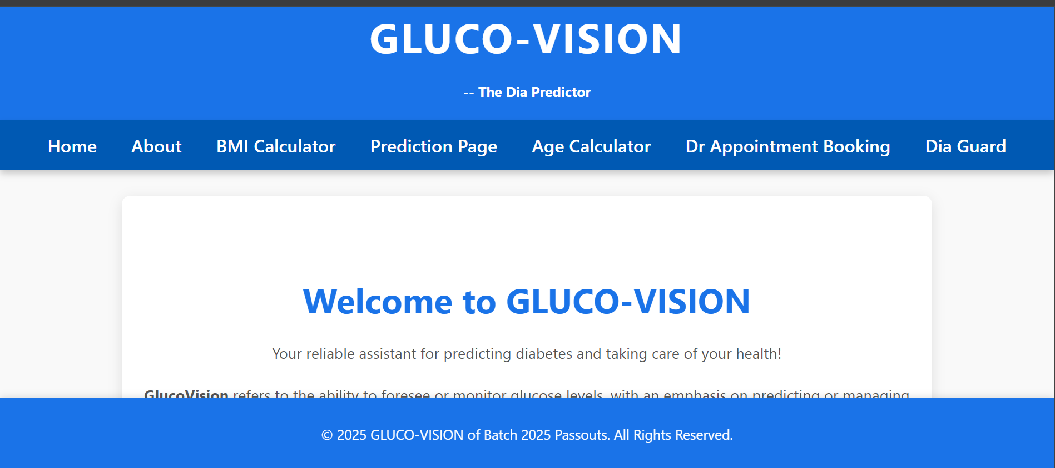
Expected Outcomes

Slide 10
Conclusion
The study demonstrates how machine learning can significantly improve early diabetes diagnosis in India, with models like Random Forest, Gradient Boosting, and Voting Classifiers boosting accuracy—Random Forest alone achieved 90.35%
Algo Nest, an ensemble model combining ten machine learning techniques such as Logistic Regression and K-Nearest Neighbors, further increased accuracy to 95%-98% through majority voting, minimizing misclassification.
This approach not only enhances diagnostic accuracy but also offers a reliable, data-driven solution for early intervention in chronic diseases like diabetes, improving healthcare outcomes.

Slide 11
References
1. Smith, A., & Johnson, L. (2016). "Predicting Diabetes using Decision
Trees and Logistic Regression on Pima Indians Dataset." Journal of
Health Informatics, 25(3), 123-135.
2. Zhang, Y., Lee, W., & Kim, S. (2018). "Enhancing Support Vector
Machine Accuracy for Diabetes Prediction using PCA." International
Journal of Medical Informatics, 45(2), 56-69.
3. Patel, N., & Sharma, P. (2019). "Random Forest and Gradient Boosting in
Diabetes Prediction: A Comparative Study." Computational Biology and
Medicine, 98(4), 112-119.
4. Kumar, R., Gupta, M., & Singh, P. (2020). "Deep Learning Models for
Diabetes Prediction from EHR Data: A Case Study." Health Data Science,
22(1), 78-90.
5. Mishra, S., & Tiwari, R. (2021). "Data Mining Techniques for Uncovering
Hidden Patterns in Diabetes Data." Journal of Clinical Data Science, 7(3),
234-245.

Slide 12
Thank You

