Slide 1
CS109A Learning Report
資工三 林靖紳

Slide 2
Contents
Self Introduction
[CS109a: Introduction to Data Science] Learning Report
Next Project Proposal

Slide 3
Self Introduction

Slide 4
Operating System Lab
Spring semester
of
freshman year
Fall semester
of
sophomore year
Spring semester
of
sophomore year
Current
Embedded systems
Radio-controlled cars
Raspberry pi
Ultrasonic distance measurement
Operating system
Scheduling
Linux schedule policy
priority
Notes:
嵌入式系統 -> IC裡的OS ；不是 embedded vector
目標: 希望應用程式可以在非super user的情況下 調整出更適合的排程方式

Slide 5
Motivations
Interests
Operating system and System programming based on Linux
Is that really suitable for me to work for?
Confused…
Introduction to Computational Methods for Data Analysis
Model the data
Tens of thousands of ways to find out (Too much exaggeration)
That absolutely have lots of fun!
Visualize the results

Slide 6
Learning Report

Slide 7
Current Progress
Data
Data Formats + Web Scraping
Pandas
Regression
KNN Regression
Linear Regression
Multi Linear and Poly Regression
Model Selection and Cross Validations
Inference
Bootstrap
Ridge and Lasso Regularization
Notes:
Bootstrap: 統計上的那個 不是網頁的那個XD…從給定訓練集中有放回的均勻抽樣，採用隨機可置換抽樣（random sampling with replacement）。對於小數據集，自助法效果很好
Cross validations: 將數據樣本切割成較小子集 先在一個子集上做分析，而其它子集則用來做後續對此分析的確認及驗證
Ridge and Lasso Regularization: 用來衡量模型複雜度，如果線性歸化會有over fitting 的問題 就可以再來用正規畫回歸
Ridge→ linear + L2 penalty
Lasso → linear + L1 penalty

Slide 8
Differences between regression above
KNN:
Input: The k closest training examples in data set.
Output: The property value of the object. (average)
Concept: Cases of the same classification are highly similar to each other.
Drawback: Majority voting classification when skew.
Overcome: Weight (distance).

Slide 9
Differences between regression above
Linear Regression
Input: One or more independent variables.
Output: Dependent variable.
Concept: Often fitted using least square approach.
Polynomial Regression
Input: The independent variable (x)
Output: The dependent variable (y)
Concept: Modelled as an nth degree polynomial in x (E(y |x))

Slide 10
Differences between regression above
 | Has a F(x) parameter | Easy to interpret
K-Nearest Regression | No | Yes
Linear Regression | Yes | Yes
Polynomial Regression | Yes | No
Notes:
線性，也會比較好去儲存 紀錄
Interpretation is important to evaluate the model and understand what the data tells us

Slide 11
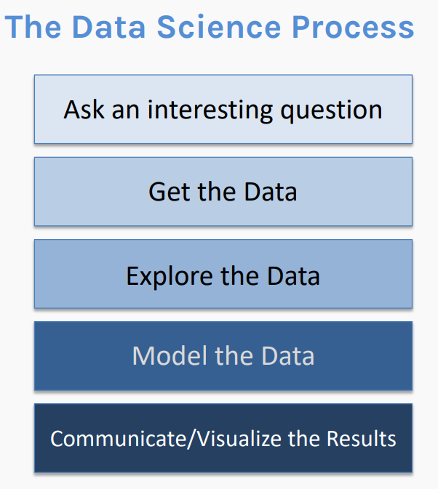
Pros and Cons
Pros:
Start from the history of data science.
Construct complete data science flow.
Use questions to arouse students’ interest or attention on the topic.
Short coding exercises after a lecture.
Project solve real-life problems.

Slide 12
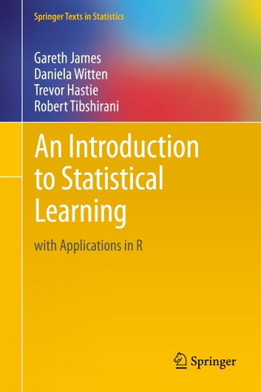
Pros and Cons
Cons:
Lectures put more emphasis on developing the intuition for the core concepts, but lake on providing mathematical background.
Not algorithm oriented.
Recommended textbook: An Introduction to Statistical Learning by Gareth James, Daniela Witten, Trevor Hastie and Rob Tibshirani

Slide 13
Project Proposal

Slide 14
Modeling COVID-19 in Taiwan
Project goals
Predict the daily number of COVID-19 cases in each county.
Evaluate the effectiveness of various COVID-related policies on the spread of the disease; what truly has helped and can help prevent the spread of COVID-19 in Taiwan?
High-level project goals
Build predictive models for the rate of COVID cases at the county level in Taiwan.
Evaluate the effectiveness of governmental policies on controlling the disease based on your predictive models

Slide 15
Modeling COVID-19 in Taiwan
Data Resources:
Covid-19 Global Dashboard by Taiwan:
https://covid-19.nchc.org.tw/dt_005-covidTable_taiwan.php
Policy data:
https://covid19.mohw.gov.tw/ch/mp-205.html
References:
https://projects.fivethirtyeight.com/covid-forecasts/
https://covid.cdc.gov/covid-data-tracker/#global-counts-rates
https://www.cdc.gov/coronavirus/2019-ncov/science/forecasting/forecasts-cases.html

