Slide 1
M4hjong
An Android Application
Heather Dykstra and Michael Williams

Slide 2
How it all got started
A few friends sat around playing a classic Chinese game called Mahjong
It was quite fun, but they wanted a way to:
Play the game on their phone
Keep track of their high score
We decided to make an Android Application so we could do just that

Slide 3
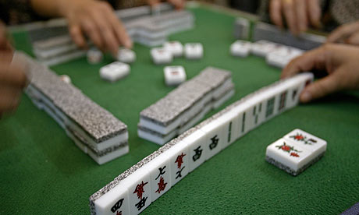
Mahjong is a card game played with tiles and fancy rules…
http://static.guim.co.uk/sys-images/Guardian/About/General/2010/2/11/1265883630193/A-game-of-mahjong-being-p-001.jpg

Slide 4
What we did next…
Michael and I went to the HackYourApp event hosted by InnovateCU
There we got help from some people in industry and others with more Android application experience then ourselves

Slide 5
On to Design!
We decided to use 2 main design patterns
Singleton – To have only 1 instance of the game at any time
Strategy- For our players, so we could have human Interaction and AI Interaction

Slide 6
Model-View-Controller
We also attempted to use Model-View-Controller in our development:
The model was our XML
The view was our Java Code
The Controller was what our user would do

Slide 7
Use Case Demo
User Can Display Rules
User Log In

