Slide 1
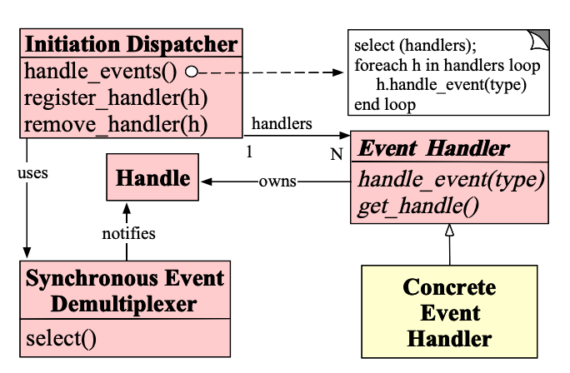
Provide or define by OS
Defined by final user for how to handle specific event

