Slide 1
Micro FC introduction
Feng Wan 11-27-2012
Xun Liu 07-20-2016

Slide 2
Agenda
What’s FC
Micro FC algorithm introduction
Hierarchical classification of a road network based on FC
Bi-direction search
A* heuristic search
Level promote strategy
FC Shortcuts
FC pros and cons

Slide 3
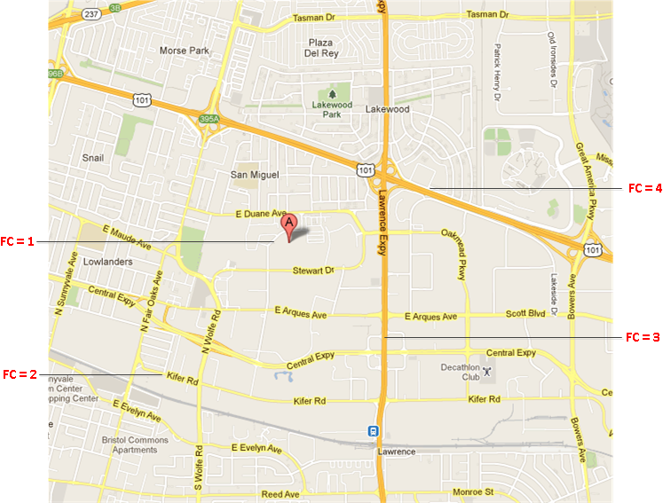
FC – illustration

Slide 4
What’s FC
Definition
FC is the hierarchical classification of a road network.
Usage
FC can be used to determine the road edge's priority for route and display.
High level FC roads are connected to form a comprehensive road network for navigation of long distance, mid-range, and short routes in any given coverage area.
Density and pattern of each FC level is influenced by the physical road network that exists in reality.

Slide 5
Description for each FC value
Value | Description
5 | These roads allow for high volume, maximum speed traffic movement between and through major metropolitan areas. There are very few, if any, speed changes. Access to the road is usually controlled.
4 | These roads are used to channel traffic to Main Roads for travel between and through cities in the shortest amount of time. There are very few, if any, speed changes.
3 | These roads interconnect FC 4 Roads and provide a high volume of traffic movement at a lower level of mobility than FC 4.
2 | These roads provide for a high volume of traffic movement at moderate speeds between neighborhoods. These roads connect with higher Priority to collect and distribute traffic between neighborhoods.
1 | These roads' volume and traffic movements are below the level of any other functional class

Slide 6
Micro FC algorithm
Bi-direction search
A* heuristic search
Hierarchical classification of a road network
Level promotion strategy
FC Shortcuts

Slide 7
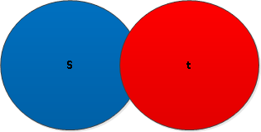
Bi-direction search illustration

Slide 8


A* - heuristic search
The heuristic factor controls the acceleration of the routing exploration. As it becomes greater, the exploration gets more accelerated, and the route calculation tends to become faster, but the probability of resulting in a less optimal route also becomes greater.

Slide 9
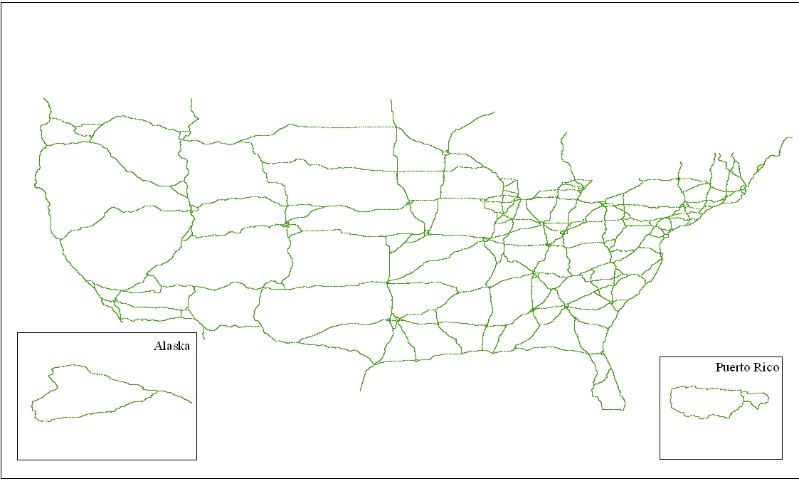
FC 5 – The highest level road network in USA

Slide 10
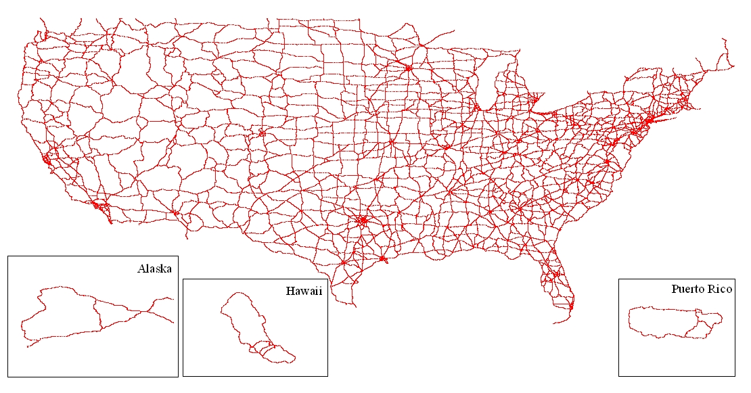
FC 4+5 – The second highest level road network
Connected, redundant high level road network makes an alternative route possible if the optimal route is jammed, avoided or closed somehow.

Slide 11
FC roads distribution
FC value | Edge Count | Percent
1 | 26,393,008 | 92.26%
2 | 1,549,488 | 5.42%
3 | 437,110 | 1.53%
4 | 181,505 | 0.63%
5 | 45,776 | 0.16%
Total Edge Count | 28,606,887
NT NA 2006 statistics data

Slide 12
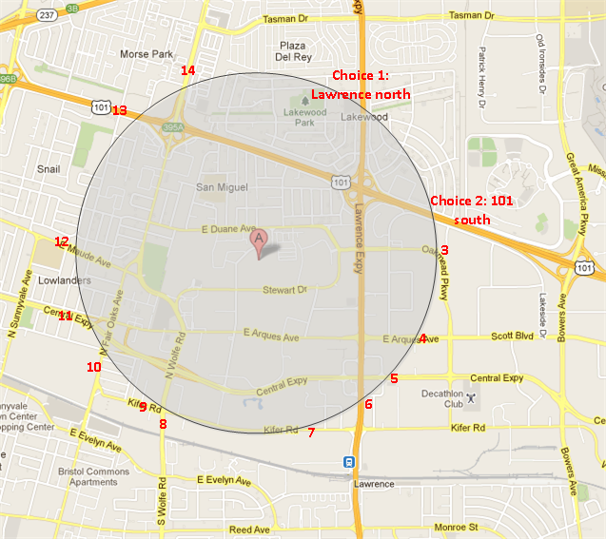
Level promote strategy - Count choices
FC keeps a count of node choices in the priority queue for each level, if the choices after level promotion reach a threshold (current is 40), then it is safe to promote
The choices threshold controls the acceleration of the routing exploration. As it becomes smaller, the exploration gets more accelerated, and the route calculation tends to become faster, but the probability of resulting in a less optimal route also becomes greater.

Slide 13
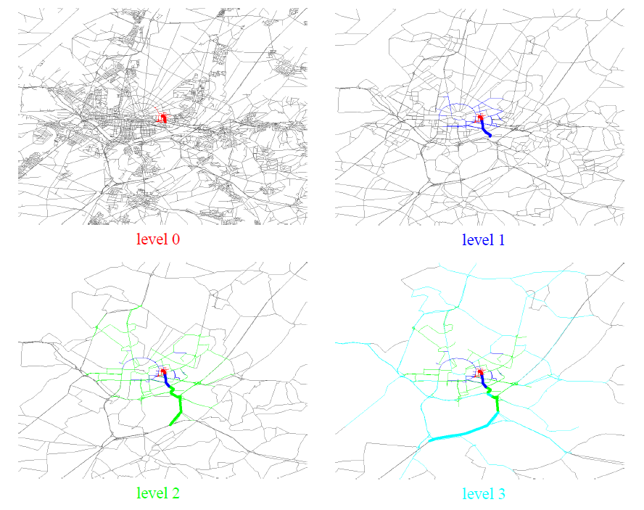
FC search space illustration

Slide 14
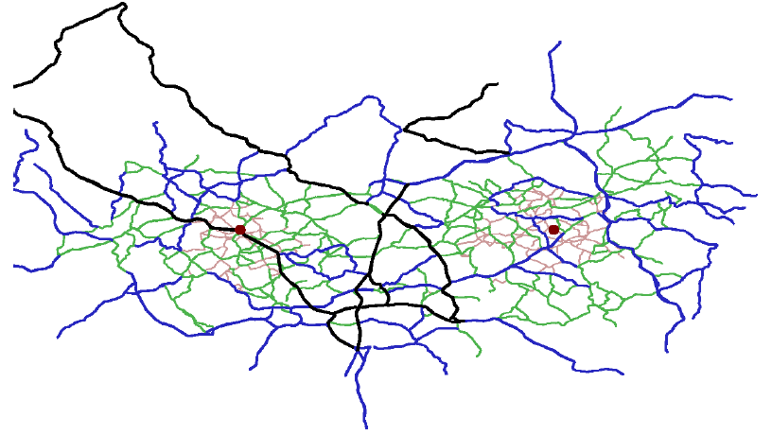
Bidirectional + level promotion search
How do people try to find a route?
1. Look for the next reasonable motorway.
2. Drive on motorways to a location close to the target.
3. Leave the motorway and search the target starting from the motorway exit.
FC algorithm is very similar to what people think naturally, therefore make good user experience.

Slide 15
FC Shortcuts
Take Kifer Rd. as an example, the whole Kifer Rd. between wolf and Lawrence is a shortcut, which includes AB, BC, CD, DE, EF,FG,GH and HI base edges.
Shortcut properties:
FC shortcut consists of same FC base edges, therefore speed is similar.
FC shortcut is short, usually less than 2 miles.

Slide 16
FC Shortcuts

Slide 17
pros of FC
Pros | Comments
Simple | Easy to learn, Easy to maintain, Less data preprocess required.
Dynamic routing | Dynamic routing means cost is unknown in data compilation time. - Avoid real time traffic, HOV, Toll road, Freeways, specific edges - Historical traffic routing - ECO routes (vehicle sensitive eco cost) - Time sensitive restrictions - Season close roads, temporary close roads
Small data size | Only 100M for NA TT shortcut data, NT data would be less.
Tunable | Easy to do customization, find a balance point between performance and quality. 1. Heuristic factor. 2. Level promote choices threshold 3. Max promote level 4. Choice count strategy
Consistent with industry | NDS (Navigation data standard), KIWI (ISO navigation standard), Garmin
Consistent with display | FC routing result is consistent with map display Display and routing could share the same high level FC shortcut data.
Incremental offline map download | Stable FC attribute makes seamless routing across downloaded maps naturally Small shortcut data size is good for downloaded map delta update
FC shortcut properties make historical speed, ECO routing easy | FC shortcut consists of same FC base edges, therefore speed is similar FC shortcut is short, usually less than 2 miles Only 3M shortcuts for NA TT.

Slide 18
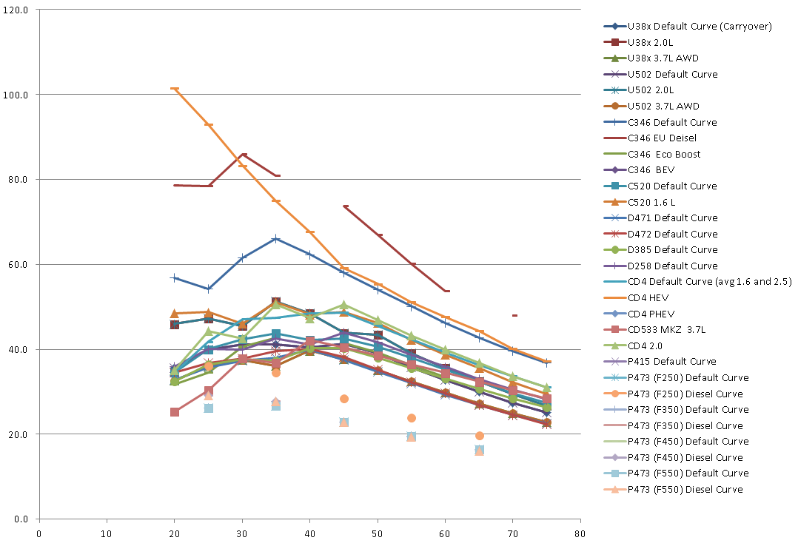
Vehicle fuel efficient curve -- ECO routing
MPG
Speed (MPH)

Slide 19
why FC supports dynamic routing well?
Multiple choices(40) after promotion
Good quality for any route style
Choices are counted in run time according to given route style
E.g. freeway is not counted as a choice in avoid freeway routing
FC is a good hierarchical road network for dynamic routing
High level edges decrease significantly
High level network is connected
High level network is redundant
High level network’s density distribution is even
By a good network, if the optimal route is jammed/avoided/closed somehow, dynamic routing can always find an alternative one.
FC makes better user experience
FC algorithm is very similar to what people think naturally

Slide 20
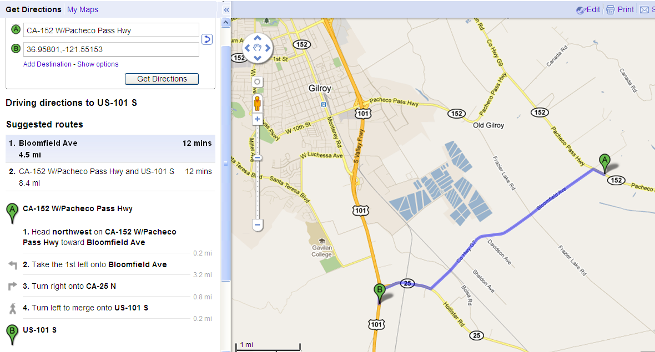
For local route, user prefer shorter route

Slide 21
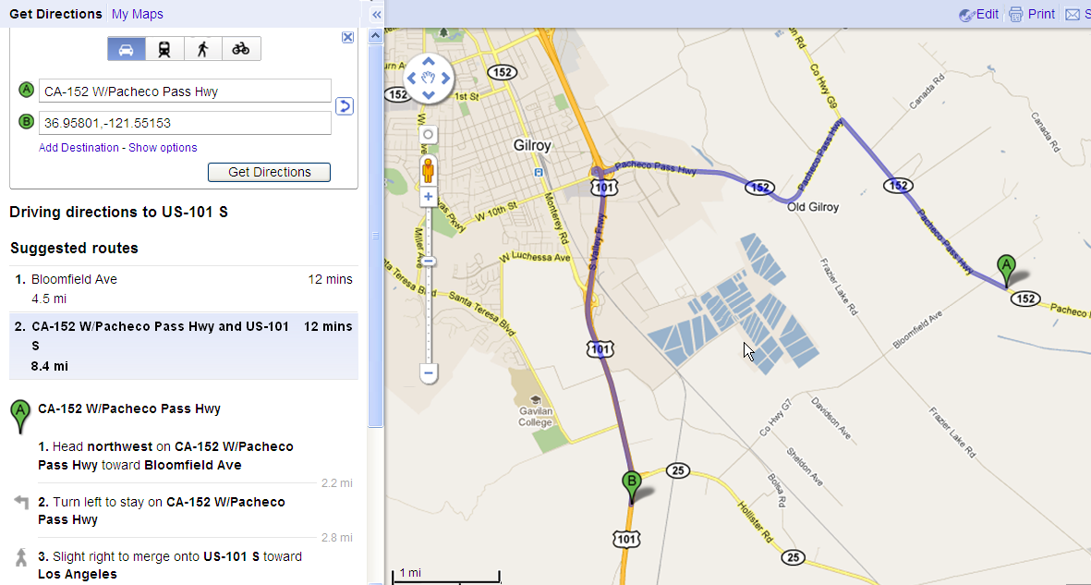
For local route, user prefer shorter route

Slide 22
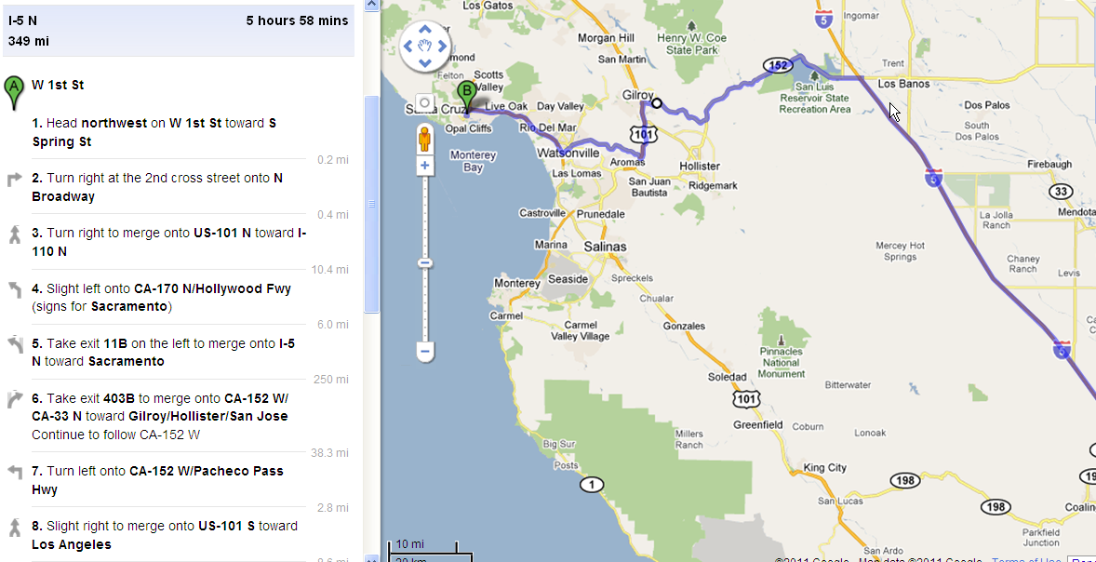
For long route, user prefer simple route

Slide 23
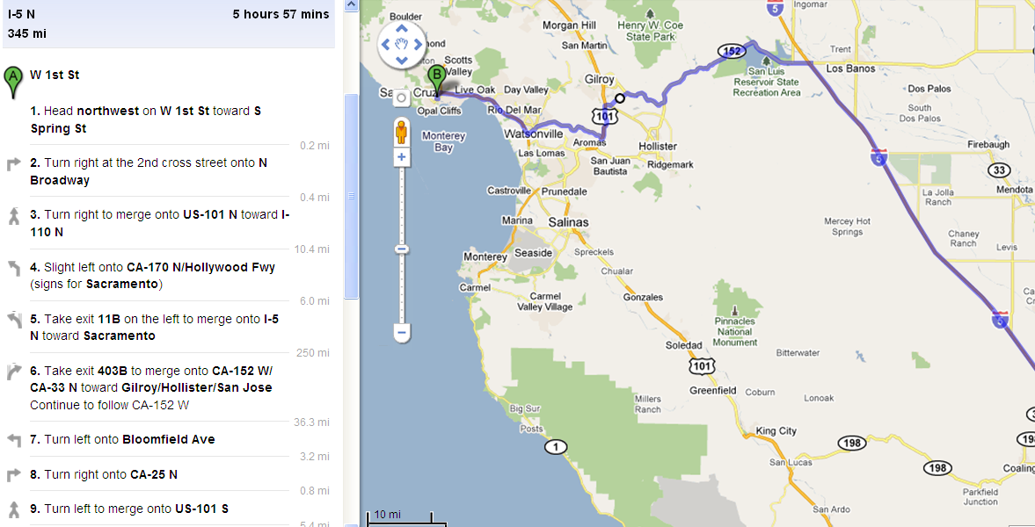
For long route, user prefer simple route

Slide 24
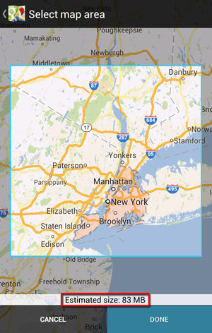
Incremental offline map download
Stable FC attribute makes seamless routing across downloaded maps natural.
Less shortcuts
Small shortcut data size
Short shortcuts
Makes delta update easy.

Slide 25
Incremental offline map download
Downloaded Map 1-Release 1
HH’s shortcuts and their level are easy to change. They depend on not only data version, but also cost model, preprocess parameters/algorithm, etc.
Assume map1 is R1, map2 is R2, comparing R2 to R1,
no vender data version change, but somehow R2 fix a routing bug by changing the cost model , therefore:
Some shortcuts’ level could change
Some R1 shortcuts could be deleted from R2
R2 could have some new shortcuts.
Routing between map1 and map 2 could have troubles, because map 1 R1’s high level network will not match with map 2 R2’s network any more, so it could not meet in bi-direction search.
Downloaded Map 2-Release 2

Slide 26
FC route is consistent with map display
If roads are invisible in the corresponding zoom level, usually FC route will not include these roads as well.

Slide 27
Do things in a right way
If the ideal road network in preprocess time is exact the same as the practical road network in run time, including cost model, then I believe HH is perfect, but we all know it is not the case.
Having said that, I never doubt that MoRE can do dynamic routing eventually, because engineers are smart, we can always figure out a way, work around, do something tricky or even change data to make it happen.
I believe if we design routing algorithm in a right way, all the routing related issues, including dynamic routing, ECO routing should be resolved naturally.

Slide 28
Cons of FC
FC algorithm depends on FC attribute quality
But, any algorithm depends on data, either speed or FC or something else
Display depends on FC as well, so we have to address the poor FC quality issue anyway, no matter we use FC or HH.
Ways to address the poor FC quality issue
Vendor or community will improve it gradually
Leverage other attributes: road type, speed, road name, lane category etc. to improve FC attribute
Increasing level promote parameter make FC algorithm less depend on FC attribute
Leverage HH/reach algorithm to improve FC attribute

Slide 29
The end, thanks

